Slide 1
Welcome to PSHEE at Kingshill School
What does PSHEE mean?
Starter
Quietly think about what the letters PSHEE might stand for.

Slide 2
By the end of this lesson you will…
… know the rules for PSHEE.
… remember the PSHEE lessons I had at my school.
… know what PSHEE will be all about at Kingshill.

Slide 3
What school did you go to?
What is PSHEE all about?
What PSHEE did you do there?

Slide 4
Rules And Expectations For The PSHEE Classroom
1
2
3
4
5
6
7
8
9
10

Slide 5
What is PSHEE all about?
ersonal
ocial
ealth
conomic
P
S
H
E
Education
PSHE

Slide 6
YEAR SEVEN QUIZ
WELCOME TO KINGSHILL
1) What is the name of your form tutor?
2) What is the name of your head of year?
3) What is the name of the head of key stage three?
4) List the different subjects you will be taking this year.
5) Name three members of staff who you could talk to if you felt there was a problem.
6) How many times a week will you get homework from the following subjects?
Maths
English
RE
7) What time does the school day start?
8) What time is your lunch?
9) Which days do you have assemblies?
10) What time does the school day finish?

Slide 7
Can you tell me…
3 rules for PSHEE
2 words describing what PSHEE will be about at Kingshill
1 new thing you have learnt about PSHEE

Slide 8
Welcome to Kingshill!
Look at the following photos and think where they are around the school

Slide 9
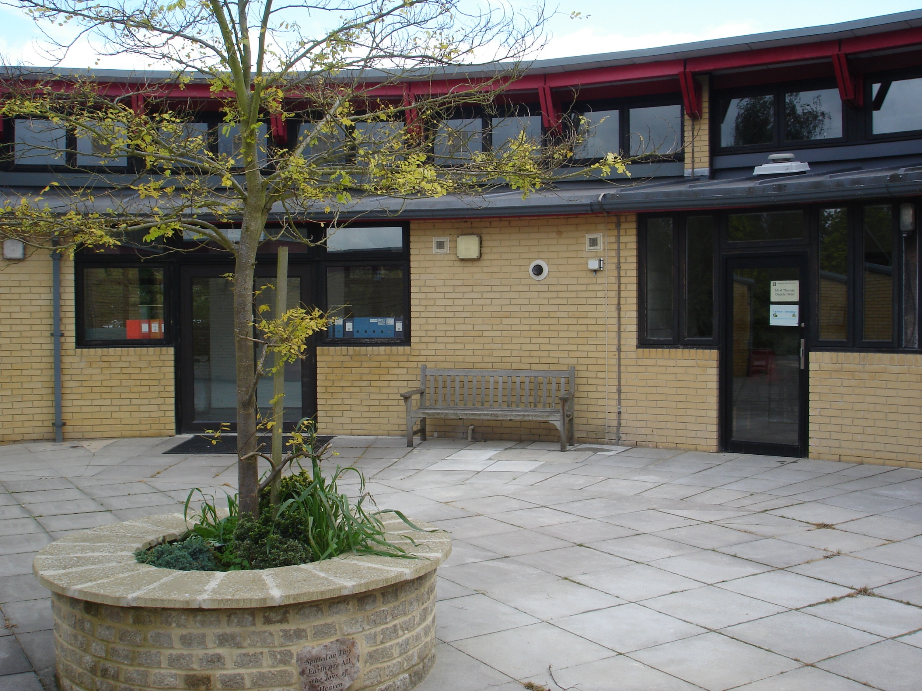
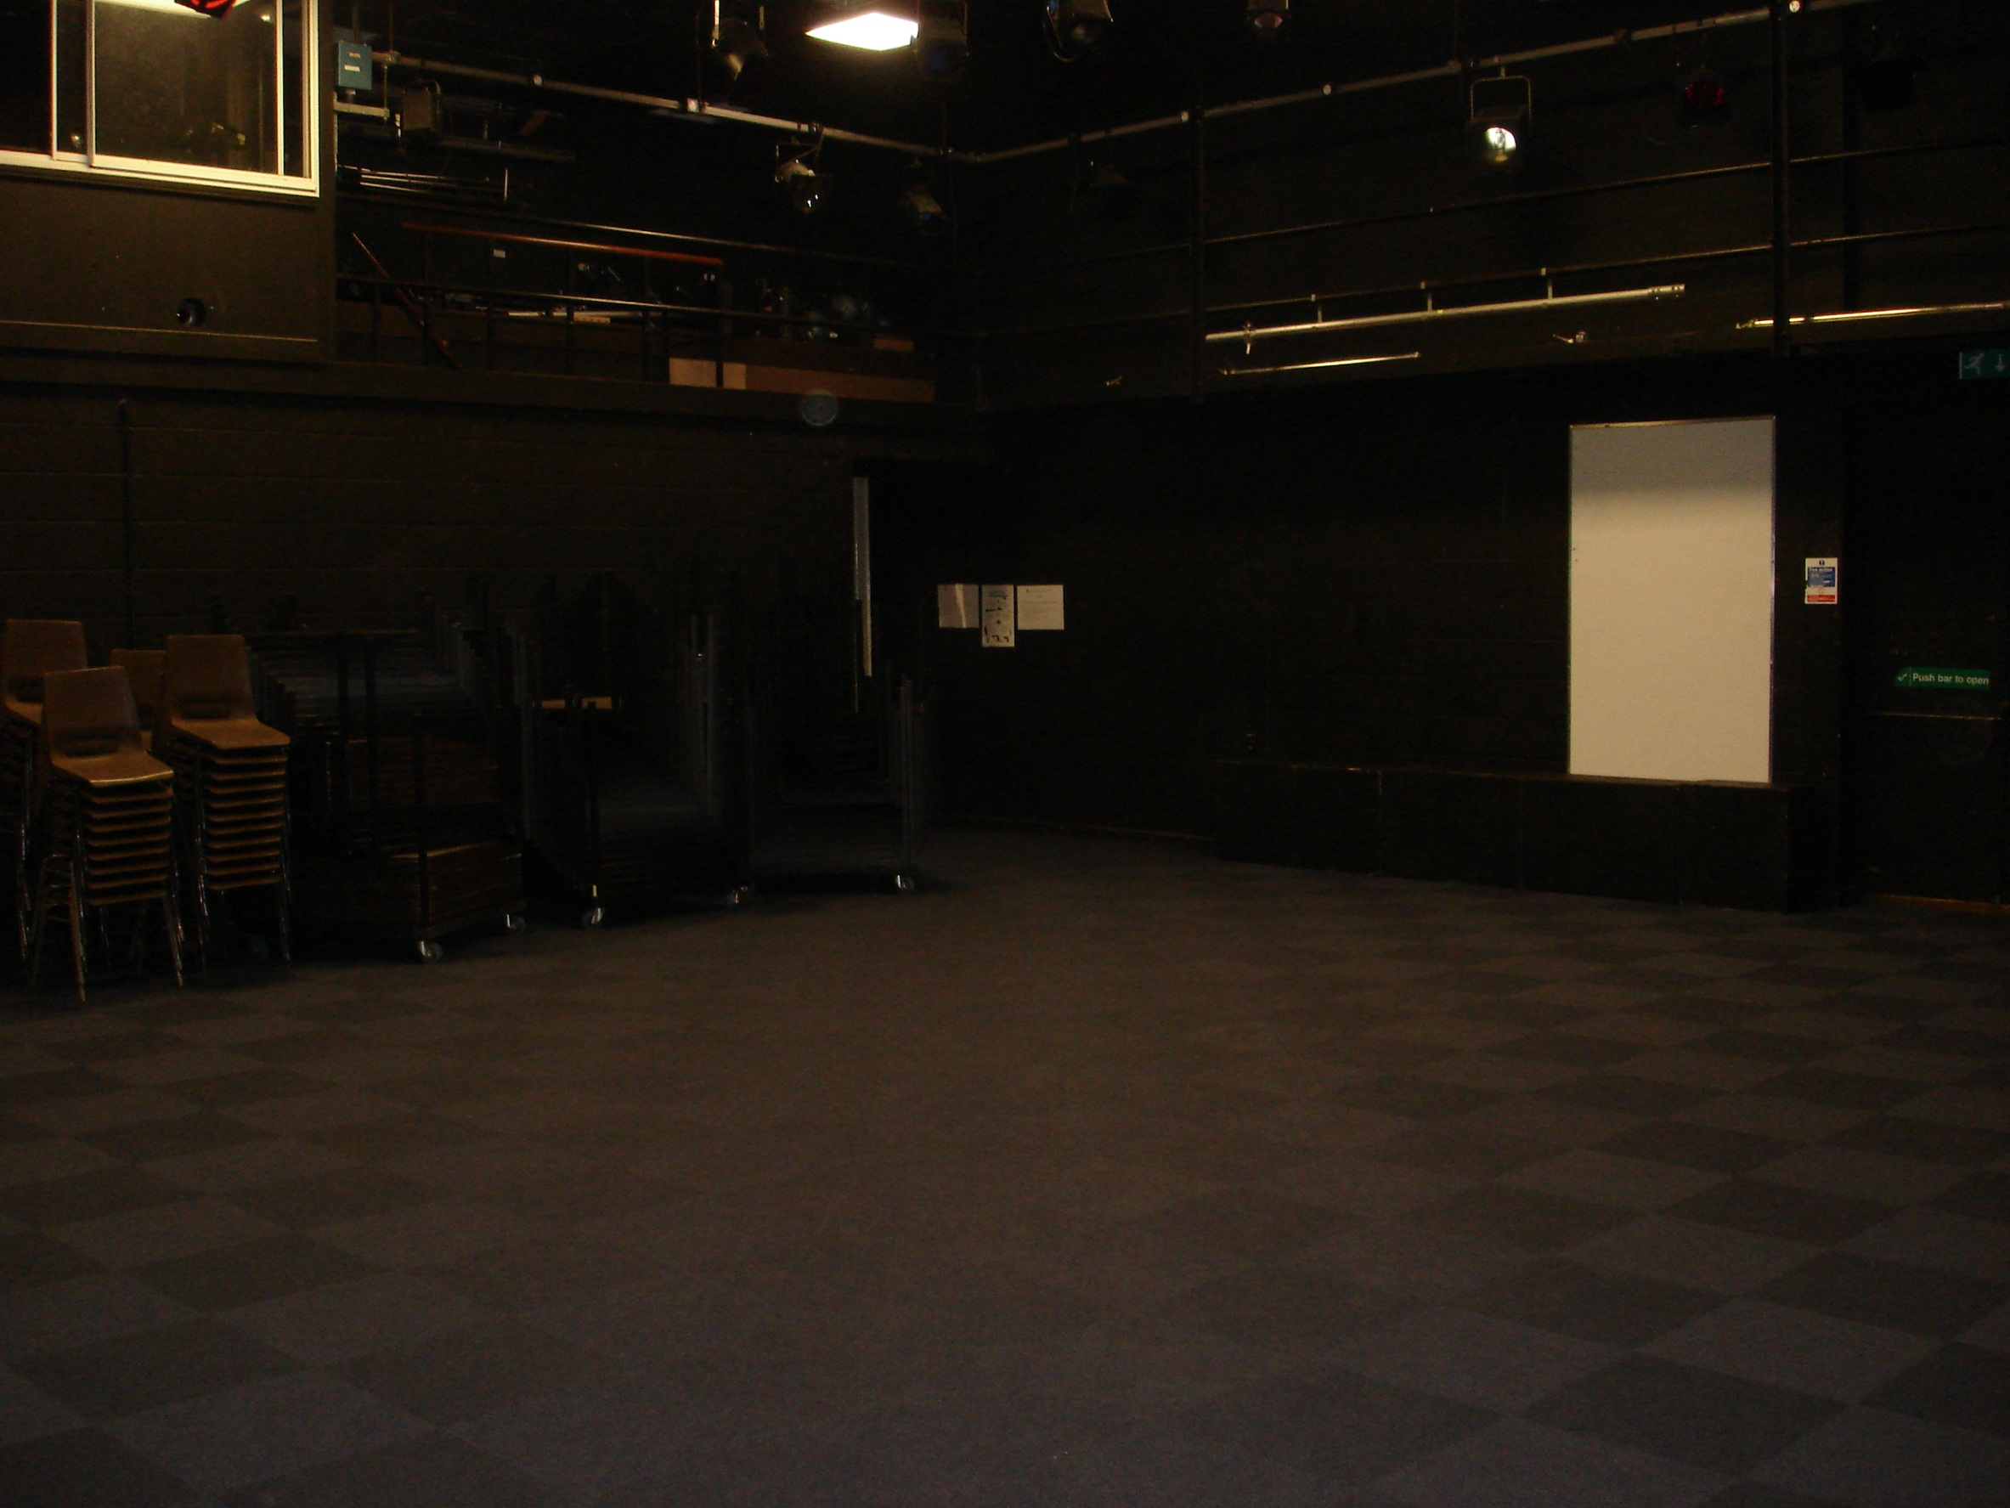
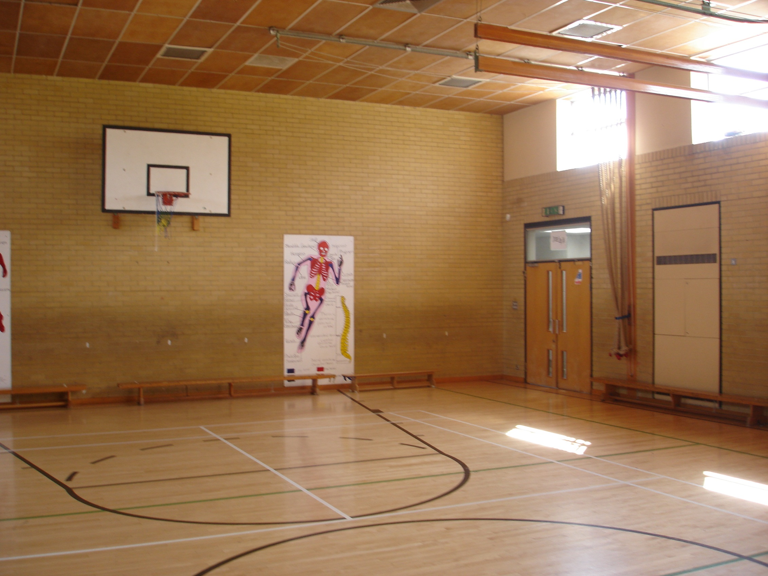
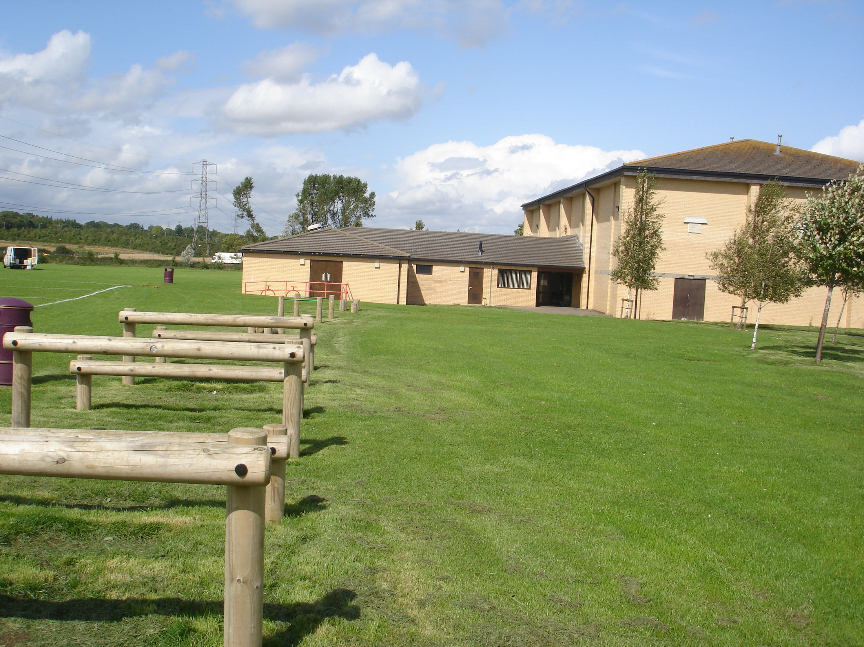
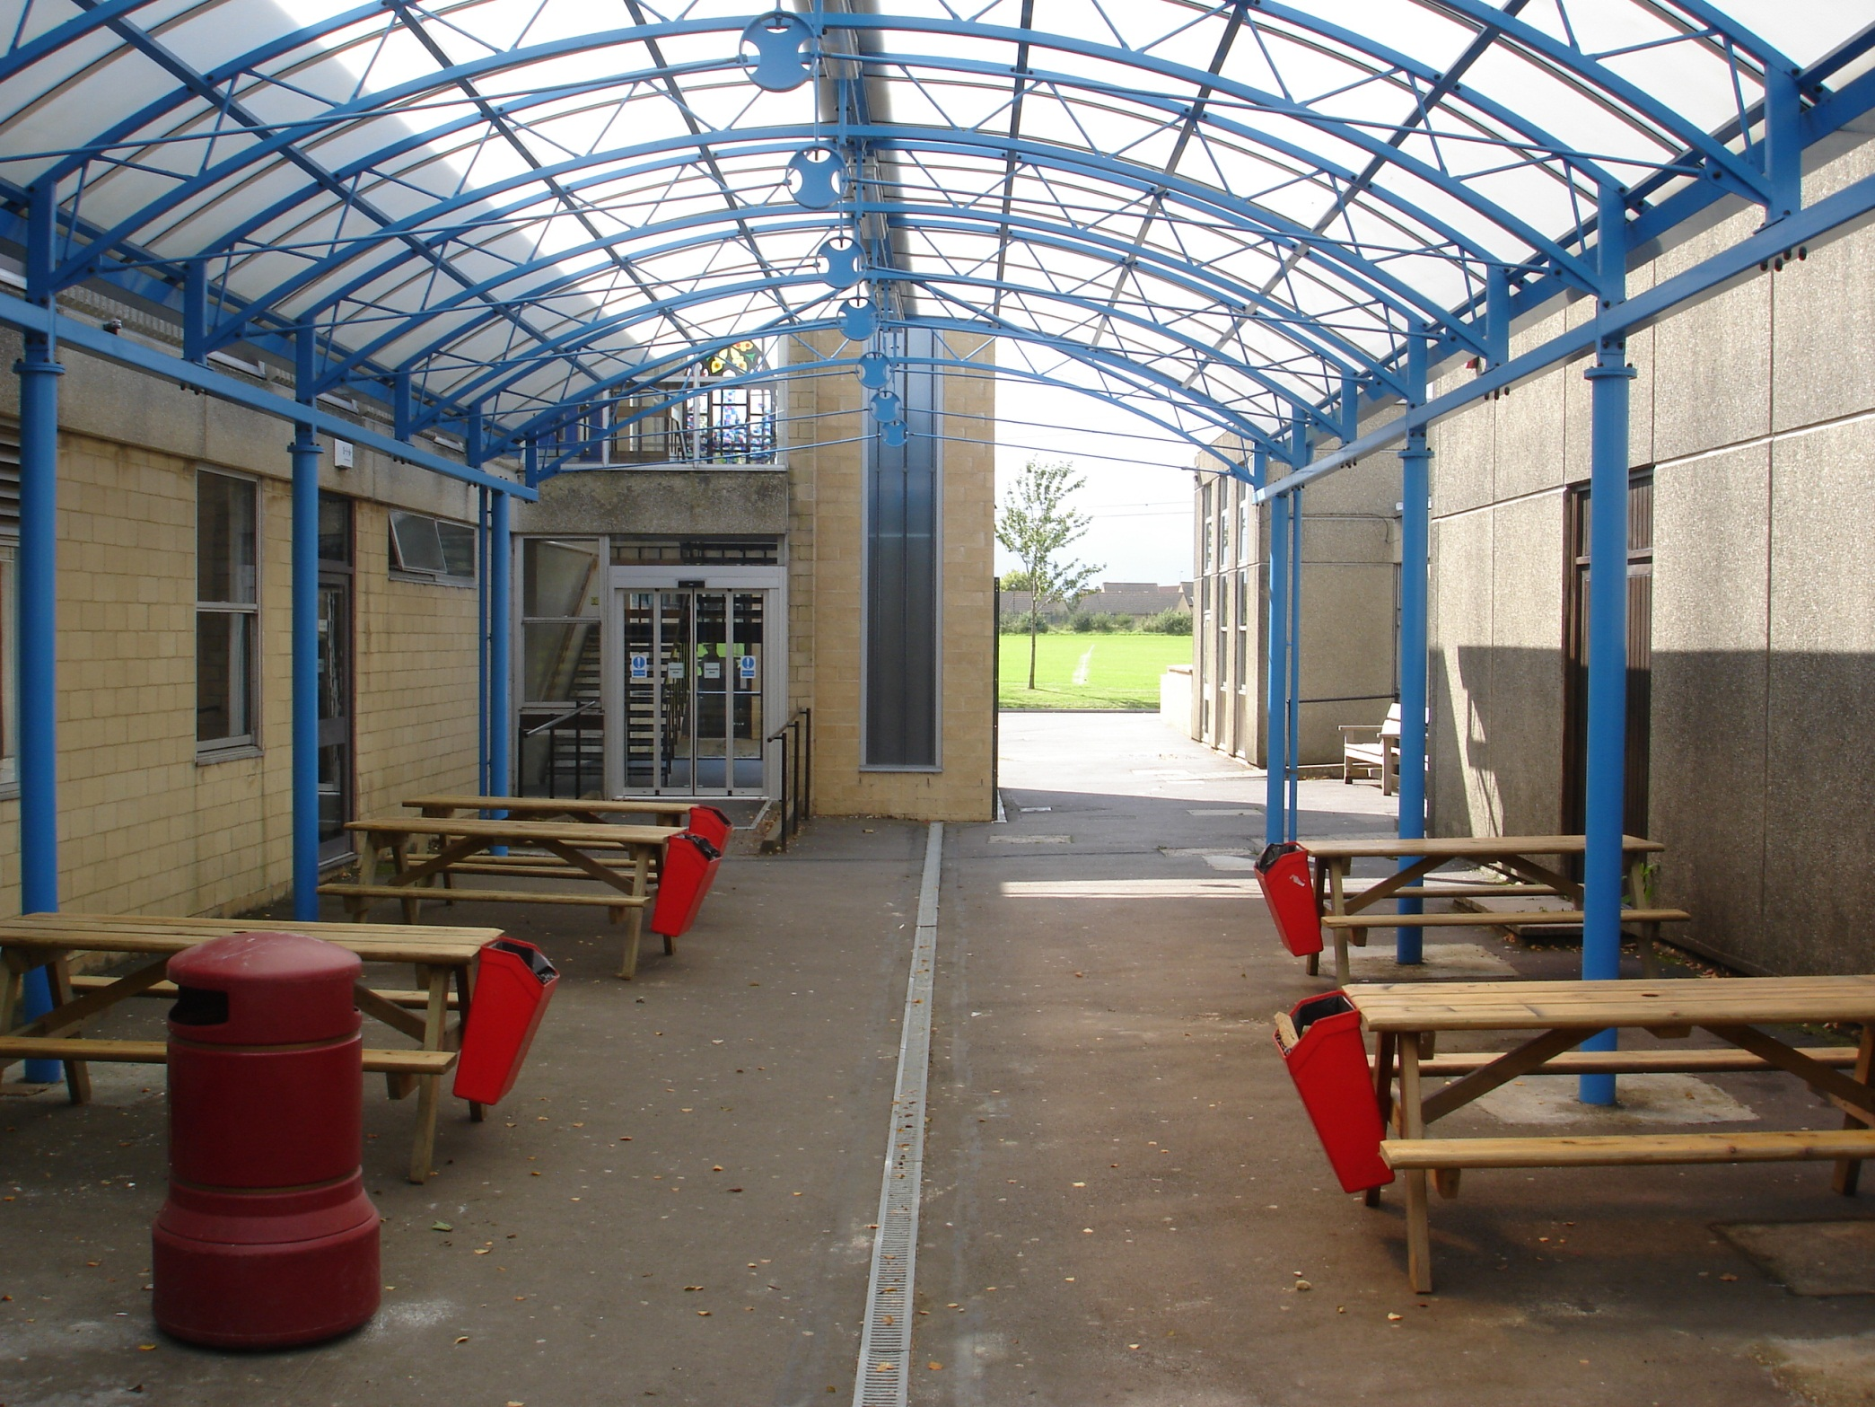
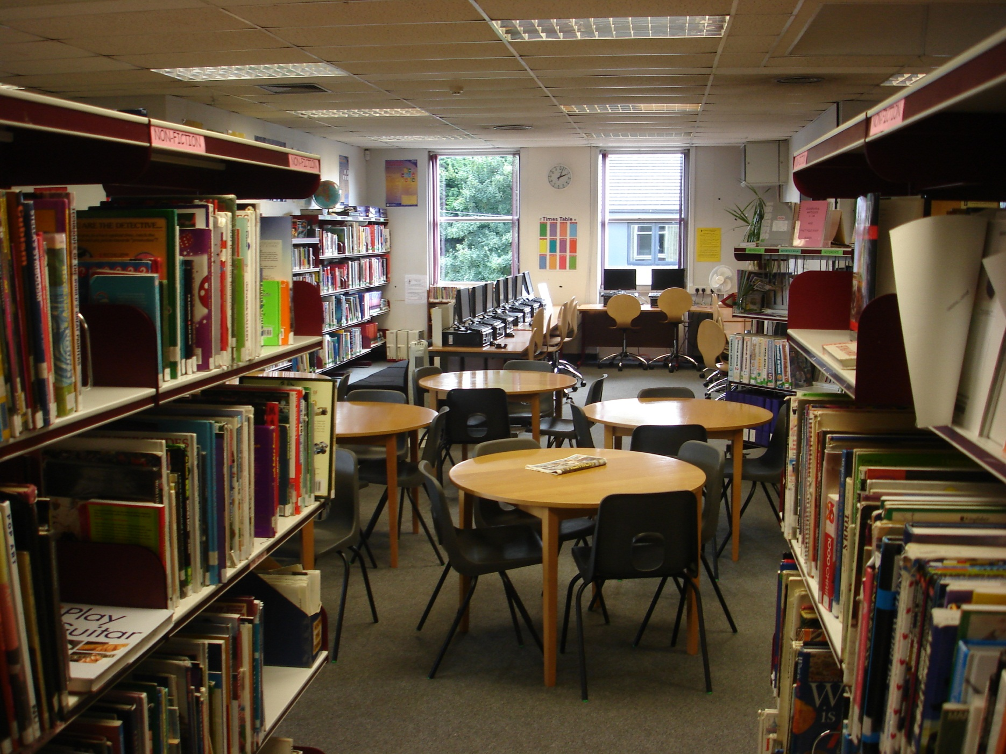
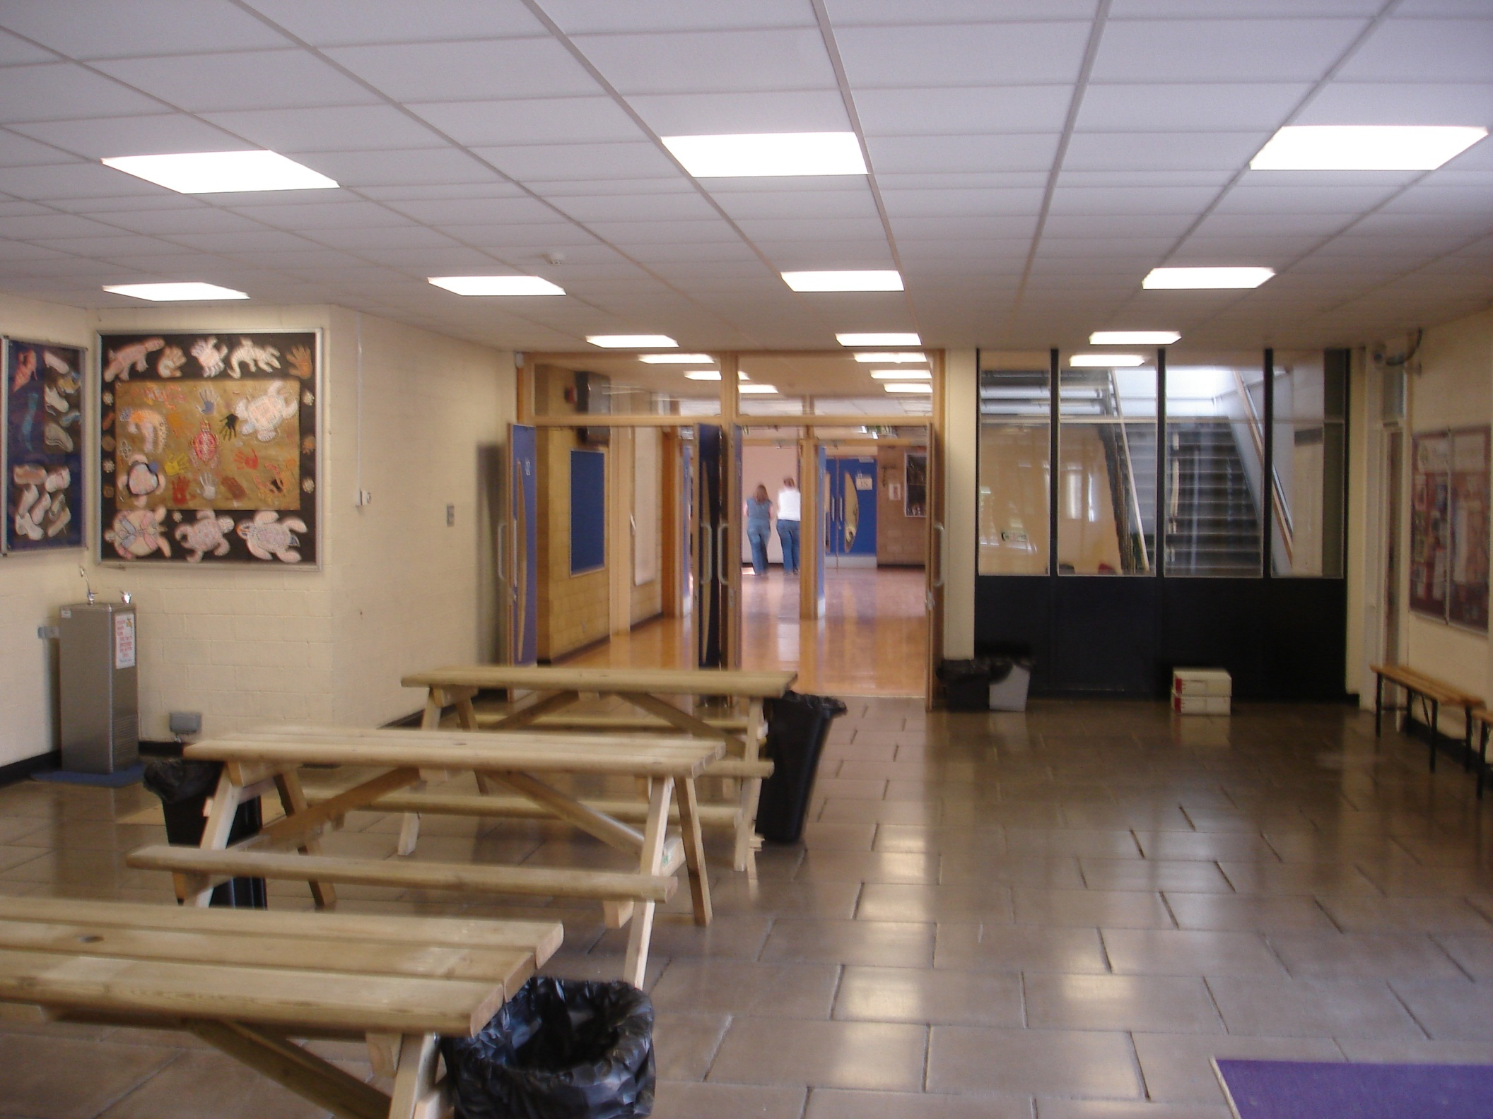

Slide 10
Prospectus

Slide 11
Your targets today are to…
… know some facts about other members of the group.
… find out some new information about Kingshill School.
… to work as a member of a group.

Slide 12
Find out the following information from three different members of your tutor group.
LIKES
DISLIKES
HOBBIES

Slide 13
Your Task
In groups you need to produce your own Kingshill school prospectus.
Each group will have a special theme.
Academic Work.
Extra-curricular Activities
Inclusion
School Rules and Routines

Slide 14
Success Criteria
Your finished Prospectus will be scored on the following three areas.
 | Group Work | SCORE
EXCELLENT WORK | The group has worked extremely well together. Everybody has made a fair contribution and a record has been made of who did what. | 4- 5 OUT OF 5
ADEQUATE WORK | The group has completed the work adequately and every member did something, although not everybody contributed a fair amount. | 2-3 OUT OF 5
LESS THAN ADEQUATE WORK | The group has been unable to work together effectively. Some members have been excluded, or have not produced work. Some members do not really know what they should have done. | 0-1 OUT OF 5
 | Information and Accuracy | SCORE
EXCELLENT WORK | The instructions have been followed. The work is accurate and correct. It is positive and provides reasons why what we do at Kingshill is helpful. It tells you more than you need to know. | 4- 5 OUT OF 5
ADEQUATE WORK | The instructions have been followed. It tells you everything you need to know. Reasons why the things we do at Kingshill are helpful are not always given. | 2-3 OUT OF 5
LESS THAN ADEQUATE WORK | It is unfinished or thin. The instructions have not been followed completely. It doesn’t really tell you a great deal about the things that happen at the school and why we do them. | 0-1 OUT OF 5
 | Presentation | SCORE
EXCELLENT WORK | The instructions have been followed. The work is extremely well put together and looks like it has been produced by a professional company. It is colourful and glossy. | 4- 5 OUT OF 5
ADEQUATE WORK | The instructions have been followed. The finished prospectus is not completely word-processed, or some bits are untidy. Large areas of black and white as opposed to colour. Some spelling errors. | 2-3 OUT OF 5
LESS THAN ADEQUATE WORK | Untidy work. It is unfinished or thin. The instructions have not been followed completely (eg only three pages, or no pictures). Too many mistakes. It looks rushed. | 0-1 OUT OF 5

Slide 15
Roles
1. People design a rough plan of what sections you need- including a contents page.
2. Split up topics eg: different subjects, rules, activities.- two people could work on each topic. One researching and one planning.
Top Tip: think about the lesson you had on PLTS- they are on the wall if you need them!

Slide 16
Watch the music videos carefully.
https://www.youtube.com/watch?v=AKs43dHBSWA&safe=true
https://www.youtube.com/watch?v=gJLIiF15wjQ&safe=true
Think about what image the songs and videos give the bands.
Write a few words down in the correct section of your books

Slide 17
Introducing the Band
Objectives
I will think back on the way my group worked together.
I will consider the strengths of my group members.
I will promote my group.

Slide 18
Your Task
Write you group’s own signature song.
It must introduce each member of the group and explain what they did for the prospectus.
Check out the past examples!!!!!

Slide 19
Your Task
Write you group’s own signature song / poem / rhyme. Include up to 4 verses/ chorus.
It must introduce each member of the group and explain what they did for the prospectus.
You may wish to include any information you found out or included.
You could tell a story through your song / poem / rhyme.

Slide 20
Lesson Objectives
I will consider the strengths of my group members.
I will think back on the way my group worked together.
I will promote my group.

Slide 21
PSHEo

Slide 23
Growing Up
I will discuss what happens during puberty
I will understand what changes will happen to my body
I will be a good listener
Any questions?
Talking about puberty in SCIENCE
Talking about puberty in PSHE

Slide 24
PUBERTY?
HOW? – Mainly “hormones”.
WHY? – Growing up, becoming an adult.
WHEN? – Any time, really, between 8 and 17.
WHERE? – Throughout your whole body (its all got
to grow!).

Slide 25
From the Greek word “hormone” – to set in motion.
HORMONES!
The pituitary gland then starts making loads of chemicals that get pumped into your blood stream and are sent to glands in your sex organs, enabling them to start developing.

Slide 26
Changes…
BOYS
Arms and legs get longer
Hands and feet get bigger
Height and weight increases
Face lengthens, nose and jaw get bigger
Body sweats more
Facial hair and body hair
Voice “breaks”, “Adam’s Apple” gets larger
Shoulders and chest get bigger
Pubic hair grows
Penis gets larger and longer
Scrotum gets bigger, baggier and turns darker
Testicles get larger and fuller
Testicles produce sperm
Penis ejaculates sperm, sometimes during “wet dreams”.
Hair and skin can become oily and spotty.
GIRLS
Arms and legs get longer
Hands and feet get bigger
Height and weight increases
Face widens and lengthens a bit
Body sweats more
Hair on arms and legs becomes more visible
Voice deepens a little
Shoulders and chest get bigger
Pubic hair grows
Hips get wider and more curvy
Breasts and nipples get larger
Nipples may darken in colour
Internal and external sex organs become larger and more developed
Vagina produces a sticky, whitish liquid
Ovaries begin releasing eggs
Periods start
Hair and skin can become oily and spotty.

Slide 27
Periods
Every girl is born with thousands of eggs.
During puberty hormones help the eggs develop and grow.
When an egg is ready, it heads down a fallopian tube to the uterus/womb.
The womb develops a lining, like a blanket of blood cells to
look after the egg during its stay there.
If the egg doesn’t get fertilized, it breaks down and dissolves.
The same thing happens to the lining.
They then leave the body through the vaginal opening.
This happens roughly every 28 days and is called “having a period”.

Slide 28
Periods
It can be a bit frightening at first, but its perfectly normal – just part of
growing up. They tend to last between 3 – 8 days. Flows can vary from
person to person, and even from month to month.

Slide 29
Periods
The bad news…
Most girls, at some time or another get tummy cramps during their
periods. Also, your breasts can feel sore, your body can feel a bit
bloated and you can feel tired, grumpy, sad and even deeply miserable.
One minute you want to sit in a corner and cry and the next you want to
Kick someone – and you don’t even know why!

Slide 30
Periods
Tips
If the pain isn’t too bad, a bit of light exercise can help
If the pain gets strong, take a painkiller
Lie down with a hot water bottle on your tummy
Try relaxing in a hot bath
Don’t be afraid to go and see the doctor or the nurse
if the pain gets very bad. Don’t suffer in silence – talk to
an adult.

Slide 31
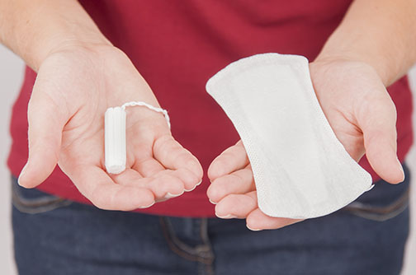
Sanitary Towels & Tampons
Sanitary towels are strips of padded material that fit inside your knickers. You buy them in different thicknesses depending on how heavy or light your period is.
Most have a strip of sticky tape down one side to hold the towel in place on your knickers.
Some have flaps called “wings” that fold under your knickers for extra grip.
They are quick and easy to use.
Tampons are about the same size as your thumb and have a piece of string attached to the end of them. They are made of the same material as sanitary towels, but it is compressed so they can be pushed up inside the vagina.
Don’t forget to change your tampons and towels regularly – at least every three or four hours during the day, as well as last thing at night and first thing in the morning, no matter how light your period is.

Slide 32
Changes…

Slide 33
Periods
When do you start your period?
What actually happens?
What products can you use? When? How?!!
What can you do if it hurts?

Slide 34
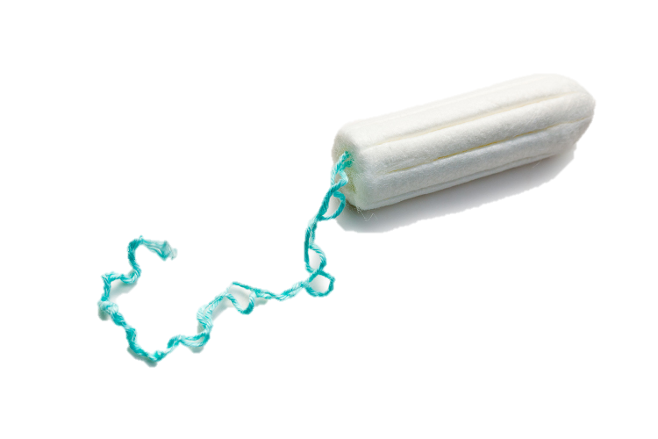
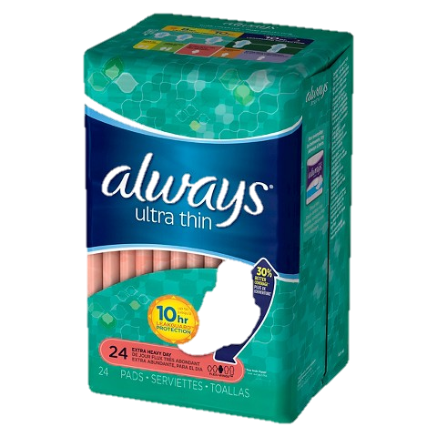
Products

Slide 35
Want more advice?
Visit the NHS website and search for ‘puberty’
Speak to someone at school (Tutor/ school nurse…)
The Radio 1 website (really good) http://www.bbc.co.uk/programmes/articles/bnb45CxxpnMb8x90Tmrv19/puberty-females
Talk to your friends- everyone goes through it!

Slide 36
Finished
Create your own advice sheet!
What happens in puberty?
What products might you need?
How might you feel?
Who should you go to for help?

