Slide 1
Sexual Relationships
I will know what we will be covering in this topic.
I will help to create the ground rules.
I will understand why these rules will be important.

Slide 2
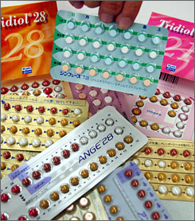
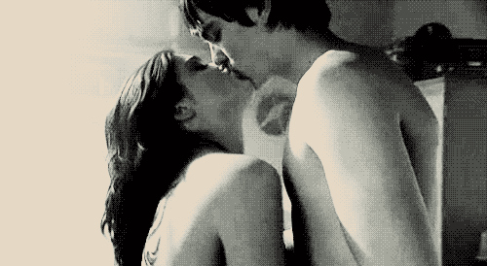
Sexual Relationships

Slide 3
Pair Work
Discuss and write a list of possible difficulties when covering these topics

Slide 4
Atmosphere
How should the teacher approach the subjects?
What do the you want from me as a teacher?
How should you approach the subjects?

Slide 5
Rules
Respect the views of every individual.
Treat the topic with maturity.
Allow people the chance to talk and listen to what they have to say.
No laughing at other people’s contributions.
You do not have to contribute or join in if you don’t wish to.
No names should ever be mentioned.
Nobody has to give away personal information.
Confidentiality must be respected – what is said in the room remains in the room.*

Slide 6
Quick Topic Quiz!
This quiz is individual and useful to identify how much you know about the next topic.
Marks will be collected in at the end!

Slide 7
Q1
It is illegal for a man to have sexual intercourse with a young woman under 16 years old.
True or False?

Slide 8
Q2
It is illegal for a woman to have sexual intercourse with a man under:
13 years old
16 years old
18 years old
No specific
age

Slide 9
Q3
If two 15 year old girls have a sexual relationship they are breaking the law.
True or False?

Slide 10
Q4
The age of consent for 2 men to have a sexual relationship is:
21 years old
18 years old
16 years old
Still illegal

Slide 11
Q5
To get contraceptive advice a person needs to be:
16 years old
18 years old
21 years old
Any age

Slide 12
Q6
Two people can get married or enter a civil partnership at 16 years of age if their parents/guardians agree.
True or False?

Slide 13
Q7
In England and Wales two people can marry or enter a civil partnership even if their parents/guardians disagree at 17 years of age.
True or False?

Slide 14
Q8
A woman will always get an abortion on request.
True or False?

Slide 15
Q9
Abortion cannot take place after the 20th week of pregnancy.
True or False?

Slide 16
Q10
Prostitution is illegal.
True or False?

Slide 17
Q11
At what age can a woman be prescribed the pill?
18 years old
16 years old
14 years old
Any age

Slide 18
Q12
To buy condoms a person needs to be:
18 years old
16 years old
12 years old
Any age

Slide 19
Q13
It is illegal for schools and youth projects to talk to young people about homosexuality.
True or False?

Slide 20
Q14
Male rape is legal.
True or False?

Slide 21
Q15
It is illegal for a man to rape his wife.
True or False?

Slide 22
Q16
If a young woman under the age of consent asks for contraceptive advice her parents/guardians will be told.
True or False?

Slide 23
Q17
Parents and guardians have a legal right to withdraw their children from sex and relationships education (SRE).
True or False?

Slide 24
Q18
It is illegal for a man to have sexual intercourse with a person they know is their sister, mother, daughter or grand-daughter.
True or False?

Slide 25
The Answers
Find another coloured pen/pencil to mark your answers.

Slide 26
Q1
It is illegal for a man to have sexual intercourse with a young woman under 16 years old.
True or False?
True
It is lower however in some other European countries (e.g. Spain)

Slide 27
Q2
It is illegal for a woman to have sexual intercourse with a man under:
13 years old
16 years old
18 years old
No specific
age
B

Slide 28
Q3
If two 15 year old girls have a sexual relationship they are breaking the law.
True or False?
True
Since 2003 the age has been 16.

Slide 29
Q4
The age of consent for 2 men to have a sexual relationship is:
21 years old
18 years old
16 years old
Still illegal
C

Slide 30
Q5
To get contraceptive advice a person needs to be:
16 years old
18 years old
21 years old
Any age
D

Slide 31
Q6
Two people can get married or enter a civil partnership at 16 years of age if their parents/guardians agree.
True or False?
True

Slide 32
Q7
In England and Wales two people can marry or enter a civil partnership even if their parents/guardians disagree at 17 years of age.
True or False?
False
You need to be 18 to marry without consent.

Slide 33
Q8
A woman will always get an abortion on request.
True or False?
False
The law states that two doctors must grant consent. They must agree that the continuation of the pregnancy will cause risk to the woman’s physical or mental health or that the baby will be born with severe disabilities.

Slide 34
Q9
Abortion cannot take place after the 20th week of pregnancy.
True or False?
False
The limit is 24 weeks. However in exceptional circumstances abortions can be carried out after then.

Slide 35
Q10
Prostitution is illegal.
True or False?
False
However, soliciting (publicly advertising your availability for sexual services), keeping an immoral house and / or living off immoral earnings is illegal.

Slide 36
Q11
At what age can a woman be prescribed the pill?
18 years old
16 years old
14 years old
Any age
D

Slide 37
Q12
To buy condoms a person needs to be:
18 years old
16 years old
12 years old
Any age
D

Slide 38
Q13
It is illegal for schools and youth projects to talk to young people about homosexuality.
True or False?
False

Slide 39
Q14
Male rape is legal.
True or False?
False
Initially the law only recognised that rape could be committed by a man against a woman. This was changed in 1994.

Slide 40
Q15
It is illegal for a man to rape his wife.
True or False?
True
However, the law only changed in 1992. Before then, a man could not
be prosecuted for the rape of his wife.

Slide 41
Q16
If a young woman under the age of consent asks for contraceptive advice her parents/guardians will be told.
True or False?
False

Slide 42
Q17
Parents and guardians have a legal right to withdraw their children from sex and relationships education (SRE).
True or False?
True
But only from specific programmes, not the areas covered by the national curriculum.

Slide 43
Q18
It is illegal for a man to have sexual intercourse with a person they know is their sister, mother, daughter or grand-daughter.
True or False?
True
This is illegal even if the woman gives consent.

Slide 44
Sex and Relationships
Objectives
To be aware of the topic for the term.
To consider the questions raised by this topic.

Slide 45
Write your questions on the slips of paper.
Fold them up.
Put them in the box.

Slide 46
What is a sexual relationship?
What is sex?
Why do people have sex?
What are the different
types of sexual activity?

Slide 47
Consent
I WILL REMEMBER THE GROUND RULES FROM LAST LESSON.
I WILL KNOW WHAT A RELATIONSHIP IS.
I WILL THINK ABOUT EXPECTATIONS IN DIFFERENT RELATIONSHIPS.

Slide 48
Brainstorm:
What makes a good relationship?

Slide 49
Legal Definition of Rape
The legal definition of rape in England and Wales, as defined in the Sexual Offences Act 2003, 10 is as follows:
(1) A person (A) commits an offence if— (a) he intentionally penetrates the vagina, anus or mouth of another person (B) with his penis
(b) B does not consent to the penetration, and (c) A does not reasonably believe that B consents.
(2) Whether a belief is reasonable is to be determined having regard to all the circumstances, including any steps A has taken to ascertain whether B consents.
It is also important to note that a person guilty of an offence under this section is liable, on conviction on indictment, to imprisonment for life.

Slide 50
Definition of Consent
“agreeing by choice and having the freedom and capacity to make that choice”
So, for consent to be real someone must
Have a choice
Agree to that choice because they want to (say yes)
Be free to make that choice
Have the capacity (be able) to make that choice

Slide 51
Kate
Synopsis: Kate, 14, has been ‘hanging out’ with Carl recently and really ‘fancied him’. He invited her to his house one night; she wore skinny jeans and 22 a stripy top that made her ‘boobs look good’. They chatted, just the two of them, but Carl was ‘acting weird’ and received lots of messages on his phone. Gavin and Shane, two of Carl’s friends, turned up and ‘annoyed’ Kate by ‘going on’ about how good her breasts look. Carl ‘plays up’ to them. She went to the kitchen to text her friend, but is followed by the boys. Shane snatched Kate’s mobile phone and although she tried to get it back, Carl told her she could only have it if she kissed them. Kate did this as she wanted her phone back; Carl said to her ‘Come on Kate, show some effort’. They all go to the living room, where things go ‘too far, just too much’ while Carl told all of them to ‘do stuff’. The three boys ‘took in turns to have sex’ with Kate and filmed it.

Slide 52
Kate
Do you think the boys got consent from Kate?
Do you think what Kate has described is rape?
Did Kate have freedom to choose or give consent?
How would Kate feel about what happened?

Slide 53
Gavin
. Gavin is 15 and was invited to Carl’s house with Shane. Kate was there and ‘looked fit’. He asks ‘You think I liked it? It got way out of hand.’ Gavin knew that Kate did not want to ‘do it’, but felt that the 23 boys would think he was a ‘pussy’, so he felt compelled to take part. He knows it was wrong, it felt wrong, and now he feels weird about what ‘he’s done’.

Slide 54
Gavin
What do you think Gavin has said?
Do you think Gavin raped Kate?
Did Gavin seek consent from Kate?
What could Gavin have done differently?

Slide 55
Sabrina
Sabrina is 13 years old and likes Amir, a boy in the year above her at school. They have been flirting recently and she has sent him a couple of photos. She thought he liked her too, so went to his house. Once there Amir showed her a pornographic video on his mobile phone, which Sabrina thought was ‘kind of nasty, but a bit funny’. She had never seen anything like that before. Afterwards they started kissing and Amir put his hand up Sabrina’s top, which she liked, but when he started to put his hand into her underwear she was unsure. Amir asked if Sabrina gave head – she says no and they both laughed. He told Sabrina he really liked her and that he thought she liked him too. When they kissed again Amir told Sabrina she made him ‘hard’ and that there was somewhere else he wanted her to kiss. As she did not want him to think she was frigid, Sabrina agreed, at which point Amir showed her his penis. She kissed his penis and Amir held her head down. She ‘didn’t know what to do’ as she had ‘never done anything like that before’. When he was finished Amir asked Sabrina if she liked it, and she said yes, but just wanted to ‘go home’.

Slide 56
Sabrina
What do you think Sabrina has said?
Do you think Amir got consent from Sabrina?
Do you think what Sabrina has described is rape?
Did Sabrina have the freedom to choose or give consent?

Slide 57
https://online.clickview.co.uk/libraries/categories/22095337/videos/22101744/sex-and-relationships-in-my-experience-just-good-friends
https://online.clickview.co.uk/libraries/categories/22095337/videos/22101742/sex-and-relationships-in-my-experience-dating
https://online.clickview.co.uk/libraries/categories/22095337/videos/22101740/sex-and-relationships-in-my-experience-pressue
https://online.clickview.co.uk/libraries/categories/22095370/videos/22101998/life-stuff-the-a-z-of-love-and-sex-a-j
https://online.clickview.co.uk/libraries/categories/22095370/videos/22101994/life-stuff-the-a-z-of-love-and-sex-k-q
https://online.clickview.co.uk/libraries/categories/22095370/videos/22101996/life-stuff-the-a-z-of-love-and-sex-r-z

Slide 58
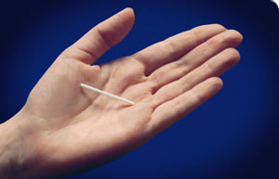
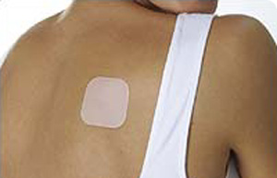
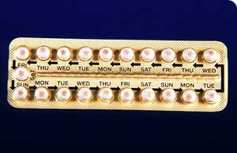
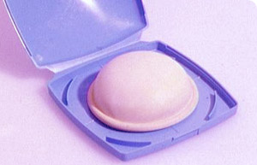
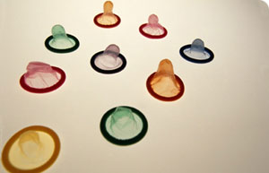
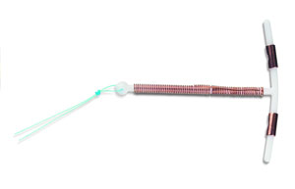
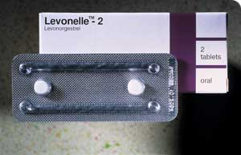
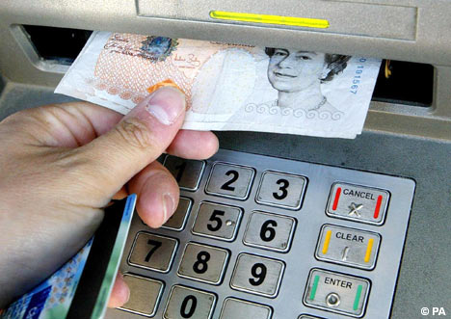
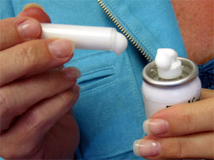
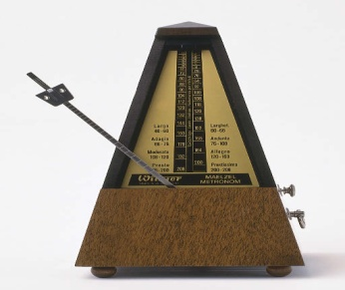
CONTRACEPTION
A | B | C | D
E | F | G | H
I | J | K | L

Slide 59
Evaluation of Contraceptives
What is the safest form of contraception?
Which is the easiest to use?
Which is the worst?
Which is ideal for a married couple who are faithful and don’t want any more children?
Which ones work well together?

Slide 60
CONDOMS
I will know what a condom is.
I will know how to use a condom.
I will understand why a condom should be used carefully.
I will know what condoms are made of.
I will know how a condom can protect me.
Which are the three most important lesson targets for you?
Why?

Slide 61
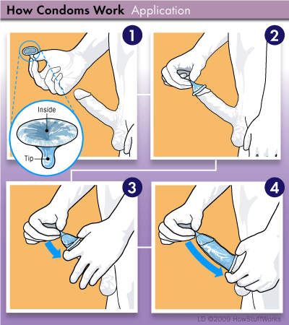
You have thirty seconds to study the following picture…

Slide 62
Now tell me what to do!

Slide 63
In your groups...
What is the correct way to put a condom on?
Why must it be put on like this?
What are the “dangers” involved in handling a condom?
What other bits of advice can you give me?

Slide 64
WHAT WOULD YOU EXPECT TO SEE IN A GOOD DEMONSTRATION?
WHAT WOULD YOU EXPECT TO HEAR IN A GOOD DEMONSTRATION?

