Slide 1
Year 9 Spanish TERM 1: Viva 2 textbook, chapter 2
If pupils are absent from lessons they should spend time revising and learning vocabulary. All of the vocabulary for this term is on the following slides. First of all, they should recap the vocabulary which they learned the previous week. Then they should start to learn the next section of vocabulary which they have not yet covered in class. This could be done by using the look, cover, write, check method or by making flashcards etc. It should also be written in their orange book. There are also a few tasks to complete. A plan for the term is on the next slide.
Pupils can also revise vocabulary on Linguascope-
Username is kingshill password is mfl123*
Any new vocabulary they learn can be written in their orange books or on paper.
If pupils wish to do extension work they can access free MFL lessons on the Oak National Academy website:
https://classroom.thenational.academy/subjects-by-key-stage

Slide 2
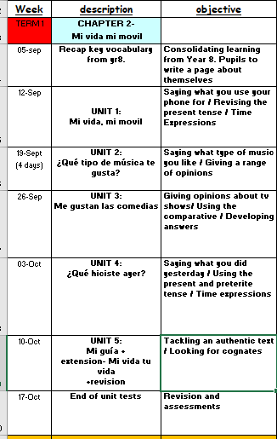

Slide 3
Week 1 – w/c 5th September
Revise the key vocabulary from yr8 which is on the next few slides. Then write a paragraph in Spanish about yourself.

Slide 4
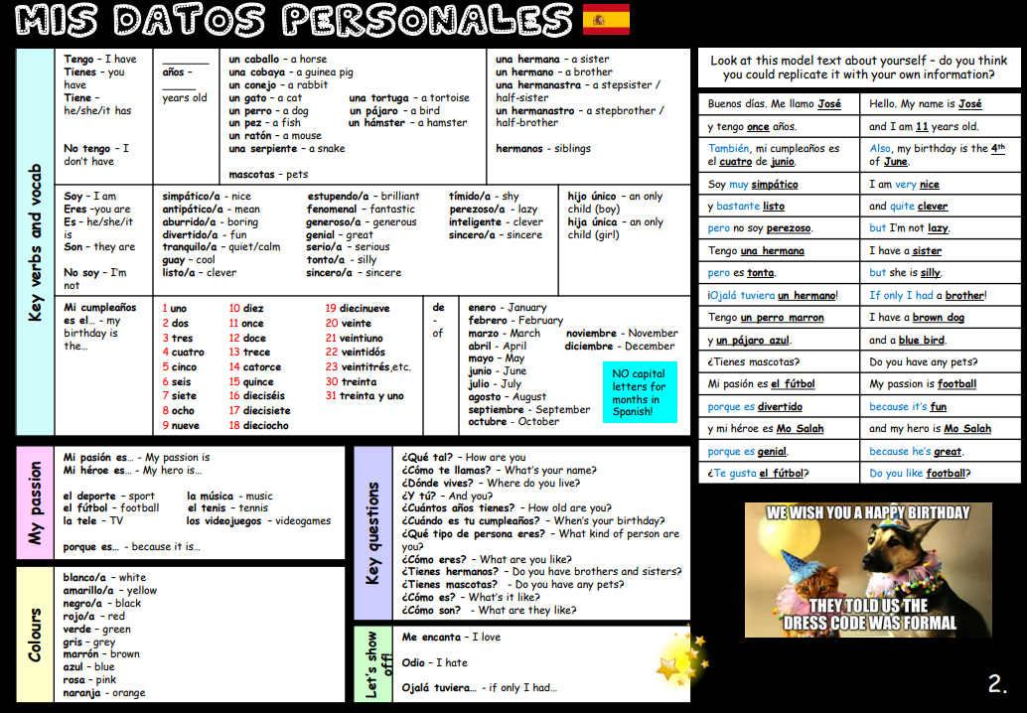

Slide 5
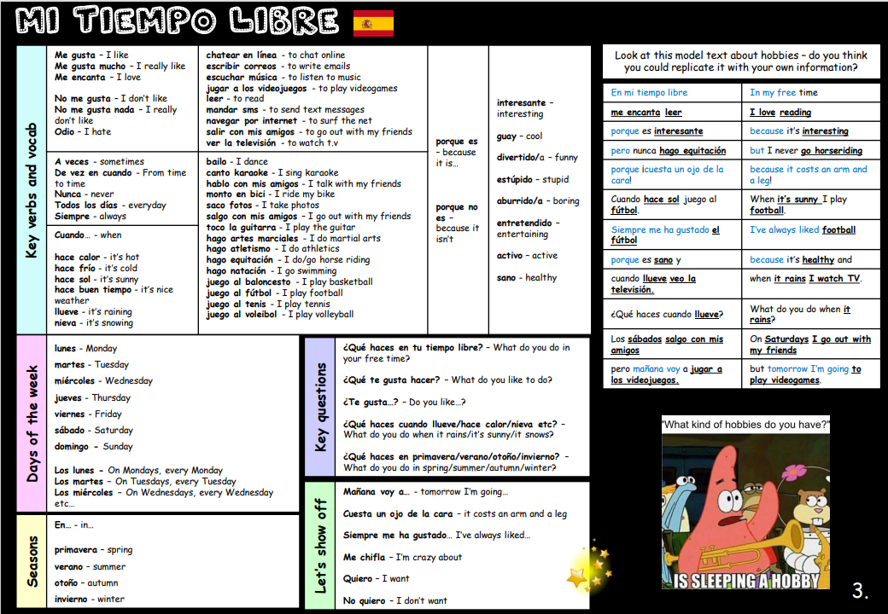

Slide 6
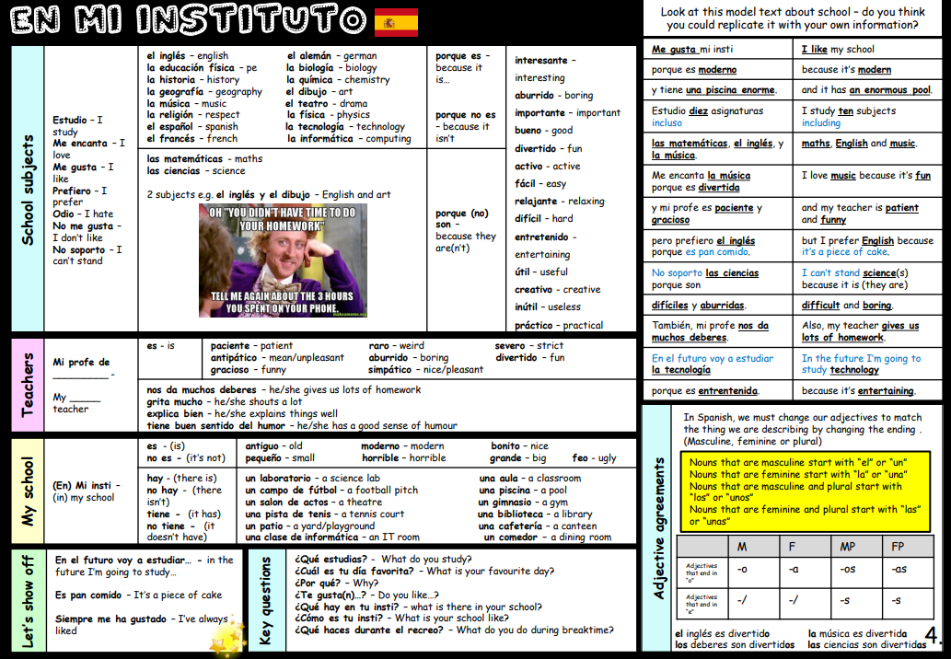

Slide 7
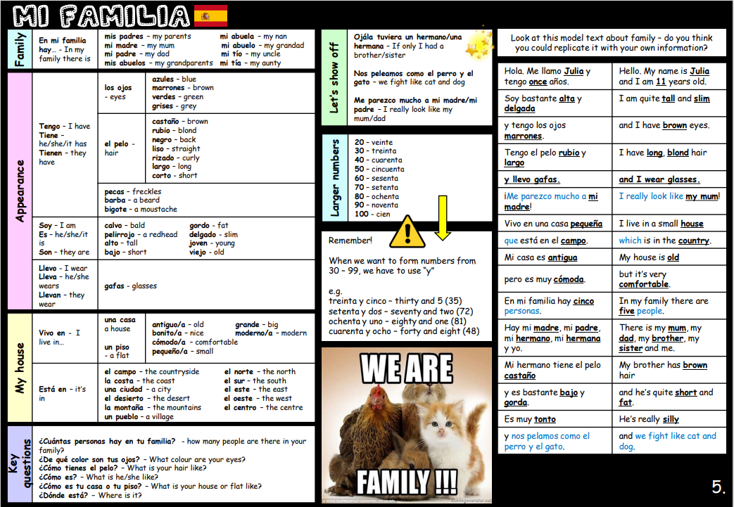

Slide 8
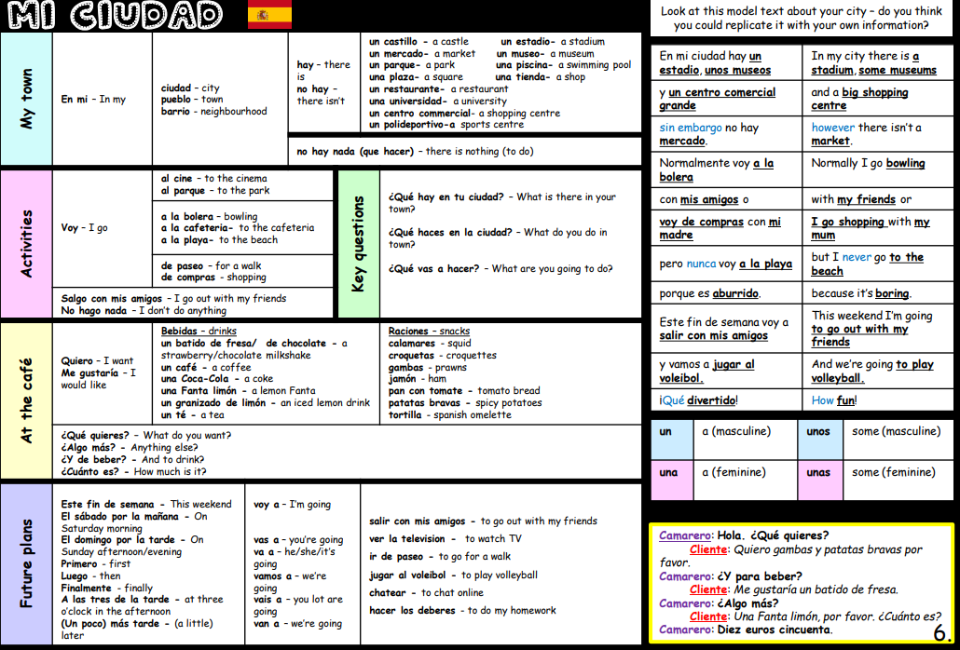

Slide 9
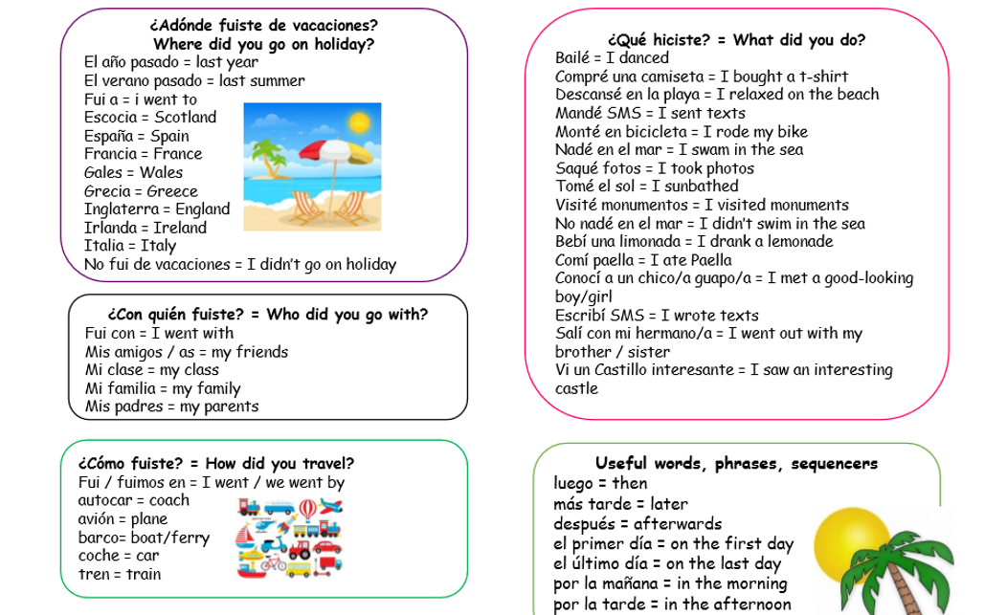

Slide 10
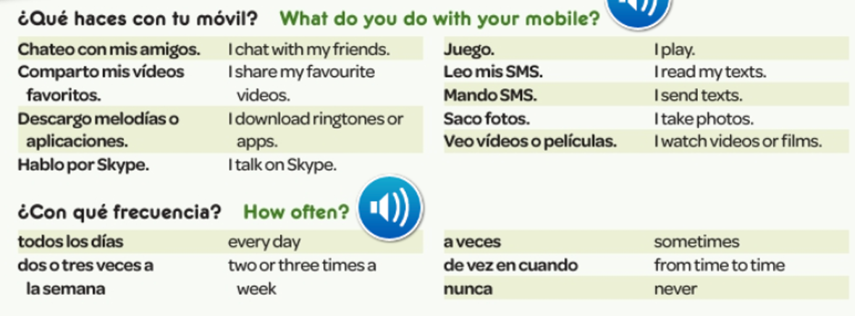
Read through the vocabulary for this week and spend a good amount of time trying to learn it. You will need these words to complete the tasks on the next few slides.
Week 2 – w/c 12th September

Slide 11
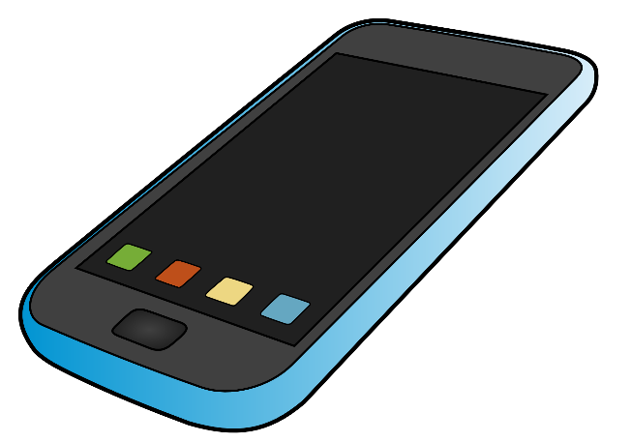
Mi vida, mi móvil
EXT: How would you say these in the third person?
Mando ➔ manda
To use the present tense to say what I use my phone for.
Match the phrases to the English.
Saco fotos
Hablo por Skype
Mando SMS
Juego
Leo mis SMS
Descargo melodías o aplicaciones
Chateo con mis amigos
Comparto mis vídeos favoritos
Veo vídeos o películas
I read my texts
I watch videos or films
I share my favourite videos
I play
I take photos
I download ringtones or apps
I send texts
I chat with my friends
I talk on Skype

Slide 12
The present tense: something you are doing NOW. Copy these notes.
Hablar = to speak → remove the –ar → Habl → add the present tense endings for AR verbs
I speak = hablo
You speak (sing.) = hablas
He/she speaks = habla
We speak = hablamos
You speak (plural) = habláis
They speak = hablan
Now do the same for the verb cantar (to sing)
Remove the –AR → cant
Add the present tense endings
I sing = canto
you (sing) sing =
He/she sings =
We sing =
You (plural) sing =
They sing =

Slide 13
Copy out and fill in the gaps
day
2 or 3
never

Slide 14
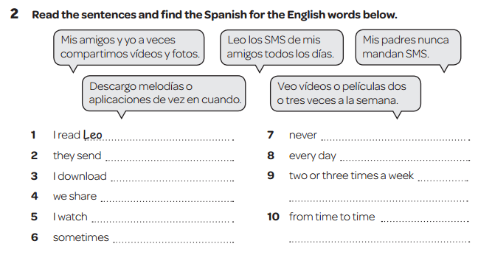

Slide 15
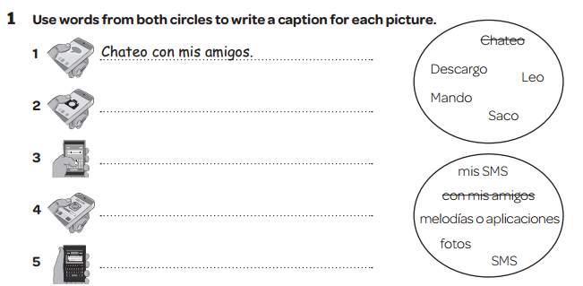
In Spanish of course!
(I take photos)
(I send texts)
(I download ringtones and apps)
(I read my texts)

Slide 16
Read through the vocabulary for this week and spend a good amount of time trying to learn it. You will need these words to complete the tasks on the next few slides.
Week 3 – w/c 19th September

Slide 17
La cultura
Reggaeton is a musical genre which originated in Puerto Rico during the late 1990s. It is influenced by hip hop and Latin American and Caribbean music. Vocals include rapping and singing, typically in Spanish.
¿Qué piensas?

Slide 18
Gramática – Copy these notes
When you give opinions with me gusta, make sure you use el, la, los or las before the noun.
You may not use ‘the’ in English, but you must use el, la, los or las in Spanish.
Me gusta el rap.
I like rap.
However, you do not need el, la, los or las when you are talking about what music you listen to.
Escucho rap.
I listen to rap.

Slide 19
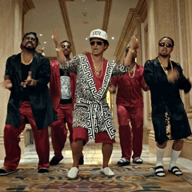
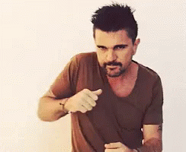
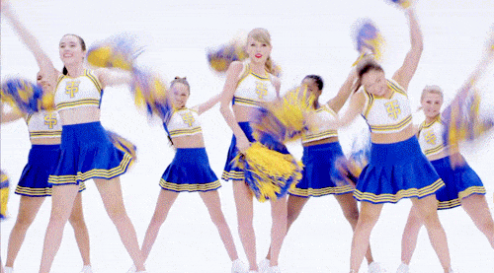
Genius Task: Who do you agree with and why?
Find the 6 phrases below in Spanish in the texts
Me encanta la música de Bruno Mars. Es mi cantante favorito. Escucho R’n’B porque me gusta el ritmo. ¡Es guay!
Mi grupo favorito es One Direction porque los chicos son muy guapos. Mi canción favorita es ‘Gotta Be You’. Es muy triste.
Me gusta mucho la música del cantante colombiano Juanes. Mi canción favorita es ‘Me Enamora’ porque me encanta la melodía.
Me encanta la música de Taylor Swift porque me encanta la letra. No me gusta nada la música de Katy Perry. En mi opinion, es horrible.
He’s my favourite singer.
Because I like the rhythm.
My favourite group is…
My favourite song is…
I love the tune.
I love the lyrics.

Slide 20
Me encanta la música de Bruno Mars. Es mi cantante favorito. Escucho R’n’B porque me gusta el ritmo. ¡Es guay!
Mi grupo favorito es One Direction porque los chicos son muy guapos. Mi canción favorita es ‘Gotta Be You’. Es muy triste.
Me gusta mucho la música del cantante colombiano Juanes. Mi canción favorita es ‘Me Enamora’ porque me encanta la melodía.
Me encanta la música de Taylor Swift porque me encanta la letra. No me gusta nada la música de Katy Perry. En mi opinion, es horrible.
Why does she listen to R’n’B?
Why does she like One Direction?
Why is ‘Me Enamora’ his favourite song?
Why does she like Taylor Swift?
Why does she not like Katy Perry?
Genius Task: A) Where is Juanes from?
B) Why does she like ‘Gotta Be You’?

Slide 21
Read the vocab. Try and learn it:
Prefiero = I prefer
me chifla =I’m crazy about
me encanta ₌ I love
me mola = It’s cool to me
me flipa = I go mental for
no me gusta (nada)
odio = I don’t like (at all)
detesto = I detest

Slide 22
Translate the following text in to English:
Me gusta el rap, mi cantante favorito es Stormzy porque me encanta la letra. Pero no me gusta nada Little Mix porque su musica es tonta.
Mañana voy a escuchar a Ed Sheeran, es fenomenal, va a ser muy guay y divertido.

Slide 23
OPTIONAL TASK-
Log on to Linguascope and learn the ‘musical instrument’ vocabulary by playing some of the games. Make a note of the new words. They are in the beginner section):
Username – kingshill password – mfl123*

Slide 24
Week 4 – w/c 26th September
Read through the vocabulary for this week and spend a good amount of time trying to learn it. You will need these words to complete the tasks on the next few slides.

Slide 25
Match up the pictures 1-9 with the programmes a-i

Slide 26
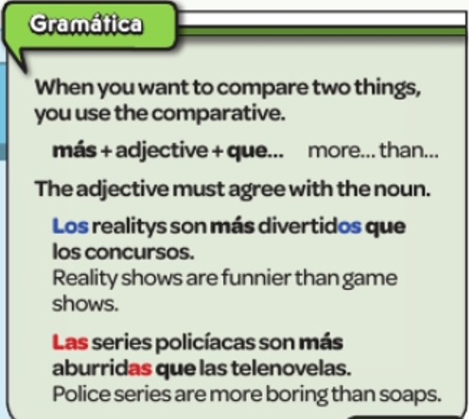
Copy the following grammar:

Slide 27
Copy these sentences and then translate them in to English.
Me gusta Eastenders, es una telenovela.
Me encantan las comedias, especialmente Big Bang Theory, es muy divertido.
Odio el telediario porque es bastante aburrido.

Slide 29
Week 5 – w/c 3rd October
Read through the vocabulary for this week and spend a good amount of time trying to learn it. You will need these words to complete the tasks on the next few slides.

Slide 30
Read the texts and find the 9 phrases below in Spanish
Ayer, por la mañana hice kárate.
Luego monté en bici.
Por la tarde jugué en línea con mis amigos.
Y un poco más tarde vi una película. ¡Qué divertido!
Ayer, por la mañana hice gimnasia.
Luego hablé por Skype con mi abuela.
Por la tarde hice los deberes y bailé en mi cuarto.
Un poco más tarde salí con mis amigas. ¡Qué guay!
I went out with my friends.
I played online with my friends.
I talked on Skype.
I went cycling.
I did gymnastics.
I watched a film.
I did my homework.
I danced in my room.
I did karate.

Slide 31
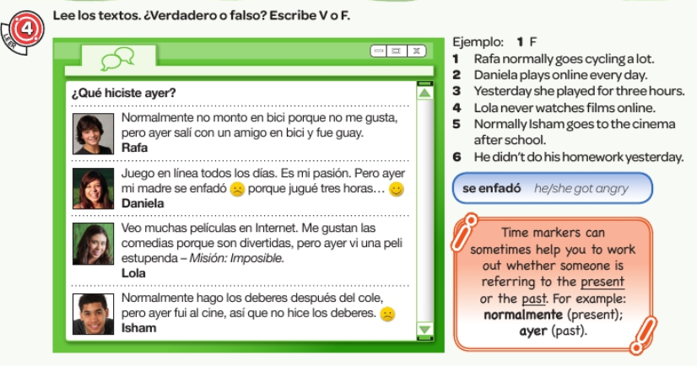
Read the texts. True or false? Write V for true and F for false

Slide 34
Week 6 – w/c 10th October
There are no new words to learn this week but look over the words from the previous weeks in order to complete the tasks on the next few slides.

Slide 35
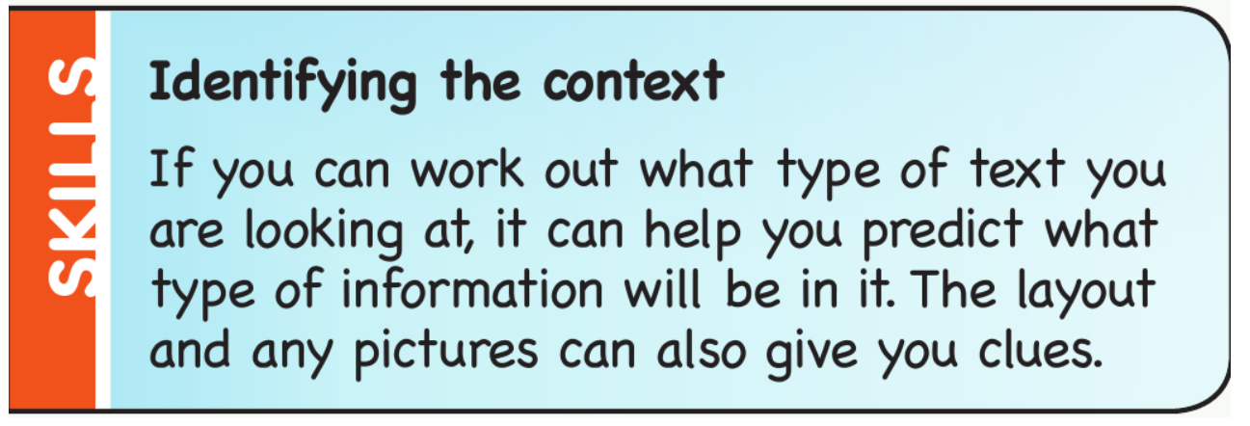
What type of programmes are these? Eg. 18.30 TVE1 – una telenovela
 | 18:30 | 19:00 | 19:30 | 20:00 | 20:30
TVE 1 | Eastenders (repetición) | El Telediario y tiempo | Telediario local | La voz
2 | Transformar tu casa |  | Cocinar con Nigella | Las islas Galápagos – El efecto del calentamiento global
Canal+ | Los Simpson | El Gran Hermano | ¿Quién quiere ser el millonario? | Estreno: El Gran Gatsby (Con actuación de Leonardo DiCaprio y Carey Mulligan)
Dep4 | Fútbol: La liga |  |  | Los mejores equipos del día | El maratón de Nueva York 2013

Slide 36
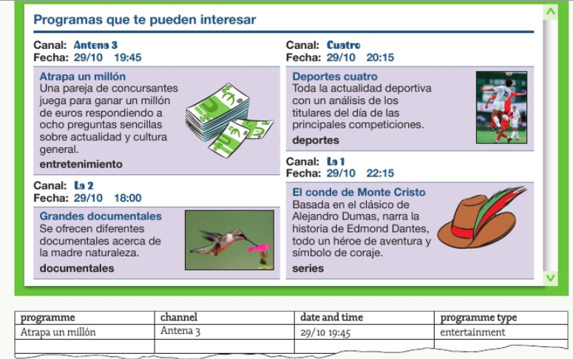
Read the tv guide about the four programmes. Then fill in the table in English.

Slide 37
Read the phrases and then write the correct name for each of the six pictures.
Example – 1 Martín

Slide 38
Read the text and complete the profile

Slide 39
Log on to Linguascope and practise the ‘tv programme and film genre’ vocabulary by playing some of the games. They are in the beginner section):
Username – kingshill password – mfl123*

Slide 40
Week 7 – w/c 17th October
This week is assessment week. Spend some time revising all of the vocab on the next slide, then please contact your teacher for the assessment papers. You could make vocabulary posters or flashcards to help you prepare.

Slide 41
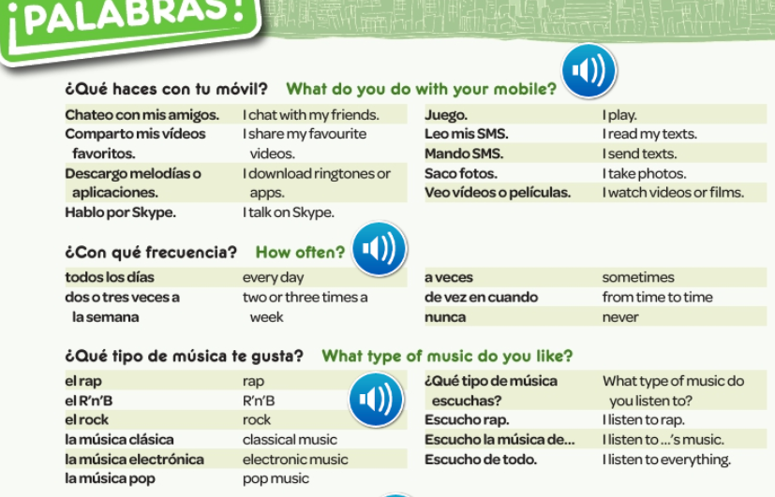

Slide 42
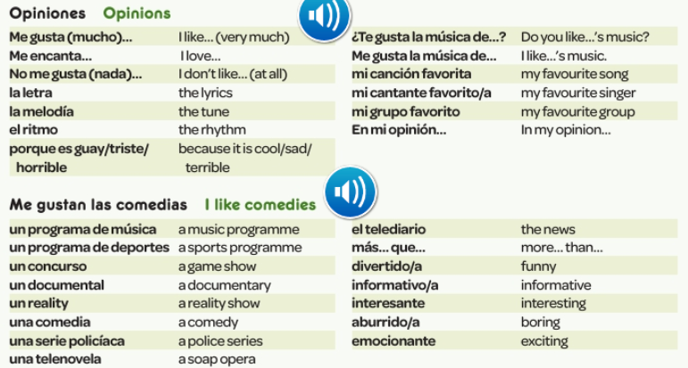

Slide 43
