Slide 1


Year 9 German TERM 1: Echo 2 textbook, chapter 3
If pupils are absent from lessons they should spend time revising and learning vocabulary. All of the vocabulary for this term is on the following slides. First of all, they should recap the vocabulary which they learned the previous week. Then they should start to learn the next section of vocabulary which they have not yet covered in class. This could be done by using the look, cover, write, check method or by making flashcards etc. It should also be written in their orange book. There are also a few tasks to complete. A plan for the term is on the next slide.
Pupils can also revise vocabulary on Linguascope-
Username is kingshill password is mfl123*
Any new vocabulary they learn can be written in their orange books or on paper.
If pupils wish to do extension work they can access free MFL lessons on the Oak National Academy website:
https://classroom.thenational.academy/subjects-by-key-stage

Slide 2
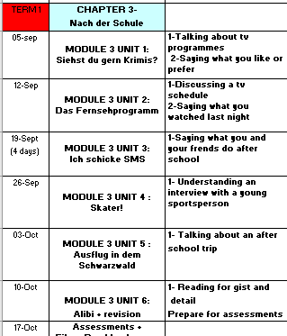

Slide 3
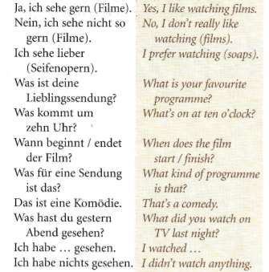
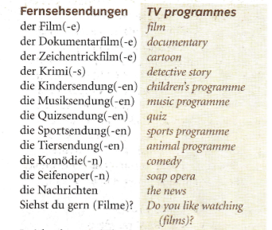
Read through the vocabulary for this week and spend a good amount of time trying to learn it. You will need these words to complete the tasks on the next few slides.
Week 1 – w/c 5th September

Slide 4
Write about your television viewing habits and preferences in German. Use the phrases below to help you.
Was siehst du gern?
Ich sehe gern...
Was siehst du nicht gern?
Ich sehe nicht gern...
Was siehst du lieber?
Ich sehe lieber...
Was siehst du am liebsten?
Am liebsten sehe ich...
Was ist deine Lieblingssendung?
Meine Lieblingssendung ist...
Was für eine Sendung ist das?
Das ist ein(e)...
What do you like watching?
I like watching...
What don’t you like watching?
I don’t like watching.....
What do you prefer watching?
I prefer watching...
What do you like watching best of all?
I like watching.....best of all.
What is your favourite programme?
My favourite programme is...
What sort of a programme is that?
That is a...

Slide 5

Use the vocabulary sheet on the previous slide to translate these sentences in to German
I like watching comedies
I don’t like watching the news
I prefer to watch cartoons/animations
The thing I like to watch the most is soaps.
My favourite show is MOTD.
That is a Sports programme.
I think the programme is great and interesting.
Notes:
Vocabulary list

Slide 6
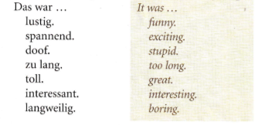
Read through the vocabulary for this week and spend a good amount of time trying to learn it. Also, look back at the words from last week to remind yourself of the tv programme vocabulary. You will need these words to complete the tasks on the next few slides.
Week 2 – w/c 12th September

Slide 7
Fernsehen – watching TV Spend some time looking at the vocabulary on here which you looked at last week.
Vokabeln
Was siehst du gern?
Ich sehe gern...
Was siehst du nicht gern?
Ich sehe nicht gern...
Was siehst du lieber?
Ich sehe lieber...
Was siehst du am liebsten?
Am liebsten sehe ich...
Was ist deine Lieblingssendung?
Meine Lieblingssendung ist...
Was für eine Sendung ist das?
Das ist ein(e)...
What do you like watching?
I like watching...
What don’t you like watching?
I don’t like watching.....
What do you prefer watching?
I prefer watching...
What do you like watching best of all?
I like watching.....best of all.
What is your favourite programme?
My favourite programme is...
What sort of a programme is that?
That is a...
Notes:
Vocabulary list

Slide 8
Without looking at your notes, can you match up the following?
Vokabeln
fantastisch
lustig
interessant
süß
langweilig
doof
toll
boring
great
sweet
fantastic
stupid
funny
interesting
Notes:
Vocabulary list

Slide 9
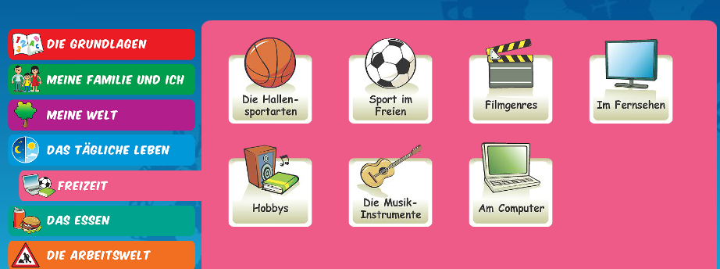
Log on to Linguascope and practise the ‘tv programme and film genre’ phrases. They are in the beginner section). Make a note of any new words you come across:
Username – kingshill password – mfl123*

Slide 10
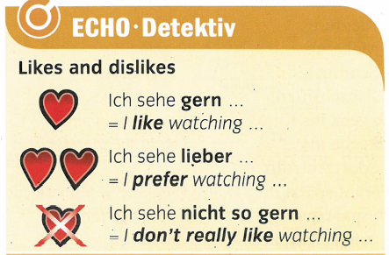
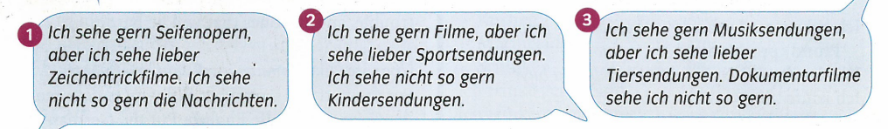
Read the information on the left about likes and dislikes and then translate the speech bubbles in to English.

Slide 11
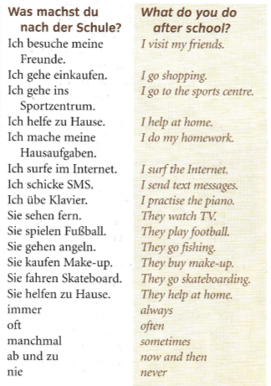
Week 3 – w/c 19th September
Read through the vocabulary for this week and spend a good amount of time trying to learn it. You will need these words to complete the tasks on the next few slides.

Slide 12
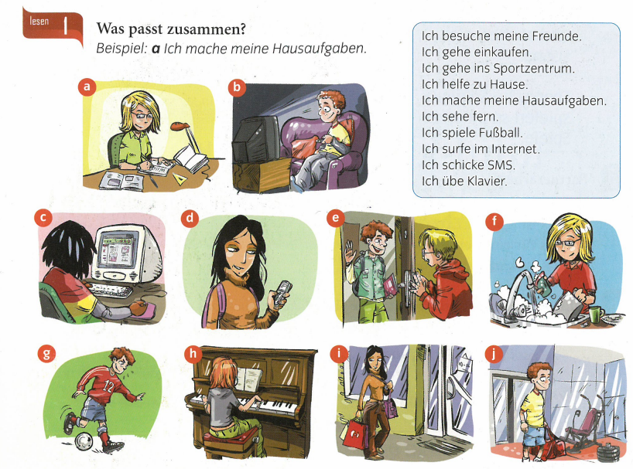
Label the pictures a-j with a phrase from the blue box

Slide 13

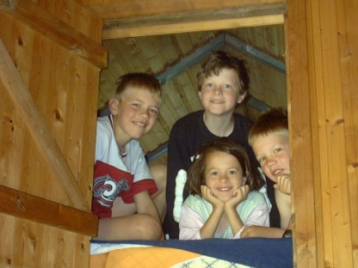



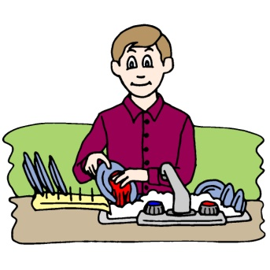
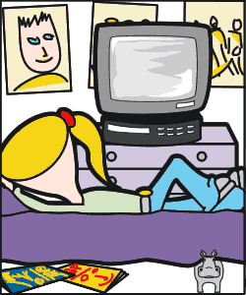




Make a poster of the after school activies?
Sportzentrum
Ich gehe ins Sportzentrum.
Ich besuche meine Freunde.
Ich gehe einkaufen.
Ich sehe fern.
Ich spiele Fußball.
Ich helfe zu Hause.
Ich mache
meine Hausaufgaben.
Ich surfe im Internet.
Ich schicke SMS.
Ich übe Klavier.

Slide 14
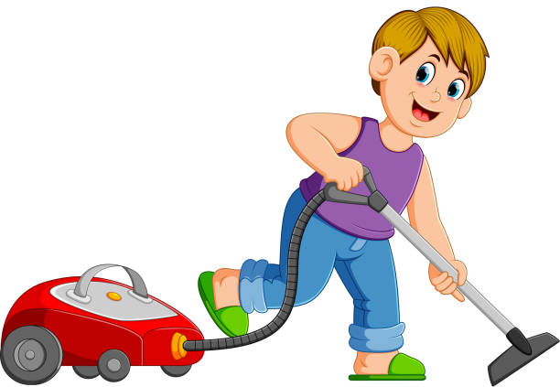

Copy out the sentences and then translate them:
1) Ich besuche oft meine Freunde
2) Ich übe jeden Tag Klavier
3) Ich helfe ab und zu zu Hause
4) Ich mache nie meine Hausaufgaben
5) Ich gehe von Zeit zur Zeit einkaufen

Slide 15
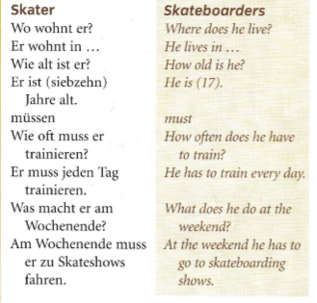
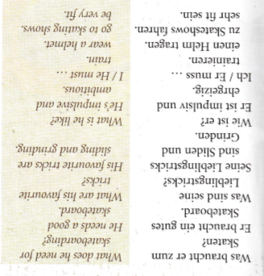
Week 4 – w/c 26th September
Read through the vocabulary for this week and spend a good amount of time trying to learn it. You will need these words to complete the tasks on the next few slides.

Slide 16
Lesen
Find these words in German in the Interview with Ingo Strasse
professional skater
to train
skateboarding show
helmet
elbows
favourite tricks
impulsive and ambitious
Info-Karte
Name: Ingo Strasser
Alter:
Wohnort:
Charakter:
Hobby:
Er braucht:
Lieblingstricks:
Meinung:
17 Jahre
Hamburg
impulsiv und ehrgeizig
Skateboard fahren
ein Skateboard,
einen Helm und Schützer
Sliden und Grinden
Skateboard fahren ist fantastisch,
aber schwierig und gefährlich.
Es macht Spaß.

Slide 17
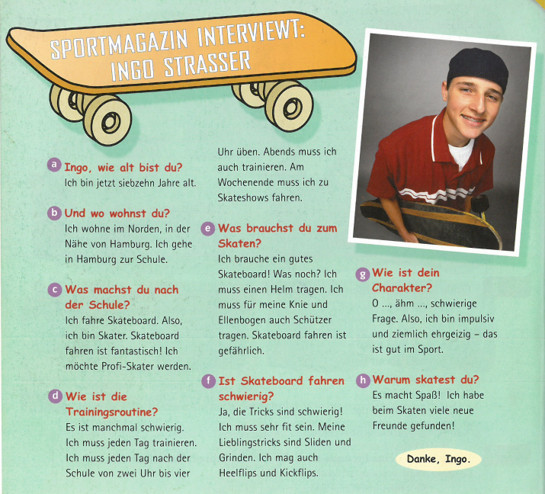
Read about Ingo. Make a few notes in English about him. You can do bullet points rather than full paragraphs

Slide 18
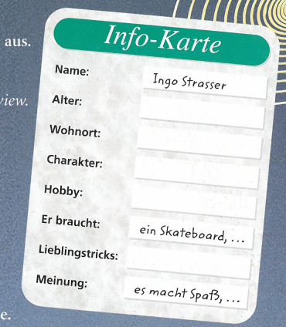
Make an information card about yourself in German a bit like this one on the right. You can choose which categories to have on it.

Slide 19
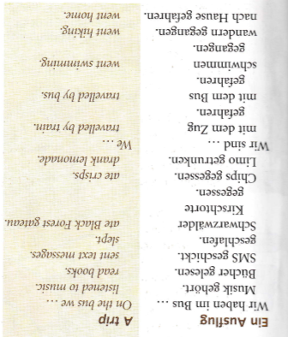
Week 5 – w/c 3rd October
Read through the vocabulary for this week and spend a good amount of time trying to learn it. You will need these words to complete the tasks on the next few slides.

Slide 20
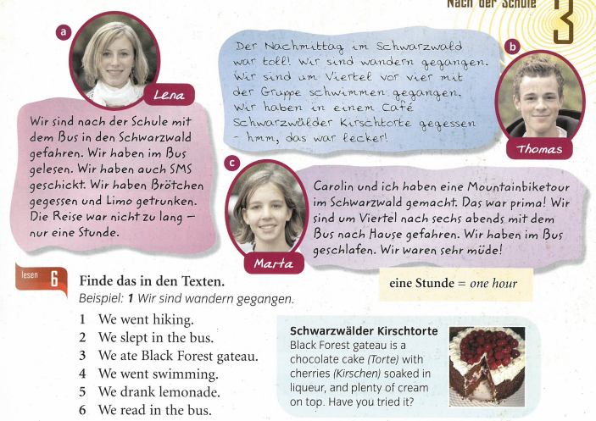
Read the three texts. Then find the 6 phrases below in German in the texts. An example is done for you

Slide 21
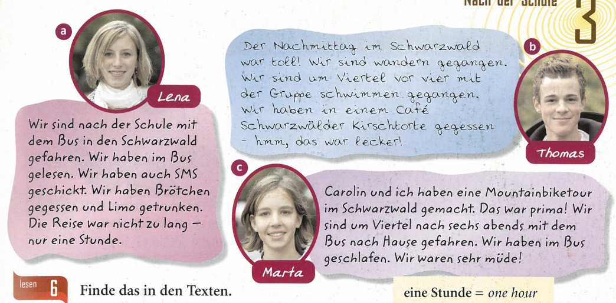
Read the texts again. Make a few notes in English about what you have read. You can do bullet points rather than full paragraphs

Slide 22
Week 6 – w/c 10th October
There are no new words to learn this week. All of the tasks to complete are based on the vocabulary you have learned over the past few weeks.

Slide 23


Slide 24
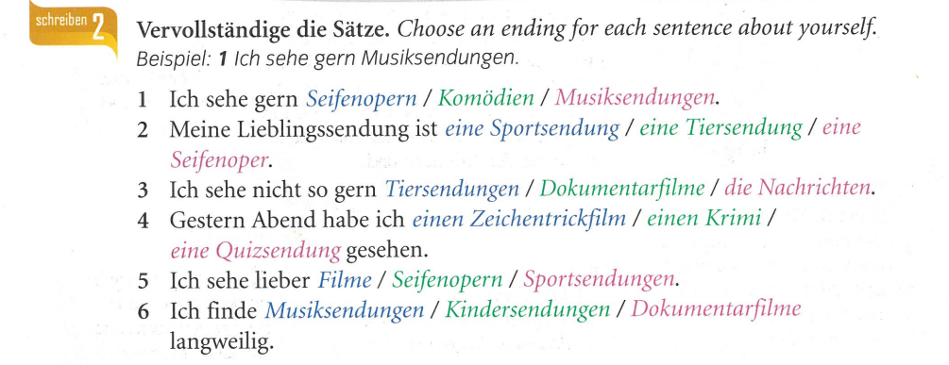

Slide 25
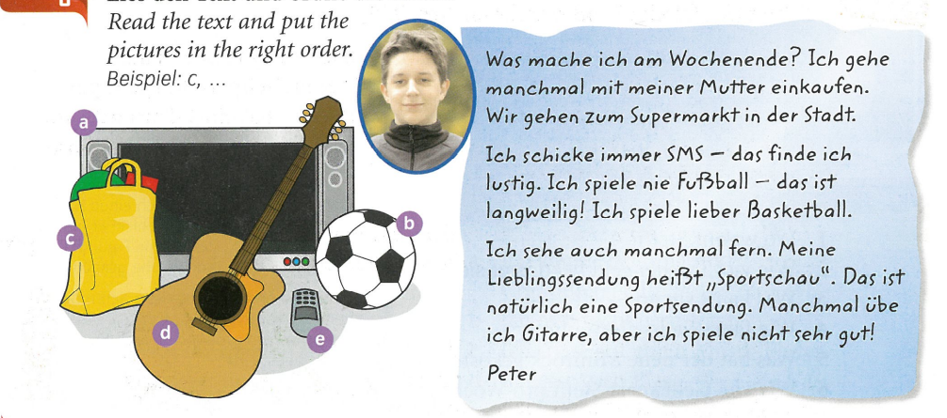

Slide 26
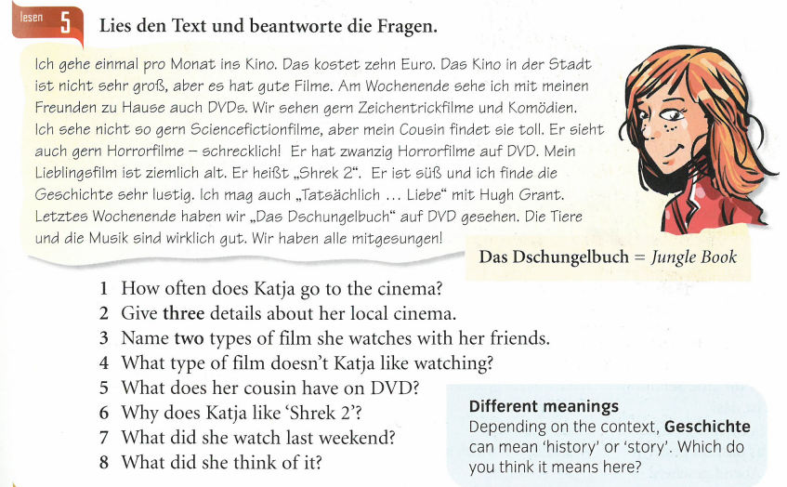
Read the text and answer the questions in English

Slide 27

Week 7 – w/c 17th October
This week is assessment week. Spend some time revising all of the vocab on the next slide, then please contact your teacher for the assessment papers. You could make vocabulary posters or flashcards to help you prepare.

Slide 28
