Slide 1
Year 9 French TERM 1: Studio 2 textbook, chapter 1
If pupils are absent from lessons they should spend time revising and learning vocabulary. All of the vocabulary for this term is on the following slides. First of all, they should recap the vocabulary which they learned the previous week. Then they should start to learn the next section of vocabulary which they have not yet covered in class. This could be done by using the look, cover, write, check method or by making flashcards etc.
Pupils can also revise vocabulary on Linguascope-
Username is kingshill password is bonjour123
Any new vocabulary they learn can be written in their orange books or on paper.
If pupils wish to do extension work they can access free MFL lessons on the Oak National Academy website:
https://classroom.thenational.academy/subjects-by-key-stage

Slide 2
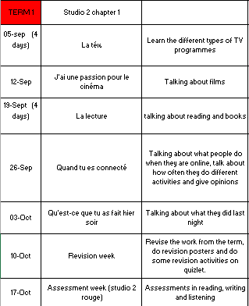

Slide 3
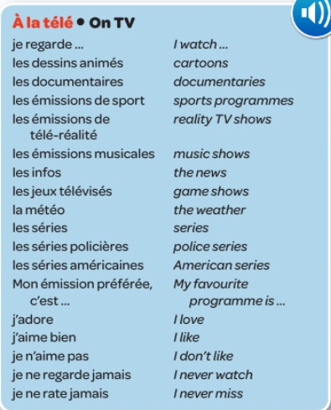
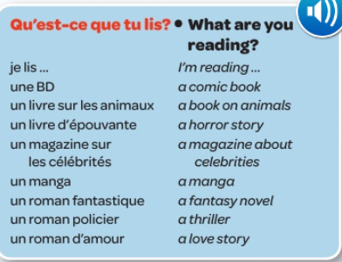
Week 1 w/c 5th September

Slide 4
Copy this grammar rule into your book

Slide 5
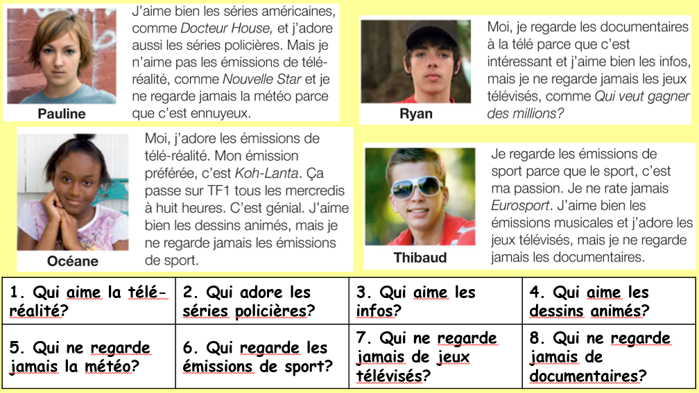
Read the texts and answer the questions

Slide 6
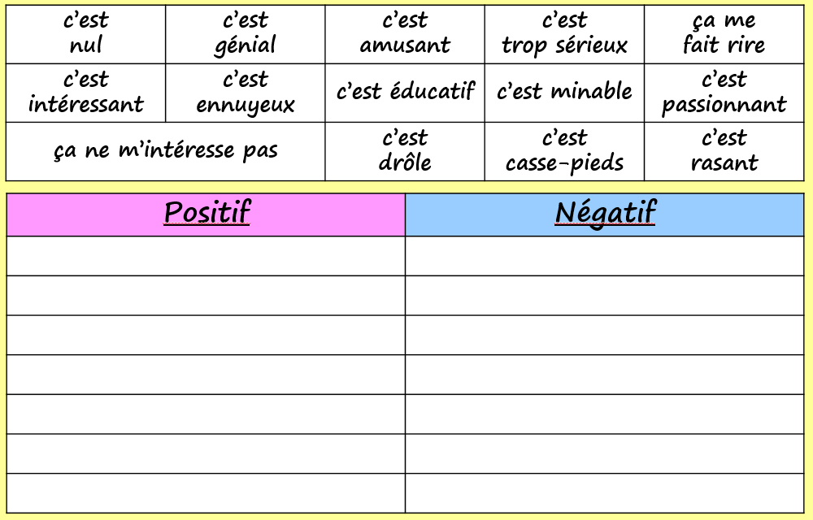
Use www.wordreference.com to find the meaning of these words and decide whether they are a positive or negative opinion. Write them in the correct column.

Slide 7
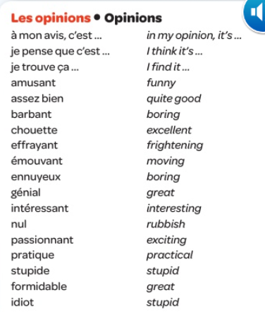
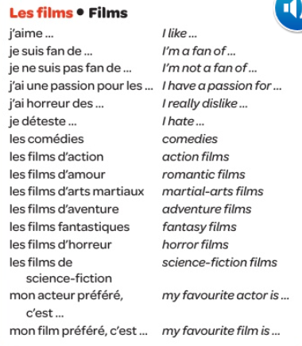
Week 2 w/c 12th September

Slide 8
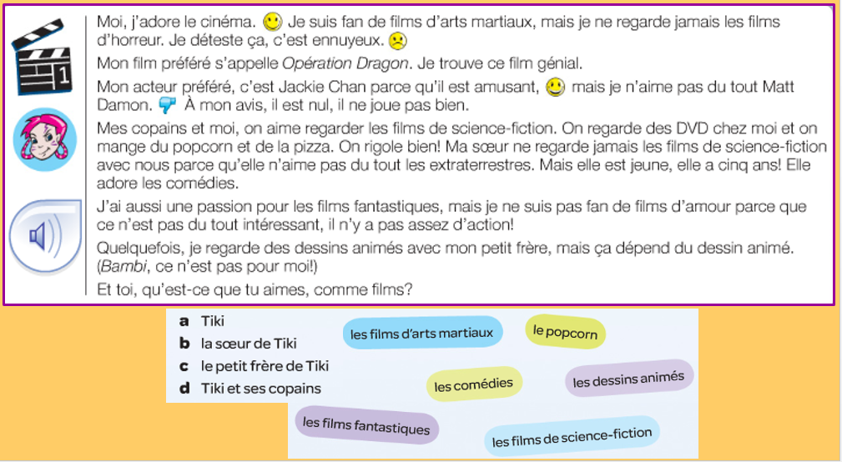
Read the text and decide what each of the people like to watch (Tiki, Tiki’s sister, Tiki’s little brother and Tiki and her friends).

Slide 9
What type of films are they talking about? Write the 2 correct letters for each conversation.

Slide 10
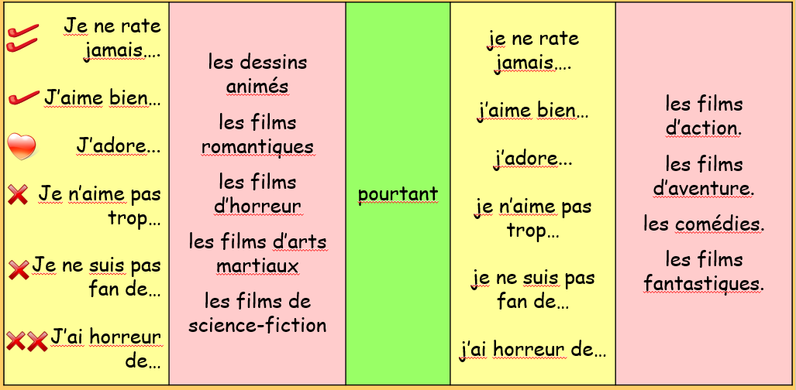
Make some sentences out of this sentence builder and translate them into English.

Slide 11
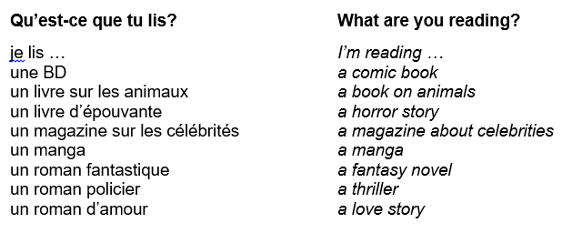
Week 3 w/c 19th September

Slide 12
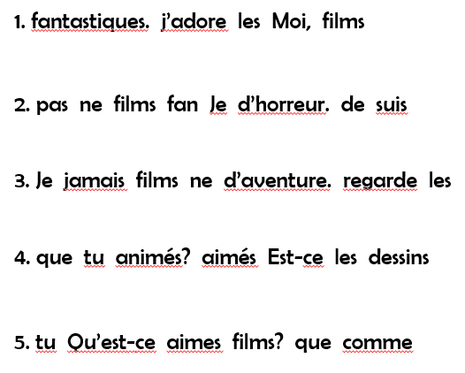
Can you put the words in these sentences in the right order?
Listen to the recording and fill in the table with the type of book and an opinion about it

Slide 13
Read the text and choose the correct verb to finish the sentences on the right.
Copy the grammar box into your book. Can you write up a rule for conjugating -ir and -re verbs?

Slide 14
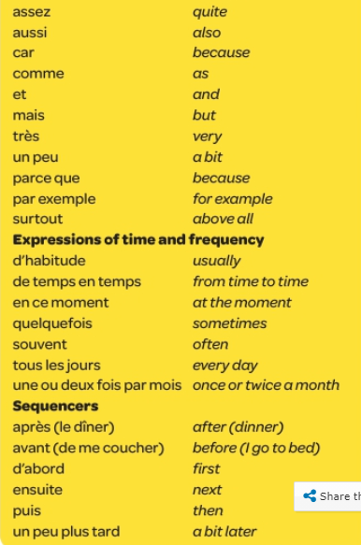
Week 4 w/c 26th September

Slide 15
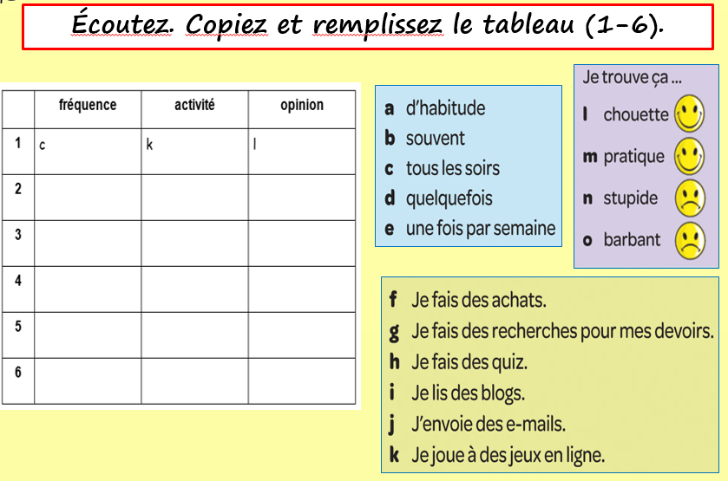
Listen to the recording and fill in the table.

Slide 16
Read the text and correct the errors in the sentences:

Slide 17
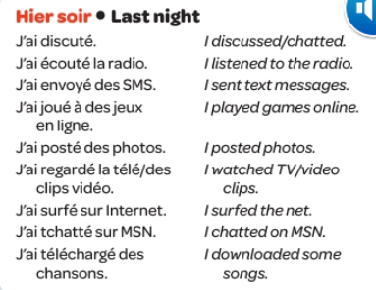
Week 5 w/c 3rd October
Copy the grammar point into your exercise book:

Slide 18
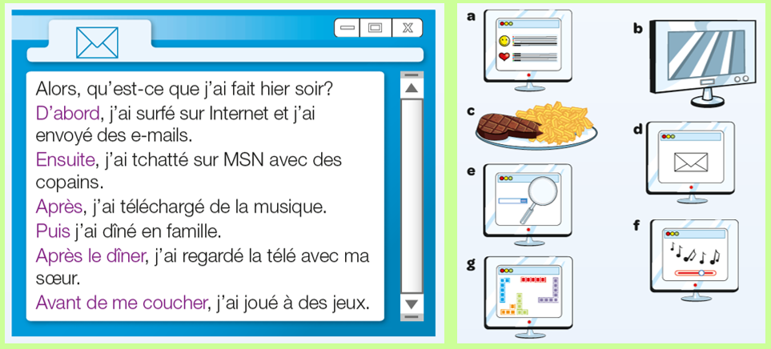
Read the text and put the pictures into the correct order:

Slide 19
Read the text and state whether each sentence is true or false. If they are false, correct the statement to make it true.

Slide 20
WEEK 6 – w/c 10th October
This week is revision week. You need to revise all of the work that we have done this term, use this presentation for all of the vocab lists.
You can also revise on this quizlet set:
Studio 2 module 1 revision

Slide 21
Week 7 – w/c 17th October
This week is revision and assessment week. Contact Mrs Millar for the assessment papers. Spend some time revising all of the vocab on these slides from week 1 and the high frequency words on the following slide.

