Slide 1
Year 8 Spanish TERM 1: Viva 1 textbook, chapter 1
If pupils are absent from lessons they should spend time revising and learning vocabulary. All of the vocabulary for this term is on the following slides. First of all, they should recap the vocabulary which they learned the previous week. Then they should start to learn the next section of vocabulary which they have not yet covered in class. This could be done by using the look, cover, write, check method or by making flashcards etc. It should also be written in their orange book. There are also a few tasks to complete. A plan for the term is on the next slide.
Pupils can also revise vocabulary on Linguascope-
Username is kingshill password is bonjour123
Any new vocabulary they learn can be written in their orange books or on paper.
If pupils wish to do extension work they can access free MFL lessons on the Oak National Academy website:
https://classroom.thenational.academy/subjects-by-key-stage

Slide 2
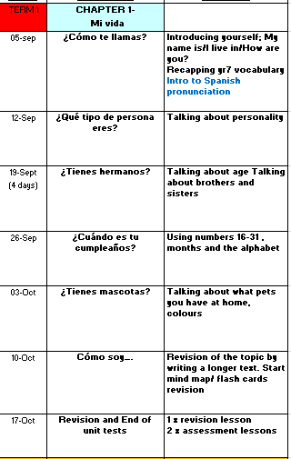

Slide 3
Read through the vocabulary for this week and spend a good amount of time trying to learn it. You will need these words to complete the tasks on the next few slides.
Week 1 – w/c 5th September

Slide 4
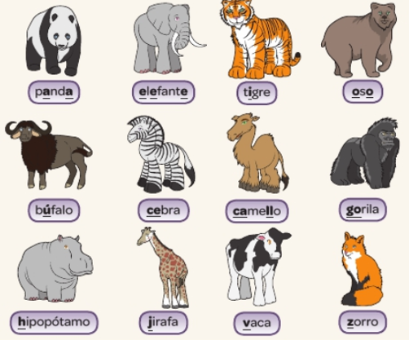
Listen to the pronunciation and repeat the words.

Slide 5
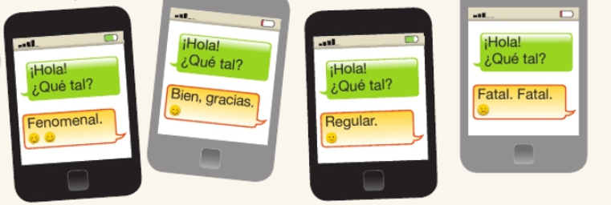
Listen to the recording and do the rap!

Slide 6
Saludos = Greetings
❖ = a  = e ⬆ = i  = o  = u
¡Bns dís! =
¡Hl! =
¡Bns nchs! =
¡dís! =
¡Bns trds! =
¡Hst lg! =
Use the code to help you copy up the Spanish greetings!

Slide 7
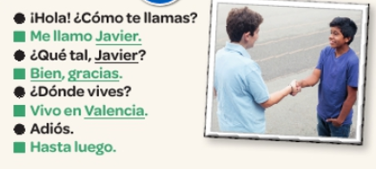
Copy out the conversation in Spanish and translate it in to English

Slide 8
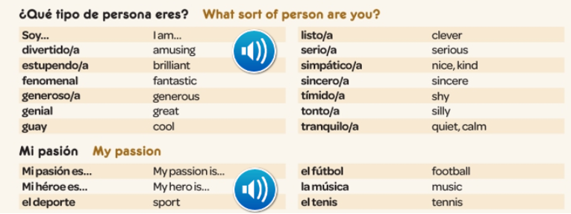
Read through the vocabulary for this week and spend a good amount of time trying to learn it. You will need these words to complete the tasks on the next few slides.
Week 2 – w/c 12th September

Slide 9
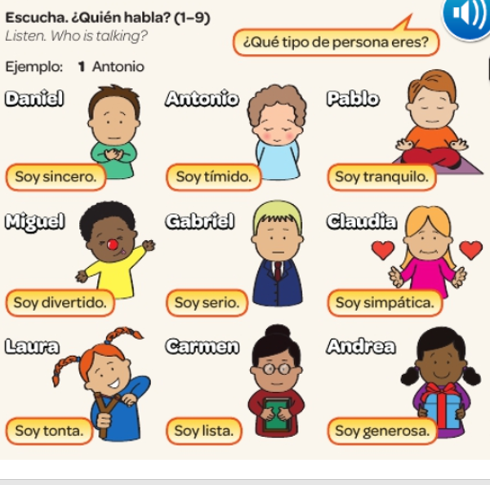

Slide 11
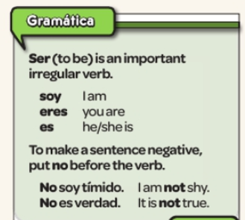
Copy out the grammar notes:

Slide 12
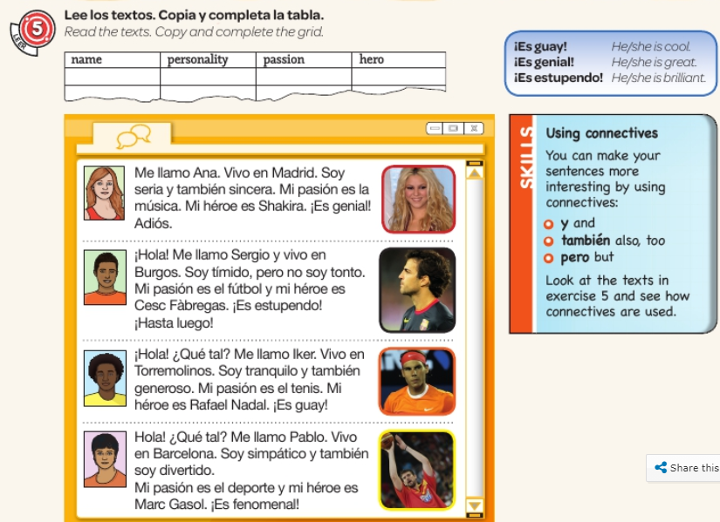

Slide 13
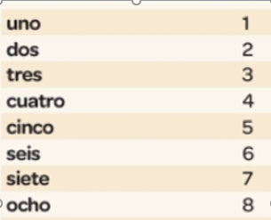
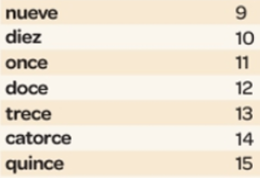
Week 3 – w/c 19th September
Read through the vocabulary for this week and spend a good amount of time trying to learn it. You will need these words to complete the tasks on the next few slides.

Slide 14
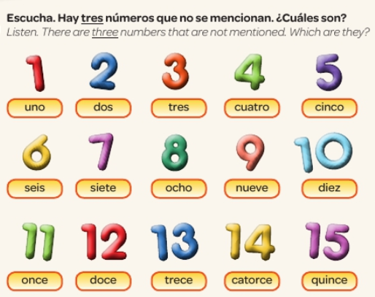

Slide 15
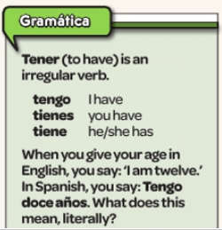
Copy out the grammar notes:

Slide 16
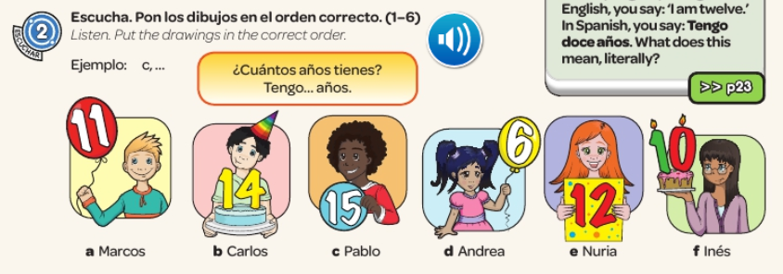

Slide 18
Log on to Linguascope and practise ‘numbers 1-10’. They are in the beginner section).
Username – kingshill password – mfl123*

Slide 19
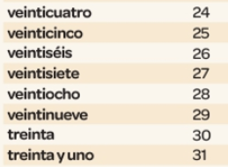
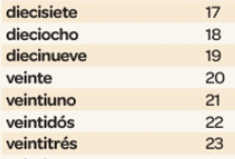
Week 4 – w/c 26th September
Read through the vocabulary for this week and spend a good amount of time trying to learn it. You will need these words to complete the tasks on the next few slides.

Slide 20
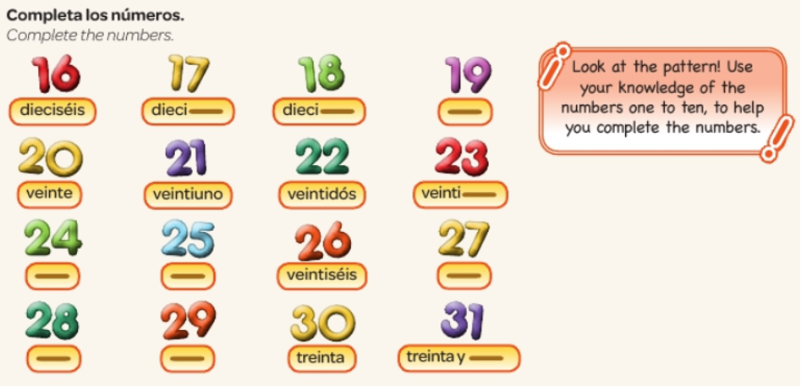

Slide 22
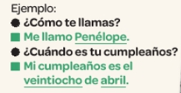
Copy the conversation in Spanish and translate it in to English.

Slide 23
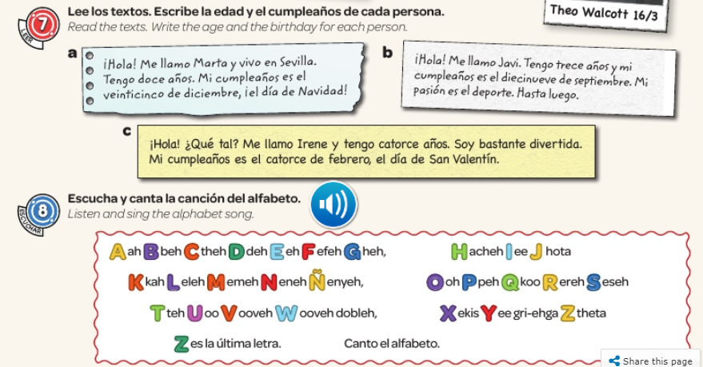

Slide 24
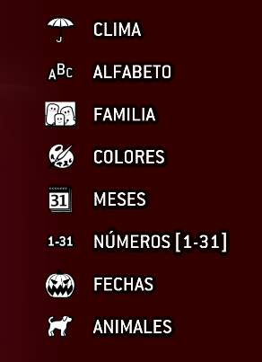
Log on to Linguascope and practise ‘numbers 1-31 and months (meses). They are in the elementary section).
Username – kingshill password – mfl123*

Slide 25
Read through the vocabulary for this week and spend a good amount of time trying to learn it. You will need these words to complete the tasks on the next few slides.
Week 5 – w/c 3rd October

Slide 26
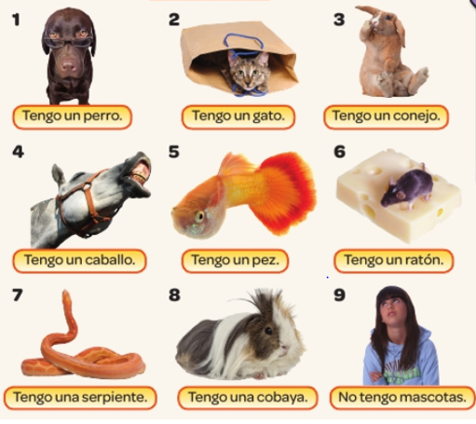
Make a poster page of the animals and colours words in Spanish. Do a picture for each word.

Slide 27
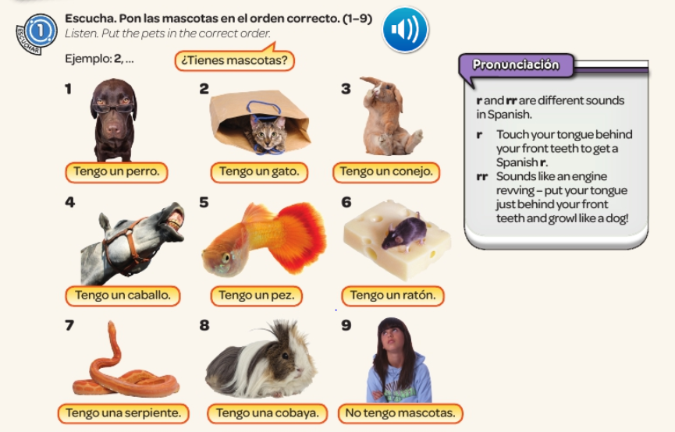

Slide 28
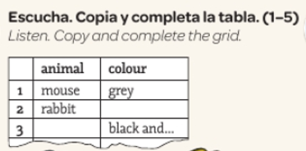

Slide 29
Week 6 – w/c 10th October
There are no new words to learn this week. All of the tasks to complete are based on the vocabulary you have learned over the past few weeks.

Slide 32
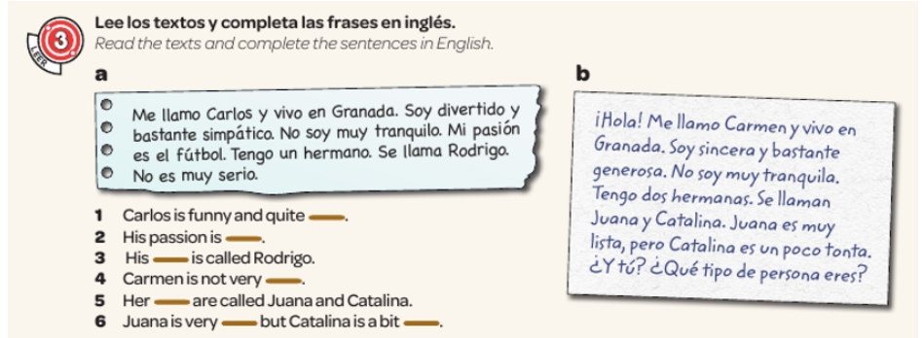

Slide 33
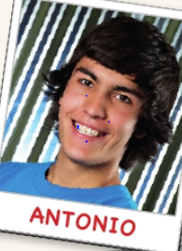
Make a few notes in English of anything that you understand

Slide 34
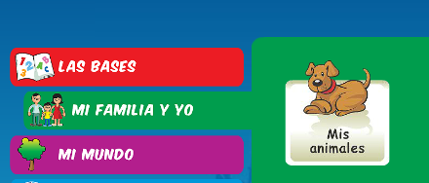
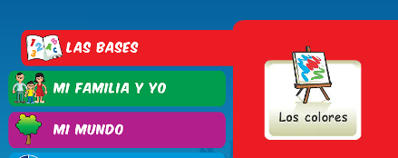
Log on to Linguascope and practise ‘pets and colours’. They are in the beginner section). Make a note of any new words you come across.
Username – kingshill password – mfl123*

Slide 35
Week 7 – w/c 17th October
This week is assessment week. Spend some time revising all of the vocab on the next few slides slides, then please contact your teacher for the assessment papers. You could make vocabulary posters or flashcards to help you prepare.

Slide 36
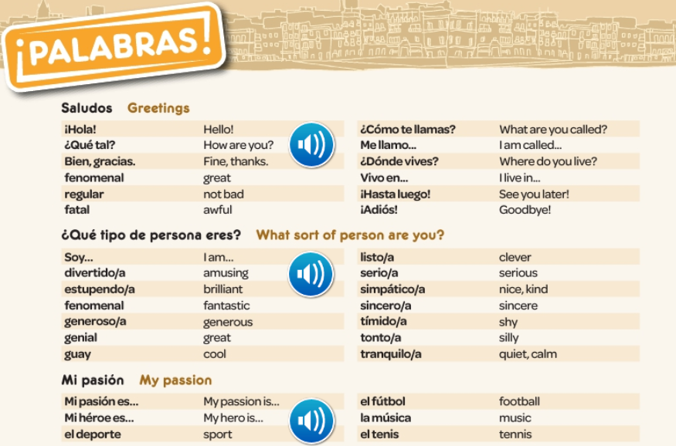

Slide 37
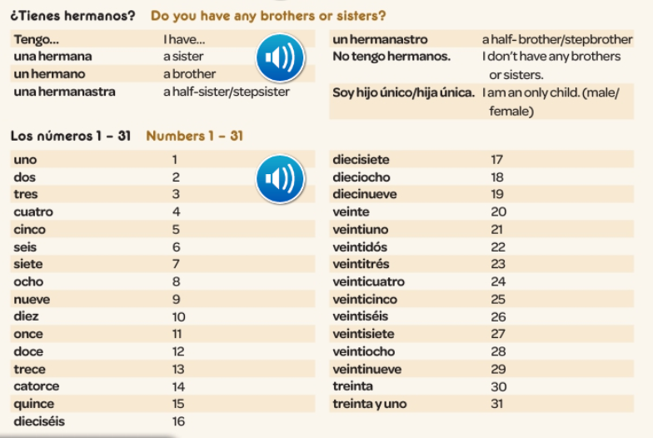

Slide 38
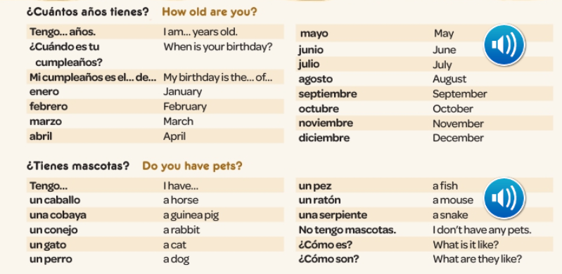

Slide 39
