Slide 1


Year 8 German TERM 1: Echo 1 textbook, chapter 3
If pupils are absent from lessons they should spend time revising and learning vocabulary. All of the vocabulary for this term is on the following slides. First of all, they should recap the vocabulary which they learned the previous week. Then they should start to learn the next section of vocabulary which they have not yet covered in class. This could be done by using the look, cover, write, check method or by making flashcards etc. It should also be written in their orange book. There are also a few tasks to complete. A plan for the term is on the next slide.
Pupils can also revise vocabulary on Linguascope-
Username is kingshill password is mfl123*
Any new vocabulary they learn can be written in their orange books or on paper.
If pupils wish to do extension work they can access free MFL lessons on the Oak National Academy website:
https://classroom.thenational.academy/subjects-by-key-stage

Slide 2
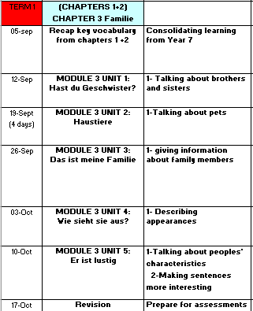

Slide 3
Week 1 – w/c 5th September
Read through the vocabulary on the next 2 slides which is what you learned in Year 7. Make revision posters to practise the vocabulary.

Slide 4
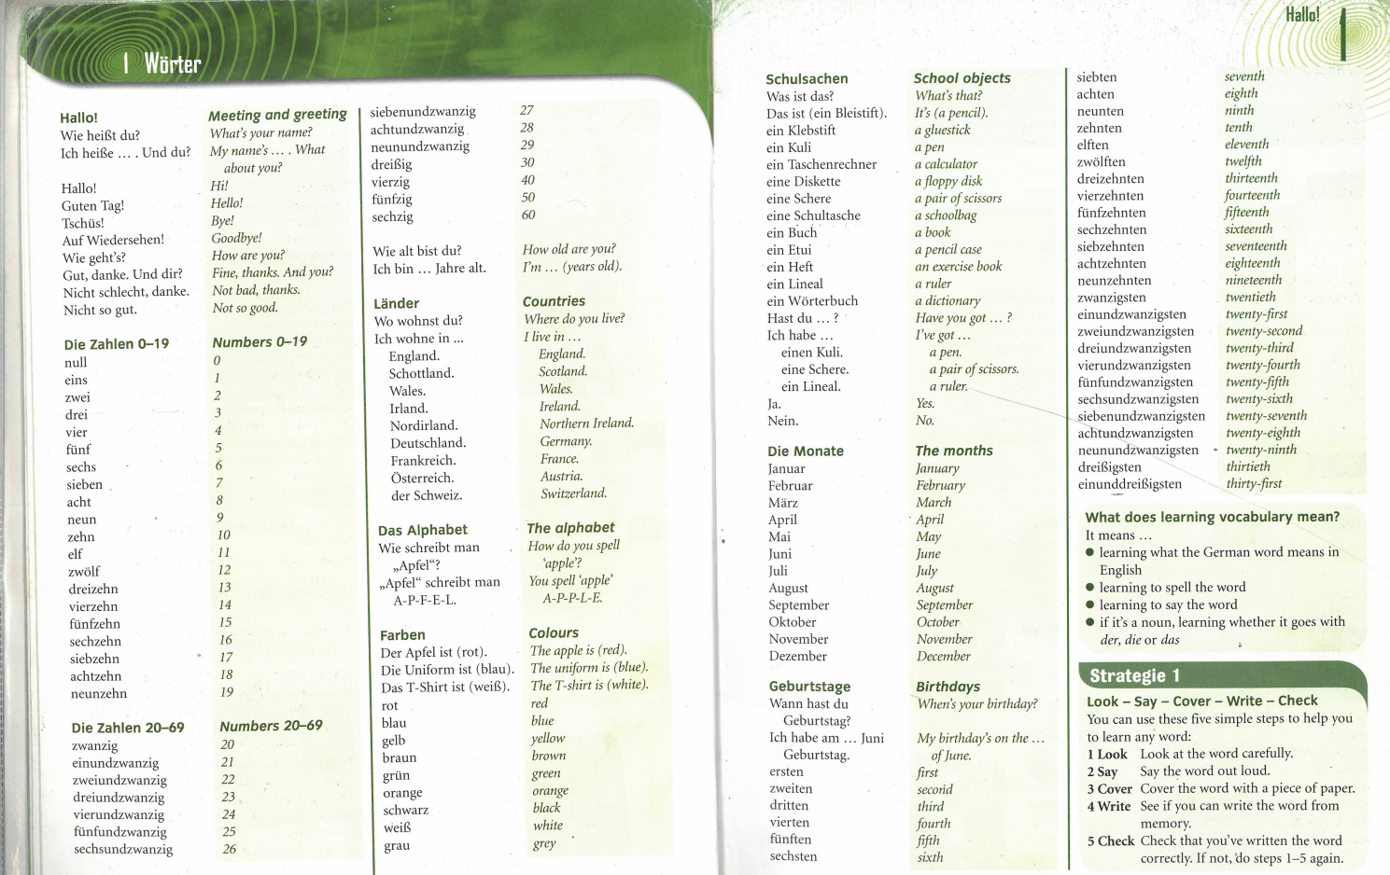

Slide 5
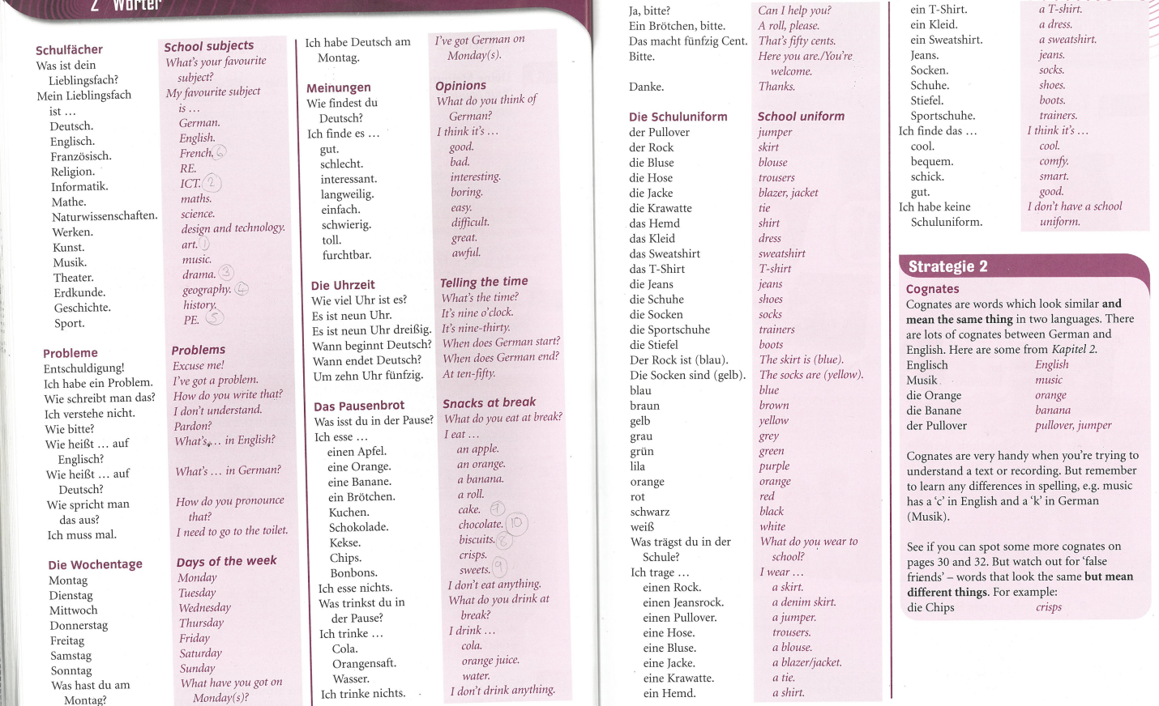

Slide 6
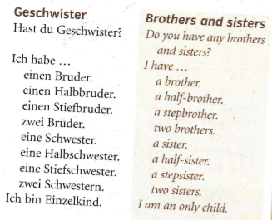
Read through the vocabulary for this week and spend a good amount of time trying to learn it. You will need these words to complete the tasks on the next few slides.
Week 2 – w/c 12th September

Slide 7

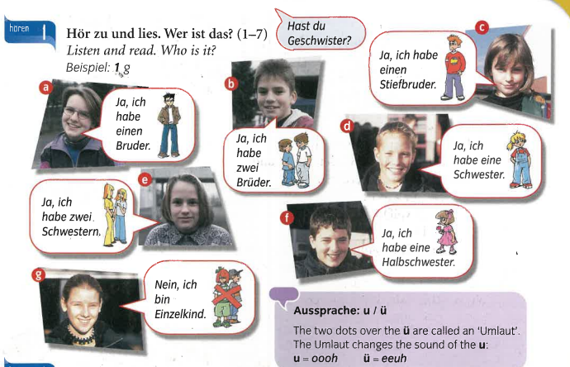

Slide 8
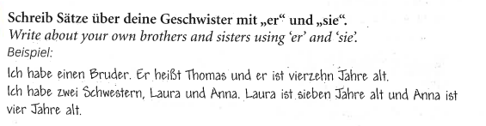
Remember:
Er/ sie heißt = He/she is called
Er/sie ist ….Jahre alt – He / she is … years old

Slide 9
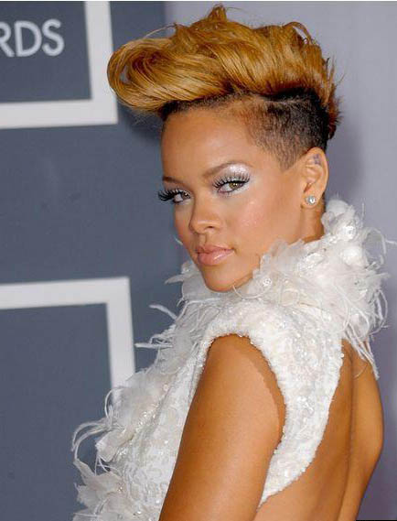
Reorder the words to make correct sentences
heiße Ich Rhianna
in LA Ich wohne .
Ich alt vierunddreißzig bin Jahre.
Habe Ich Schwestern zwei einen Bruder und

Slide 10
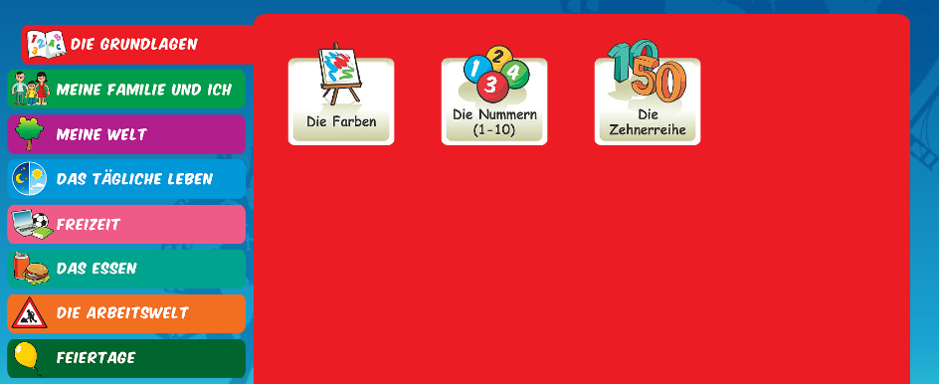
Log on to Linguascope and practise some of the vocabulary you practiced last week, e.g. days of the week, numbers, school subjects, clothing, stationery etc. They are in the beginner section):
Username – kingshill password – mfl123*

Slide 11
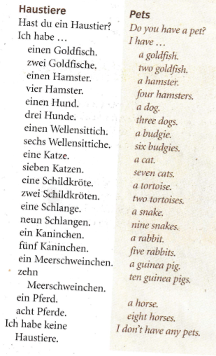
Week 3 – w/c 19th September
Read through the vocabulary for this week and spend a good amount of time trying to learn it. You will need these words to complete the tasks on the next few slides.

Slide 12

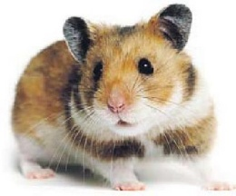



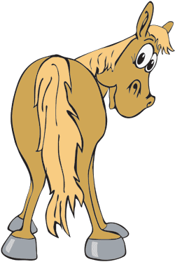





Make a poster of these animals on paper. Label them in German and in English
Ich habe…
Ich habe.....I have …
einen Hamster
eine Schlange
eine Katze
einen Hund
einen Wellensittich
einen Goldfisch
eine Spinne
ein Pferd
ein Kaninchen
eine Maus
ein Meerschweinchen
eine Schildkröte
Notes:
This time, just the text appears, and einen is highlighted on the masculine animals.

Slide 13

Match up the phrases 1-10 with a-j

Slide 14
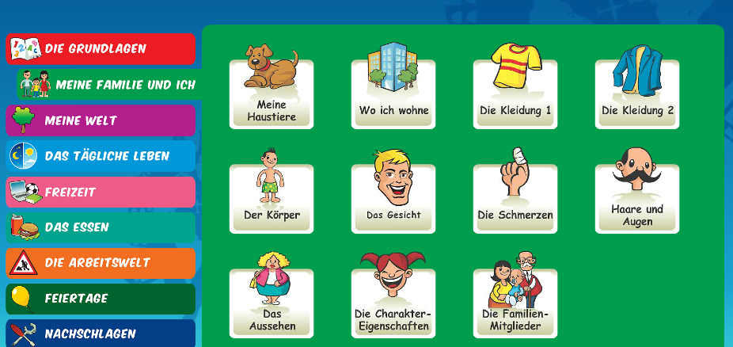
Log on to Linguascope and practise the ‘pets’ phrases. They are in the beginner section):
Username – kingshill password – mfl123*

Slide 15
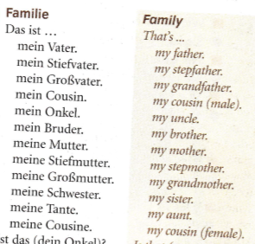
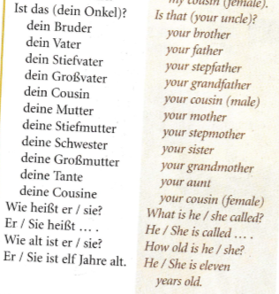
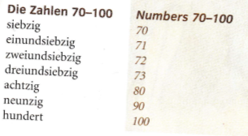
Week 4 – w/c 26th September
Read through the vocabulary for this week and spend a good amount of time trying to learn it. You will need these words to complete the tasks on the next few slides.

Slide 16
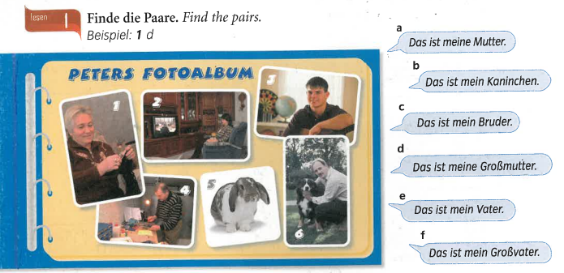

Slide 17
Translate this paragraph in to English
Hallo. Ich heiße Birgit. Ich bin dreizehn Jahre alt und ich wohne in Berlin. Das ist in Deutschland. Ich habe einen Bruder. Er heißt Paul und er ist acht Jahre alt. Ich habe eine Mutter und einen Stiefvater. Meine Mutter heißt Sarah.

Slide 18
Log on to Linguascope and practise the ‘family members’ phrases. They are in the beginner section):
Username – kingshill password – mfl123*

Slide 19
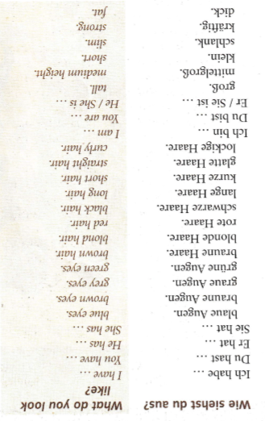
Week 5 – w/c 3rd October
Read through the vocabulary for this week and spend a good amount of time trying to learn it. You will need these words to complete the tasks on the next few slides.

Slide 20

Copy out the descriptions of the 3 people below and then draw what they look like.
Person 1- Sie hat lange, lockige, schwarze Haare. Sie hat blaue Augen. Sie ist groβ und schlank.
Person 2- Er ist klein und kräftig. Er hat braune Augen. Er hat kurze, schwarze, glatte Haare.
Person 3- Er hat kurze, braune Haare. Er hat braune Augen. Er ist kräftig.

Slide 21

Look at the picture and read the 5 sentences. Match up the sentences to the people in the picture

Slide 22
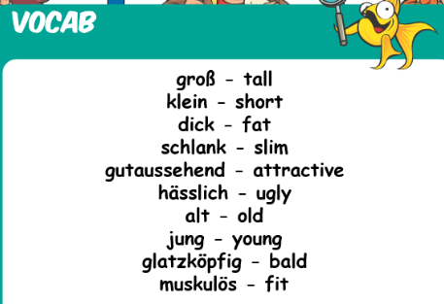
Log on to Linguascope and practise the ‘hair + eyes and physical description’ phrases. (They are in the beginner section). There are some new phrases below which you will need. :
Username – kingshill password – mfl123*

Slide 23
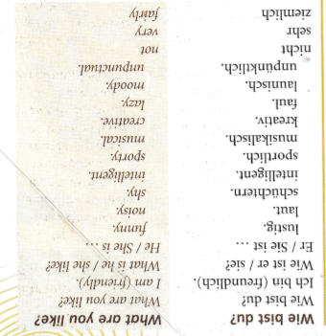
Week 6 – w/c 10th October
Read through the vocabulary for this week and spend a good amount of time trying to learn it. You will need these words to complete the tasks on the next few slides.

Slide 24
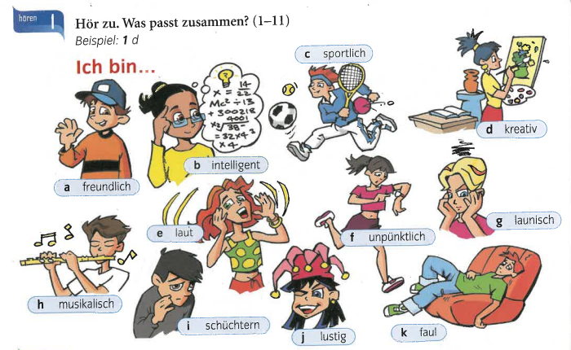
Write down 1-11 and listen to the recording. Which person is being described?
Example 1)d

Slide 25
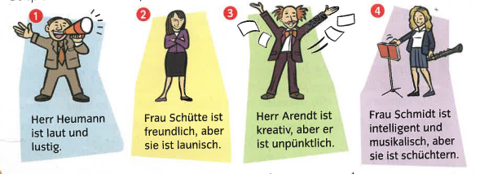
Here are four descriptions of teachers. Translate them in to English.
Herr = Mr Frau=Mrs or Miss

Slide 26
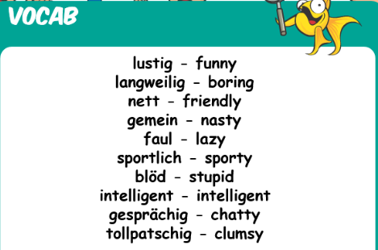
Log on to Linguascope and practise the ‘characteristics’ phrases. They are in the beginner section). Look at the new phrases which are below as well.
Username – kingshill password – mfl123*

Slide 27

Week 7 – w/c 17th October
This week is assessment week. Spend some time revising all of the vocab on the next slide, then please contact your teacher for the assessment papers. You could make vocabulary posters or flashcards to help you prepare.

Slide 28
