Slide 1


Year 8 French TERM 1: Access Studio textbook, sections 9-12
If pupils are absent from lessons they should spend time revising and learning vocabulary. All of the vocabulary for this term is on the following slides. First of all, they should recap the vocabulary which they learned the previous week. Then they should start to learn the next section of vocabulary which they have not yet covered in class. This could be done by using the look, cover, write, check method or by making flashcards etc.
Pupils can also revise vocabulary on Linguascope-
Username is kingshill password is mfl123*
Any new vocabulary they learn can be written in their orange books or on paper.
If pupils wish to do extension work they can access free MFL lessons on the Oak National Academy website:
https://classroom.thenational.academy/subjects-by-key-stage

Slide 2
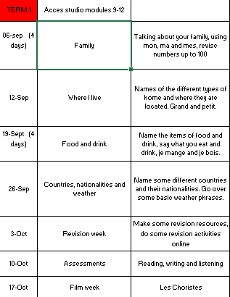

Slide 3
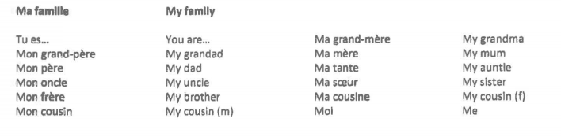
Week 1 – w/c 5th Sept
vocab

Slide 4

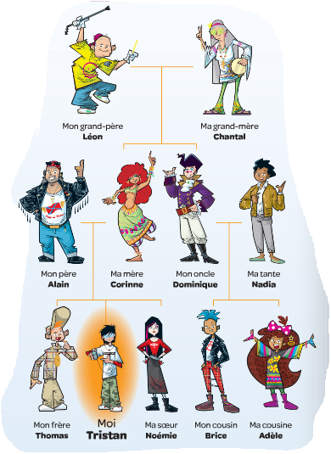

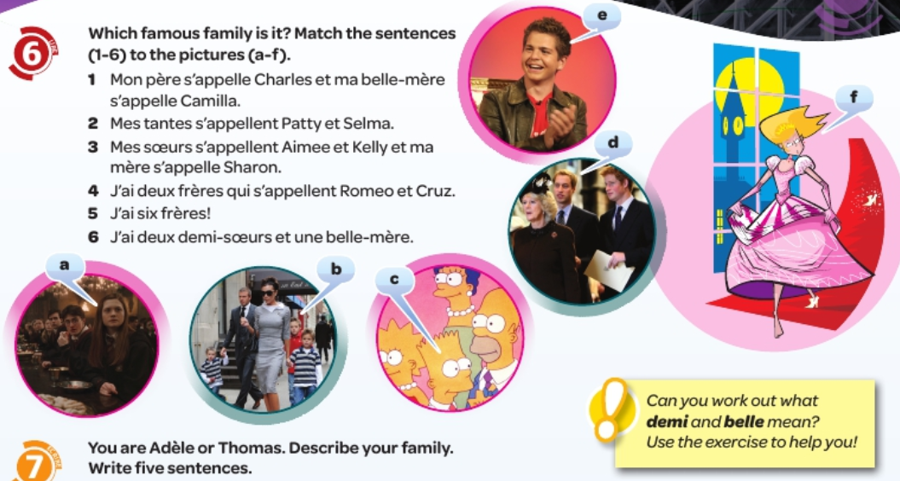
Once you have learned the family vocab, try the following tasks:

Slide 5
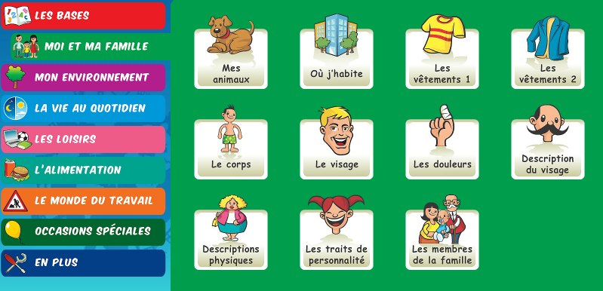
Practice the names of the family members on linguascope:

Slide 6
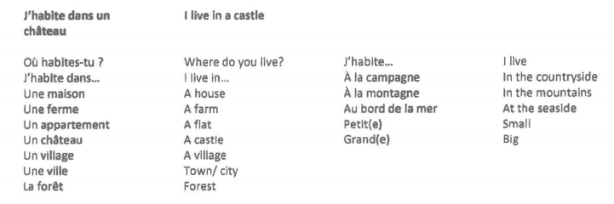
Week 2 – w/c 12th Sept
vocab

Slide 7
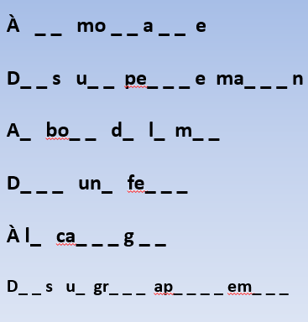
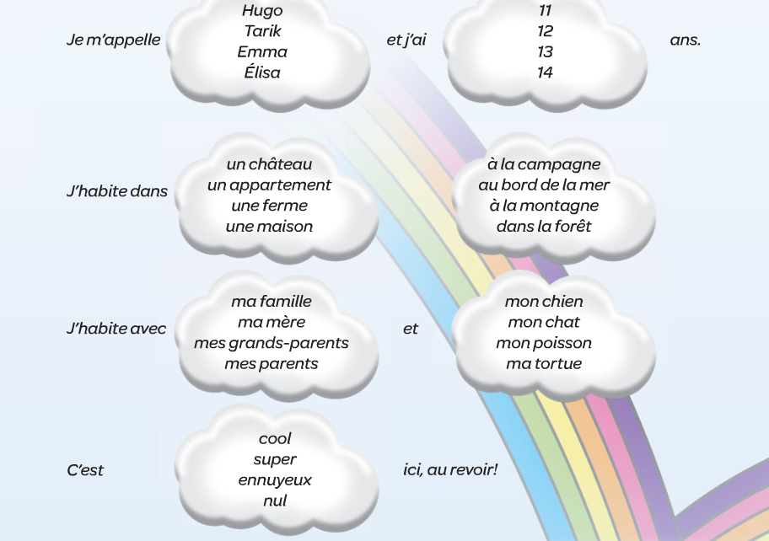
Once you have learned the family vocab, try the following tasks:
Fill in the gaps to make the sentences, what do the expressions mean?
Make a poster out of the vocab on the previous page, and draw a picture for each expression.
Make some sentences out of this grid, then translate them into English
Do some practice of the expressions by playing
the games in this quizlet set
Quizlet

Slide 8
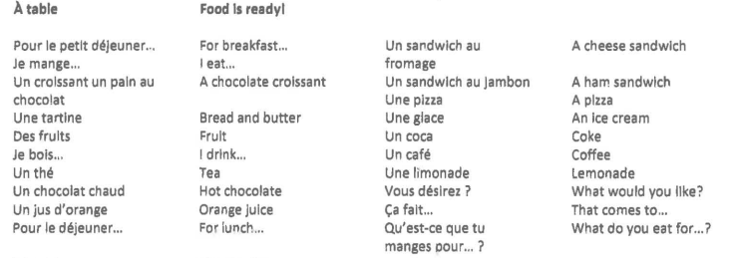
Week 3 – w/c 19th Sept
vocab

Slide 9
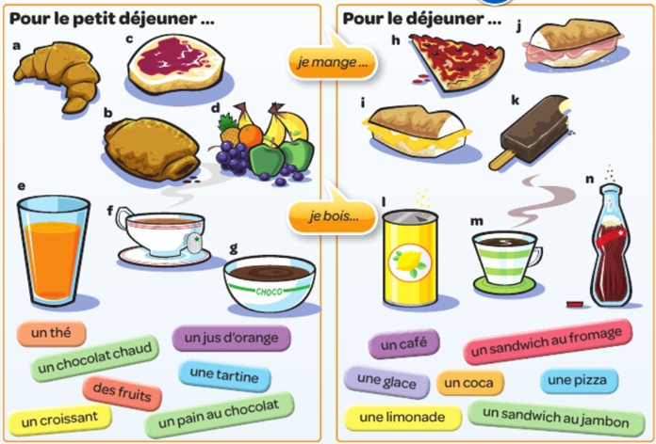
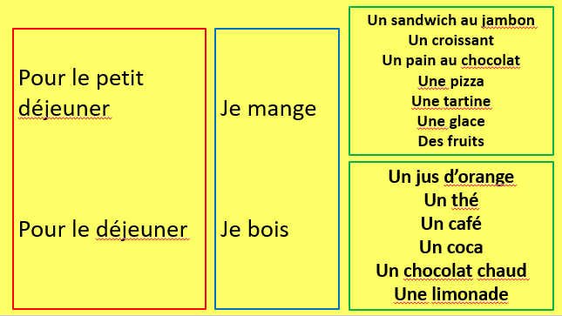
Once you have learned the food and drink vocabulary, match up the pictures with the words below. Then make some sentences about what you eat or drink for breakfast and lunch using the sentence builder.

Slide 11
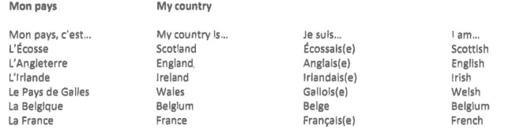
Week 4 – w/c 26th Sept
vocab

Slide 12
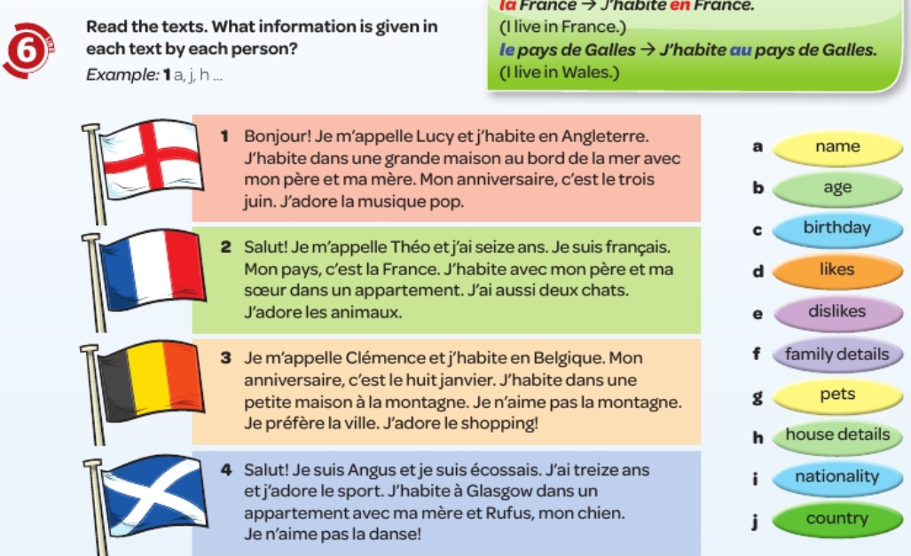
Once you have learned the vocabulary about country and nationality, try the task below

Slide 13
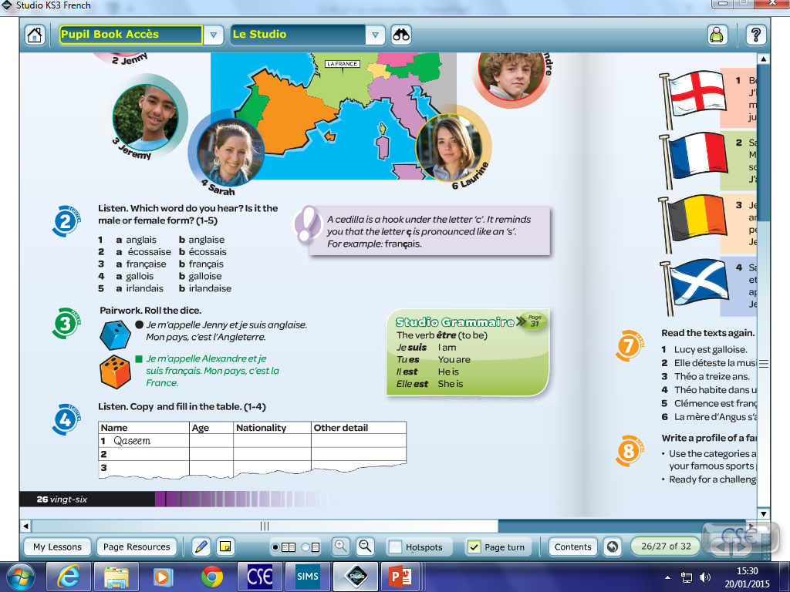
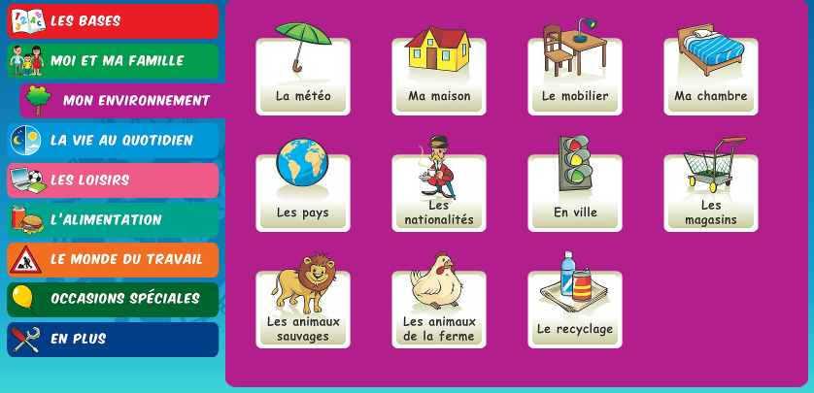
Do some activities on linguascope to practice the countries.

Slide 14
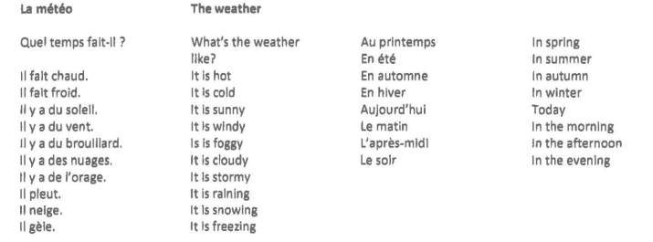

Slide 15
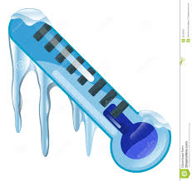

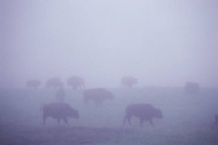

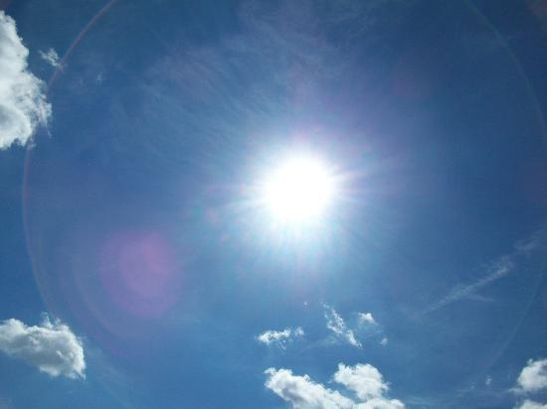
Regarde les images – choisis la bonne phrase
A
B
C
D
1.Il fait chaud
2. Il y a des nuages
3. Il pleut
1. Il y a du brouillard
2. Il fait chaud
3. Il y a du soleil
1. Il fait froid
2. Il neige
3. Il gèle
1. Il y a du vent
2. Il y a de l’orage
3. Il gèle
E
F
G
H
1.Il fait beau
2. Il y a du soleil
3. Il pleut
1. Il y a du soleil
2. Il y a des nuages
3. Il neige
1. Il y du brouillard
2. Il fait froid
3. Il neige
1. Il fait chaud
2. Il gèle
3. Il pleut

Slide 16
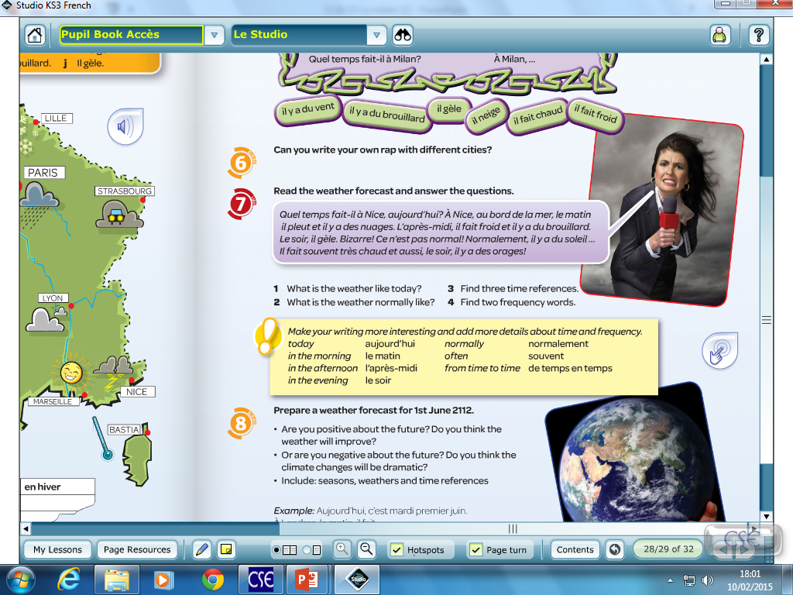

Slide 17

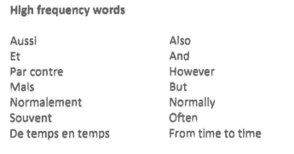
WEEK 5 – w/c 3rd October
This week is revision week. You need to revise all of the work that we have done this term, use this presentation for all of the vocab lists.
You can also revise on this quizlet set:
Year 8 term 1 revision

Slide 18

Week 6 – w/c 10th October
This week is revision and assessment week. Contact Mrs Millar for the assessment papers. Spend some time revising all of the vocab on these slides from week 1 and the high frequency words on the following slide.

Slide 19

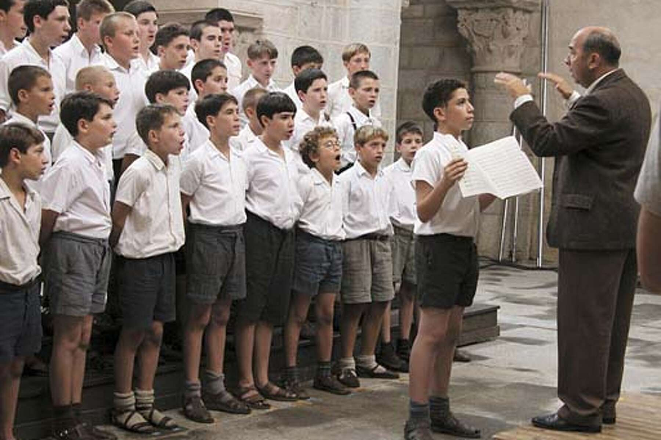
Week 7 w/c 17th October
Film week!
Watch Les Choristes, this can be found on Clickview.
Look in the ‘pupils’ section on the school website for information on how to watch films on Clickview

