Slide 1


Year 9 Spanish TERM 6:
If pupils are absent from lessons they should spend time revising and learning vocabulary. All of the vocabulary for this term is on the following slides. First of all, they should recap the vocabulary which they learned the previous week. Then they should start to learn the next section of vocabulary which they have not yet covered in class. This could be done by using the look, cover, write, check method or by making flashcards etc.
Pupils can also revise vocabulary on Linguascope-
Username is kingshill password is love4langs
Any new vocabulary they learn can be written in their orange books or on paper.
If pupils wish to do extension work they can access free MFL lessons on the Oak National Academy website:
https://classroom.thenational.academy/subjects-by-key-stage

Slide 2
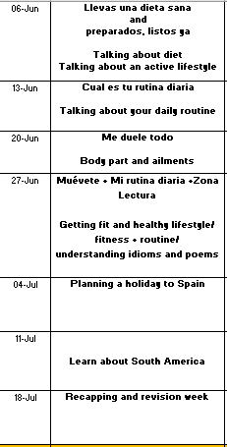

Slide 3
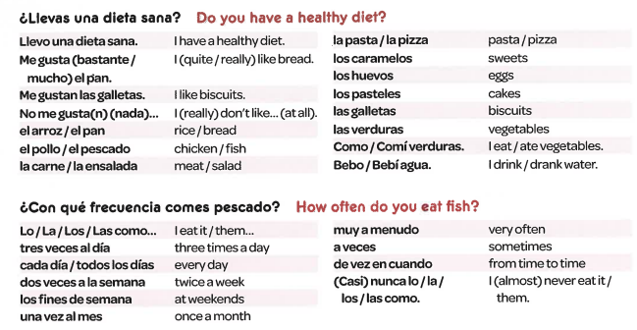
Week 1 –vocab
Read through the vocabulary for this week and spend a good amount of time trying to learn it. You will need these words to complete the tasks on the next few slides.

Slide 4
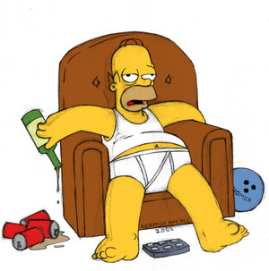
Estoy un poco gordo y no estoy en forma. Como demasiada comida basura, que contiene mucha grasa y no me siento bien. Bebo demasiado alcohol. Odio todo tipo de ejercicio y deporte.
Find the Spanish for:
I’m not fit/healthy
I eat too much rubbish food
I don’t feel well
I drink too much alcohol
I hate all exercise

Slide 5
Llevo una vida muy sana. Hago yoga todos los días – es buena para la mente y la salud. Tengo una dieta sana – como al menos cinco porciones de fruta y verduras cada día.
Creo que hacer ejercicio es muy importante.
Find the Spanish for:
I lead a healthy life
Every day
I have a healthy diet
I believe that
It’s very important

Slide 6

¿Tienes una dieta sana?
Match up the following:
nunca
de vez en cuando
siempre
a veces
todos los días
una vez al mes
casi nunca
dos veces a la semana
always
every day
almost never
twice a week
once a month
from time to time
sometimes
never
Notes:
Match for use later in the lesson

Slide 7
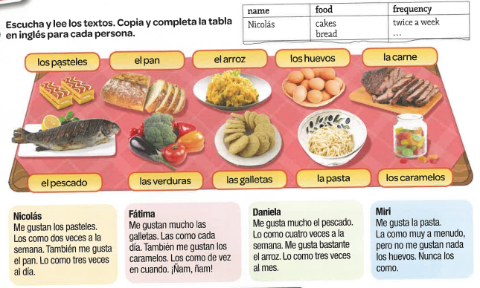
Read the texts and fill in the table in English

Slide 8
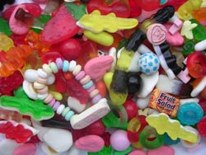


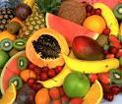
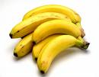

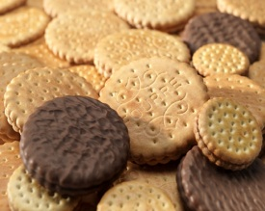

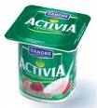
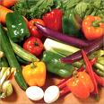

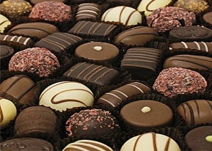
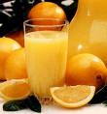
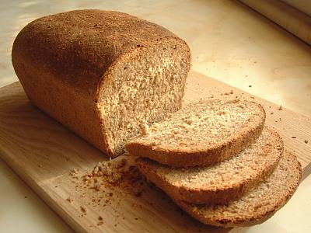
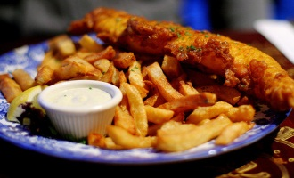

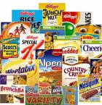
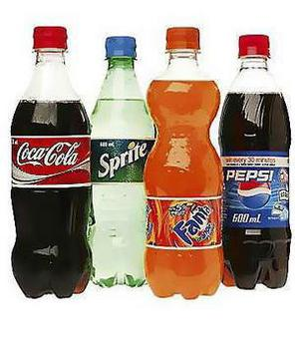
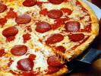
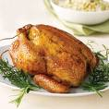
¿Tienes una dieta sana?
los caramelos
los perritos calientes
el pescado
fruta
los plátanos
las hamburguesas
galletas
Las verduras
el yogur
el agua mineral
el pan integral
pasteles
chocolates
el zumo de naranja
Use the vocabulary here to write an imaginary food diary;
Los lunes como los cereales, pan integral y bebo zumo de naranja.
Los martes tomo un yogur y como el pollo con verduras.
etc...
con; with Try using different connectives
la comida frita
patatas fritas
los cereales
las bebidas gaseosas
pizza
el pollo
Notes:
Vocab sheet; learn vocabulary for homework plus writing task

Slide 9
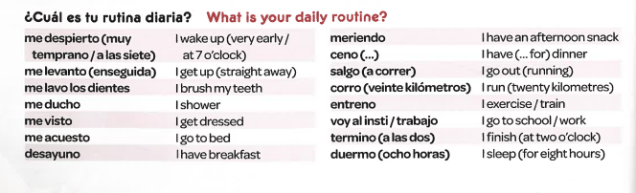
Week 2 –vocab
Read through the vocabulary for this week and spend a good amount of time trying to learn it. You will need these words to complete the tasks on the next few slides.

Slide 10
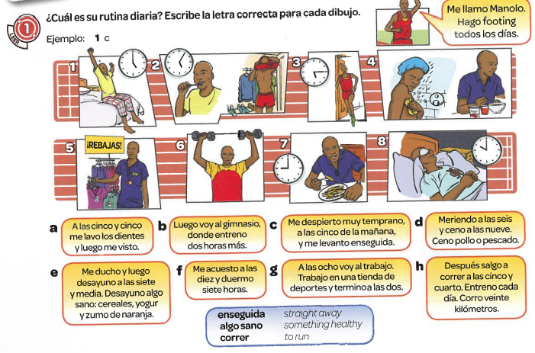
What is his routine? Write the correct letter a- h for each picture

Slide 11
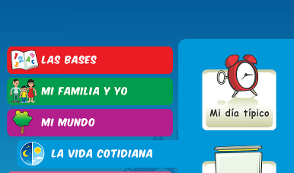
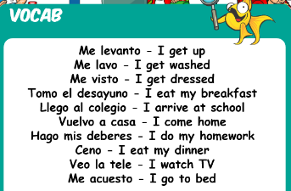
Log in to the beginner section of Linguascope and play some of the games to practice the daily routine phrases.
Username – kingshill Password – love4langs

Slide 12



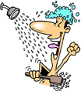
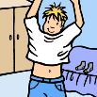

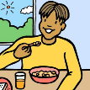
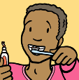



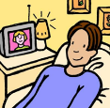
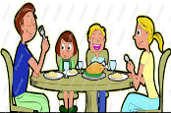
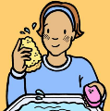

Por la mañana
Me despierto
Me levanto
Me ducho
Me visto
Me peino
Desayuno
Me lavo los dientes
Voy al colegio
Por la tarde
Hago mi deberes
Veo la televisión
Ceno
Me lavo
Me acuesto
In the morning
I wake up
I get up
I shower
I get dressed
I do my hair
I have breakfast
I brush my teeth
I go to school
In the evening
I do my homework
I watch tv
I have dinner
I wash
I go to bed
Write a short paragraph in Spanish about your daily routine. Add in times too. Use the previous slide to help you as well.

Slide 13
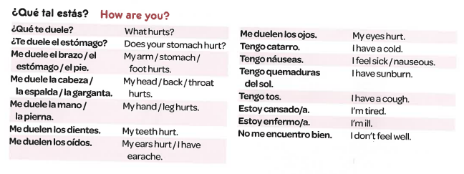
Week 3 –vocab
Read through the vocabulary for this week and spend a good amount of time trying to learn it. You will need these words to complete the tasks on the next few slides.

Slide 14
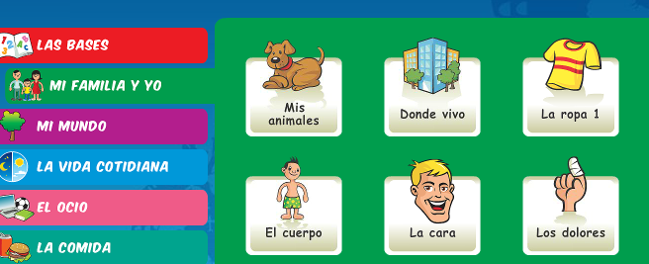
Log in to the beginner section of Linguascope and play some of the games to practice the body parts and illnesses phrases.
Username – kingshill Password – love4langs

Slide 15
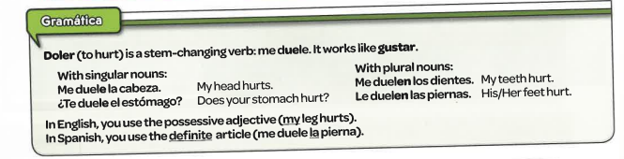
Make a note of the grammar below:

Slide 16

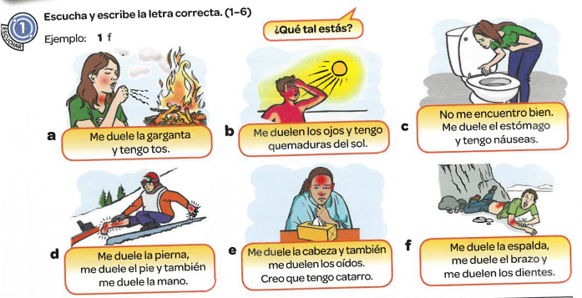
Listen to the recording. What is wrong with each of the 6 people – choose from a-f

Slide 17
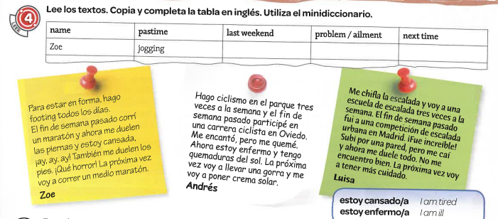
Read the texts. Copy and complete the table and complete it in English. Use a dictionary if necessary.

Slide 18
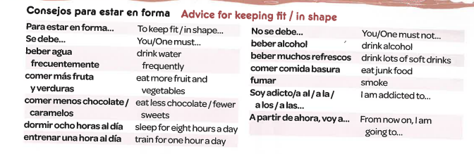
Week 4 –vocab
Read through the vocabulary for this week and spend a good amount of time trying to learn it. You will need these words to complete the tasks on the next few slides.

Slide 19
Can you remember what these phrases mean from last week? Test yourself!
What hurts?
My head hurts
My arm hurts
My back hurts
My throat hurts.
I have a cold
I have a cough.
8. have an insect bite
9. Me duele el estómago
10. Me duelen los dientes
11. Tengo quemaduras del sol.
12. Estoy enfermo
13. Tengo fiebre
14. Tengo gripe
15. Estoy cansado
¿Qué te duele?
Me duele la cabeza
Me duele el brazo
Me duele la espalda
Me duele la garganta.
Tengo catarro.
Tengo tos.
Tengo una picadura
My stomach hurts
My teeth hurt
I have sunburn.
I’m ill.
I have a fever
I have the flu
I’m tired.
Notes:
¿Qué tal estás?
How are you?
¿Qué te duele?
What hurts?
¿Te duele el estómago?
Does your stomach hurt?
Me duele el brazo
My arm hurts
Me duele el estómago
My stomach hurts
Me duele el pie.
My foot hurts
Me duele la cabeza
My head hurts.
Me duele la espalda
My back hurts.
Me duele la garganta.
My throat hurts.
Me duele la mano / la pierna.
My hand hurts.
Me duele la pierna
My leg hurts.
Me duelen los dientes.
My teeth hurt
Me duelen los oídos.
My ears hurt / I have earache.
Me duelen los ojos.
My eyes hurt.
Learn these two columns:
Tengo catarro.
I have a cold.
Tengo náuseas.
I feel sick / nauseous.
Tengo quemaduras del sol.
I have sunburn.
Tengo tos.
I have a cough.
Estoy cansado/a.
I’m tired.
Estoy enfermo/a.
I’m ill.
No me encuentro bien.
I don’t feel well.
Tengo la pierna rota
I have a broken leg
Tengo diarrea
I have diarrhoea
Tengo fiebre
I have a fever
Tengo una picadura
I have an insect bite
Tengo gripe
I have the flu
Tengo calor/frío
I am hot/cold

Slide 20
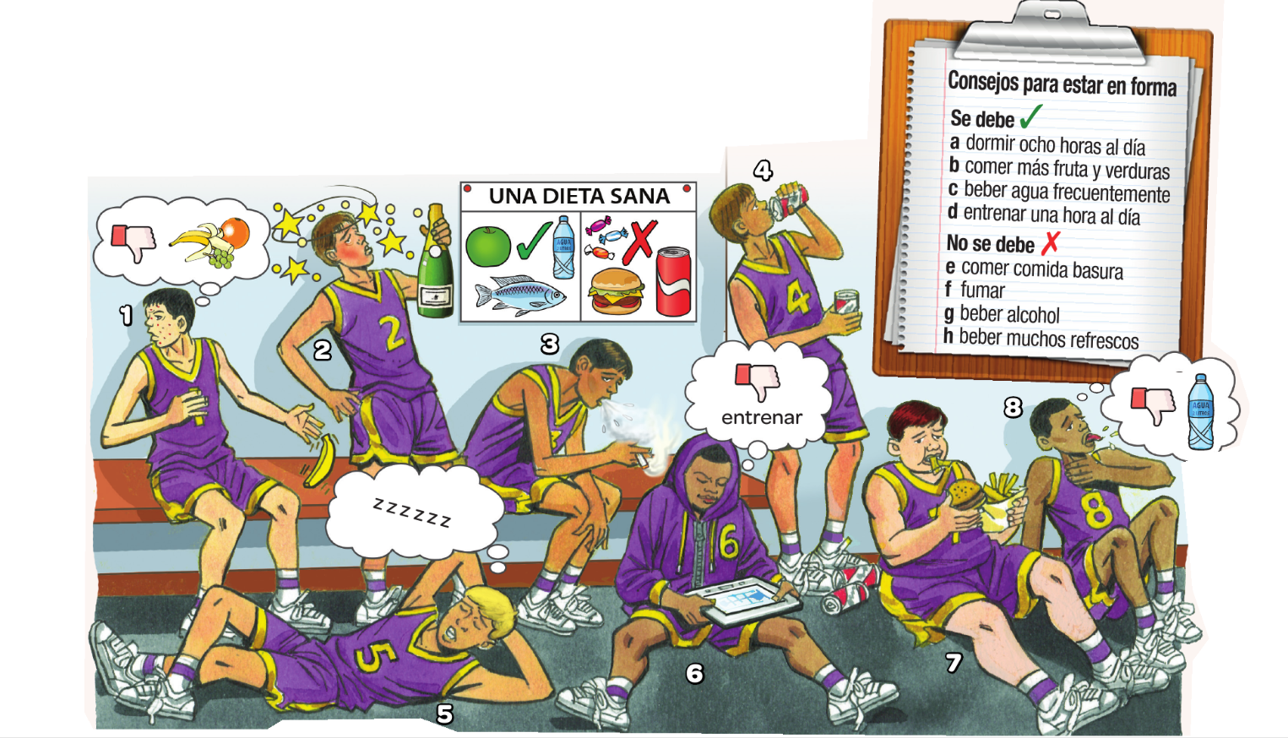
Match up the phrases a-h with the people 1-8

Slide 21
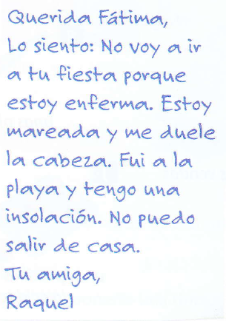
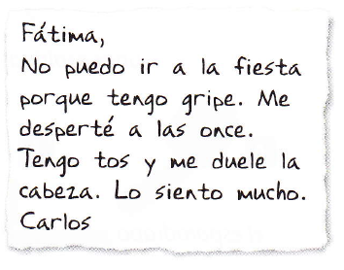
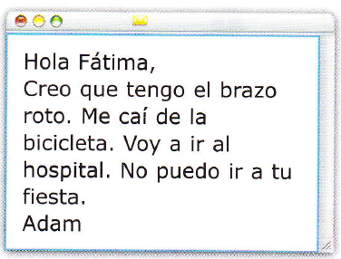
Who can't go to the party?
Who has a headache?
Who has to go to hospital?
Who has sunstroke?
Who thinks they have a broken arm?
Who says they can't go out at all?
Who has had an accident?
Who woke up late?
Who fell off their bike?
Who doesn't say sorry?

Slide 22
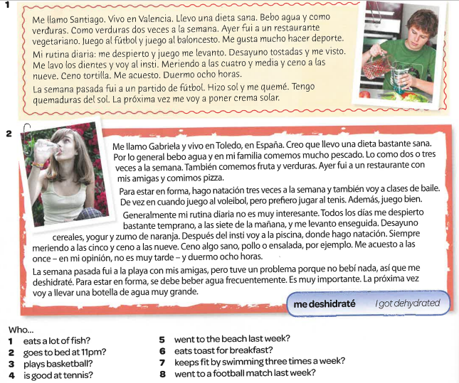

Slide 23
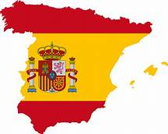
Week 5 –
vocab
This week you are planning a trip to Spain! It can be to mainland Spain or one of the islands which belong to Spain.
You need to:
Choose a location
Choose a hotel
Choose some day trips/ activities
Find some nice local restaurants and find out what the local specialities are
Find some photographs of the local area.
Make a list of some useful phrases in Spanish that will be helpful on the holiday – hello, good afternoon, thank you, I would like etc
You need to present your holiday plan on Powerpoint or Word.

Slide 24
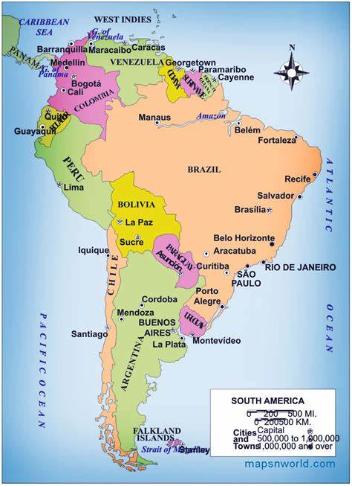
Week 6
Project week:
Research a Spanish speaking country in South or Central America which is popular with tourists. Make a poster or a presentation about the place, please include the following information.
- What is the place called and whereabouts is it?
- What can tourists do there?
- Where can tourists stay? Please find some examples of accommodation available (hotels, campsites, holiday homes etc)
- Find some nice restaurants in the area, are there any regional specialities?

Slide 25



Week 7
Recap the vocabulary you have learned this year by using your orange books, Linguascope, Quizlet and Blooket (you can play individual games on Blooket too).
Linguascope username is kingshill and the password is love4langs

