Slide 1


Year 9 German TERM 6:
If pupils are absent from lessons they should spend time revising and learning vocabulary. All of the vocabulary for this term is on the following slides. First of all, they should recap the vocabulary which they learned the previous week. Then they should start to learn the next section of vocabulary which they have not yet covered in class. This could be done by using the look, cover, write, check method or by making flashcards etc.
Pupils can also revise vocabulary on Linguascope-
Username is kingshill password is love4langs
Any new vocabulary they learn can be written in their orange books or on paper.
If pupils wish to do extension work they can access free MFL lessons on the Oak National Academy website:
https://classroom.thenational.academy/subjects-by-key-stage

Slide 2
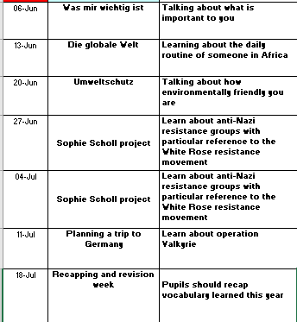

Slide 3
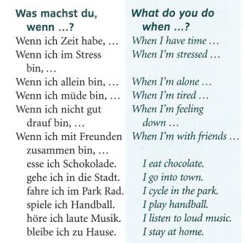
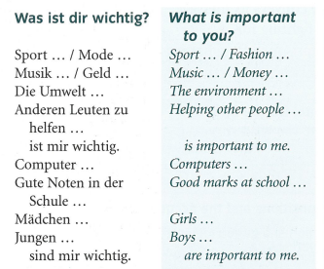
Week 1 –vocab
Read through the vocabulary for this week and spend a good amount of time trying to learn it. You will need these words to complete the tasks on the next few slides.

Slide 4
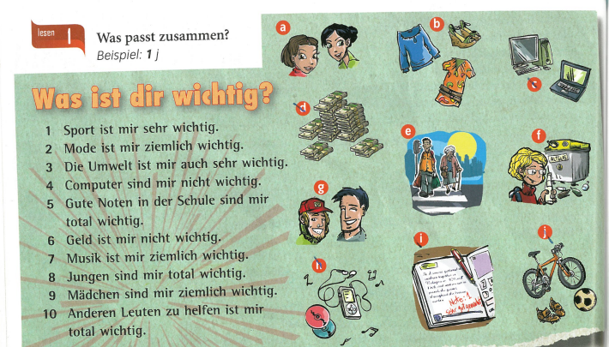
Match up the phrases with the pictures.
Example – 1j

Slide 5
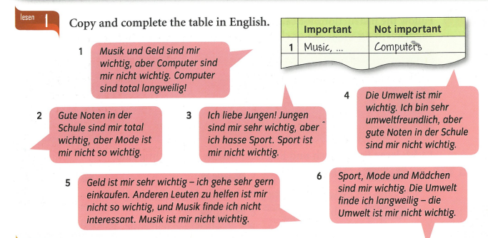

Slide 6

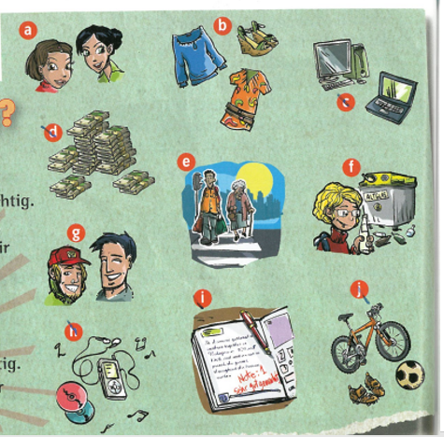
Listen to the recording
Using the phrases from the activity before. Listen to the recording and fill in the table – in words or use letters. What do they find important, very important and not important?
 | Wichtig | Sehr wichtig | Nicht wichtig
1 | Gute Noten i | Die Umwelt f
2
3
4
5
6

Slide 7

Wenn
Mix and match the sentences below - it’s completely your choice! Write them in your exercise book.
Wenn…
1. Wenn ich Zeit habe,
2. Wenn ich müde bin,
3. Wenn ich mit Freunden zusammen bin,
4. Wenn ich allein bin,
5. Wenn ich nicht gut drauf bin,
6. Wenn ich im Stress bin,
a. esse ich Schokolade.
b. gehe ich in die Stadt.
c. fahre ich in York.
d. spiele ich am Computer.
e. höre ich laute Musik.
f. bleibe ich zu Hause.

Slide 8
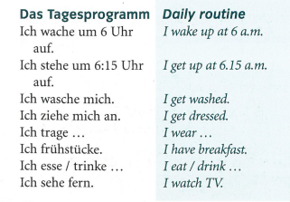
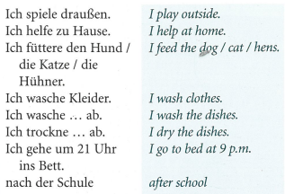
Week 2 –vocab
Read through the vocabulary for this week and spend a good amount of time trying to learn it. You will need these words to complete the tasks on the next few slides.

Slide 9
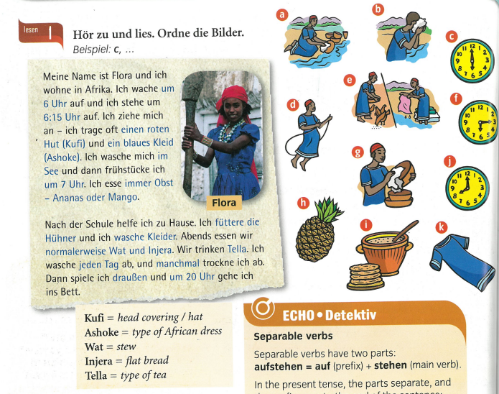
INSTRUCTIONS:
Listen to the recording and read along. Listen to flora talk about her day. Put the pictures in the correct order of when they happen.

Slide 10
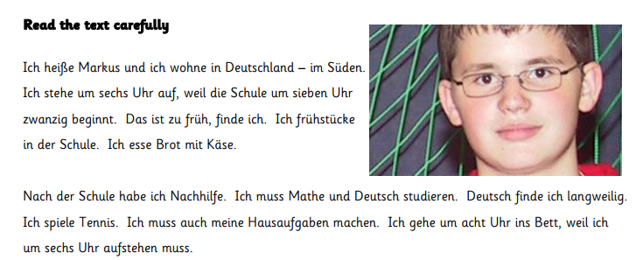
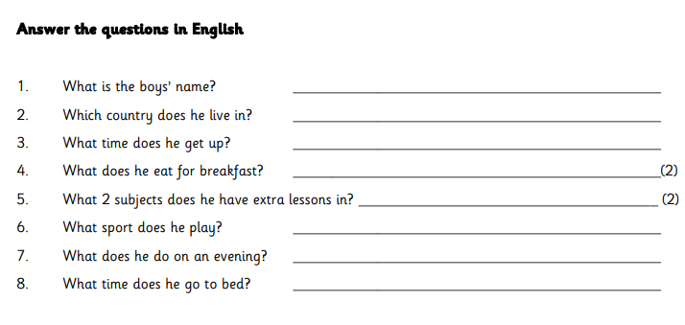

Slide 11
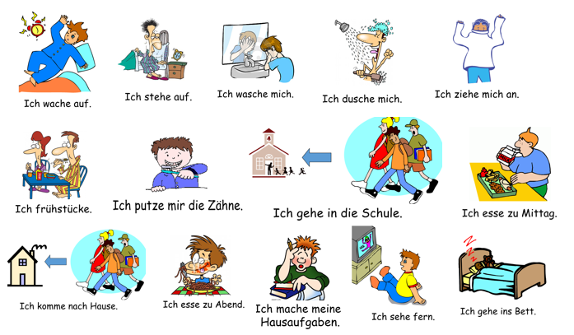
Use these daily routine phrases to write a short paragraph in German about your routine.
Example:
Ich wache um Sieben Uhr auf und ich stehe um Viertel nach Sieben auf…
Remember to put the time straight after the verb.

Slide 12
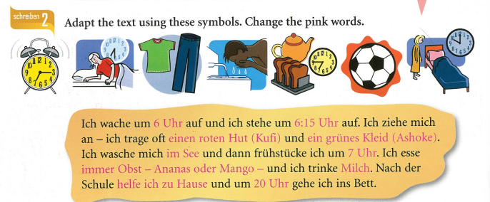

Slide 13
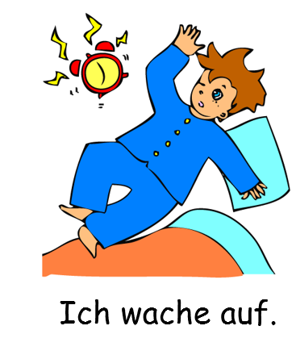
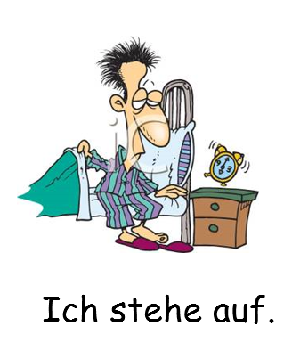
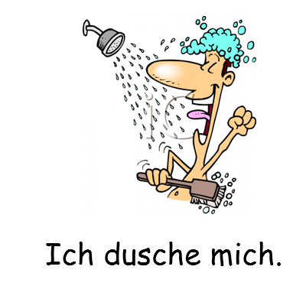

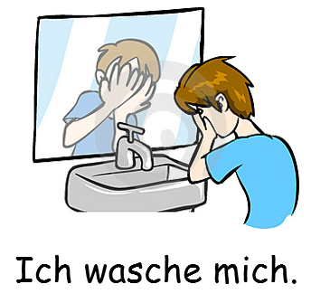
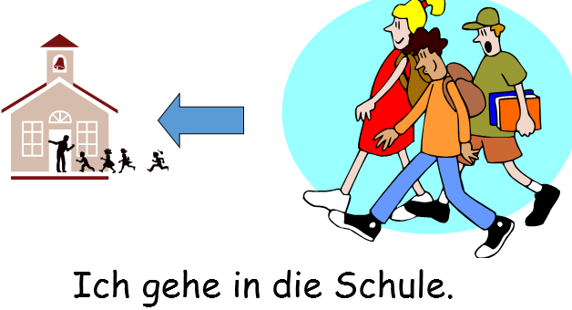

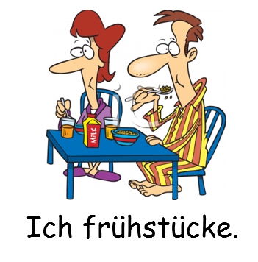
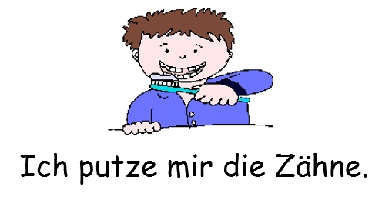
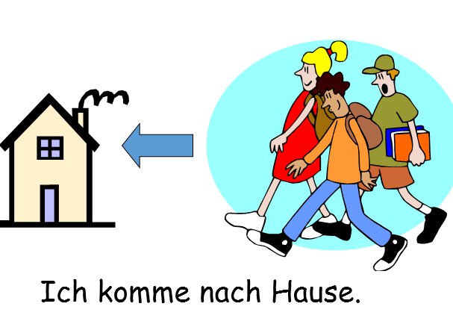

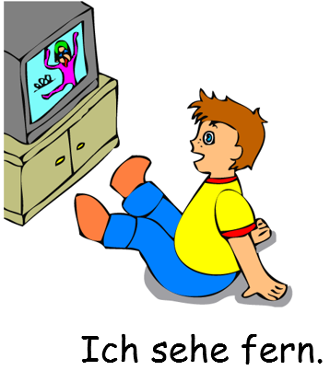

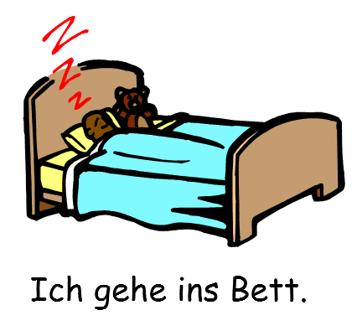



Slide 14
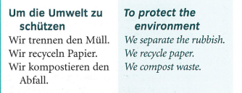
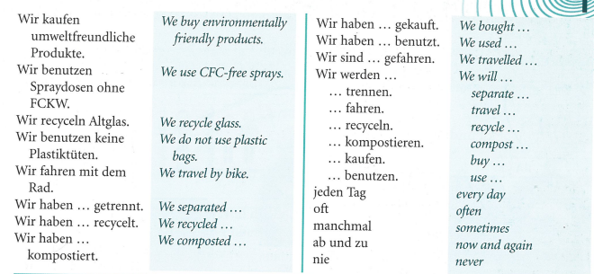
Week 3 –
vocab
Read through the vocabulary for this week and spend a good amount of time trying to learn it. You will need these words to complete the tasks on the next few slides.

Slide 15

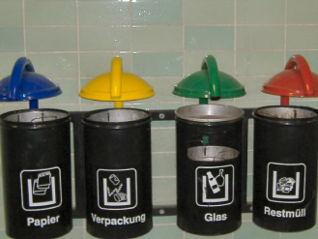
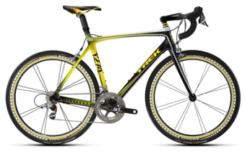


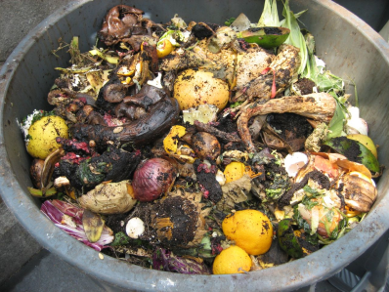

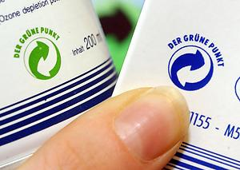
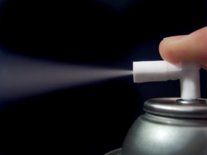
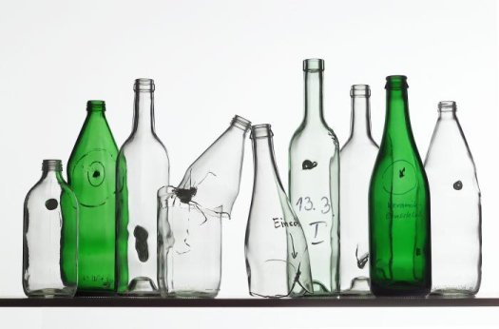
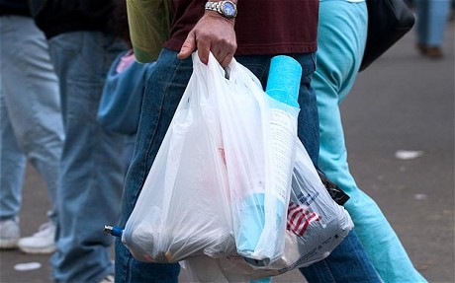
Lesen!
Match the sentence to the picture – eg. 1. g
b)
a)
1 | Wir recyceln ab und zu Altglas.
2 | Wir kaufen manchmal umweltfreundliche Produckte.
3 | Wir benutzen keine Plastiktüten.
4 | Wir trennen jeden Tag den Müll.
5 | Wir benutzen Spraydosen ohne FCKW.
6 | Wir recyceln nie Papier.
7 | Wir fahren oft mit dem Rad.
8 | Wir kompostieren den Abfall nicht.
d)
c)
f)
e)
g)
h)

Slide 16
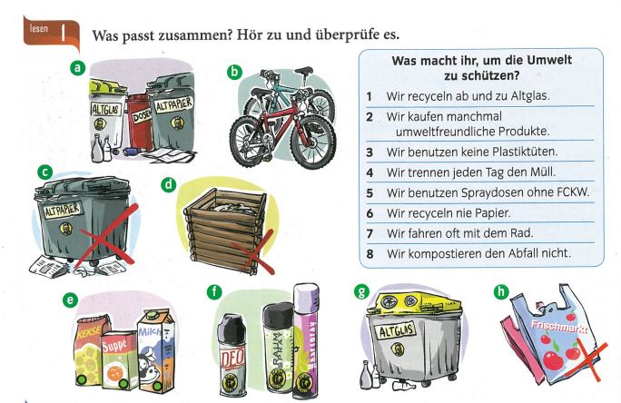
Match the pictures with the sentences

Slide 17

Listen to the recording. What does each of the 8 people do to protect the environment? Example, 1) d, b

Slide 18
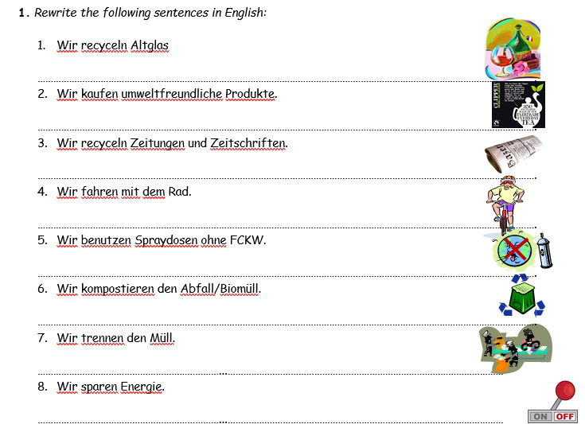

Slide 19
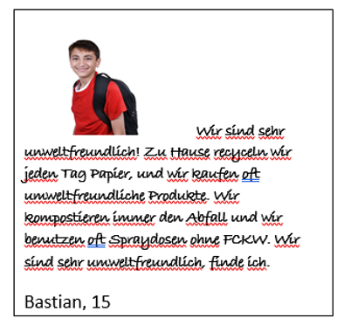
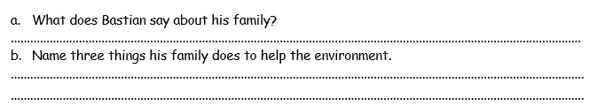

Slide 20
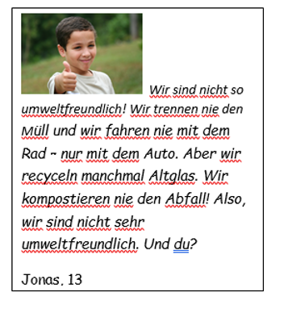
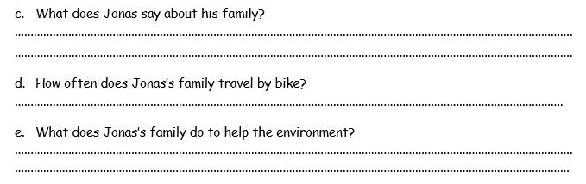

Slide 21
Week 4 –vocab
Read through the information on the next few slides about Sophie Scholl and the White Rose Resistance Movement. During the next two weeks we are learning about the group and what they did in their fight against the Nazi Party. When you have read the information. Research the group yourself and make a note of any extra information you can find out.

Slide 22

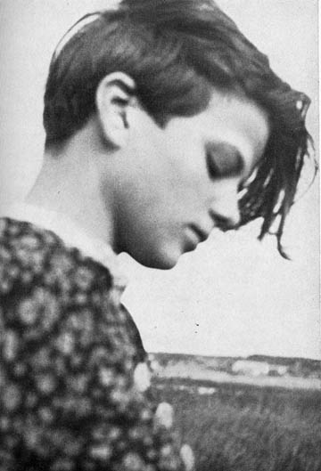

Slide 23
SOPHIE SCHOLL
Aim - To consider the idea that ‘One Person Can
Make a Difference’.
Starter: Have you ever been in a situation where you changed
someone’s point of view, or stopped someone doing something you
thought to be wrong? Or
Think of one or two individuals, either in the past or today, who have
done something which has made a positive difference to the lives of
other people.

Slide 24


SOPHIE SCHOLL
The true story of a young woman who did what few in Nazi Germany dared even think.

Slide 25
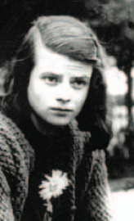
Sophie Scholl. With her brother Hans, she founded a resistance movement known as The White Rose. They distributed anti-Nazi leaflets and were caught and executed.

Slide 26

SOPHIE SCHOLL
The true story of Germany's most famous anti-Nazi heroine is brought to thrilling life in SOPHIE SCHOLL-THE FINAL DAYS. Winner of multiple awards, SOPHIE SCHOLL stars Julia Jentsch in a luminous performance as the young coed-turned-fearless activist. Armed with long-buried historical records of her incarceration, director Marc Rothemund expertly re-creates the last six days of Sophie Scholl's life: a heart-stopping journey from arrest to interrogation, trial and sentence.

Slide 27
SOPHIE SCHOLL
“It is certain that today every honest German is ashamed of his government. Who among us has any conception of the dimensions of shame that will befall us and our children when one day the veil has fallen from our eyes and the most horrible of crimes ... reach the light of day? — From the first leaflet of the White Rose. ”

Slide 28
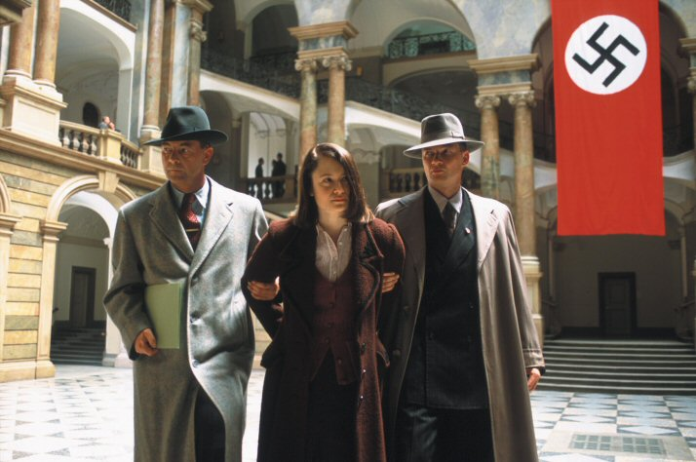
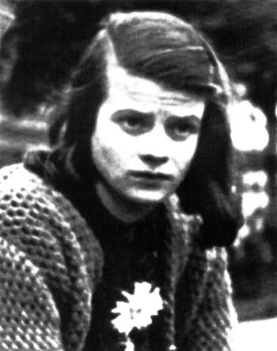
SOPHIE SCHOLL
In 1943, as Hitler continues to wage war across Europe, a group of college students mount an underground resistance movement in Munich. Dedicated expressly to the downfall of the monolithic Third Reich war machine, they call themselves the White Rose. Its sole female member, Sophie Scholl is captured during a dangerous mission to distribute pamphlets on campus with her brother Hans. Unwavering in her convictions and loyalty to the White Rose, her cross-examination by the Gestapo quickly escalates into a searing test of wills as Scholl delivers a passionate call to freedom and personal responsibility that is both haunting and timeless.

Slide 29
SOPHIE SCHOLL
On February 22, 1943, Sophie Scholl, her brother Hans and their friend Christoph Probst were found guilty of treason and condemned to death. They were all beheaded by executioner Johann Reichhart in Munich's Stadelheim Prison only a few hours later at 17:00. The execution was supervised by Dr. Walter Roemer who was the enforcement chief of the Munich district court. Prison officials emphasized the courage with which she walked to her execution. Her last words were "Die Sonne scheint noch"—"The sun still shines.“

Slide 30
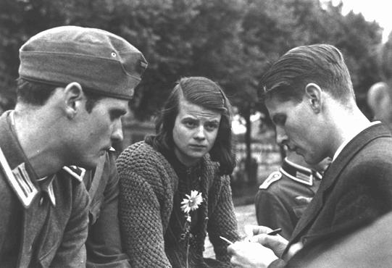
SOPHIE SCHOLL
On February 22, 1943, Sophie Scholl, her brother Hans and their friend Christoph Probst were found guilty of treason and condemned to death. They were all beheaded by executioner Johann Reichhart in Munich's Stadelheim Prison only a few hours later at 17:00. The execution was supervised by Dr. Walter Roemer who was the enforcement chief of the Munich district court. Prison officials emphasized the courage with which she walked to her execution. Her last words were "Die Sonne scheint noch"—"The sun still shines.“
Hans Scholl, Sophie Scholl, and Christoph Probst, who were executed for participating in the White Rose resistance movement against the Nazi regime in Germany.

Slide 31
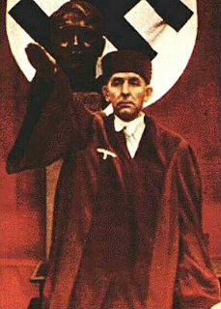
SOPHIE SCHOLL
Nazi judge Roland Freisler was particularly known for humiliating defendants and shouting loudly at them. A number of the trials for defendants in the July 20 Plot before the People's Court were filmed and recorded. In the 1944 trial against Ulrich Wilhelm Graf Schwerin von Schwanenfeld, for example, Freisler screamed so loudly that the technicians who were filming the proceeding had major problems making the defendants' words audible. Count Schwerin, like many other defendants in the plot, was sentenced to death by hanging. Among this and other show trials, Freisler headed the 1943 proceedings against the members of the "White Rose" resistance group, and ordered many of its members to be executed by guillotine.

Slide 32
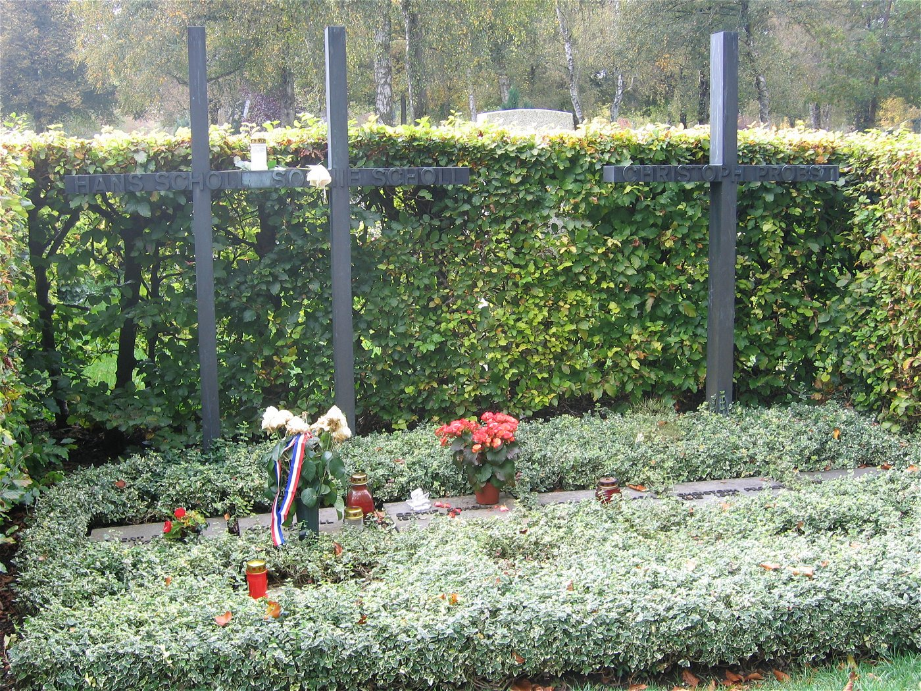
SOPHIE SCHOLL

Slide 33
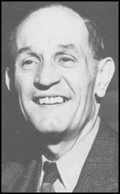

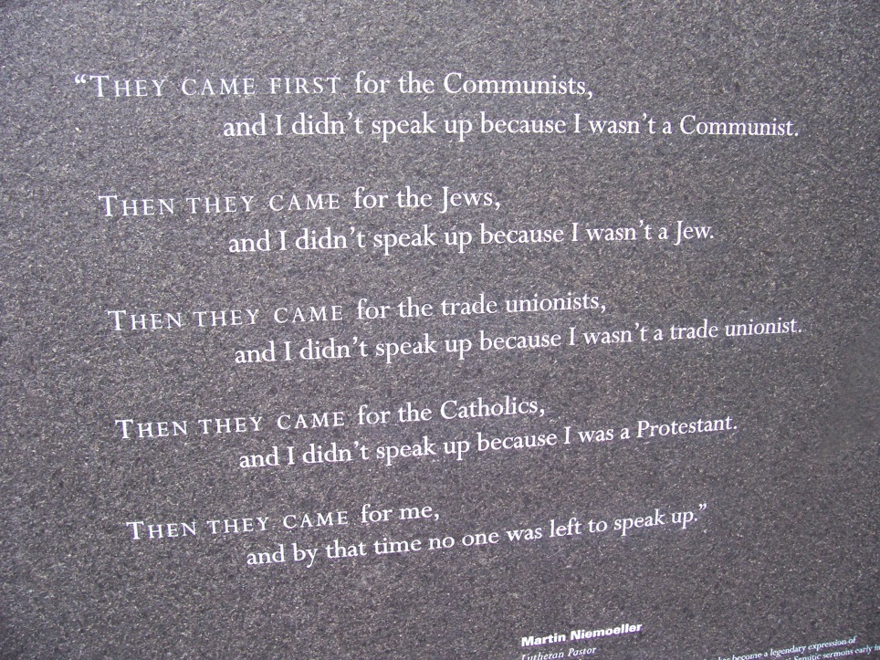


SOPHIE SCHOLL
First They Came for the Jews
First they came for the Jews
and I did not speak out
because I was not a Jew.
Then they came for the Communists
and I did not speak out
because I was not a Communist.
Then they came for the trade unionists
and I did not speak out
because I was not a trade unionist.
Then they came for me
and there was no one left
to speak out for me.
Pastor Martin Niemöller

Slide 34
SOPHIE SCHOLL
Aim - To consider the idea that ‘One Person Can Make a Difference’.
Plenary:
What do you think were the views of these people about other human
beings? How might these views differ from those doing the killing?
Are there any circumstances in which you might be prepared to risk your
life or your safety for another person?

Slide 35
Week 5 –vocab
We are continuing with our project about Sophie Scholl and the white Rose Resistance Movement this week. You can do any of the following activities:
Follow the link below to watch the film
Sophie Scholl: The Final Days (Full film) – YouTube
2) Continue researching the group and their activities
3) Research other anti-Nazi groups including the Edelweißpiraten

Slide 36

Week 6
Project week:
Research an area of Germany, Austria or Switzerland which is popular with tourists. Make a poster or a presentation about the place, please include the following information.
- What is the place called and whereabouts is it?
- What can tourists do there?
- Where can tourists stay? Please find some examples of accommodation available (hotels, campsites, holiday homes etc)
- Find some nice restaurants in the area, are there any regional specialities?

Slide 37



Week 7
Recap the vocabulary you have learned this year by using your orange books, Linguascope, Quizlet and Blooket (you can play individual games on Blooket too).
Linguascope username is kingshill and the password is love4langs

