Slide 1


Year 8 Spanish TERM 6: Viva 2 textbook, chapter 1
If pupils are absent from lessons they should spend time revising and learning vocabulary. All of the vocabulary for this term is on the following slides. First of all, they should recap the vocabulary which they learned the previous week. Then they should start to learn the next section of vocabulary which they have not yet covered in class. This could be done by using the look,cover,write,check method or by making flashcards etc.
Pupils can also revise vocabulary on Linguascope-
Username is kingshill password is love4langs
Any new vocabulary they learn can be written in their orange books or on paper.
If pupils wish to do extension work they can access free MFL lessons on the Oak National Academy website:
https://classroom.thenational.academy/subjects-by-key-stage

Slide 2
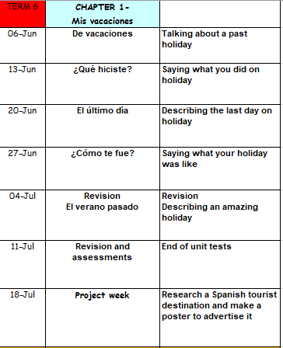

Slide 3
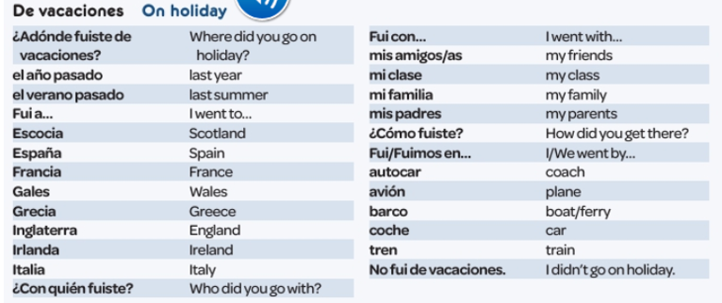
Read through the vocabulary for this week and spend a good amount of time trying to learn it. You will need these words to complete the tasks on the next few slides. There are more words on the following slide too.
Week 1 –
vocab

Slide 4
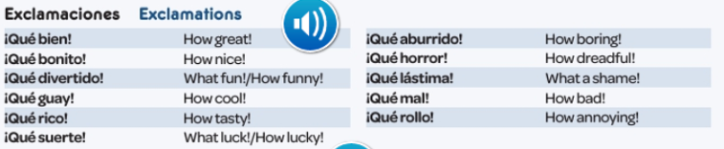

Slide 5
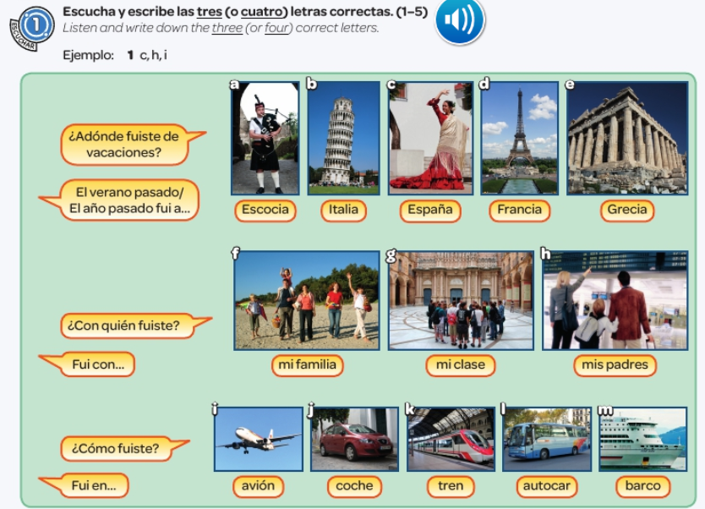



Slide 6
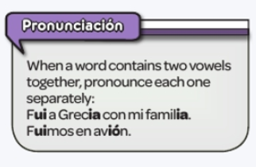
Make a note of the following…

Slide 7

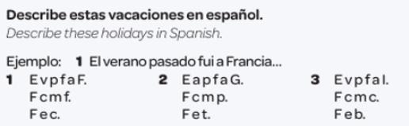

Slide 8
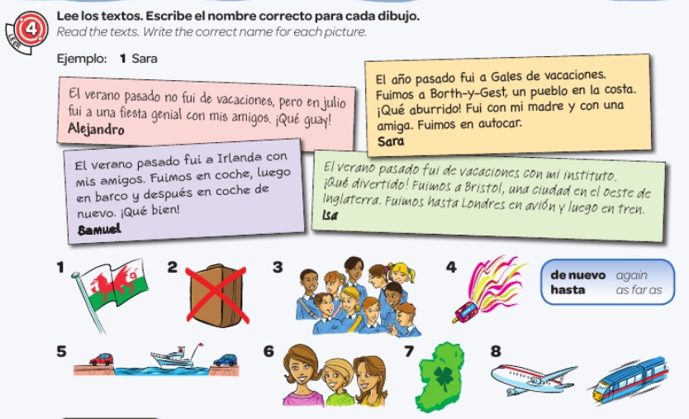

Slide 9
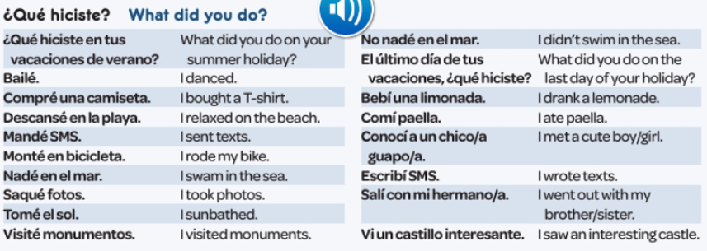
Read through the vocabulary for this week and spend a good amount of time trying to learn it. You will need these words to complete the tasks on the next few slides.
Week 2 –vocab

Slide 10
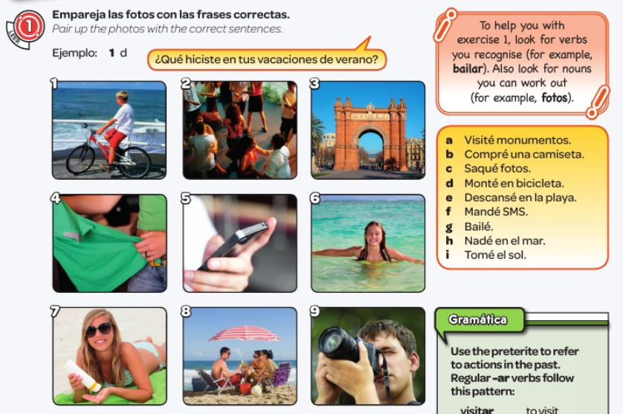

Slide 11
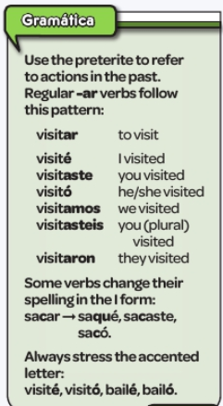
Copy out this grammar point

Slide 12
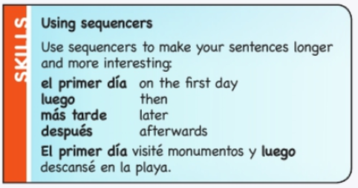
Copy out the following information:

Slide 13
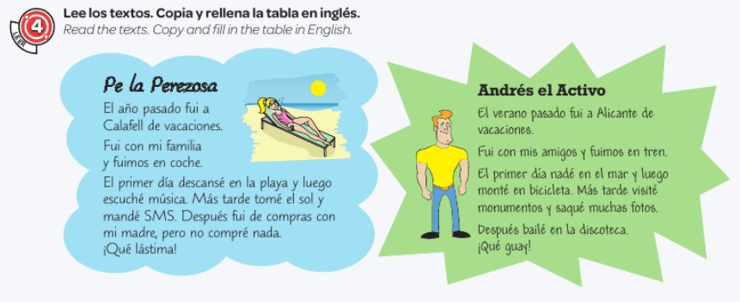
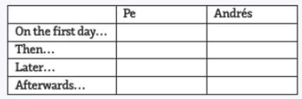


Slide 14
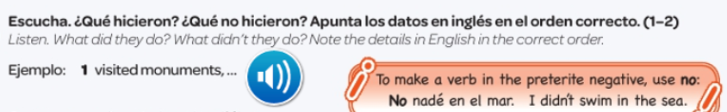


Slide 15
Week 3 –
vocab
There is no new vocabulary to learn this week but you will need to use the vocabulary from the last two weeks to do the work on the next few slides.

Slide 16
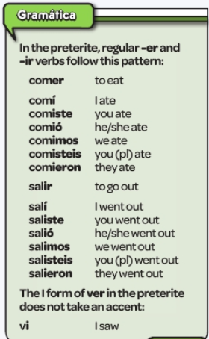
Copy the grammar point and try and learn the verb endings.

Slide 17
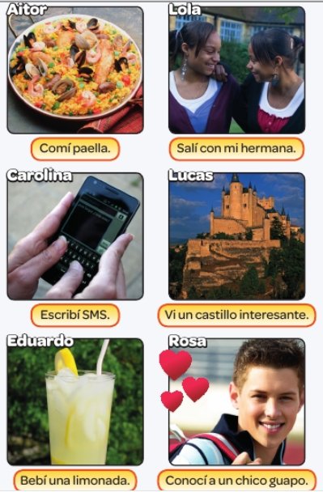




Slide 18
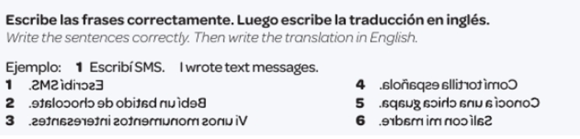

Slide 19
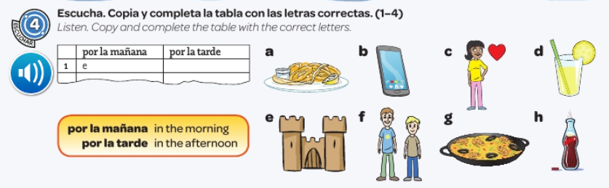


Slide 20
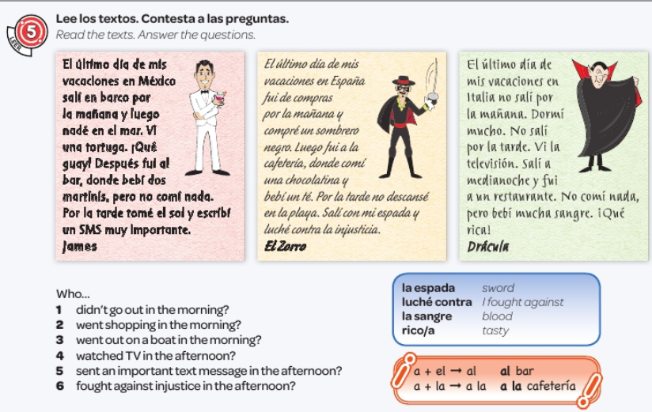

Slide 21
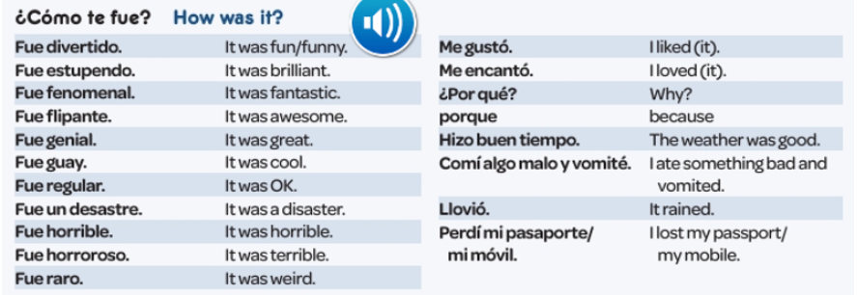
Read through the vocabulary for this week and spend a good amount of time trying to learn it. You will need these words to complete the tasks on the next few slides.
Week 4 –vocab

Slide 22
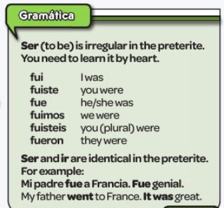
Copy the grammar point and try and learn it.

Slide 23
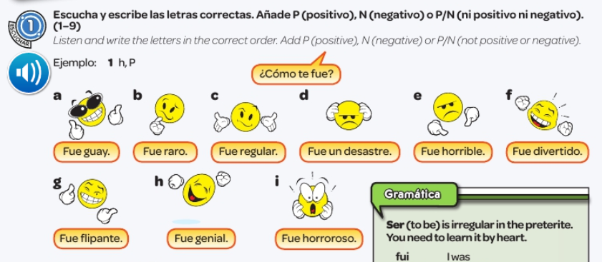


Slide 24
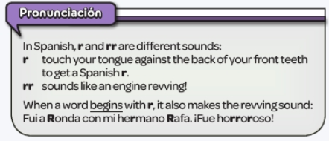

Slide 25
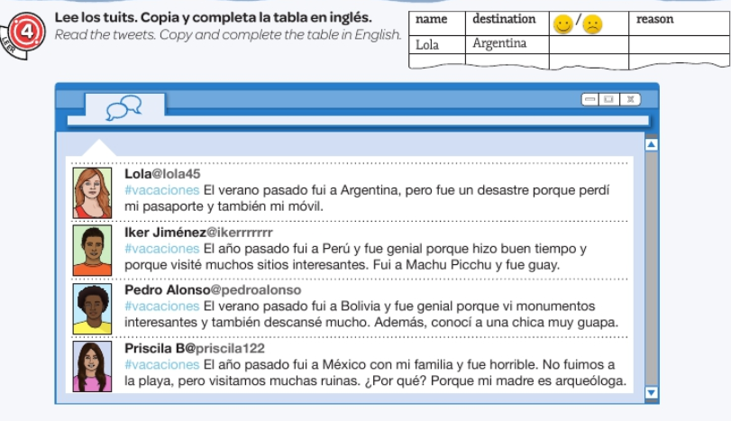

Slide 26
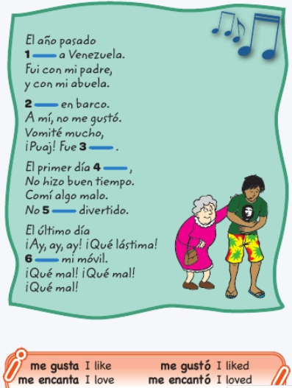
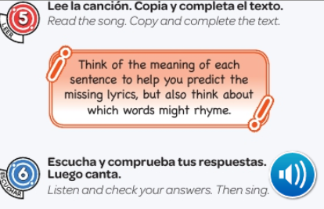


Slide 27
Week 5 –vocab
There is no new vocabulary to learn this week but you will need to use the vocabulary from the last few weeks to do the work on the next few slides.

Slide 28
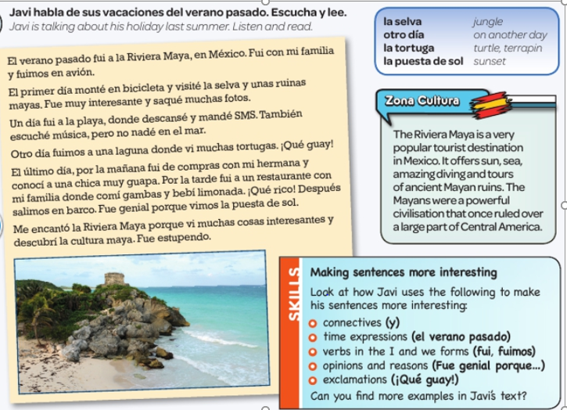

Slide 29
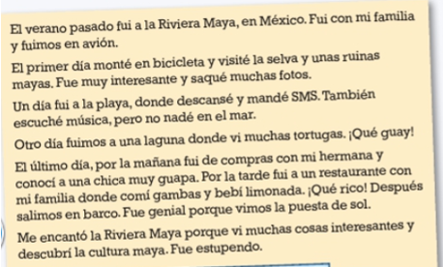
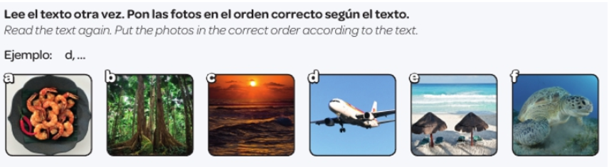

Slide 30
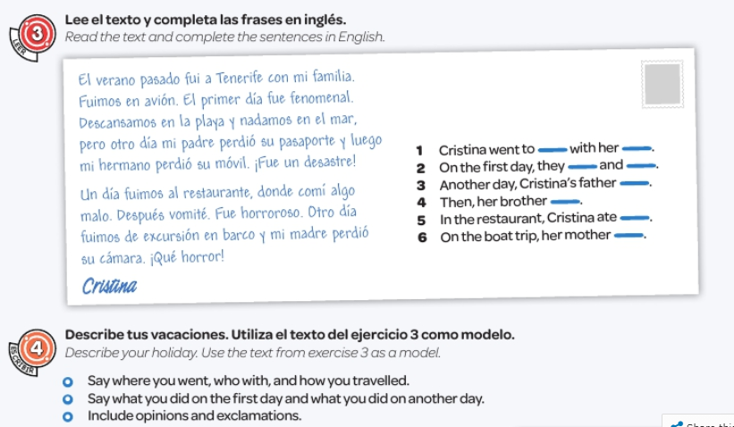

Slide 31
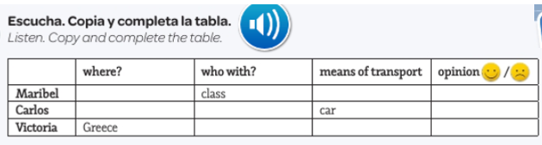


Slide 32

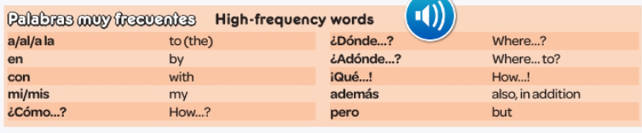
Week 6
This week is revision and assessment week. Contact your teacher for the assessment papers. Make sure you have revised all of the words and expressions that we have learned this term. If you don’t have your book at home with your vocab sheet in it, refer back to the vocabulary slides in these PowerPoint slides.
There are also some revision activities on the next few slides and some high-frequency words below to learn.

Slide 33
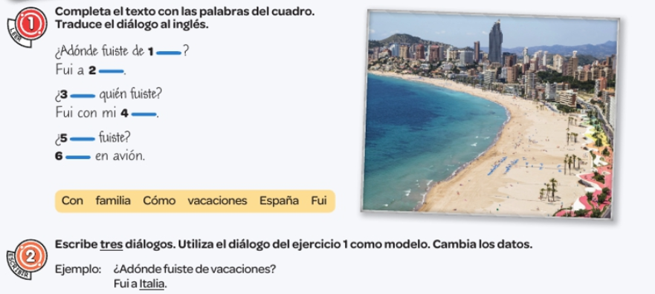
Complete the gaps with words from the box below. Then translate the text in to English.
Write your own dialogue in Spanish like the one in exercise one..

Slide 34
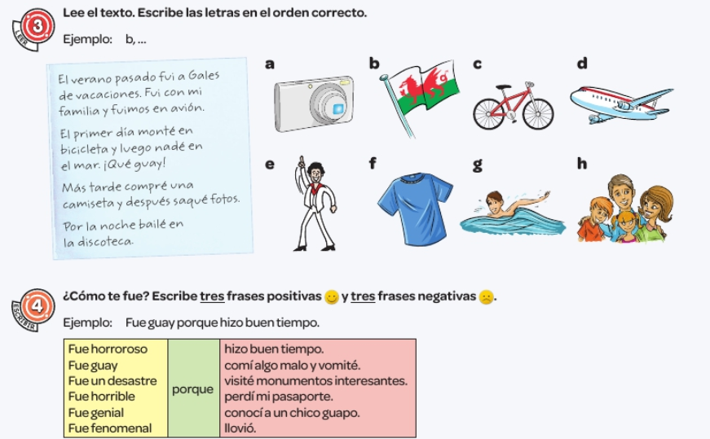
Read the text. Write the letters in the correct order.
Example, b…
How was it? Write 3 positive sentences and 3 negative ones.

Slide 35
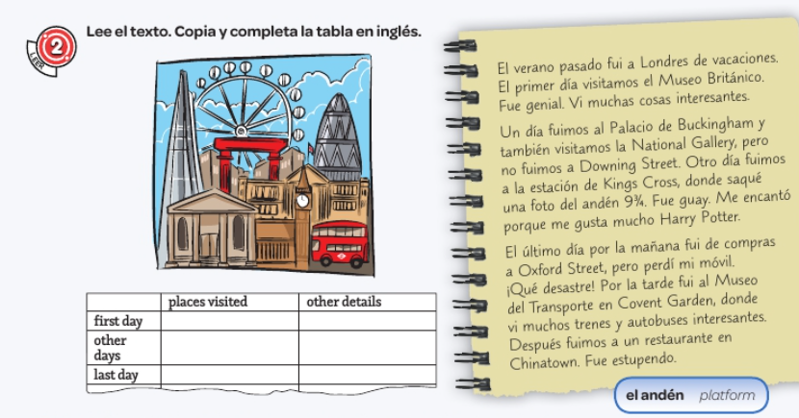

Slide 36
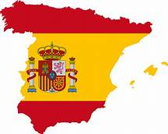
Week 7
Project week:
Research an area of Spain or a Spanish speaking country which is popular with tourists. Make a poster or a presentation about the place, please include the following information.
- What is the place called and whereabouts is it?
- What can tourists do there?
- Where can tourists stay? Please find some examples of accommodation available (hotels, campsites, holiday homes etc)
- Find some nice restaurants in the area, are there any regional specialities?

