Slide 1


Year 8 French TERM 6: Studio 1 textbook, chapter 5
If pupils are absent from lessons they should spend time revising and learning vocabulary. All of the vocabulary for this term is on the following slides. First of all, they should recap the vocabulary which they learned the previous week. Then they should start to learn the next section of vocabulary which they have not yet covered in class. This could be done by using the look, cover, write, check method or by making flashcards etc.
Pupils can also revise vocabulary on Linguascope-
Username is kingshill password is love4langs
Any new vocabulary they learn can be written in their orange books or on paper.
If pupils wish to do extension work they can access free MFL lessons on the Oak National Academy website:
https://classroom.thenational.academy/subjects-by-key-stage

Slide 2
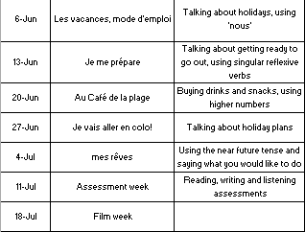
Project week

Slide 3
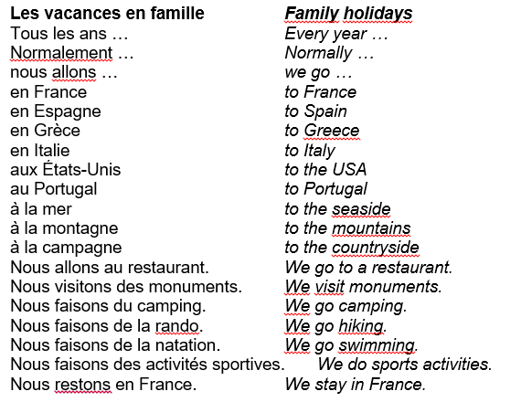
Week 1 –vocab

Slide 4
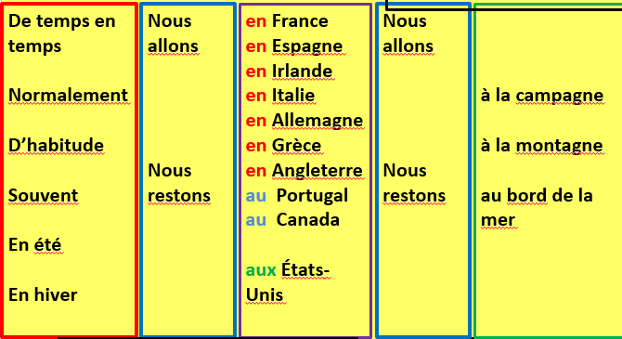
- Make a poster out of the vocab on the previous slide.
- Use the grid to make some sentences in French and translate them into English

Slide 5
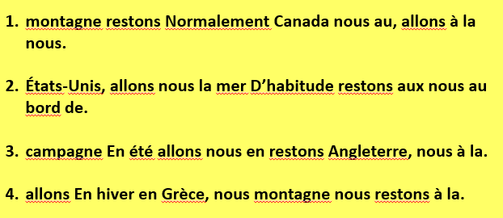
Can you put these words in the right order?

Slide 6
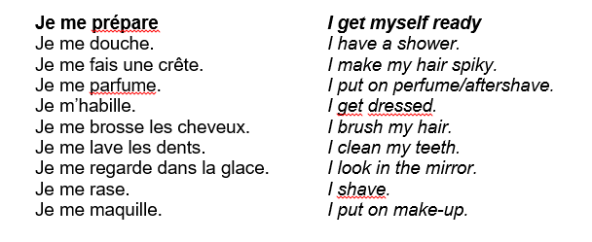
Week 2 –vocab
- Make a comic strip of someones daily routine using these words. Draw a picture for each one.

Slide 7
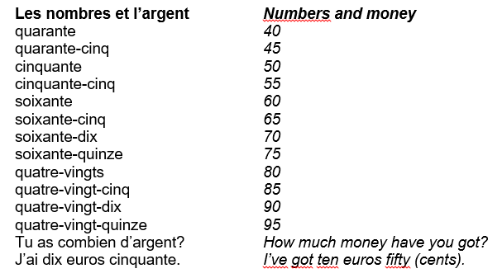
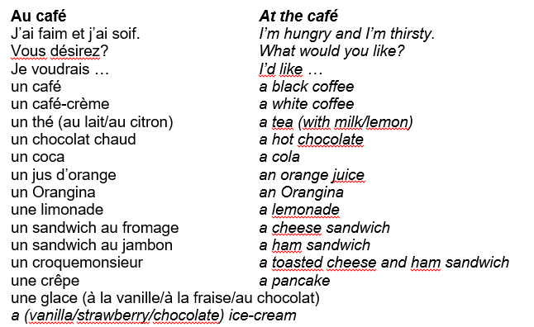
Week 3 –
vocab

Slide 8
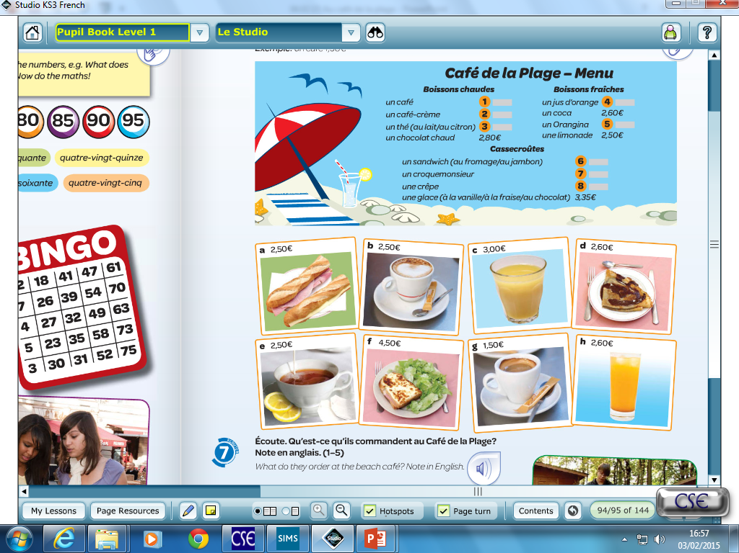
Copy the menu and fill in the gaps with the prices. Then, imagine you have a budget of 12 €. Write a dialogue with what you want to order…
Finally, design your own menu!
Serveur: Vous désirez?
Client: Je voudrais un café et une crêpe s’il vous plaît.
Serveur: Ça fait dix euros soixante.

Slide 9
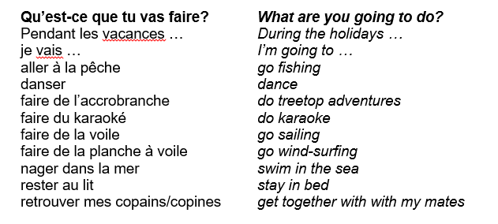
Week 4 –vocab

Slide 10
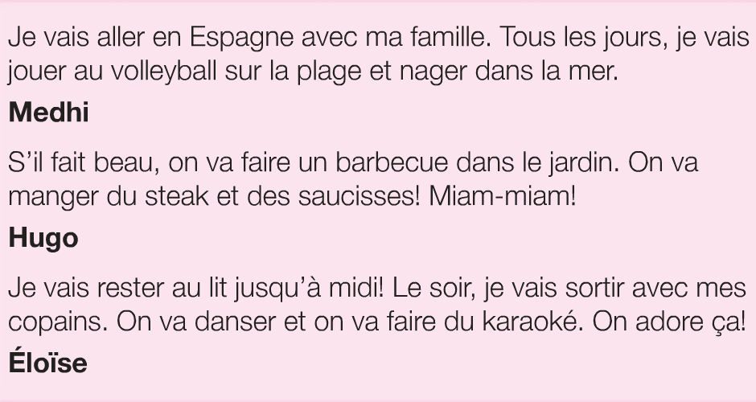
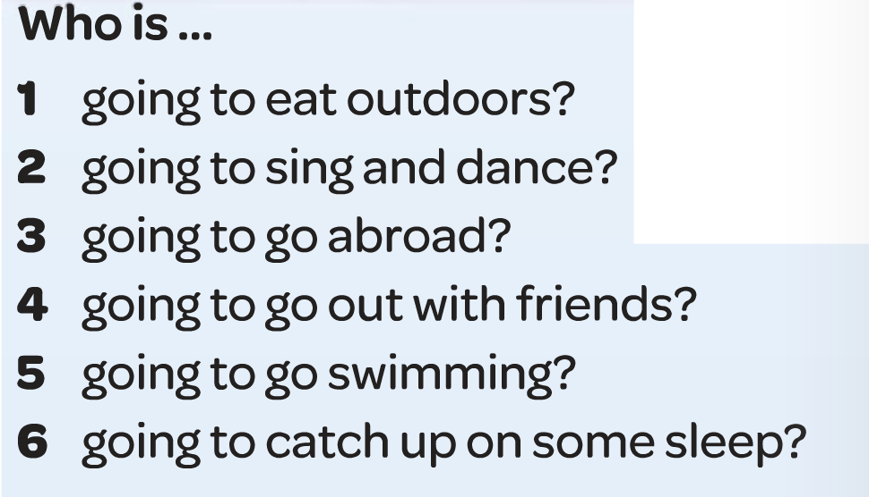
Lisez les textes et répondez aux questions en anglais.
Studio 1 p96 ex. 2
Exemple:
1. Hugo
EXTRA!
Cherchez le vocabulaire:
I am going to play
I am going to go out
We are going to eat
We are going to dance

Slide 11
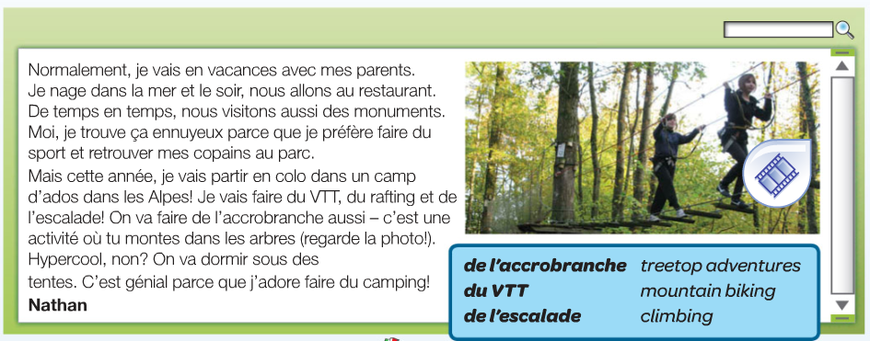
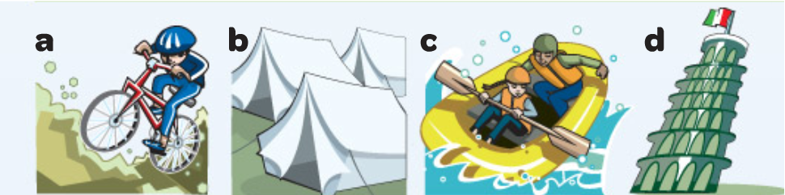
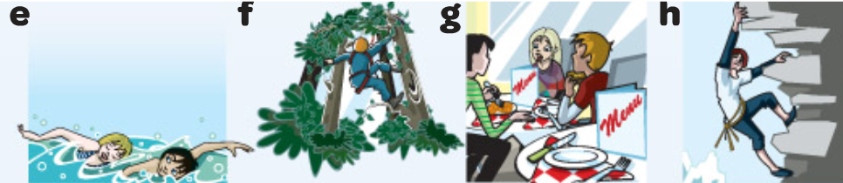
Read the text and look at the pictures. What does Nathan usually do on holiday?
Studio 1 p97 ex. 4
Exemple:
Normalement: e
En colo:

Slide 12
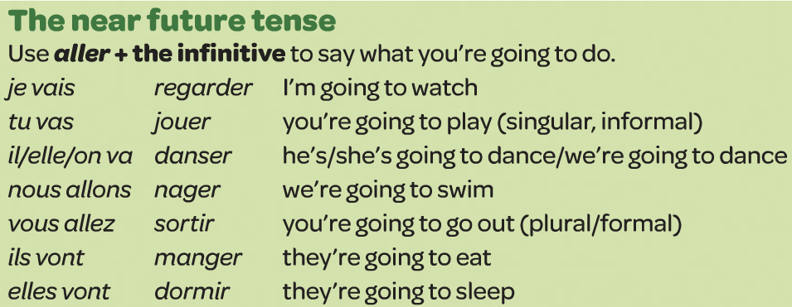
Copy the rule about the near future tense with the examples:

Slide 13
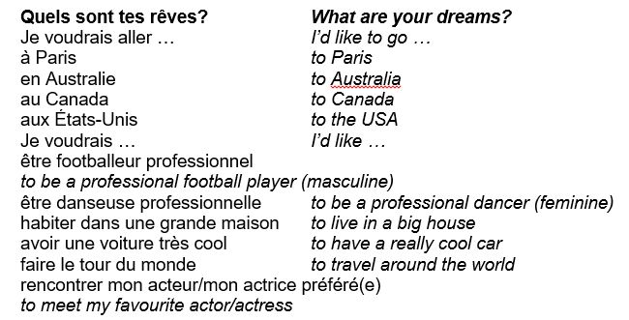
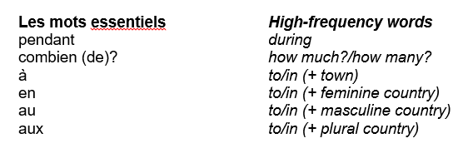
Week 5 –vocab
Revise the work from this term using this quizlet set:
Studio 1 module 5 revision

Slide 14

Week 6
This week is revision and assessment week. Contact your teacher for the assessment papers. Make sure you have revised all of the words and expressions that we have learnt this term.

Slide 15

Week 7
Project week:
Research an area of France which is popular with tourists. Make a poster or a presentation about the place, please include the following information.
- What is the place called and whereabouts in France is it?
- What can tourists do there?
- Where can tourists stay? Please find some examples of accommodation available (hotels, campsites, holiday homes etc)
- Find some nice restaurants in the area, are there any regional specialties?

