Slide 1
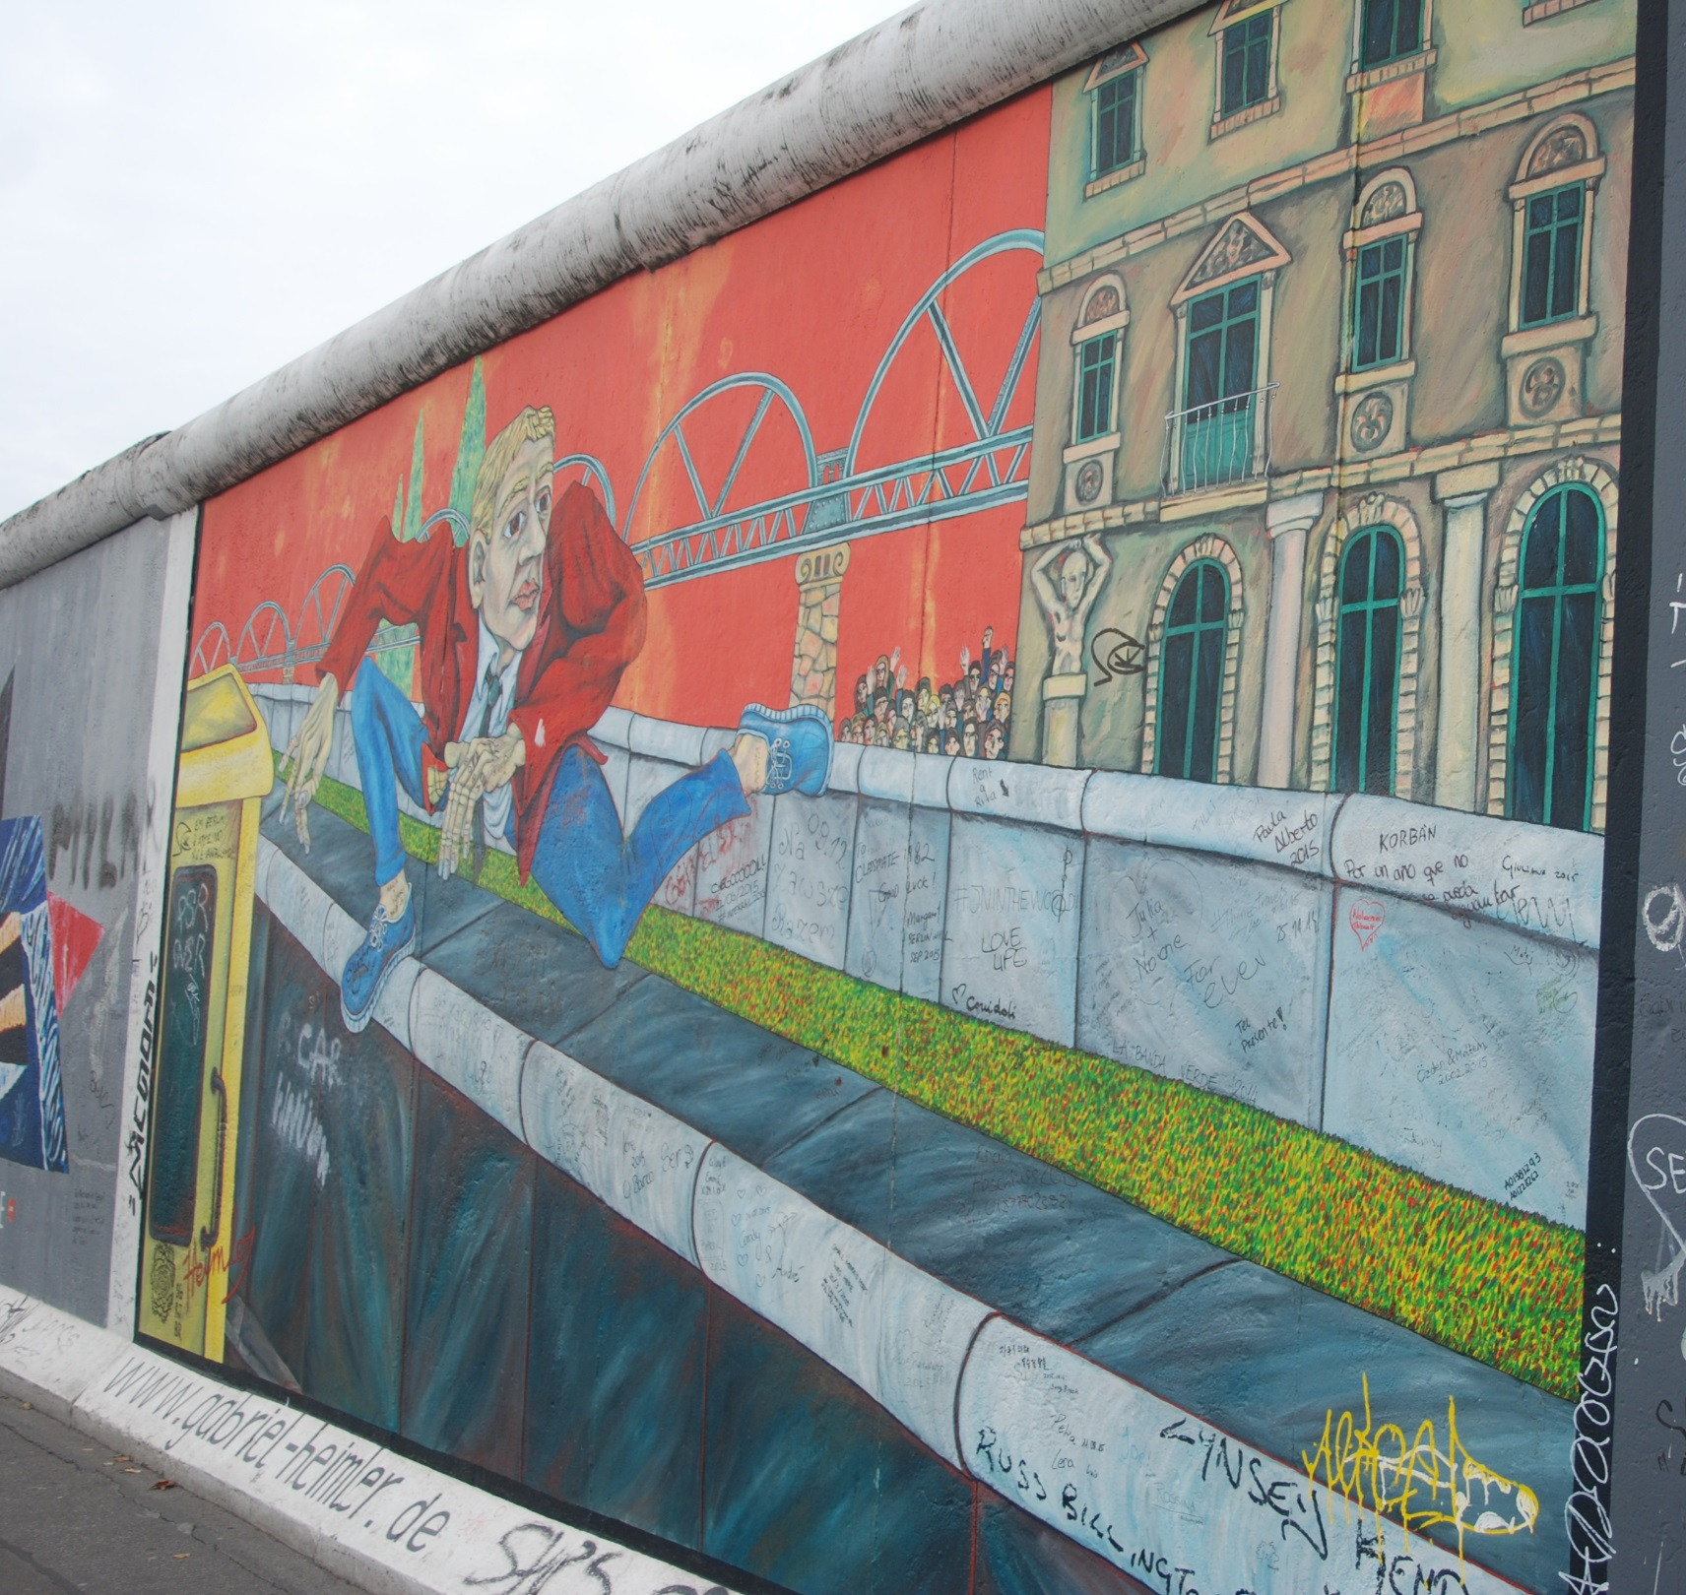
Before we start this lesson, here are some questions to consider:
What is the painting on?
What is this picture of?
What is the man thinking?
What do the two grey and black sections in the painting represent?
How big might this painting be? Imagine if you were standing next to it.

Slide 2
The painting is on a concrete wall – The Berlin Wall.
The picture is of a man escaping from one country to another.
The man looks like he is trying to find freedom.
The two grey and black sections in the painting represent the Berlin Wall. There were two parts to the Berlin Wall and more, which we’ll see in this presentation.
To see how big it was….

Slide 3
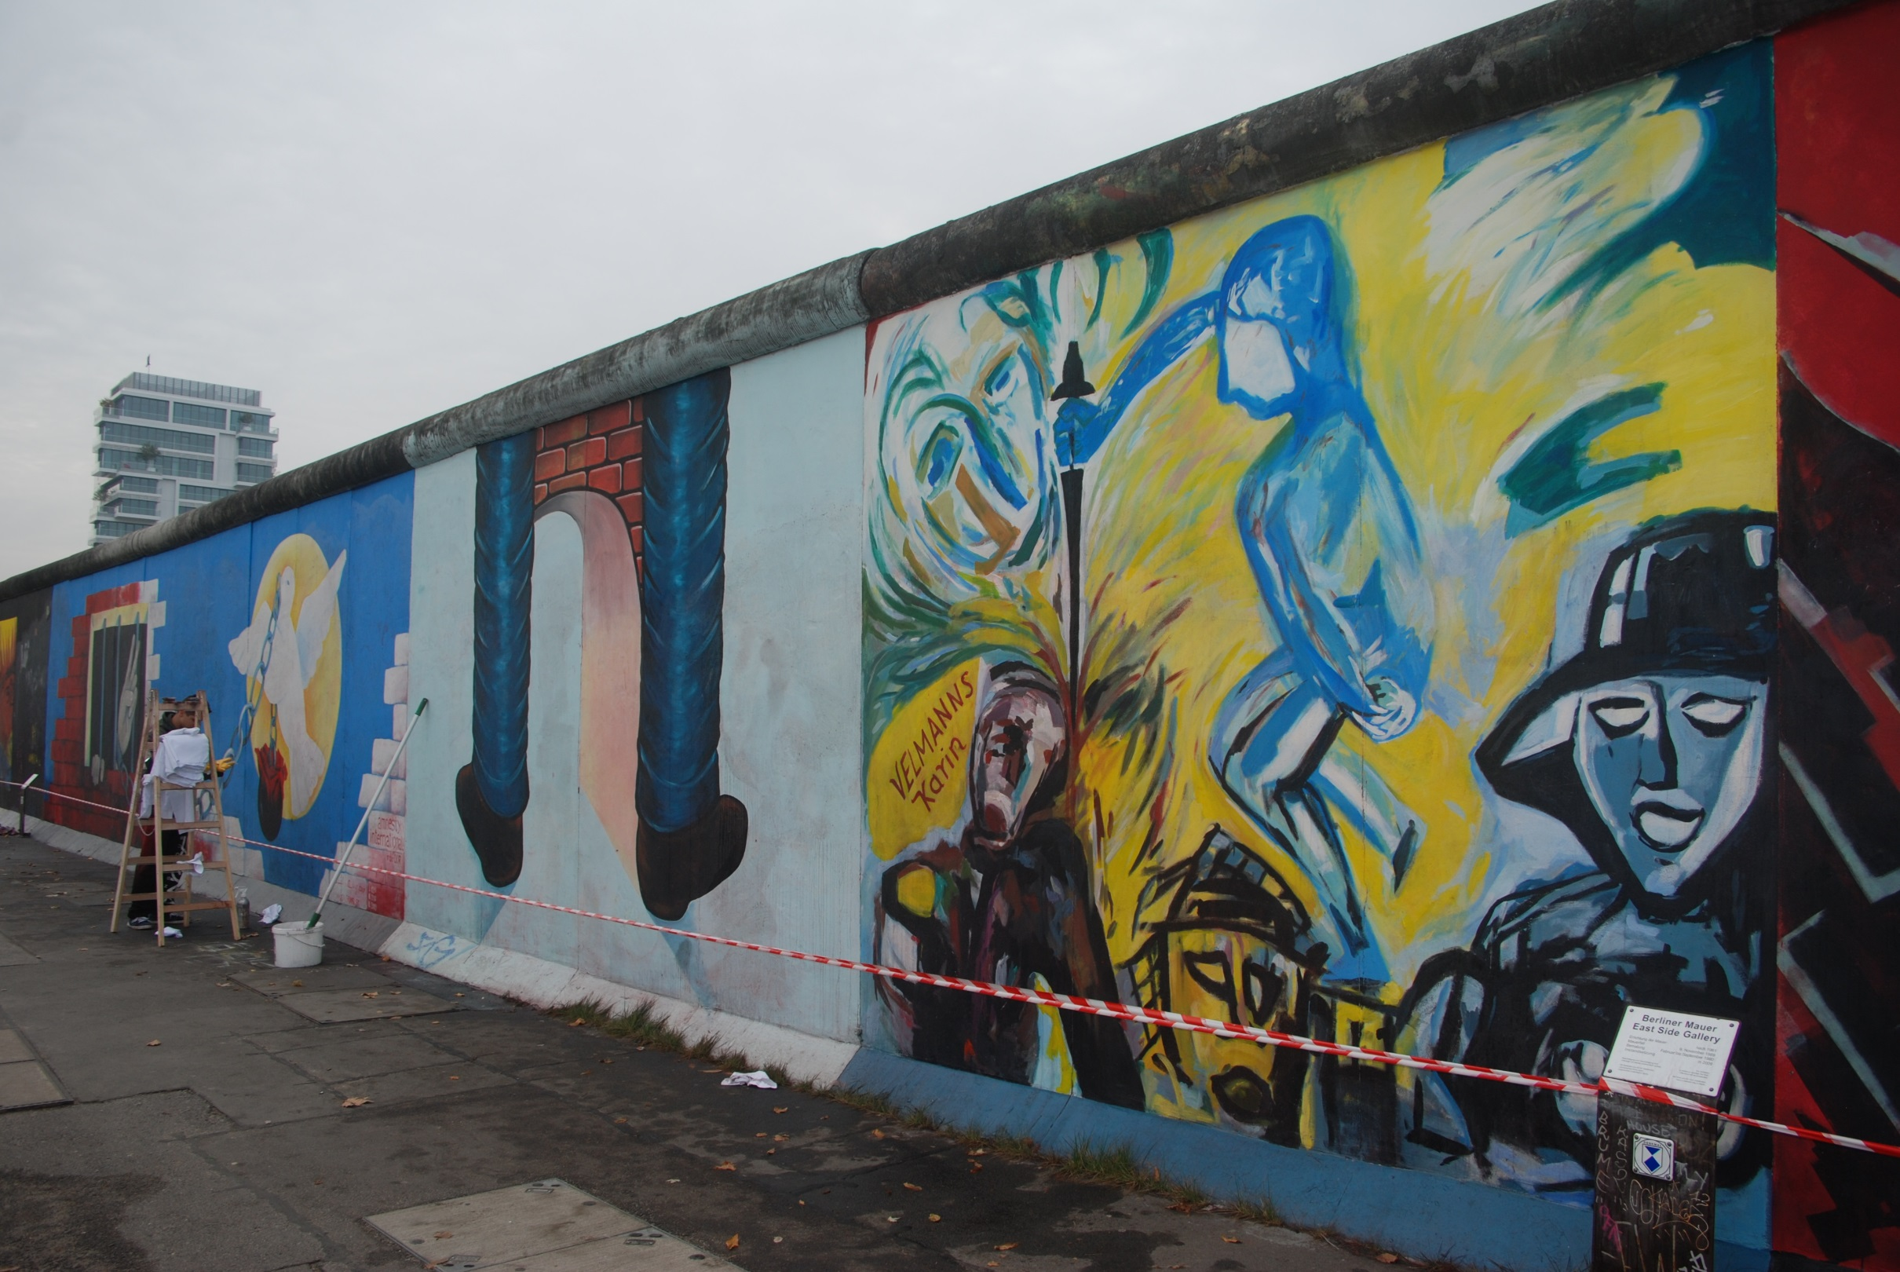
…..here is an artist repainting
a section of the Berlin Wall.
Between February and September 1990,
118 artists from 21 countries created 106 artworks
on a remnant of the Berlin Wall.
In the process, the East Side Gallery,
the world’s largest open-air gallery was created.

Slide 4
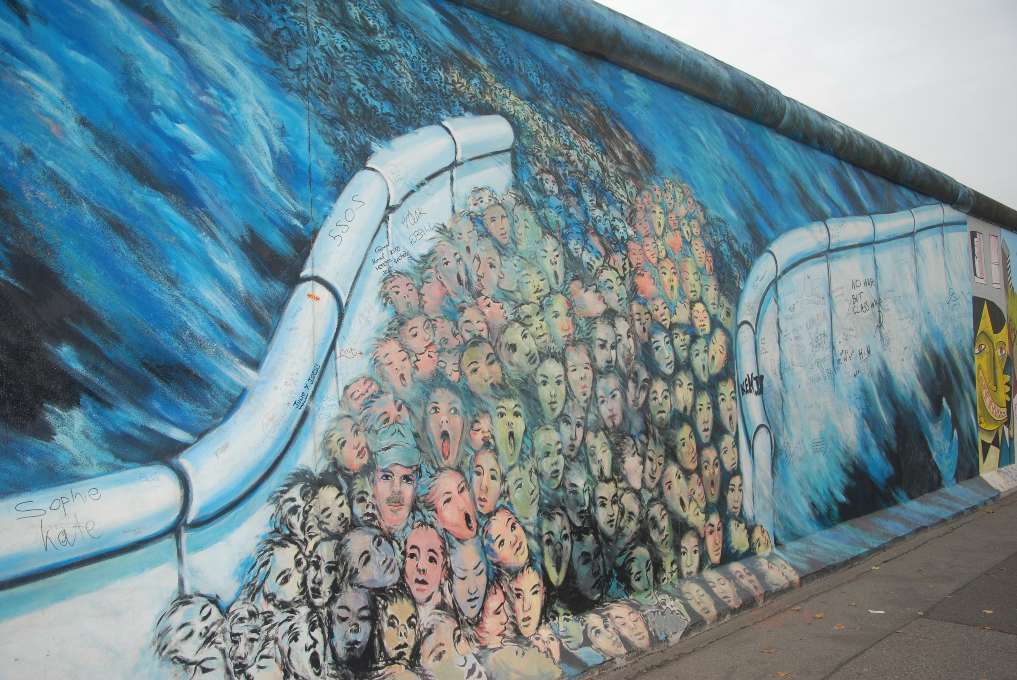
So if this is the Berlin Wall
in the present,
what happened in the past?

Slide 5
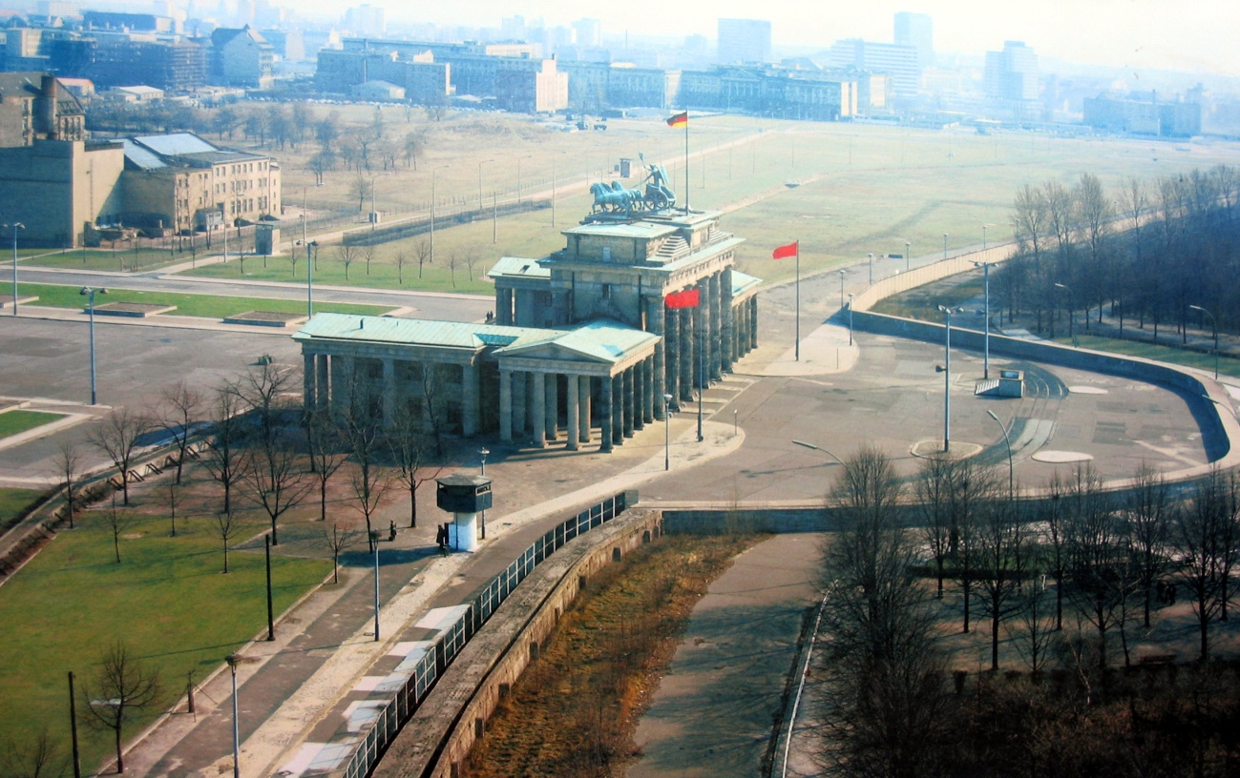
Our objective:
To learn about the events that led to the building and, eventually, the fall of the Berlin Wall.

Slide 6
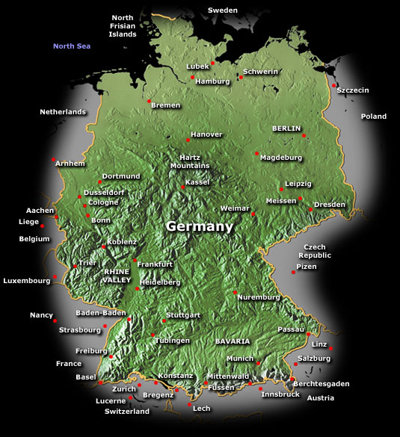
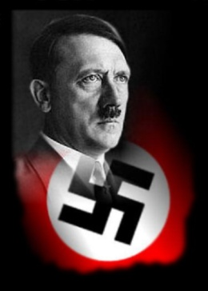
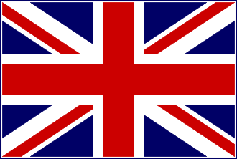
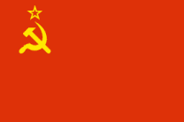
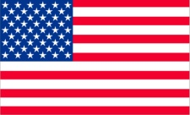
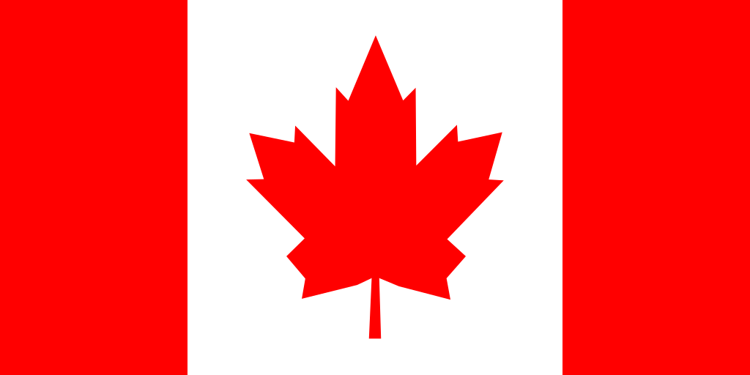

By 1945, the Second World War had gone on for nearly six years, but things were starting to change.
Following the success of D-Day, the Allied armies in Western Europe from Britain, France, Canada and the United States started to advance on Berlin
from the West.
Meanwhile , Soviet forces were attacking from the East, leaving Nazi Germany surrounded.
On the May 7th 1945 Germany officially surrenders. War in Europe was finally over.

Slide 7
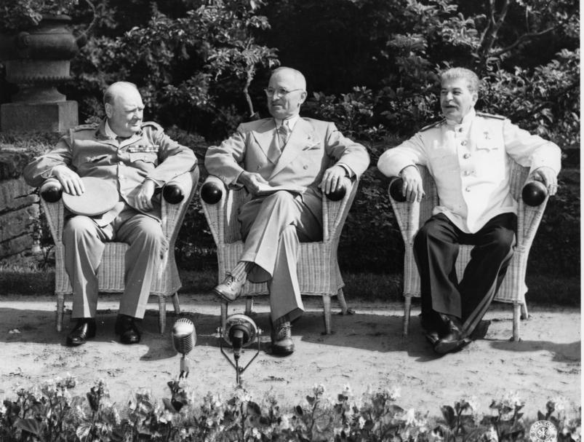
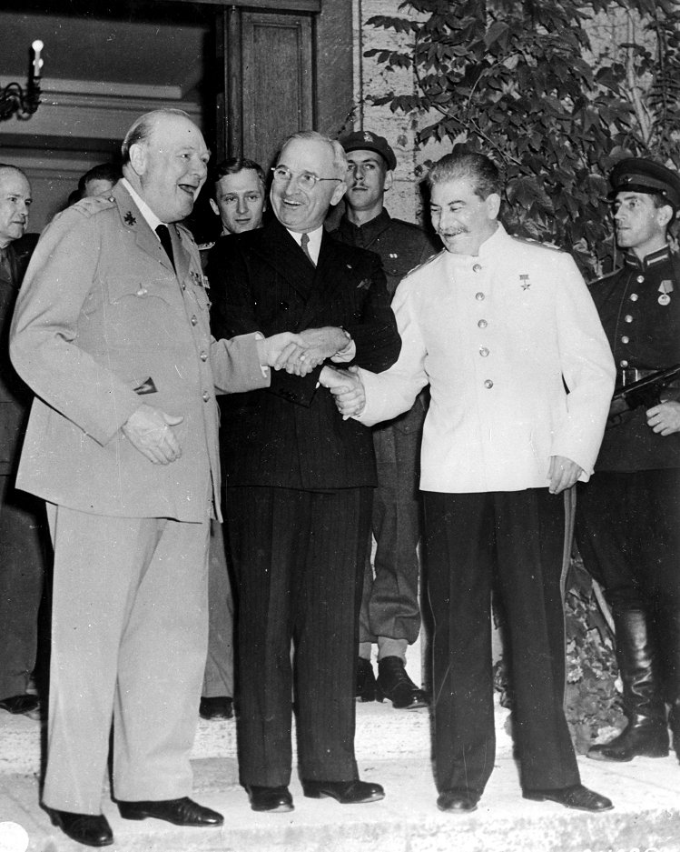
The Potsdam Conference
17th July – 2nd August 1945
Held near Berlin, the Potsdam Conference was attended by the Prime Minister of Great Britain, Winston Churchill, the new American president Harry S.Truman and the Premier of the Soviet union, Joseph Stalin. The conference discussed how to deal with Germany and Berlin.

Slide 8
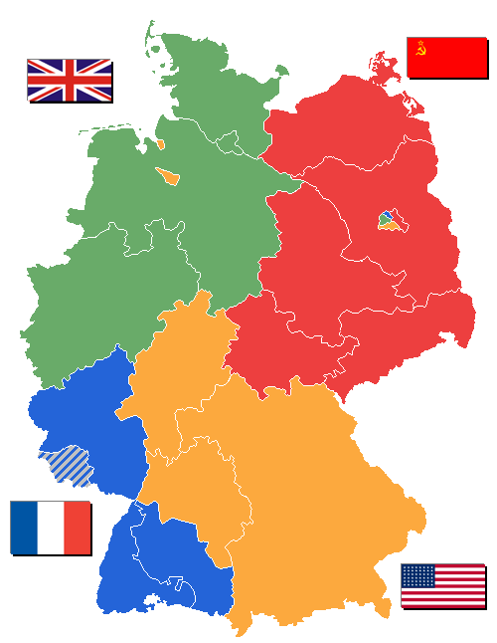
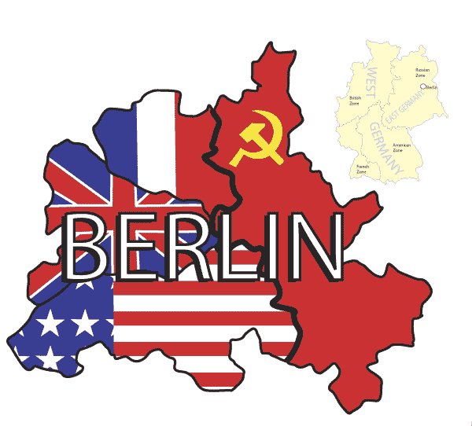
Germany and Berlin were divided into areas that would be ruled by the allies
British
Soviet
French
American

Slide 9
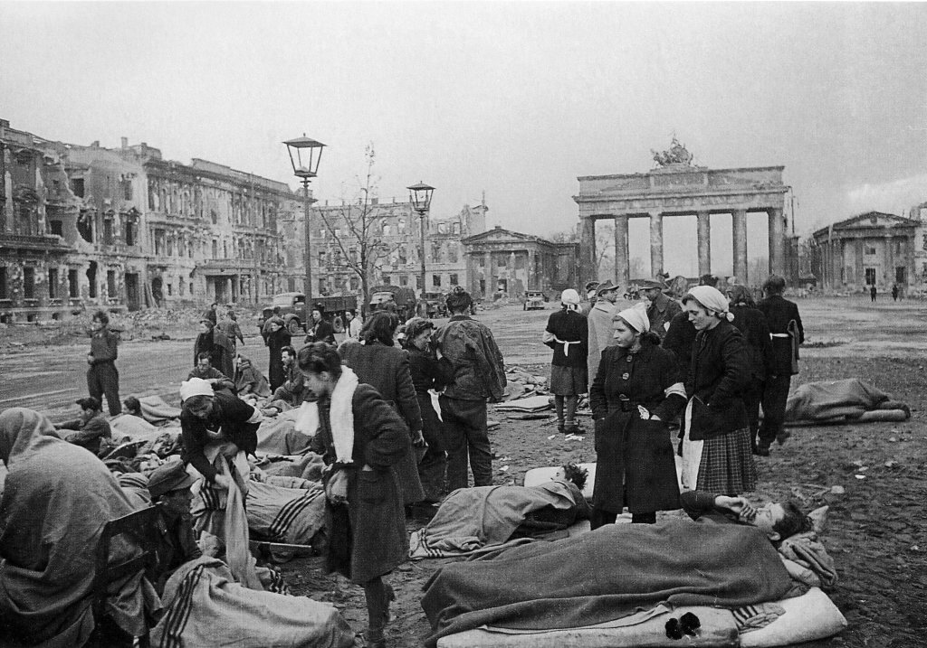
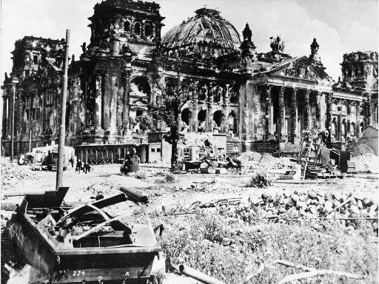
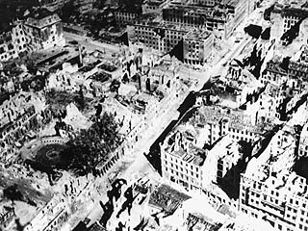
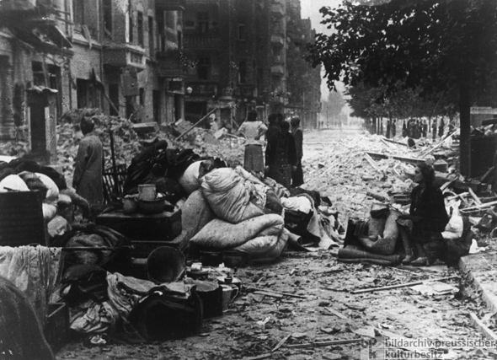
Berlin, 1945 – a city in ruins

Slide 10
Berlin in 1945
http://www.youtube.com/watch?v=oCXox3l7fWU&feature=related
‘Germany 1945 – the ruins’

Slide 11
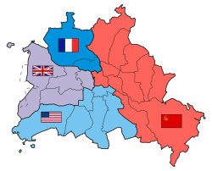
The Berlin Airlift
Between 1945 and 1949, the occupying powers focussed their
efforts on feeding the public and rebuilding the infrastructure in
their zones. People were allowed to move freely between the 4
zones.
However, Cooperation between the Allies broke down
in 1947.
The 3 Western powers decided to create a separate
WEST GERMAN government in their zones.
The Soviets were not happy with this and started causing trouble,
leading to the Berlin Blockade, starting on 24th June, 1948, when all
ground travel in and out of West Berlin was stopped by the Soviets.
The Western allies had to arrange an AIRLIFT to ensure that
supplies reached the people living in West Berlin because Berlin was
inside the section of Germany ruled by the Soviet Union.

Slide 12
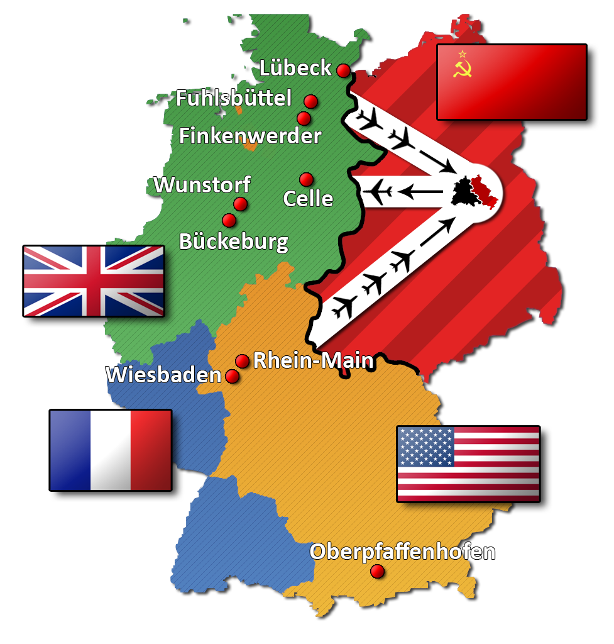
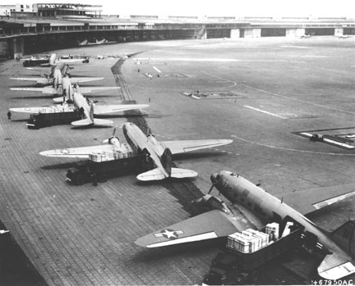
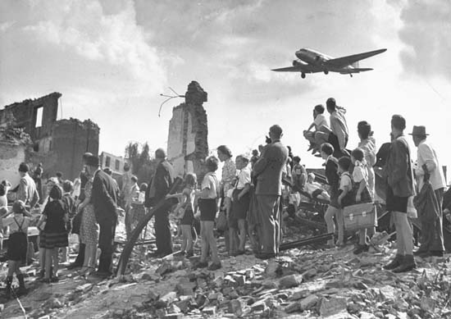

Slide 13
... Eventually, on May, 11th 1949, 11 months after it had began, the Soviets lifted the blockade.
Life soon returned to ‘normal’ in the occupied zones with people passing freely between East and West Berlin. Up to half a million people were crossing the border from one part of the city into the other daily. Many East Berliners went to the cinema or discos in the West, they even worked in the West or went shopping in the West.
It gradually became clear to many East Germans living under Soviet control that life was much better in the Allied occupied zones and millions began to leave the East.

Slide 14
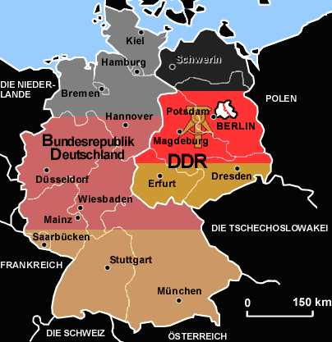
Divided Germany
Germany breaks into 2 separate countries in 1949 with 2 different flags.
The Federal
Republic of
Germany
(FRG)
The German
Democratic
Republic
(GDR)
Oct 1949
May 1949
Berlin is located
in the
German
Democratic
Republic
(GDR)

Slide 15
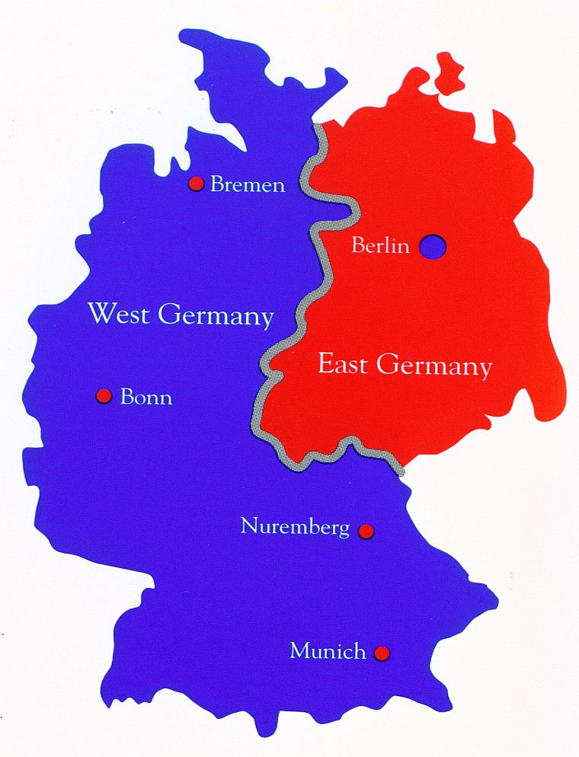
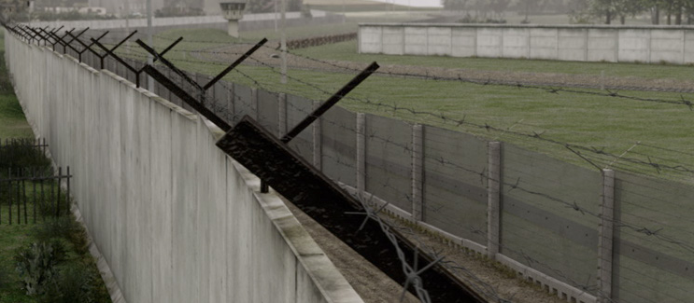
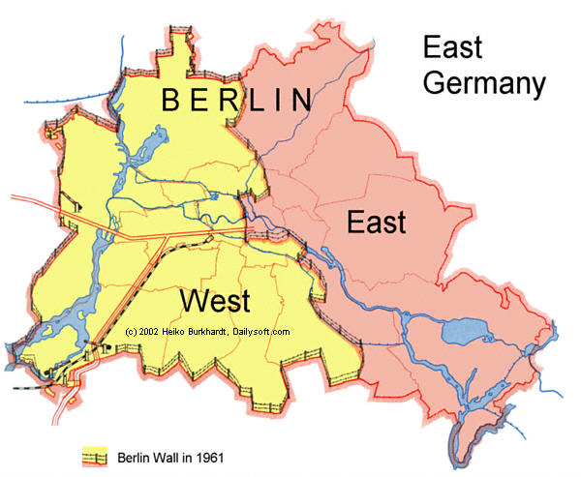
Travel between East and West Germany was not allowed. The border was closed from 1952 onwards and measured 866 miles in length. The border is the grey line.
However, people were still allowed to travel between East & West Berlin. This provided tens of thousands of people with an escape route to the West. Once in West Berlin people fleeing East Berlin/Germany could either remain in West Berlin or fly out to West Germany. East Germany had to stop this, so in 1961, the Berlin Wall began.

Slide 16
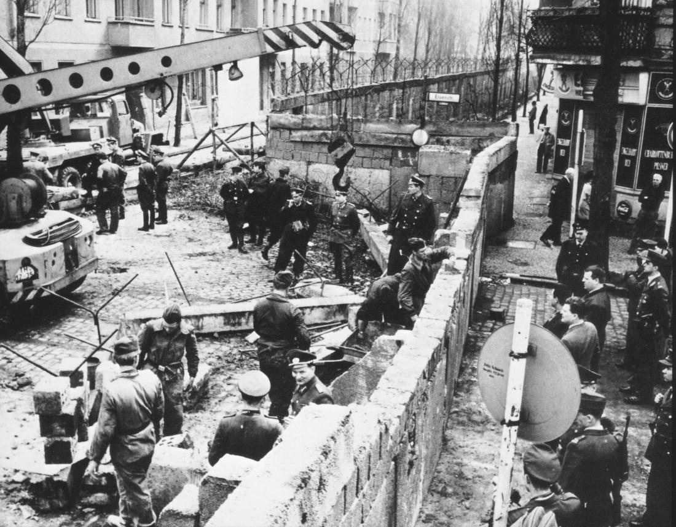
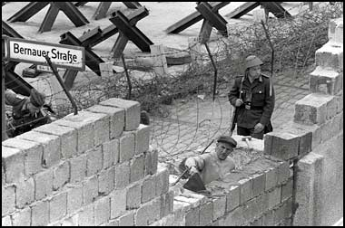
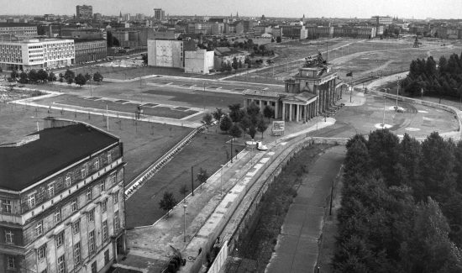
Building the Berlin Wall, 13th Aug 1961
Berliners woke up on 13th August to find themselves separated from friends, family, work and even their homes and in the coming weeks and months, the barrier was strengthened with concrete walls and guard towers.

Slide 17
Building the Berlin Wall
August 1961
http://www.youtube.com/watch?v=QwOfphFsUwM&feature=related
‘The Berlin Wall is built’

Slide 18
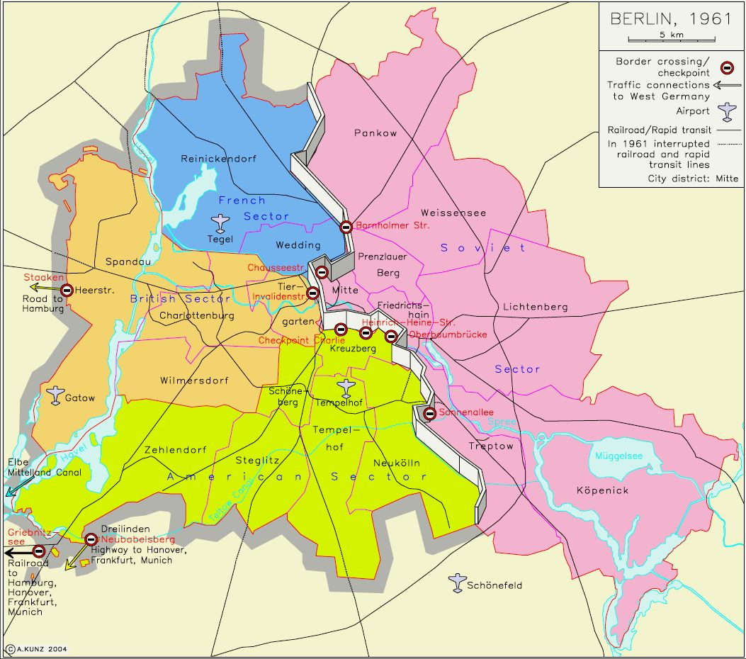
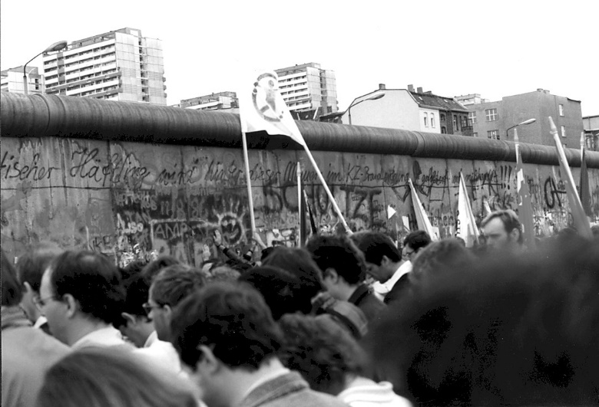
Total length
around West
Berlin 96 miles ( the grey line)
Border between
East & West
Berlin 27 miles (the white divide down the centre)
Concrete Wall
3.6 metres high
Wire mesh fencing 41 miles
THE
FACTS:
Anti-vehicle trenches: 65 miles
Number of watch towers: 302
Persons killed on Berlin Wall: 192
Persons injured by shooting: approx. 200

Slide 19
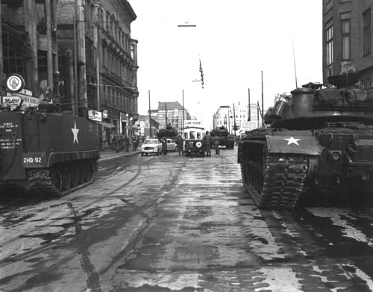
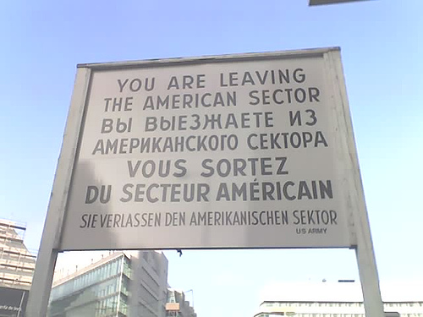
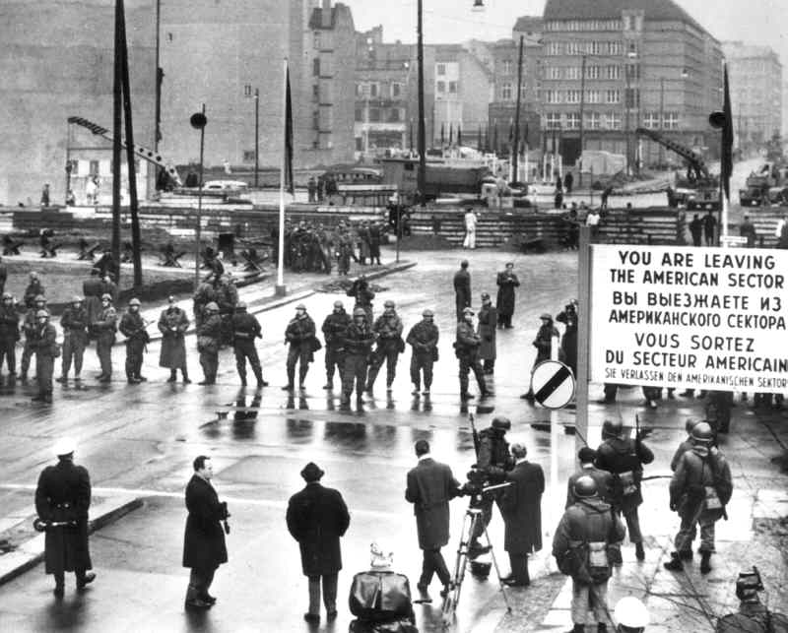
Travelling between East and West
Most people could not travel to the West, but there was one group of Berliners that crossed without risking their lives – the 50,000 Grenzgängers – who were permitted to work in the West, with its larger salaries, capitalist economy and political freedoms.

Slide 20
In total, about 5,000 people are thought to have escaped East Germany by crossing the wall – including more than 1,300 guards.
Escape Attempts
http://www.youtube.com/watch?v=DQHk-i3tCoE

Slide 21
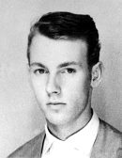
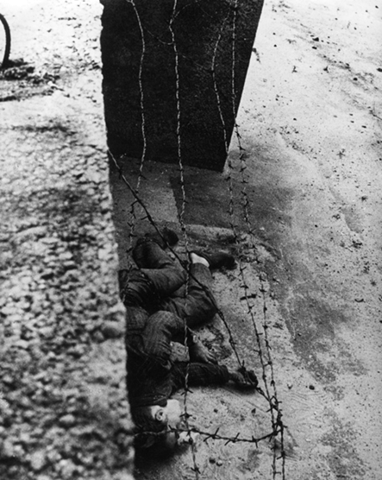
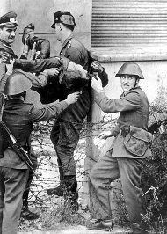
Peter Fechter
Fechter was shot and killed trying to cross the Berlin Wall from East to West just over a year later on August 17th 1962. He was shot in the back by GDR Boarder Guards and fell to the base of the wall in the "death zone". Bystanders in the West tried to rescue him, but were prevented from doing so at gunpoint. He was left to bleed to death and his body was removed an hour later.

Slide 22
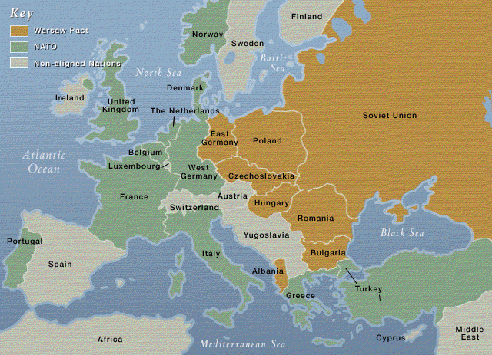
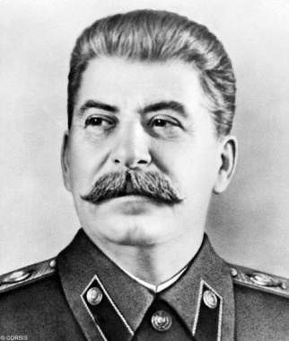

The division did not
only affect
Germany,
but the whole of Europe was divided by the ‘Iron Curtain’.
The Iron Curtain was a barrier erected by the Soviet Union to seal off the East from open contact with the West.
‘Iron Curtain’

Slide 23
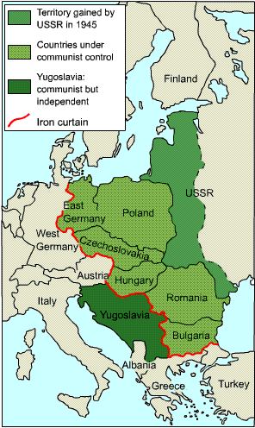
Protests & Demonstrations
In the late 1980s a series of radical political changes took place in some Eastern Bloc countries (Poland & Hungary), allowing their citizens greater freedoms.
In August 1989 Hungary opened its border with Austria. During September 1989 more than 13,000 East Germans travelled to the open border and crossed into Austria and the West.
To stop this, the East German Government ordered the Hungarians to stop more East Germans crossing the border. At the same time the East German Government stopped all travel between East Germany and Hungary.

Slide 24
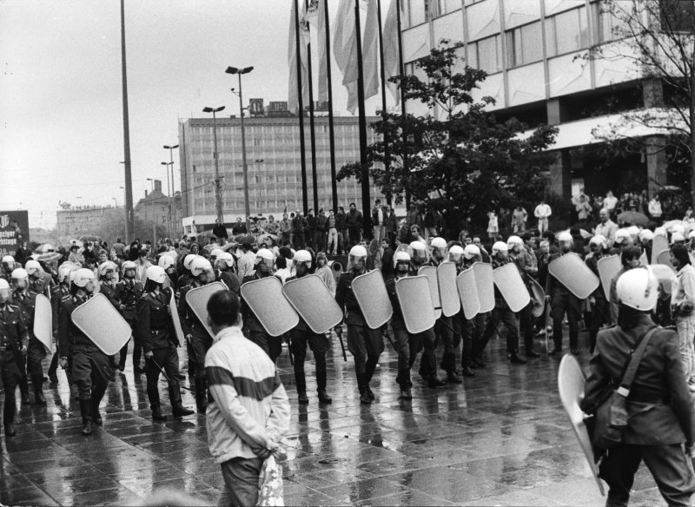
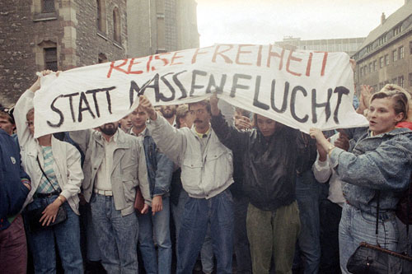
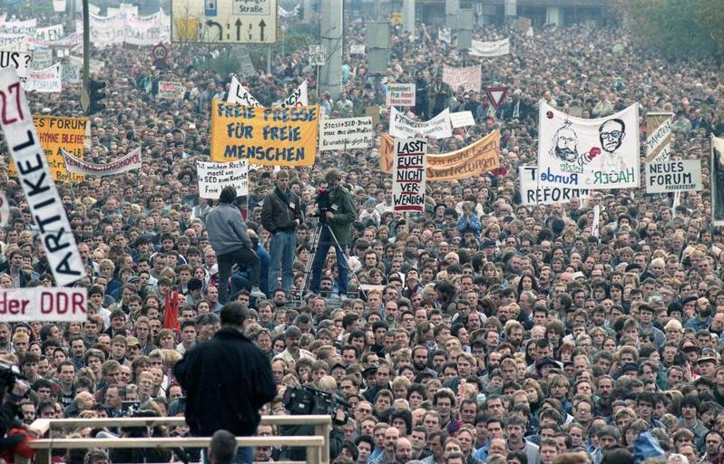
In cities all over East Germany protest demonstrations broke out against the Regime. People were calling for greater freedoms; freedom to travel, free elections & the freedom to take control of their own lives.
The biggest demonstration took place on 4th November 1989 in East Berlin’s largest public square ‘Alexanderplatz’.
The East German Government realised that the mass demonstrations could not be brought under control using force & on 9th November the decision was taken to allow East German citizens to travel freely between East & West Germany, including Berlin.

Slide 25
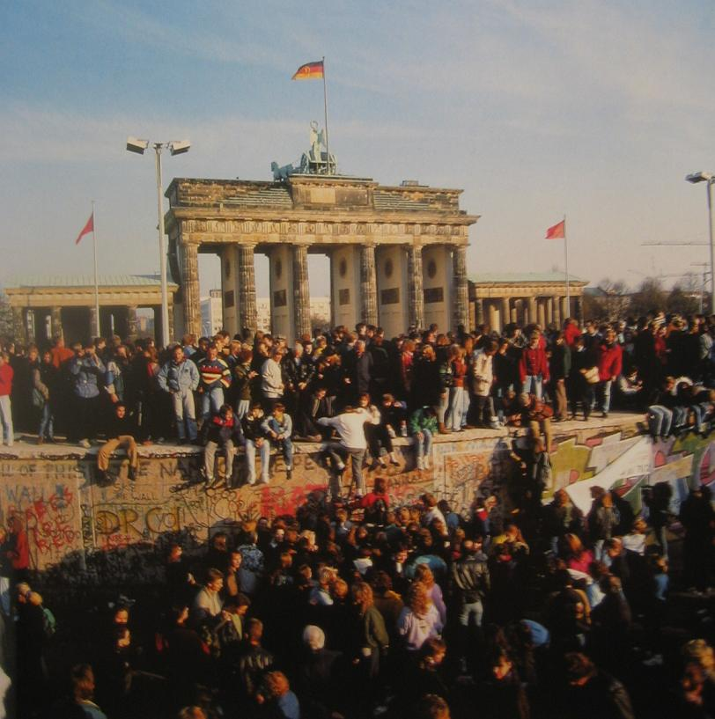
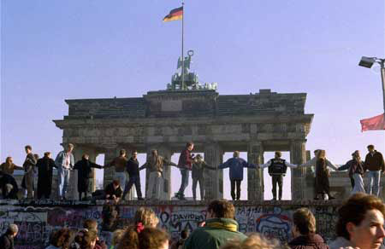
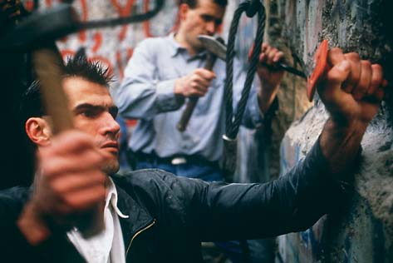
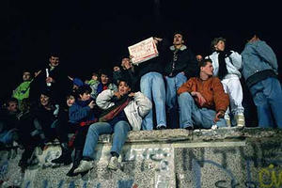
The Fall of the Berlin Wall, 9th Nov 1989

Slide 27
Consequences
The Berlin Wall divided many families
Many East Berliners were unable to commute to their jobs in the West
West Berliners demonstrated against the Wall
The East German government claimed the Wall was an ‘anti-fascist protection barrier’
During the Wall’s existence there were around 5000 successful escapes into West Berlin
Varying reports claim that either 192 or 239 people were killed trying to cross the wall and many more were injured.

Slide 28
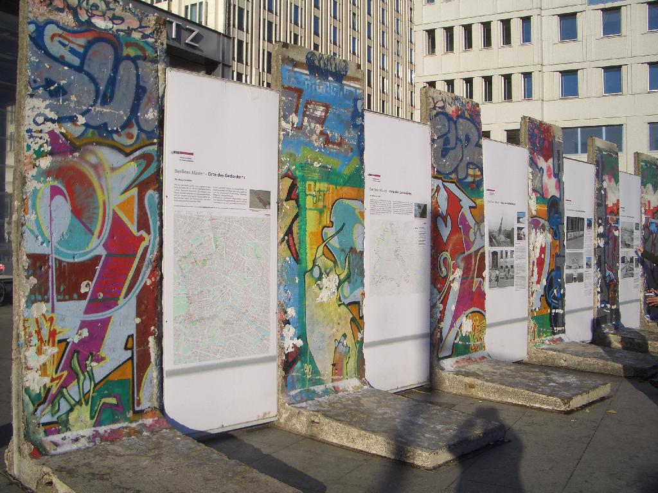
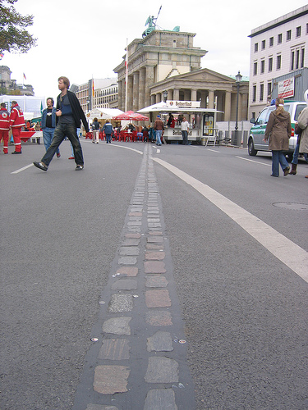
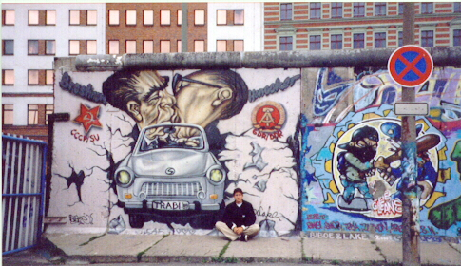
And where is the Wall now?

