Slide 1
Year 9 French TERM 5: Studio 2 textbook, chapter 5
If pupils are absent from lessons they should spend time revising and learning vocabulary. All of the vocabulary for this term is on the following slides. First of all, they should recap the vocabulary which they learned the previous week. Then they should start to learn the next section of vocabulary which they have not yet covered in class. This could be done by using the look, cover, write, check method or by making flashcards etc.
Pupils can also revise vocabulary on Linguascope-
Username is kingshill password is love4langs
Any new vocabulary they learn can be written in their orange books or on paper.
If pupils wish to do extension work they can access free MFL lessons on the Oak National Academy website:
https://classroom.thenational.academy/subjects-by-key-stage

Slide 2
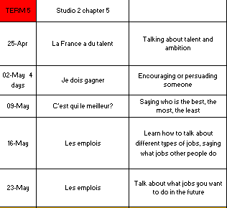

Slide 3
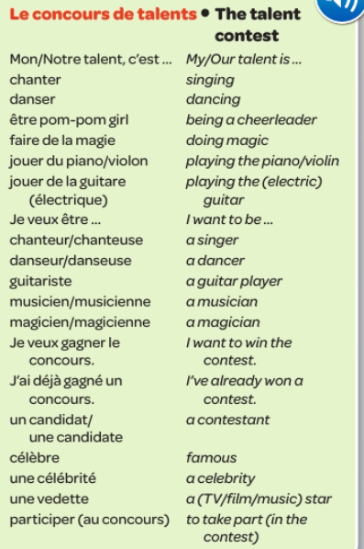
Week 1 –vocab
Read through the vocabulary for this week and spend a good amount of time trying to learn it. You will need these words to complete the tasks on the next few slides.

Slide 4
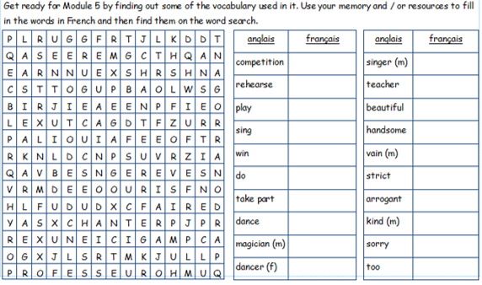

Slide 5
Read the text and complete the sentences below.

Slide 6
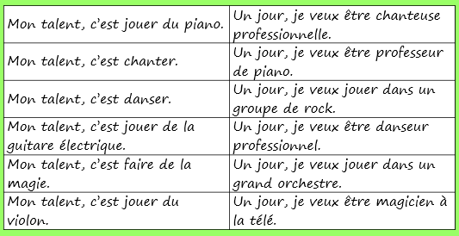
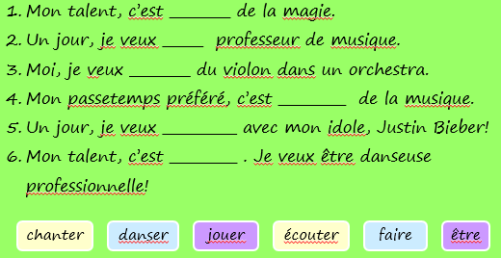
Match up the French and the English expressions.
Copy down each sentence and complete with the correct verb.

Slide 7
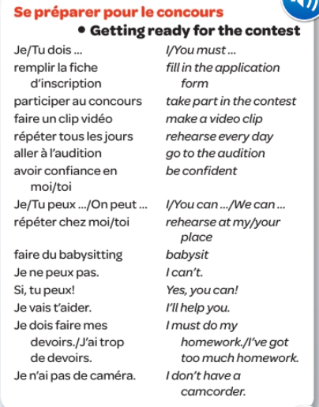
Week 2 –vocab
Read through the vocabulary for this week and spend a good amount of time trying to learn it. You will need these words to complete the tasks on the next few slides.

Slide 8
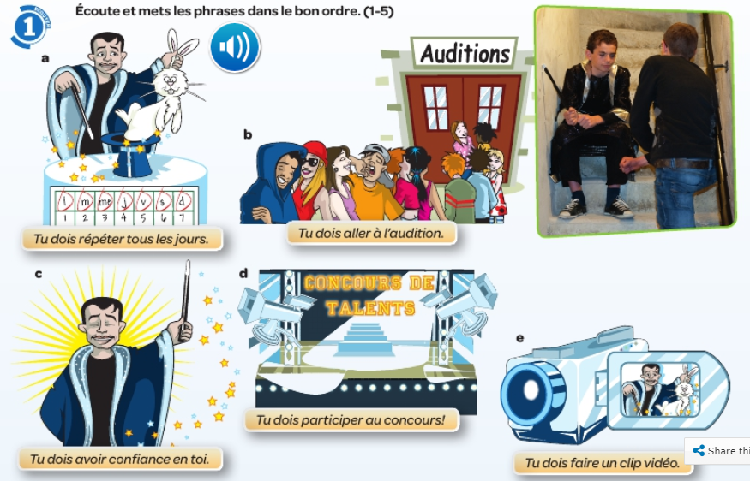
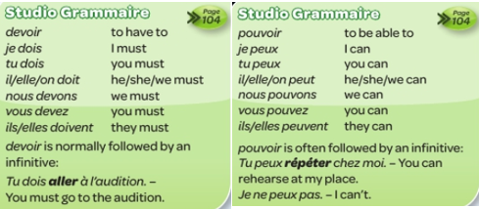
Listen and put the sentences into the correct order.
Copy down the verbs Devoir and Pouvoir.

Slide 9
Read the emails and for each question write the name of the relevant person.

Slide 10
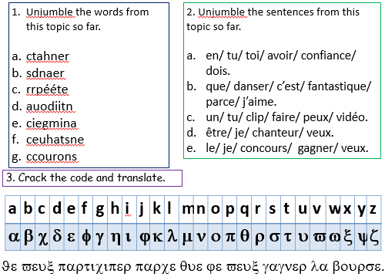

Slide 11
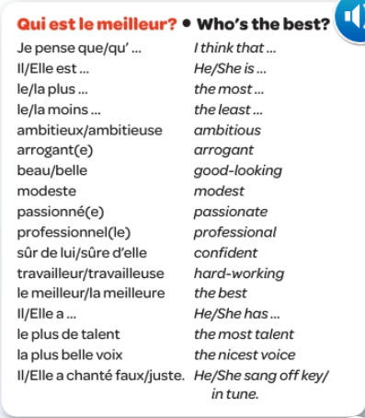
Week 3 –vocab
Read through the vocabulary for this week and spend a good amount of time trying to learn it. You will need these words to complete the tasks on the next few slides.
Click on the link to revise the vocab:
https://quizlet.com/_b8yeir?x=1qqt&i=1jjrw5

Slide 12
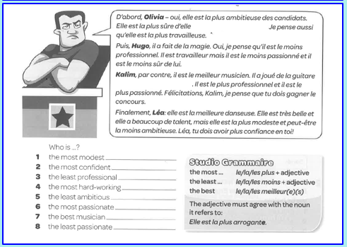
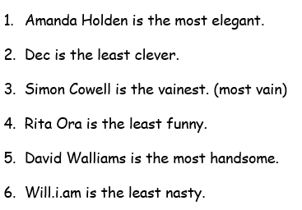
Read the text and answer the questions.
Then, translate the sentences below.

Slide 13
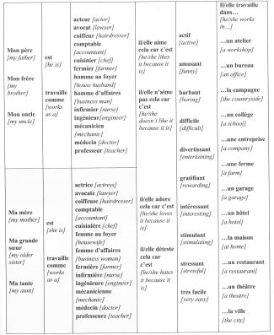
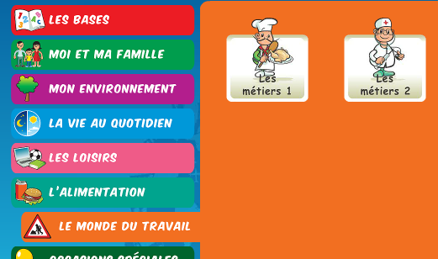
Week 4 –vocab
Play some games on Linguascope to practice the different types of jobs.

Slide 14
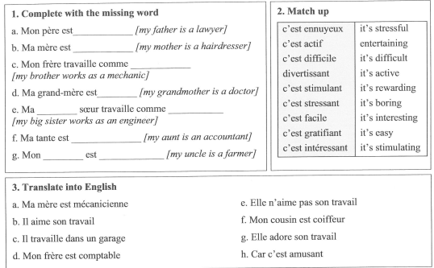

Slide 15
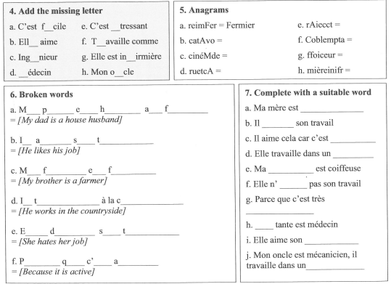

Slide 16
Week 5 –vocab
Play some games on Linguascope to practice the different types of jobs.

Slide 17
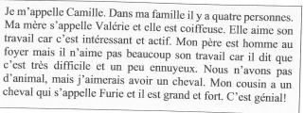
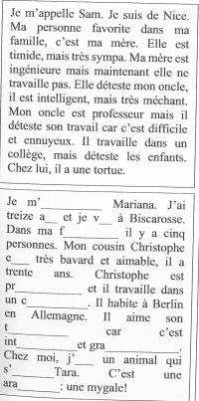
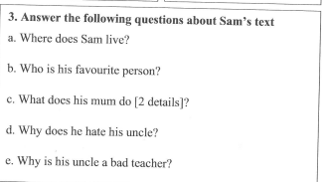
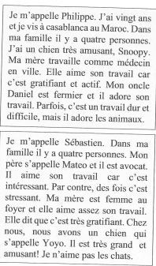
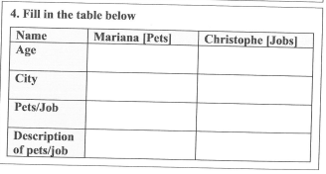

Slide 18
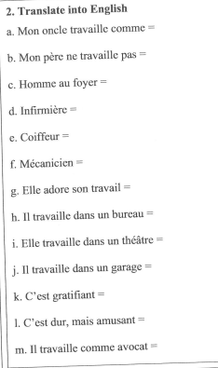
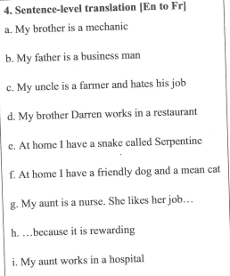
Translate the following sentences.

