Slide 1
Year 8 Spanish TERM 5: Viva 1 textbook, chapter 5
If pupils are absent from lessons they should spend time revising and learning vocabulary. All of the vocabulary for this term is on the following slides. First of all, they should recap the vocabulary which they learned the previous week. Then they should start to learn the next section of vocabulary which they have not yet covered in class. This could be done by using the look, cover, write, check method or by making flashcards etc.
Pupils can also revise vocabulary on Linguascope-
Username is kingshill password is love4langs
Any new vocabulary they learn can be written in their orange books or on paper.
If pupils wish to do extension work they can access free MFL lessons on the Oak National Academy website:
https://classroom.thenational.academy/subjects-by-key-stage

Slide 2
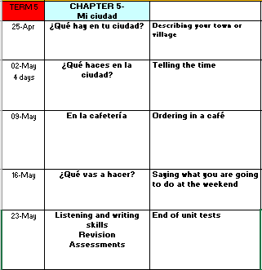

Slide 3
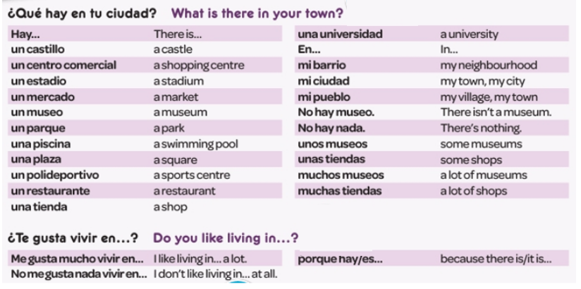
WEEK 1 –
Read through the vocabulary for this week and spend a good amount of time trying to learn it. You will need these words to complete the tasks on the next few slides.

Slide 4
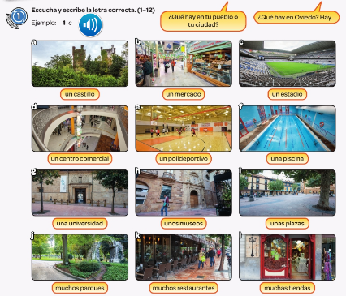
Listen to the recording. Which place is mentioned?
Example 1c

Slide 5
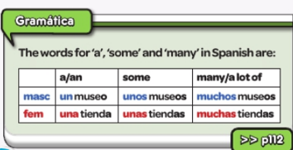
Copy out the grammar.

Slide 6
Listen to the recording. What is there in town and what isn’t there in town?
Example below.

Slide 7
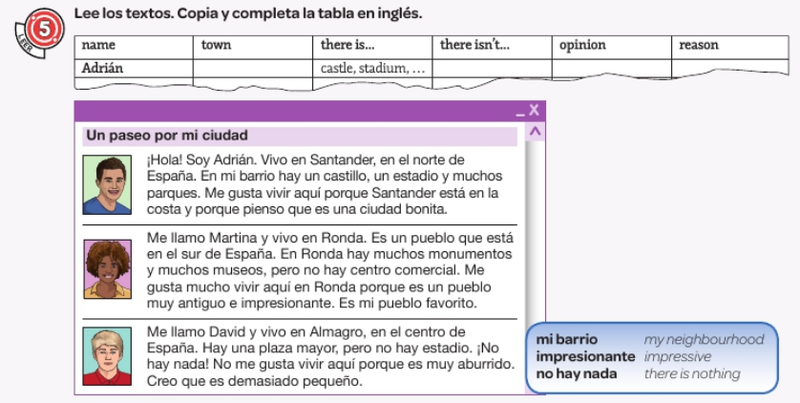
Read the texts. Copy the table and complete it in English.

Slide 8
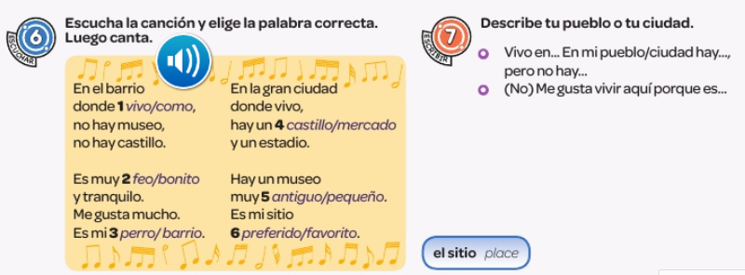
Write down 1-6. Listen to the recording. Which word do you hear? There is a choice of two words each time.
Translate the song in to English.

Slide 9
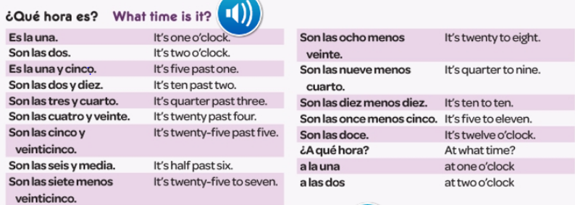
WEEK 2 –
Read through the vocabulary for this week and spend a good amount of time trying to learn it. There are more words on the next slide too. You will need these words to complete the tasks on the next few slides.

Slide 11
Follow the link to BBC Bitesize. Watch the video about telling the time in Spanish to remind yourself how it works.
https://www.bbc.co.uk/bitesize/topics/zfgt6v4/articles/zmftwty

Slide 12
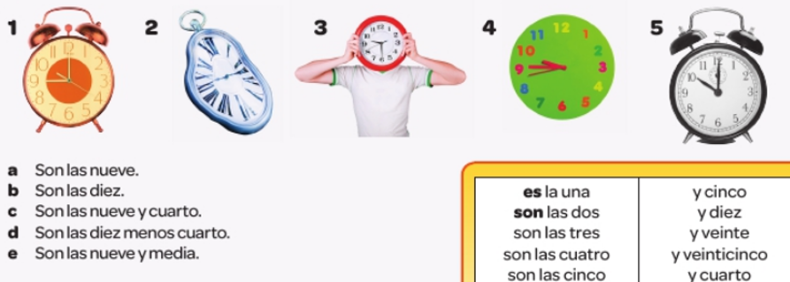
Write down 1-5. Match the five clocks with the times a-e.
Listen to the recording to check your answers.

Slide 13
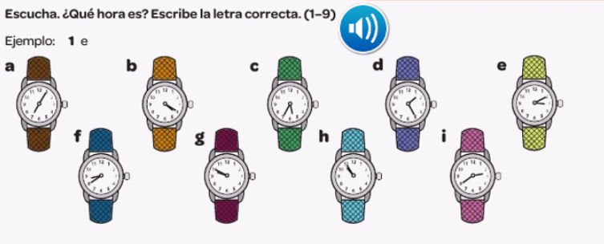
Write down 1-9. Listen to the recording and match the 9 times you hear with the watches a-i.
Example, 1e

Slide 14
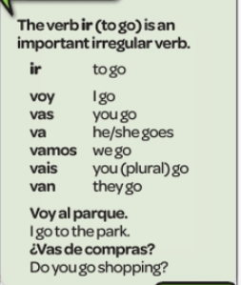
Copy out the grammar below.

Slide 15
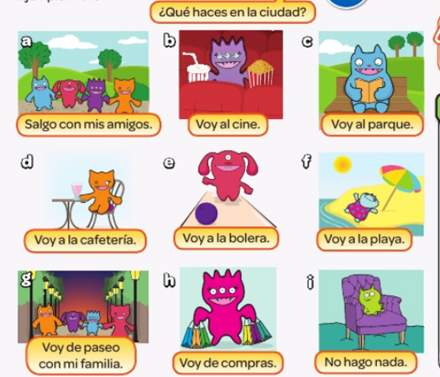
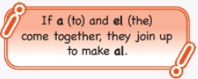
Write down 1-9. Listen to the recording. Which activity do they say you can do in their town.
Example – 1b

Slide 16
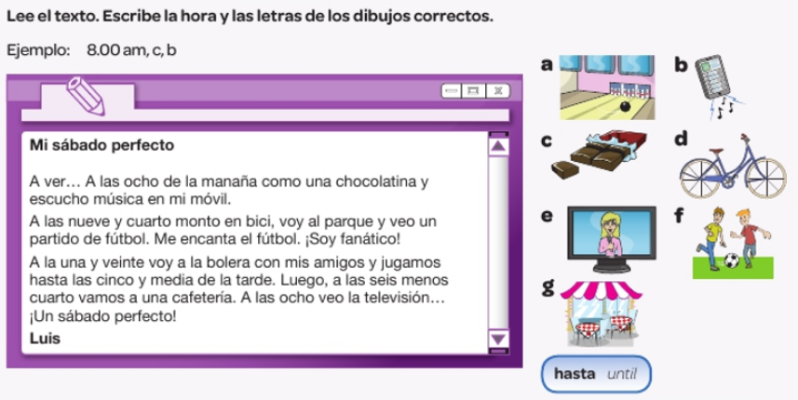
Read the text. Write the times and say which activities they do a-g
Example – 8am, c, b

Slide 17
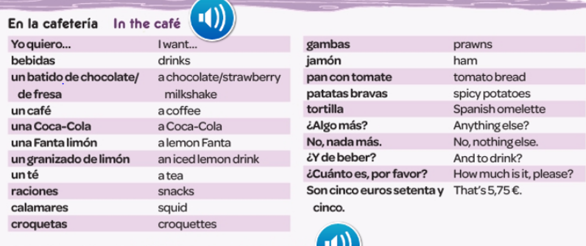
WEEK 3 –
Read through the vocabulary for this week and spend a good amount of time trying to learn it. You will need these words to complete the tasks on the next few slides.

Slide 19
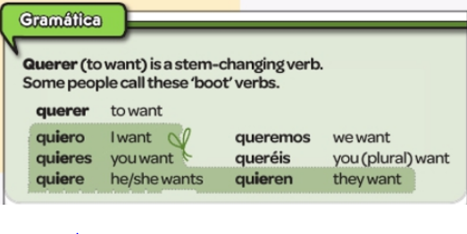
Listen to the recording and check your answers from the previous task.
Copy the grammar notes below:

Slide 21
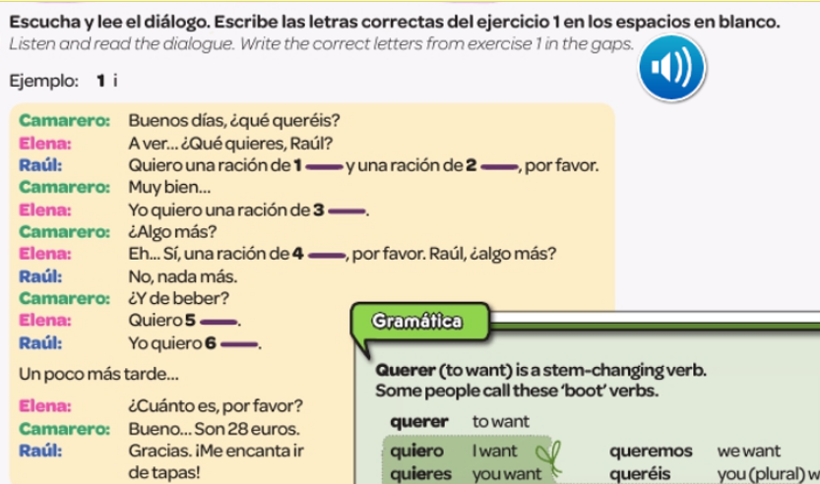
Listen to the recording below. Fill in the gaps in the conversation. What do they order?
Example 1) Calamares

Slide 22
Log on to Linguascope and practise food vocabulary. Look in the beginner section):
Username – kingshill password – love4langs

Slide 23
WEEK 4 –
Read through the vocabulary for this week and spend a good amount of time trying to learn it. You will need these words to complete the tasks on the next few slides.

Slide 24
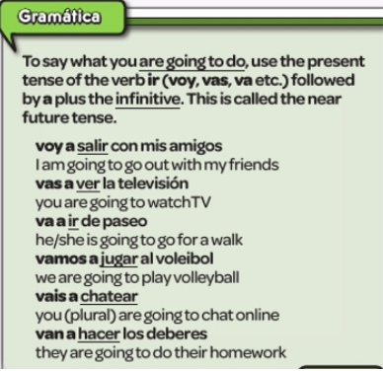
Copy out the grammar notes.

Slide 25
Listen to the recording and follow the story. Make bullet point notes in English of what you understand.

Slide 26
Copy out the table and listen to the recording. What are they going to do this weekend? Fill in the information in Spanish. You need to say when they are doing the activity and what it is. The first one is done for you.

Slide 27
Pretend you are a famous person. Say what you are going to do on Saturday. Ideas and sentences starters are below.

Slide 28
WEEK 5 –
There are only a few new words to look at this week. You will need to refer to the vocabulary sheet in your book or the vocabulary on the previous slides to help you with the revision tasks on the following slides.

Slide 29
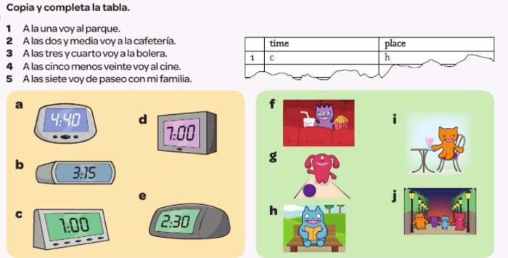
Copy and complete the table. Read the 5 sentences and choose the correct clock time (a-e) and activity (f-j)

Slide 30
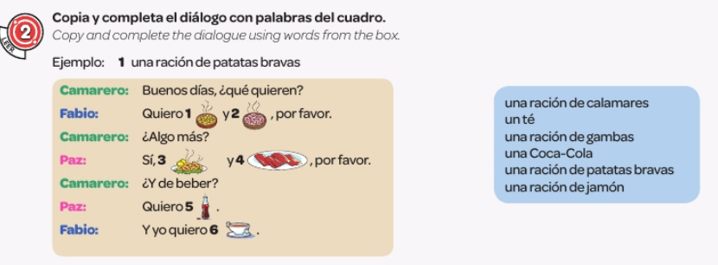

Slide 33
Read the text and answer the questions in English

