Slide 1
Year 8 German TERM 5: Echo 2 textbook, chapter 1
If pupils are absent from lessons they should spend time revising and learning vocabulary. All of the vocabulary for this term is on the following slides. First of all, they should recap the vocabulary which they learned the previous week. Then they should start to learn the next section of vocabulary which they have not yet covered in class. This could be done by using the look, cover, write, check method or by making flashcards etc.
Pupils can also revise vocabulary on Linguascope-
Username is kingshill password is love4langs
Any new vocabulary they learn can be written in their orange books or on paper.
If pupils wish to do extension work they can access free MFL lessons on the Oak National Academy website:
https://classroom.thenational.academy/subjects-by-key-stage

Slide 2
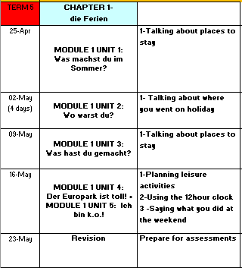

Slide 3
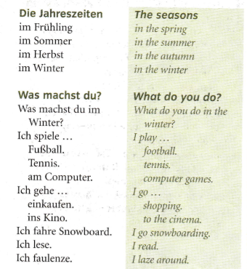
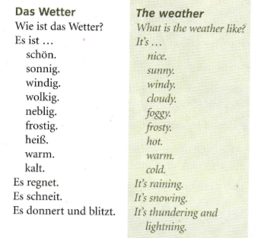
Read through the vocabulary for this week and spend a good amount of time trying to learn it. You will need these words to complete the tasks on the next few slides.
WEEK 1 –

Slide 4
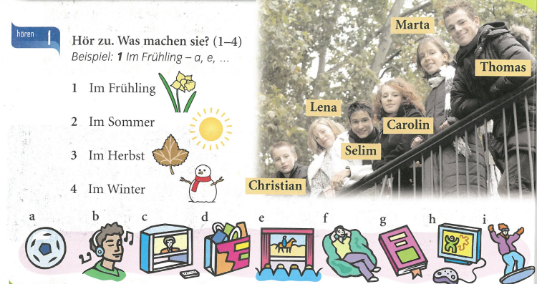
Listen to the recording. Which activities do they like doing in each season? Example is below.

Slide 5
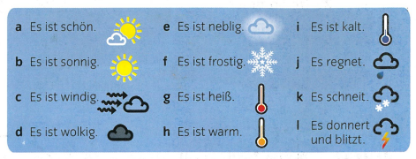
Make a poster of the weather phrases in your books.

Slide 6
Listen to the recording. Which places is mentioned and what is the weather like?
Example: 1) Hamburg - g

Slide 7
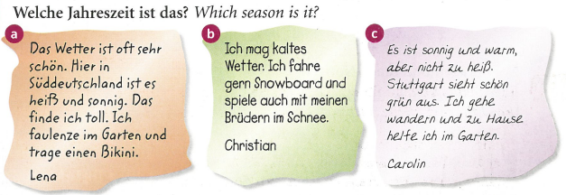
Which season is being described?

Slide 8
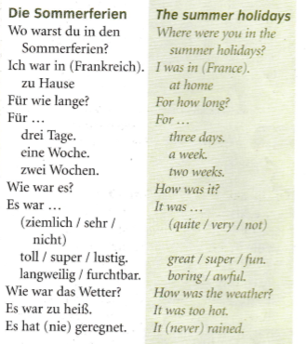
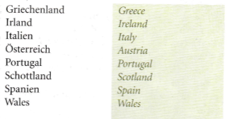
Read through the vocabulary for this week and spend a good amount of time trying to learn it. You will need these words to complete the tasks on the next few slides.
WEEK 2

Slide 9
Match up the pictures with the countries listed on the right hand side.

Slide 10
Listen to the recording. Write down 1-8. Where did they go on holiday and how long did they go for? Write your answers in English.
Example is below.

Slide 11
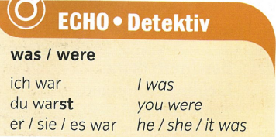
Copy down the following:

Slide 12
Listen to the recording. Copy out the table and complete it in German. How long did they go on holiday for? Where did they go? What is their opinion? How was the weather? The first one is done for you.

Slide 13
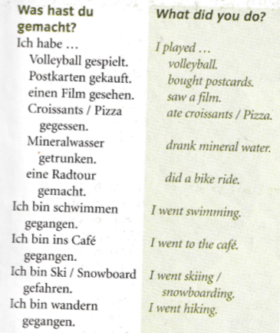
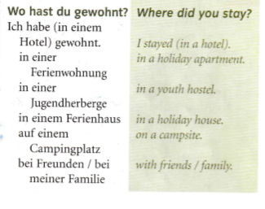
WEEK 3 –
Read through the vocabulary for this week and spend a good amount of time trying to learn it. You will need these words to complete the tasks on the next few slides.

Slide 14
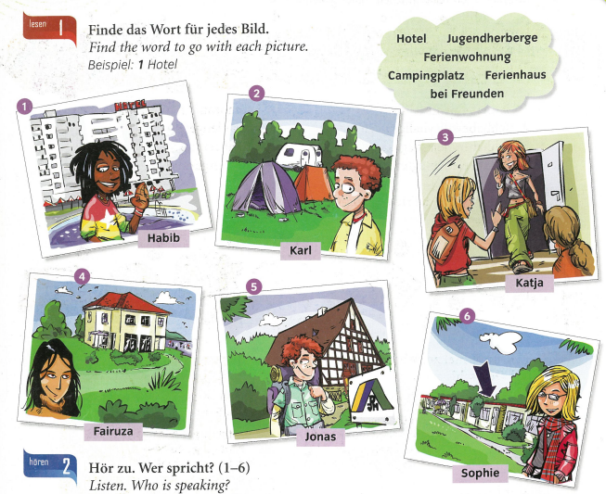
Match the 6 pictures with the accommodation words
In the cloud at the top of the slide.

Slide 15
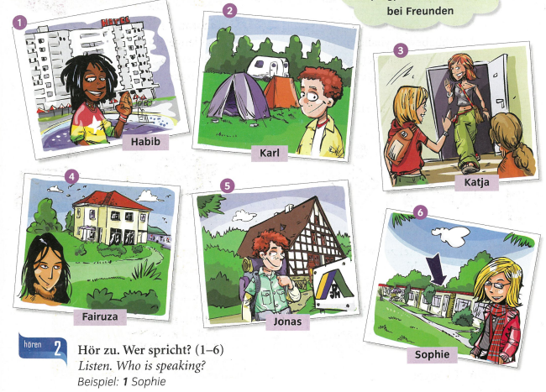
Listen to the recording. Who is talking?
Example, 1) Sophie

Slide 16
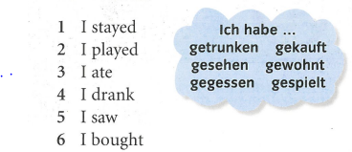
Match up the English with the German.

Slide 17
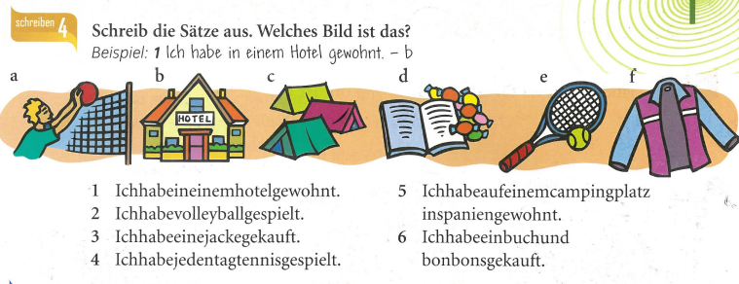
Write out the sentences correctly (add in the gaps and the capital letters). Then match them up to the pictures.
Example – 1) Ich habe in einem Hotel gewohnt - b

Slide 18
Listen to the recording. Write the correct order in which they happen.
Example, I, b …

Slide 19
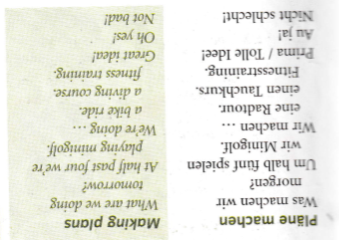
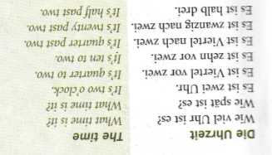
WEEK 4 –
Read through the vocabulary for this week and spend a good amount of time trying to learn it. You will need these words to complete the tasks on the next few slides.

Slide 20
Watch the video which explains how to tell the time in German.
Telling the time - KS3 German - BBC Bitesize - BBC Bitesize

Slide 21
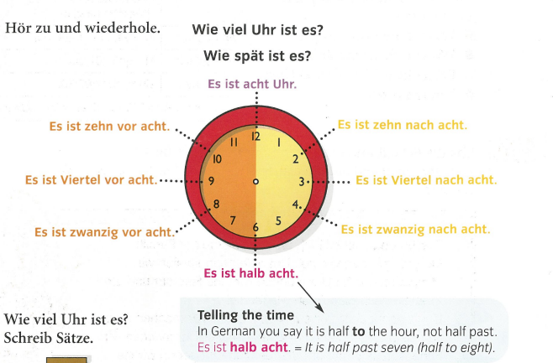
This is a reminder of how to tell the time:

Slide 22
Match up the clocks with the phrases
A) Es ist zehn nach elf
B) Es ist drei Uhr
C) Es ist Viertel vor zehn
D) Es ist Viertel nach eins
E) Es ist halb acht
F) Es ist zwanzig vor elf

Slide 23
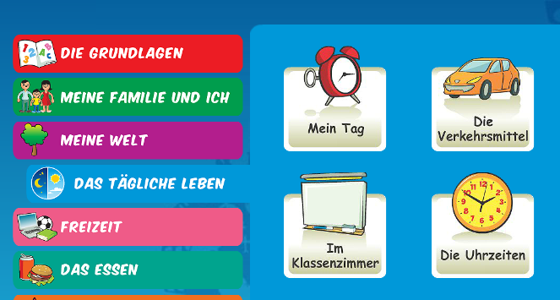
Log on to Linguascope and practise the ‘telling the time’ phrases. They are in the beginner section):
Username – kingshill password – love4langs

Slide 24
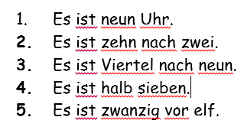
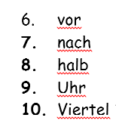
Can you translate these in to English?
Challenge task.
Can you translate these in to German?
It is quarter past three
It is half past four
It is eight o’clock
It is twenty to five
It is ten past nine

Slide 26
WEEK 5 –
There is no new vocabulary this week but it would be a good idea to look back at the vocabulary from the previous weeks to help you complete the tasks on the following pages.

Slide 27
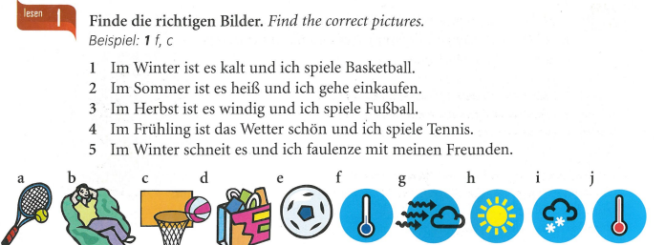

Slide 28
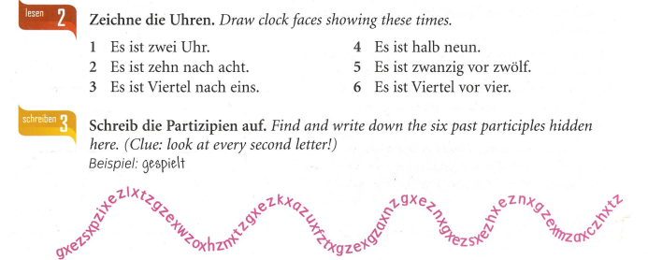

Slide 29
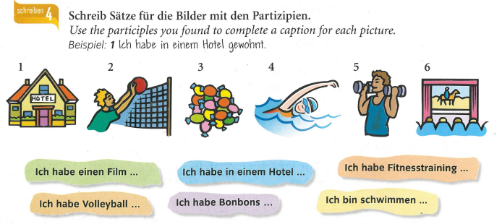

Slide 30
