Slide 1
Year 8 French TERM 5: Studio 1 textbook, chapter 4
If pupils are absent from lessons they should spend time revising and learning vocabulary. All of the vocabulary for this term is on the following slides. First of all, they should recap the vocabulary which they learned the previous week. Then they should start to learn the next section of vocabulary which they have not yet covered in class. This could be done by using the look, cover, write, check method or by making flashcards etc.
Pupils can also revise vocabulary on Linguascope-
Username is kingshill password is love4langs
Any new vocabulary they learn can be written in their orange books or on paper.
If pupils wish to do extension work they can access free MFL lessons on the Oak National Academy website:
https://classroom.thenational.academy/subjects-by-key-stage

Slide 2
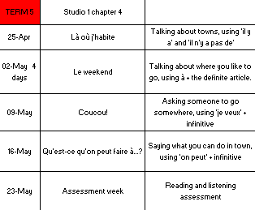

Slide 3
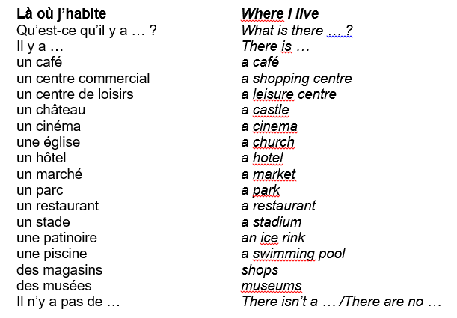
Week 1 –vocab
Read through the vocabulary for this week and spend a good amount of time trying to learn it. You will need these words to complete the tasks on the next few slides.

Slide 4
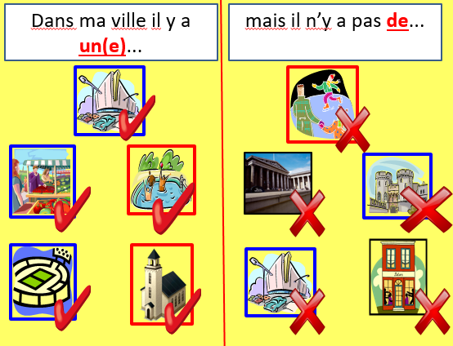
Copy out the sentences on this slide and translate them into English. Use the vocab on the previous slide to help you.
- Dans ma ville = in my town
Listen to this clip and make a list of things that there are and things that there are not in the town.
Make a poster about a town, draw and label the things that you can find there.

Slide 5
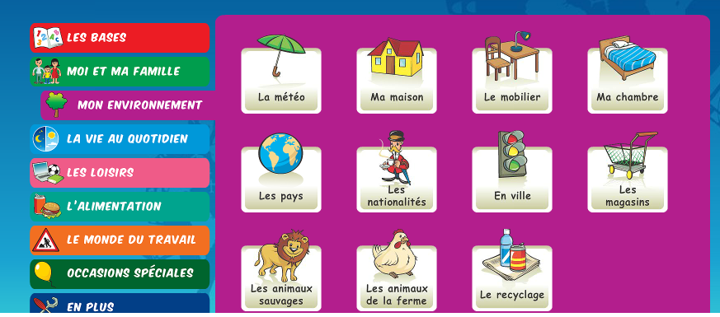
Play some games in the ‘en ville’ section on linguascope.

Slide 6
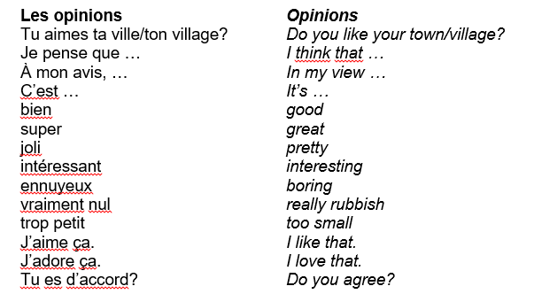
Week 2 –vocab
Read through the vocabulary for this week and spend a good amount of time trying to learn it. You will need these words to complete the tasks on the next few slides.

Slide 7
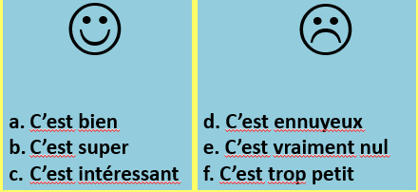
Copy and translate the following opnions into your book. Use the previous slide to help you with the translations.
Use the website www.wordreference.com (or a dictionary if you have one) to come up with a list of at least 10 other adjectives in French that you can use to describe a town.

Slide 8
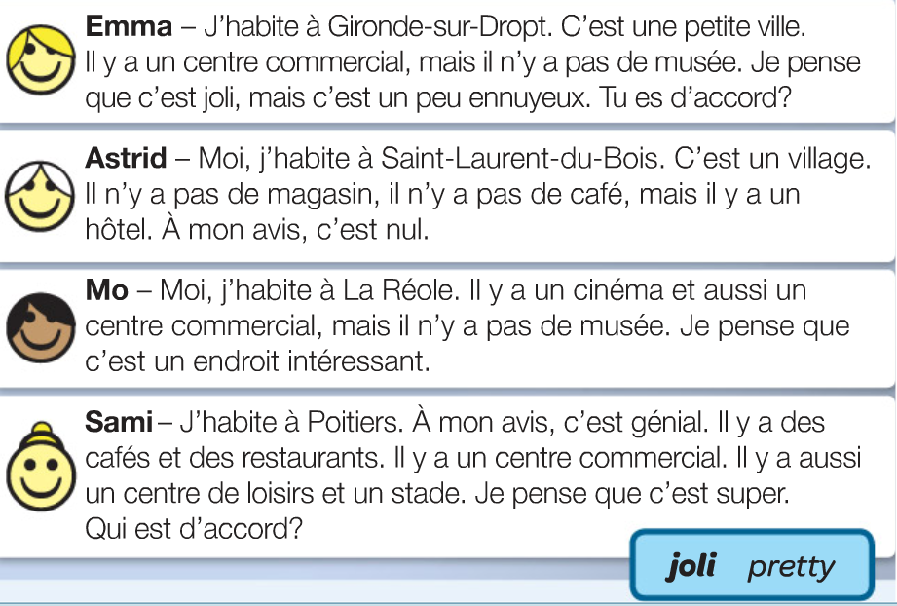
Copy and translate the following passages into your book.

Slide 9
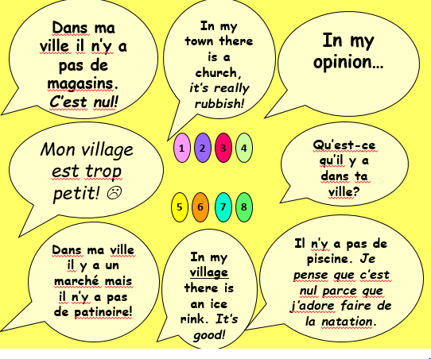
Translate the speech bubbles into English.

Slide 10
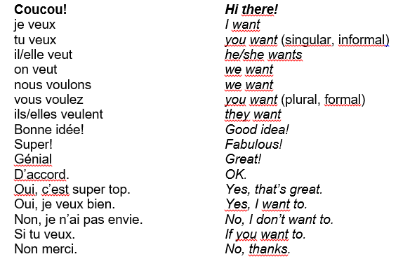
Week 3 –
vocab
Read through the vocabulary for this week and spend a good amount of time trying to learn it. You will need these words to complete the tasks on the next few slides.

Slide 11
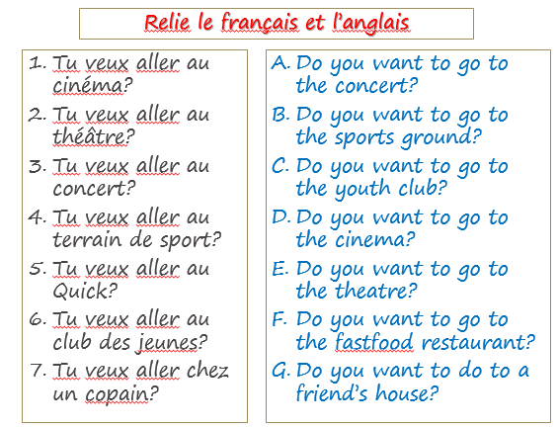
Match up the French and the English sentences.

Slide 12
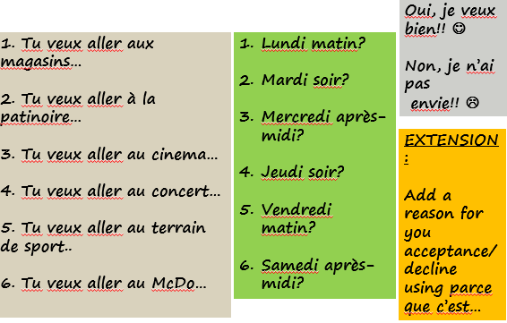
Use the sentences in these boxes to make a conversation between 2 people. Translate your conversation into English. Please write a minimum of 3 conversations.
Click the link and play some of the quizlet games to revise the vocab.
https://quizlet.com/_6o40gr?x=1jqt&i=1jjrw5

Slide 13
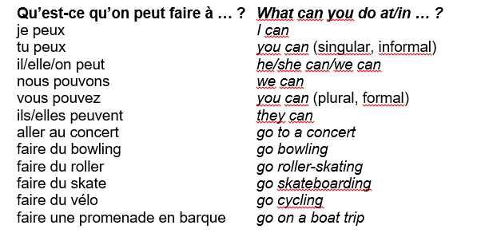
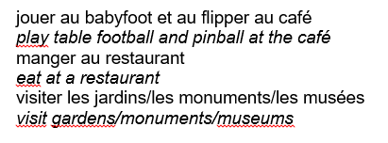
Read through the vocabulary for this week and spend a good amount of time trying to learn it. You will need these words to complete the tasks on the next few slides.
Week 4 –vocab

Slide 14
7. Traduisez
On peut faire du vélo
Il y a des magasins
J’adore le centre commercial
La ville est jolie
Où est le château ?
On peut visiter les musée
J’aime aller au marché
Il n’y a pas de patinoire
Tu veux aller au cinéma ?
Je vais au café
Nous allons au parc
Translate as many of these sentences as you can. Try to do it without using the notes on the previous slide first, only use them if you need help.
Make a poster using the vocab on the previous slide about what activities you can do in Cirencester, or another town if you prefer. Use the expression ‘on peut’ – ‘you can’. You can also talk about things you cannot do using ‘on ne peut pas’.

Slide 15
WEEK 5 –
This week is assessment week. Spend some time revising all of the vocab on these slides, then please contact Mrs Millar for the assessment papers.
Play some games on quizlet to help you revise
https://quizlet.com/_6k2uua?x=1jqt&i=1jjrw5

