Slide 1
Year 7 French rotation 2: Access Studio textbook, sections 5-8
If pupils are absent from lessons they should spend time revising and learning vocabulary. All of the vocabulary for this term is on the following slides. First of all, they should recap the vocabulary which they learned the previous week. Then they should start to learn the next section of vocabulary which they have not yet covered in class. This could be done by using the look, cover, write, check method or by making flashcards etc.
Pupils can also revise vocabulary on Linguascope-
Username is kingshill password is love4langs
Any new vocabulary they learn can be written in their orange books or on paper.
If pupils wish to do extension work they can access free MFL lessons on the Oak National Academy website:
https://classroom.thenational.academy/subjects-by-key-stage

Slide 2
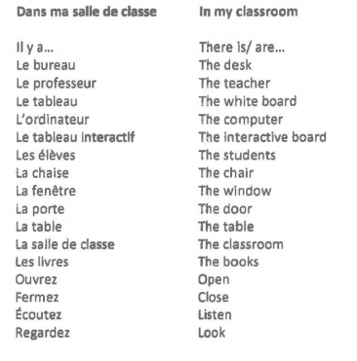

Slide 3
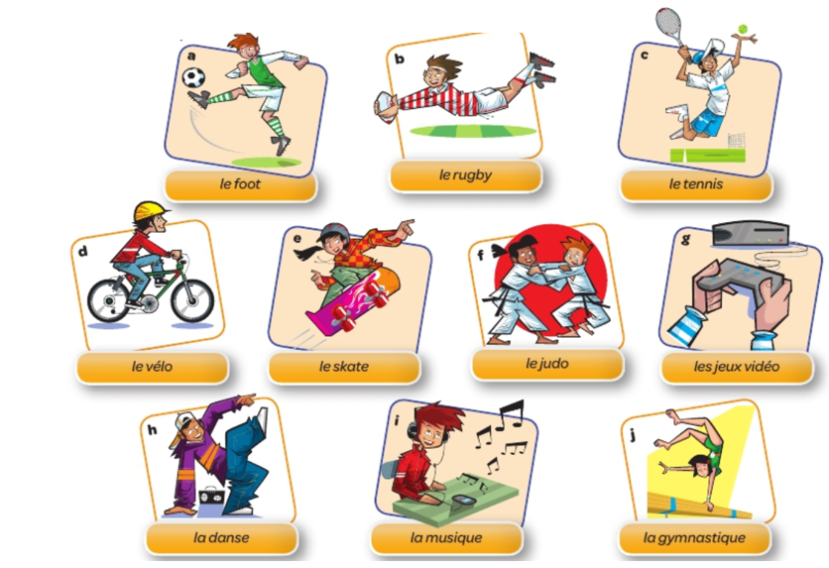

Slide 4
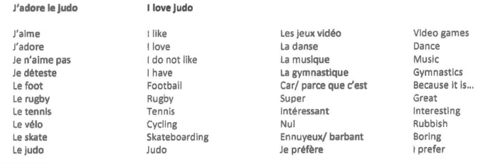

Slide 5
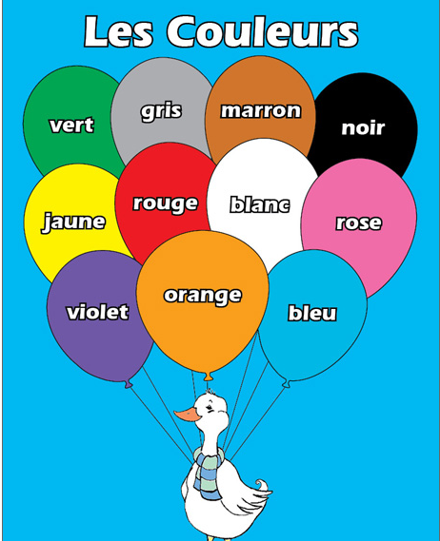

Slide 6
Once you have learned your colours, try the following tasks:

Slide 8
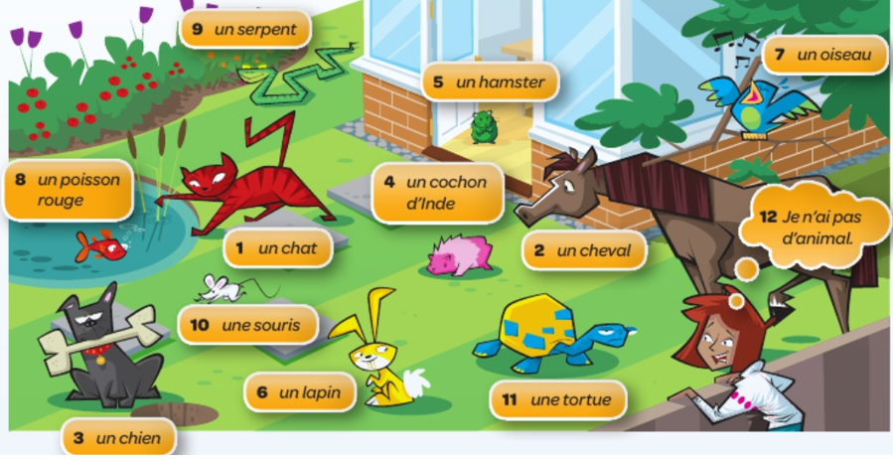

Slide 10
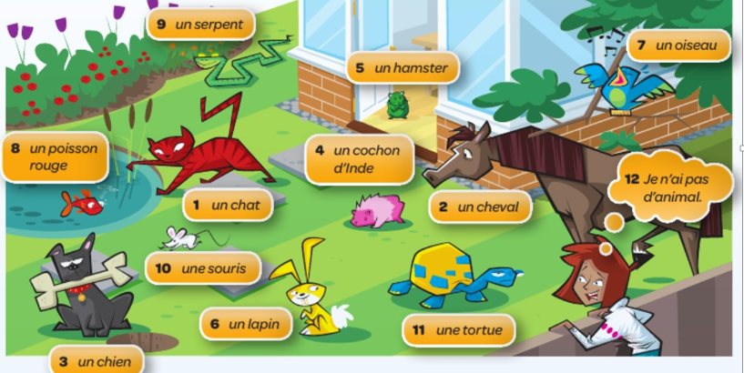
Once you have learned your animals, try the following task:

Slide 11
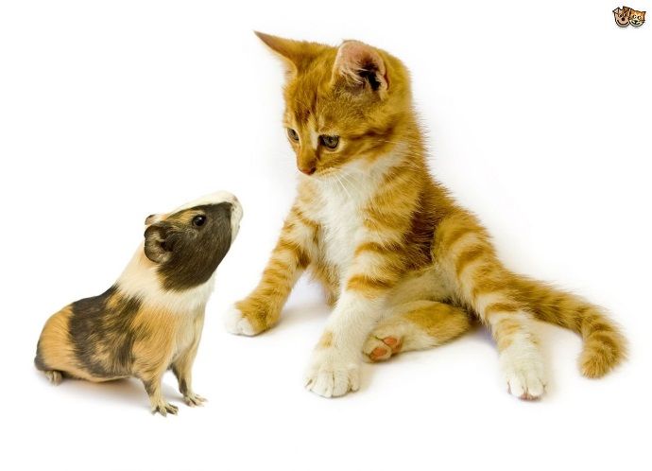
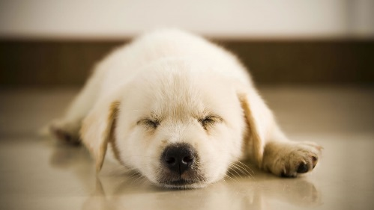
Year 7 French work This week we will be doing some work on animals in French. Please copy the title: As-tu un animal? (Do you have a pet?) into your orange book /on paper.
Task 1:
Copy the following animals into your book /paper in French and English.
J’ai…… = I have….
une araignée = a spider 2) un chat = a cat 3) un cheval = a horse 4) un chien = a dog
5) un cochon d’Inde = a guinea pig 6) un hamster = a hamster 7)un lapin = a rabbit
8) un oiseau = a bird 9) un poisson = a fish 10) un serpent = a snake 11) une souris = a mouse
12) une tortue = a tortoise
Task 2:
Log on to www.linguascope.com and play around on the French beginner section. Mes animaux (my animals) is in the green section with the dog icon. Start with the presentation first and then work through the activities practising the vocabulary.

Slide 12
Task 3: Unjumble the letters and find the animals in French.
Bonus optional task - can you add to the numbered
letters below and work out the phrase in French
and English

Slide 13
a | b | c | d | e | f | g | h | i | j | k | l | m
a | b | c | d | e | f | g | h | i | j | k | l | m
n | o | p | q | r | s | t | u | v | w | x | y | z
n | o | p | q | r | s | t | u | v | w | x | y | z
Task 4 (Optional):
Use the code above to crack the code below of what is written in French and then translate each sentence into English.
jai un lapin et une souris
jai un chat et un chien
jai une araignee et un serpent
jai une tortue et un poisson
jai un cheval et un hamster

