Slide 1


Year 9 Spanish TERM 3: Viva 2 textbook, chapter 4
If pupils are absent from lessons they should spend time revising and learning vocabulary. All of the vocabulary for this term is on the following slides. First of all, they should recap the vocabulary which they learned the previous week. Then they should start to learn the next section of vocabulary which they have not yet covered in class. This could be done by using the look, cover, write, check method or by making flashcards etc. It should also be written in their orange book. There are also a few tasks to complete. A plan for the term is on the next slide.
Pupils can also revise vocabulary on Linguascope-
Username is kingshill password is love4langs
Any new vocabulary they learn can be written in their orange books or on paper.
If pupils wish to do extension work they can access free MFL lessons on the Oak National Academy website:
https://classroom.thenational.academy/subjects-by-key-stage

Slide 2
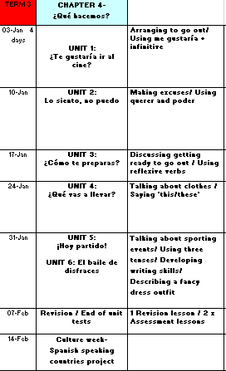

Slide 3
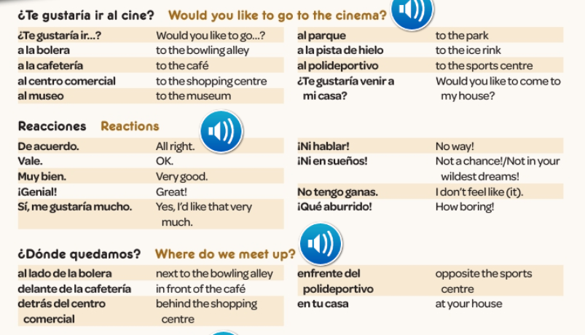
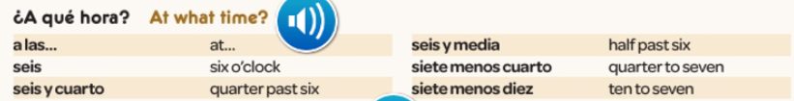
WEEK 1 –
Copy this vocab in to your book.
There are a lot of new words this
week, so please spend a good
amount of time trying to learn it.

Slide 4
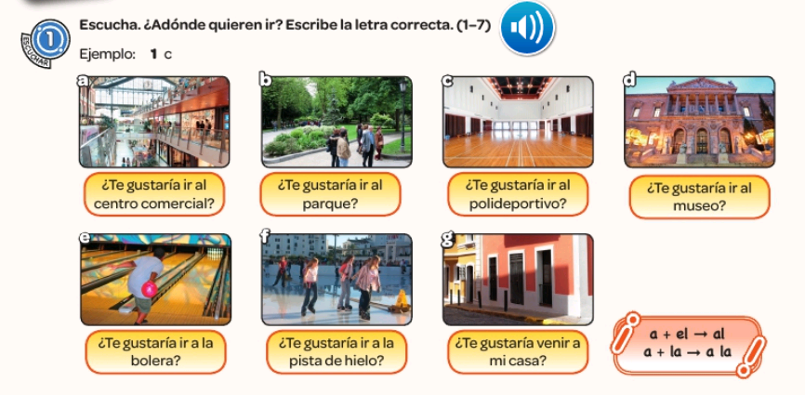

Write down 1-7. Listen to the track. Where are the people going? Example 1c

Slide 5
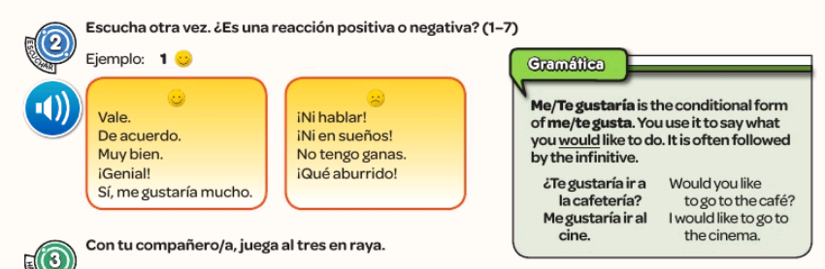
Write down 1-7 again. Listen to the track again. Is the reaction positive or negative? Example 1

Slide 6
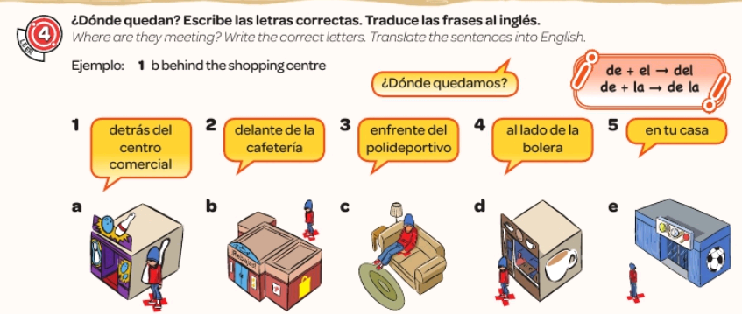
For this task you need to read the statements about where the people are meeting. You then need to match the 5 statements with the correct picture and say what the phrases mean in English. Example, 1) b behind the shopping centre.

Slide 7
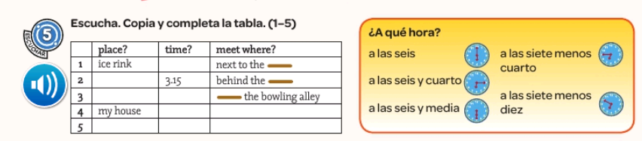
For this track you need to copy out the table and fill in the information in English.

Slide 8
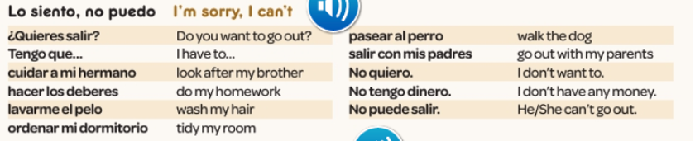
WEEK 2 –
Copy this vocab in to your book and spend some time trying to learn it. Also look back through last week’s words.

Slide 9
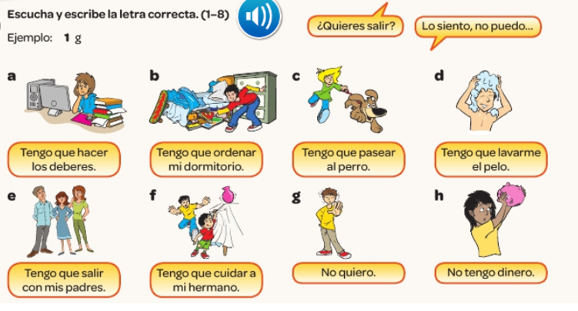
Write 1-8. Listen to the recording. Which excuse do they give? Example, 1g

Slide 10

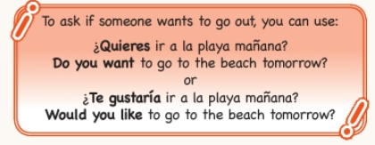

Have a go at translating one of these conversations into English.

Slide 11
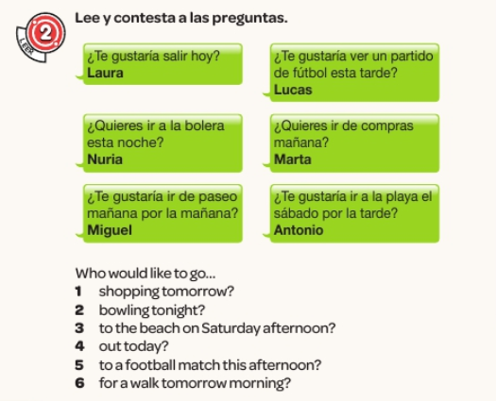
Read the texts and answer the questions in English

Slide 12
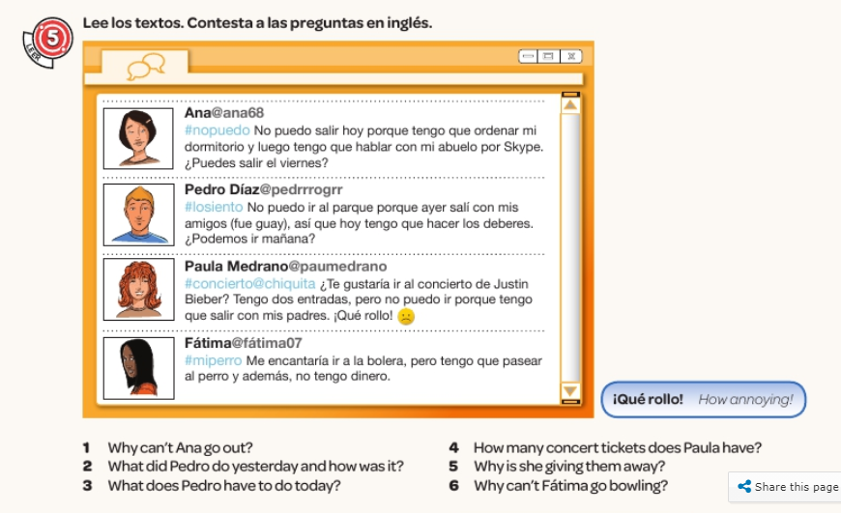
Write numbers 1-6 and answer the questions using the emails in the picture.

Slide 13

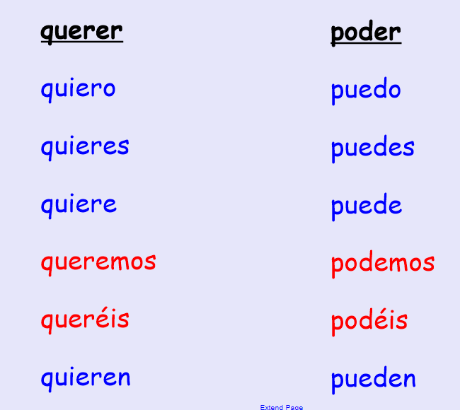
These are the two stem-changing verbs that you need to know for this topic.
Make a note of these 2 verbs.
No puedo = I can’t
¿Quieres …? = Do you want …?
to want
to be able
I want
I can
You want
You can
He/she/it wants
He/she/it can
We want
We can
You (pl) want
You (pl) can
They want
They can

Slide 14
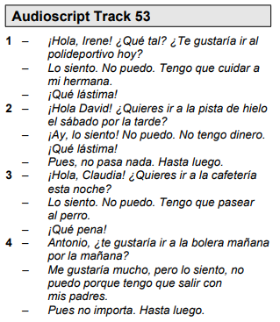
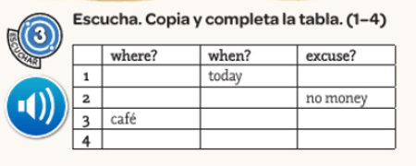
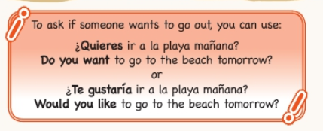
Copy and complete the grid using the transcript of the listening track provided.

Slide 15
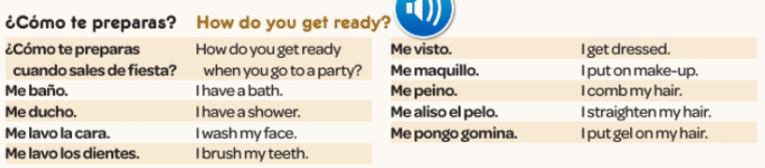
WEEK 3 –
Copy this vocab in to your book and spend some time trying to learn it..

Slide 16

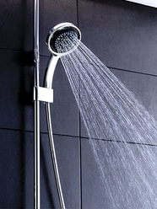
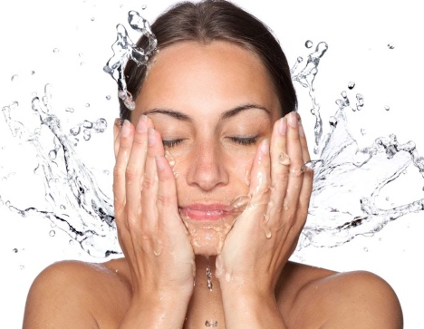
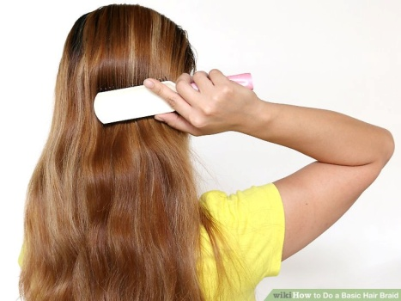
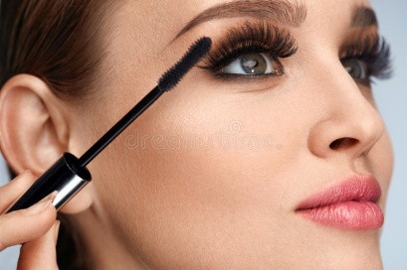
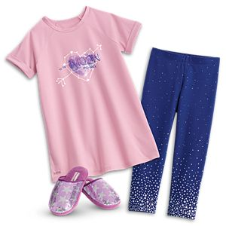
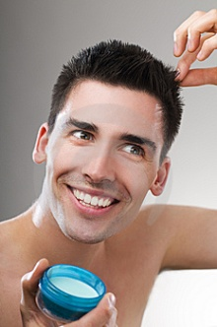
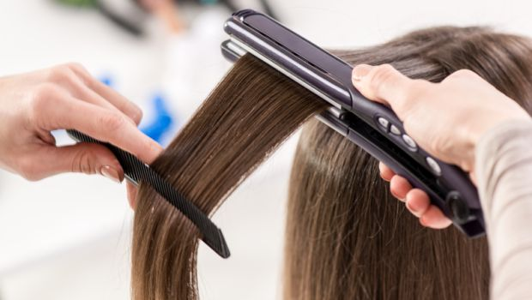
Read through the vocab
Me baño
Me ducho
Me lavo la cara
I have a bath
I have a shower
I wash my face
Me maquillo
Me visto
Me peino
I put on makeup
I get dressed
I brush my hair
Me pongo gomina
Me aliso el pelo
I gel my hair
I straighten my hair

Slide 17

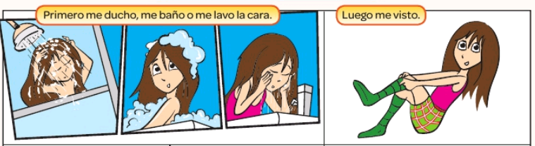
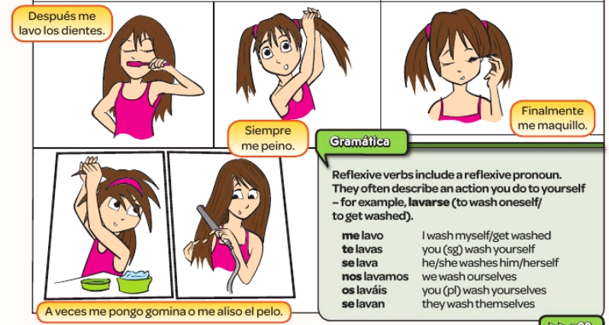
Listen to the recording and read along

Slide 18
Match up the phrases
Primero
Luego
Después
Finalmente
Siempre
Nunca
Never
Finally
First
Then
Always
Afterwards

Slide 19
Read the texts and fill in the table in Englisj
Simon: Cuando salgo de fiesta, primero me ducho. Luego me peino y después me pongo gomina. Finalmente me lavo los dientes. Nunca me maquillo.
Laura: Cuando salgo de fiesta, primero me lavo la cara. Luego me visto y después me aliso el pelo. Finalmente me maquillo. Nunca me baño – siempre me ducho.
Name | First | Then | Afterwards | Finally | Never
Simon
Laura
Shower
Wash face

Slide 20
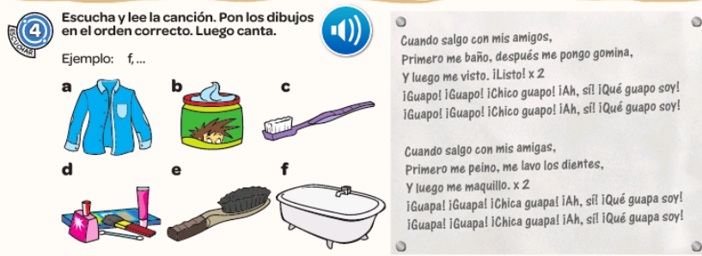
Listen to the song and put the pictures in the correct order

Slide 21

IMPORTANT - Write a couple of sentences in Spanish using the phrases we have learned (you could also add desayuno + I eat breakfast) then email them to me by the end of the day please.
A ver = let’s see

Slide 22
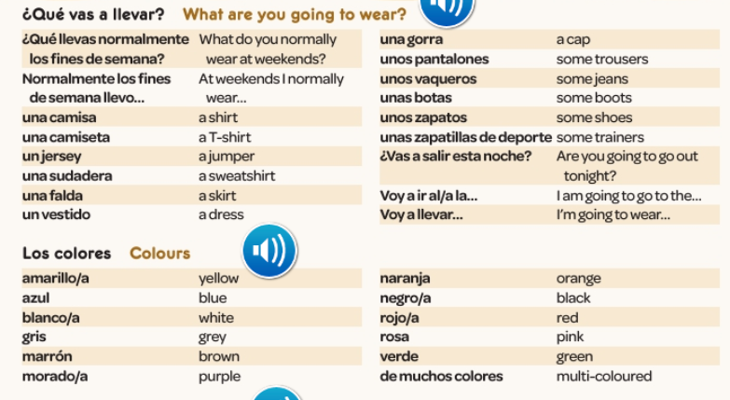
WEEK 4 –
Copy this vocab in to your book and spend some time trying to learn it.

Slide 23

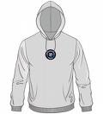
Write 1-12. Label these in Spanish
3
1
2
4
7
8
6
5
11
12
9
10
De moda

Slide 24
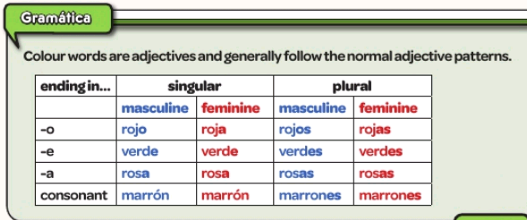
Remember adjectives have to agree with the gender of the noun in Spanish. Remind yourself of the pattern

Slide 25
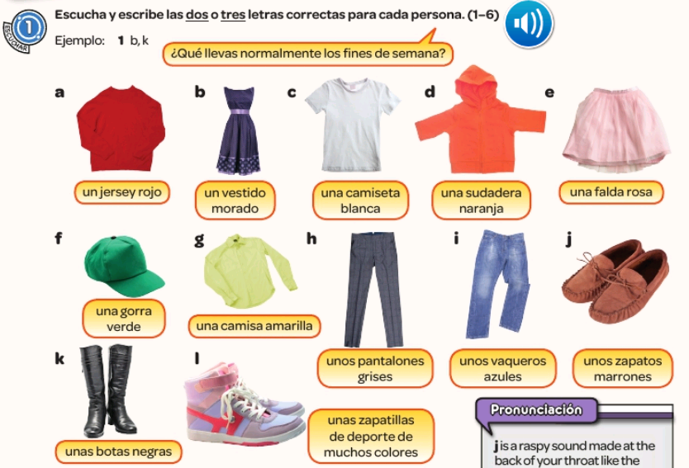
Listen to the recording. Write 1-6. What does each person wear? Write the letters of the items

Slide 26
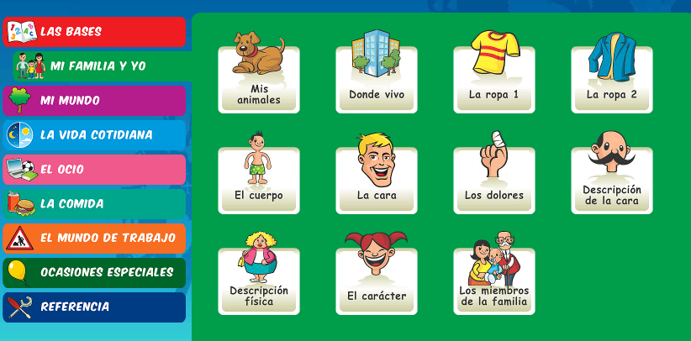
Username – kingshill password- love4langs
Practise the clothing vocabulary on Linguascope. Make a note of new words in your book.

Slide 27
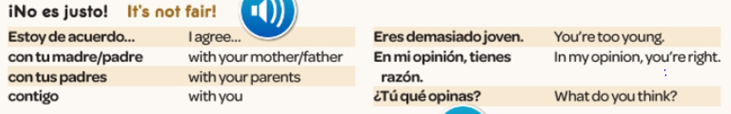
WEEK 5 –
Copy this vocab in to your book and spend some time trying to learn it. Then work through the tasks on the following slides.

Slide 28
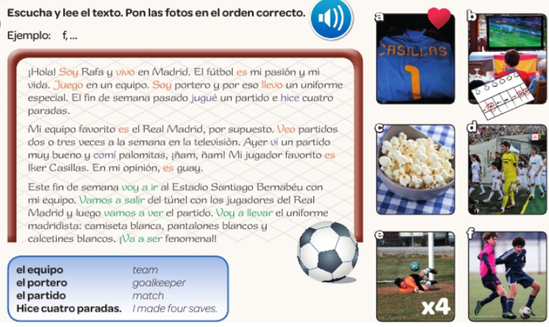
Read the text and put the pictures in the correct order.

Slide 29
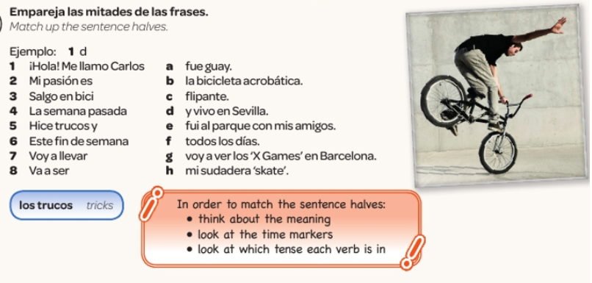

Slide 30
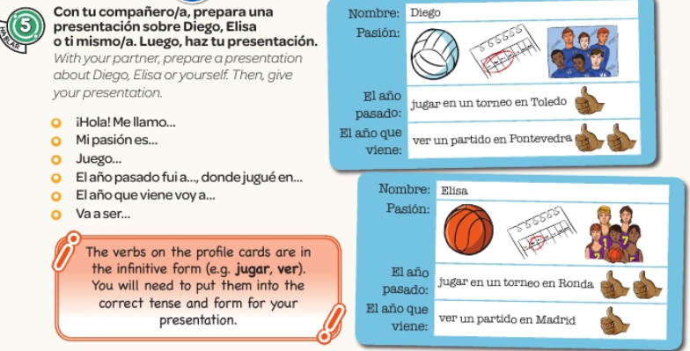

Slide 31
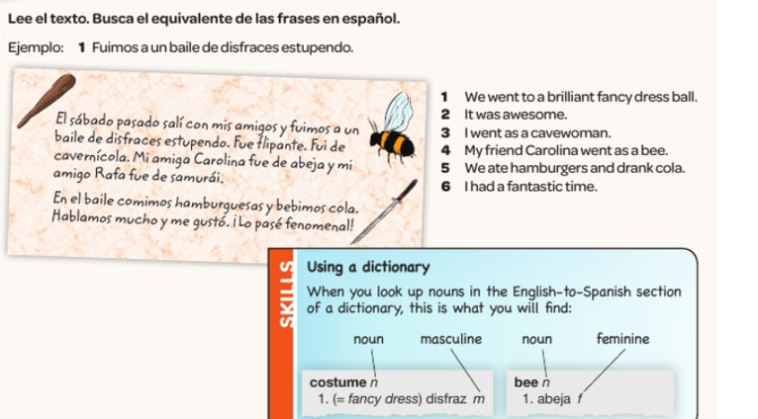
Read the text. Find the Spanish for the 6 English sentences below.

Slide 32
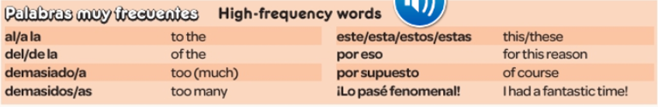
WEEK 6 –
This week is assessment week. Spend some time revising all of the vocab on these slides so far and the high frequency words below. Then email your teacher for the test papers. There are also revision activities on the next slide.

Slide 33
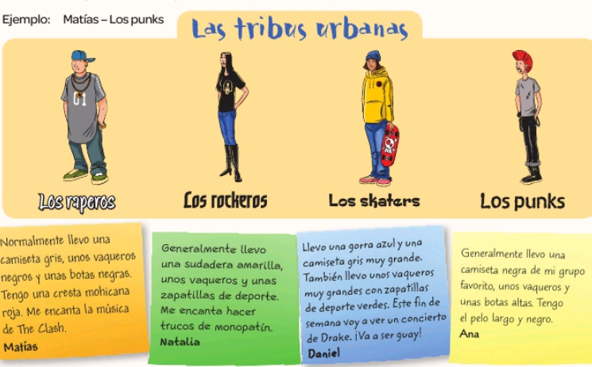
Read the description of Matias, Natalia, Daniel and Ana. Match the people with the urban tribes.

Slide 34
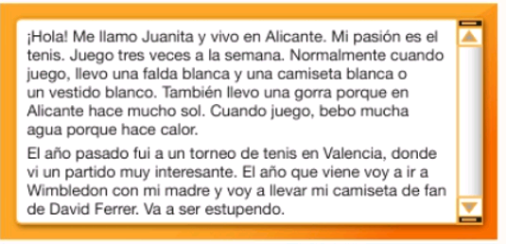
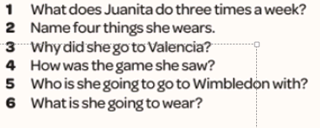
Read the text and answer the questions in English.
llevo = I wear
Hace mucho sol = it’s very sunny
Hace calor = it’s hot
un torneo = a tournament

Slide 35
WEEK 7 –
Project week. Research a Spanish speaking country of your choice. You could make a poster or powerpoint and show it to your teacher when you are back in school.

