Slide 1
Year 9 Spanish TERM 2: Viva 2 textbook, chapter 3
If pupils are absent from lessons they should spend time revising and learning vocabulary. All of the vocabulary for this term is on the following slides. First of all, they should recap the vocabulary which they learned the previous week. Then they should start to learn the next section of vocabulary which they have not yet covered in class. This could be done by using the look, cover, write, check method or by making flashcards etc. There are also a few tasks to complete. A plan for the term is on the next slide.
Pupils can also revise vocabulary on Linguascope-
Any new vocabulary they learn can be written in their orange books or on paper.
If pupils wish to do extension work they can access free MFL lessons on the Oak National Academy website:
https://classroom.thenational.academy/subjects-by-key-stage

Slide 2
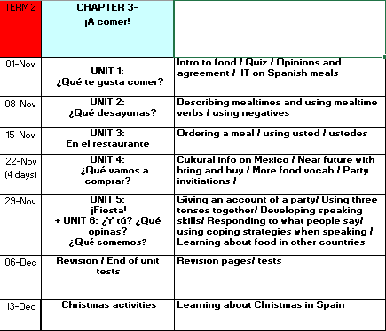

Slide 3
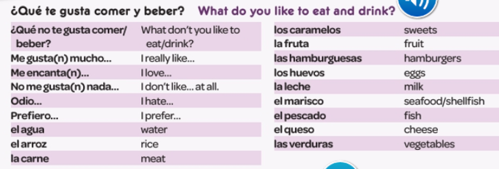
WEEK 1 –
Copy these words in to your orange book (you could make a poster if you prefer) and try and learn them.

Slide 4
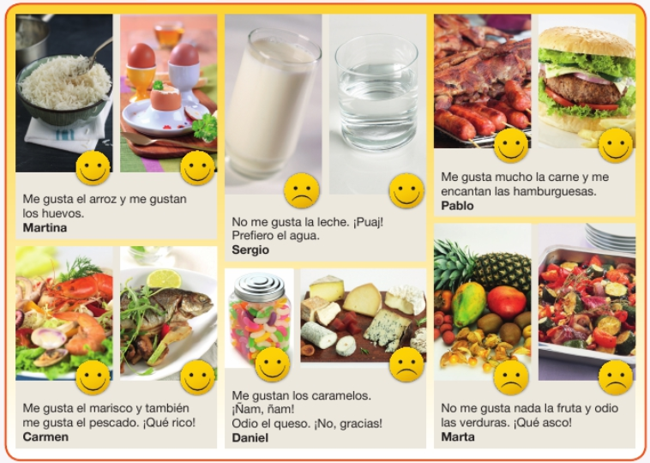
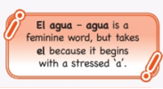
Listen to the recording and read the texts. Write the correct name for each person you hear speak.
Then, translate these sentences in to English.

Slide 5
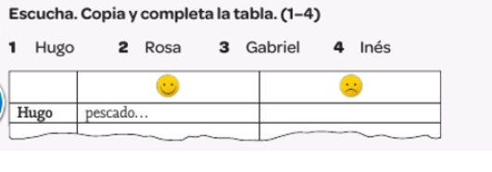
Listen to the recording. Complete the table in Spanish saying what they like and don’t like

Slide 6
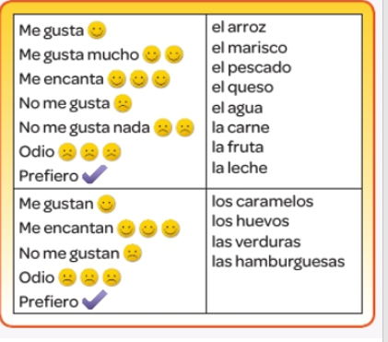
Use the table to write some sentences about your preferences.

Slide 7
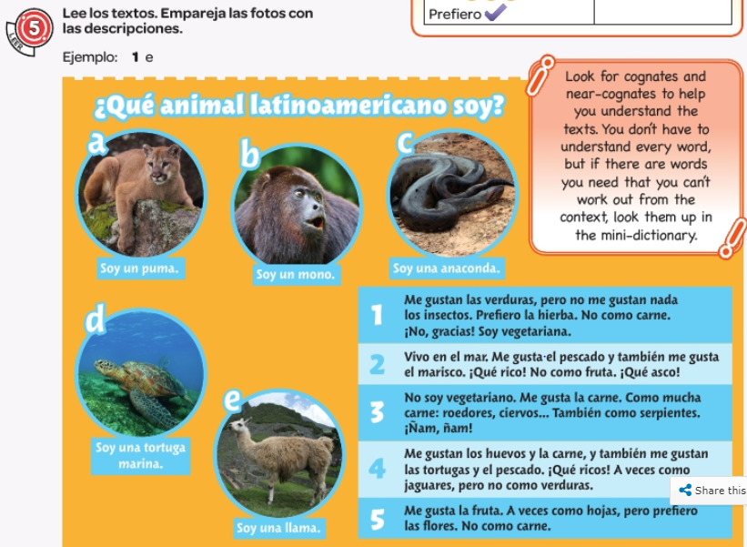
Read the texts and match them to the photos.

Slide 8
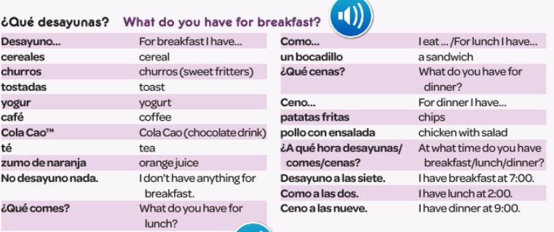
WEEK 2 –
Copy these words in to your orange book (you could make a poster if you prefer) and try and learn them.

Slide 9
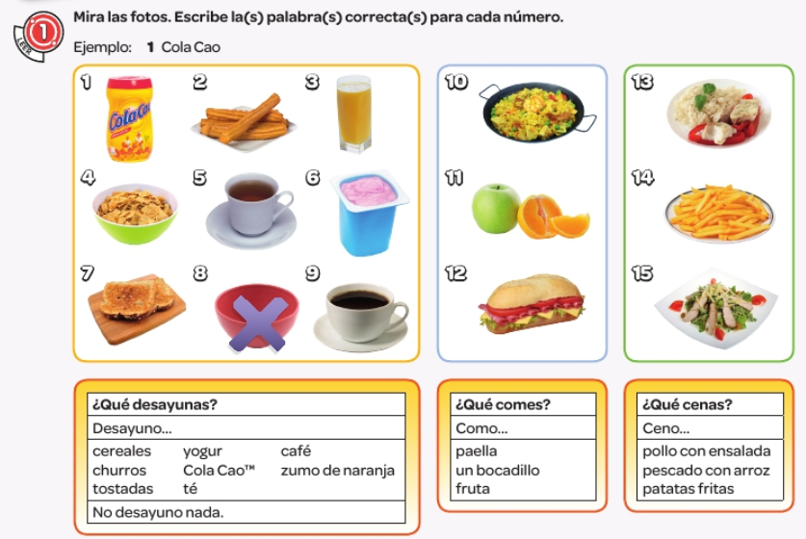
Look at the pictures. Write the correct word for each picture from the lists below.

Slide 10
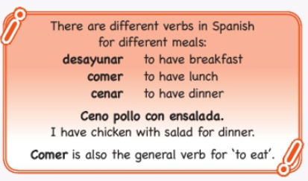
Copy down the following information:

Slide 11
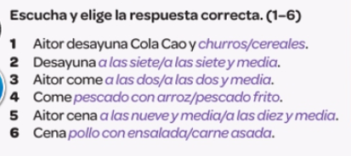
Listen to the track and choose the correct answer.

Slide 12
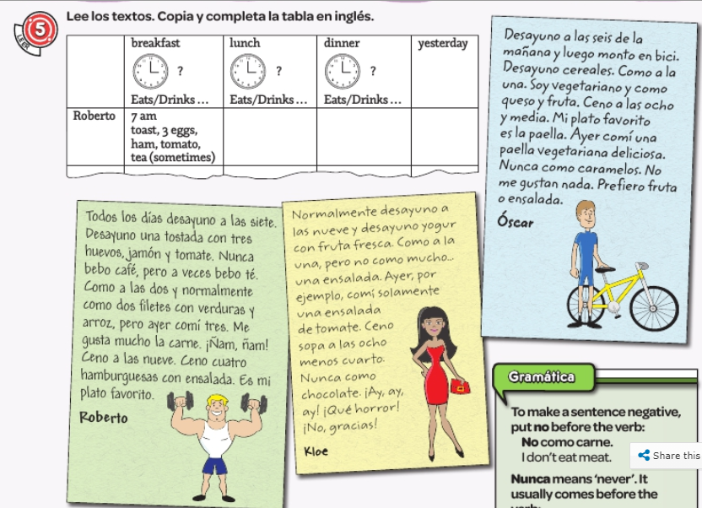
Read the texts. Copy and complete the table in English.

Slide 13
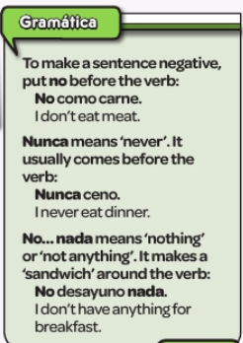
Copy down the following information:

Slide 14
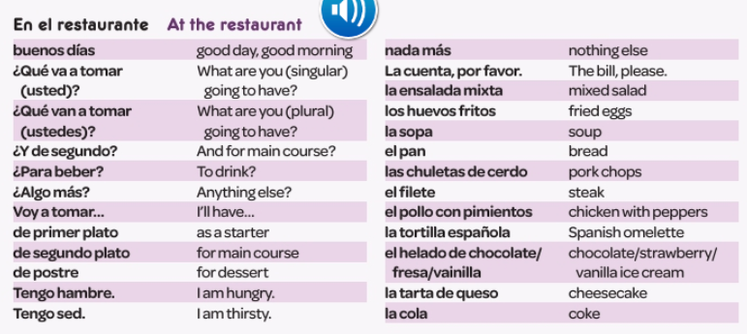
WEEK 3 –
Copy these words in to your orange book and try and learn them.

Slide 15
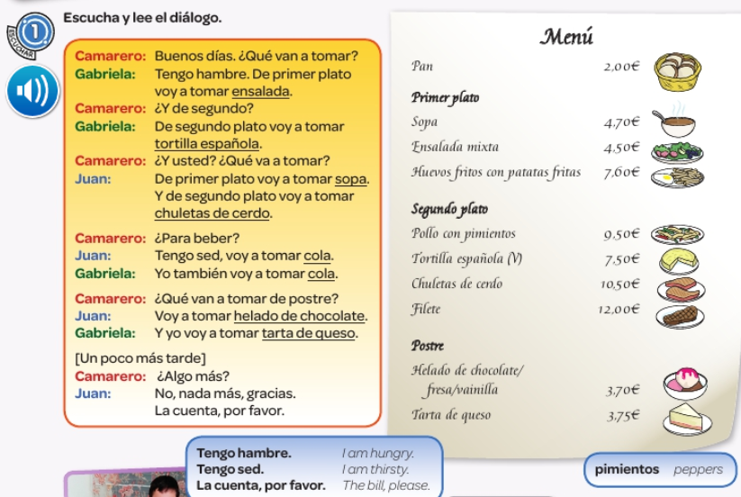
Listen to the people ordering. Look up any new words you don’t know from the conversation or the menu

Slide 16
Read the conversation again on the previous slide. Fill in the table with what they order as a starter, main course, to drink and for dessert.

Slide 17
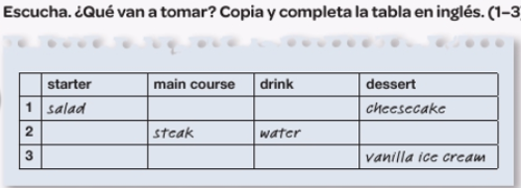
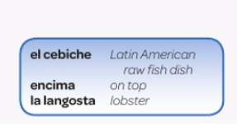
Listen to what they order and fill in the table in English.

Slide 18
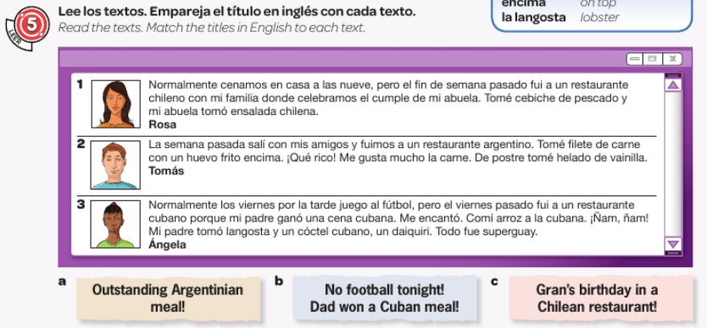

Slide 19
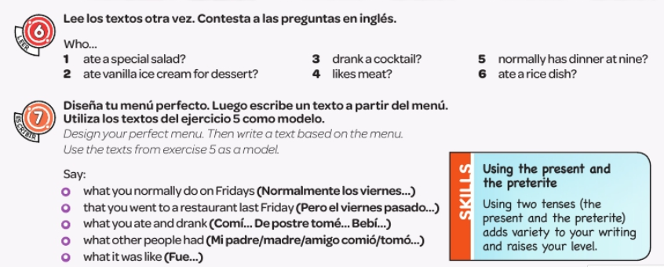
Read the texts on the previous page again and then say who did the following things:

Slide 20
WEEK 4 –
Copy these words in to your orange book and try and learn them.

Slide 21
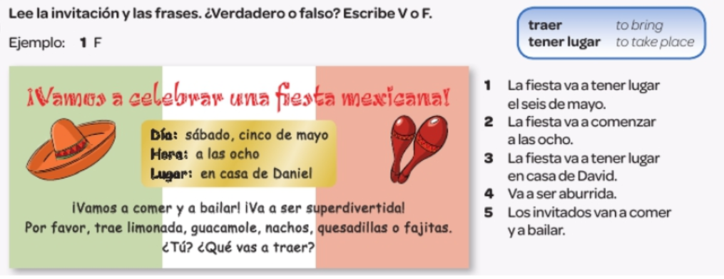
Read the invitation and say if they 5 sentences are true or false

Slide 22
Copy the following grammar point into your orange book

Slide 23
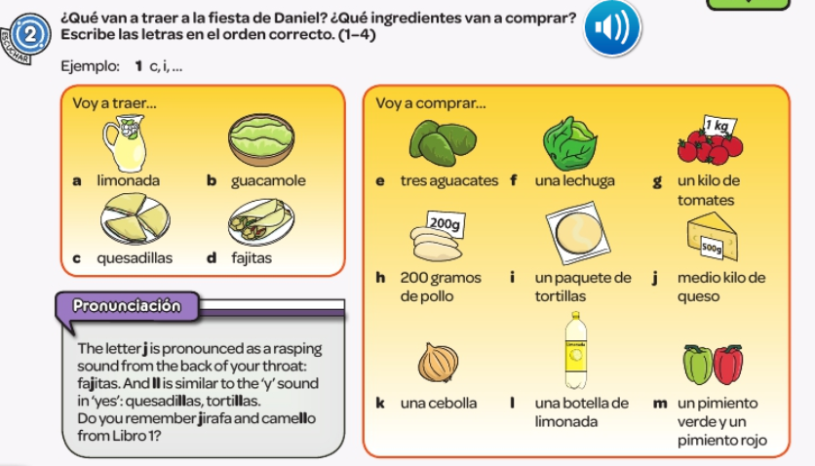
What are they going to take to Daniel’s party? Which ingredients will they buy?

Slide 25
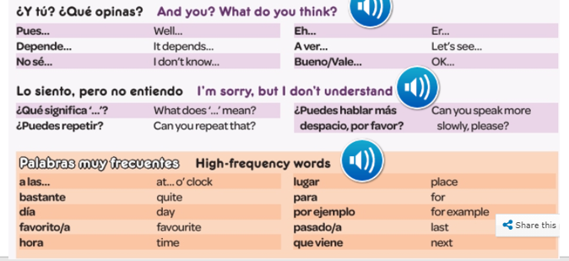
WEEK 5 –
Copy these words in to your orange book and try and learn them.

Slide 26
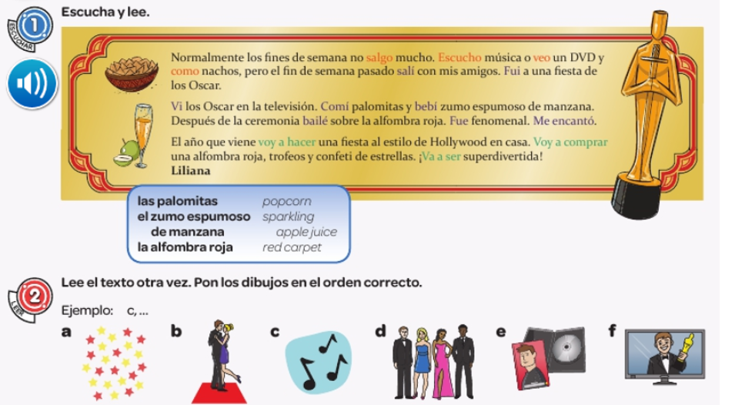
Listen and read along. Look up any new words you don’t know. Then put the pictures in exercise 2 in the order they take place.

Slide 27
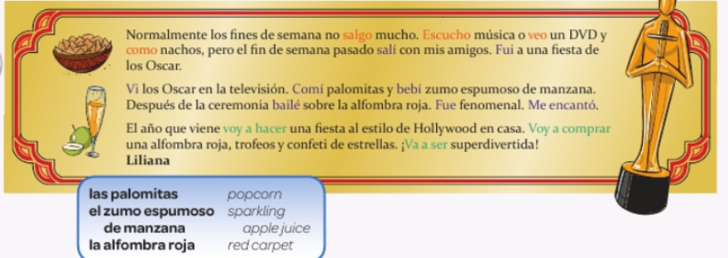
Read the text again and fill in the gaps in these sentences in English.

Slide 28
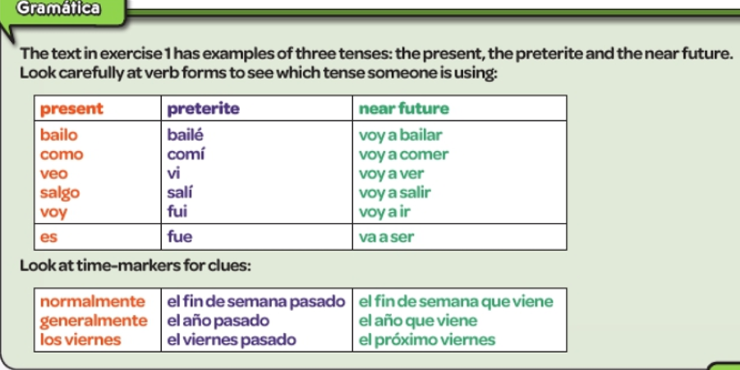
Remind yourself of the grammar below.

Slide 29
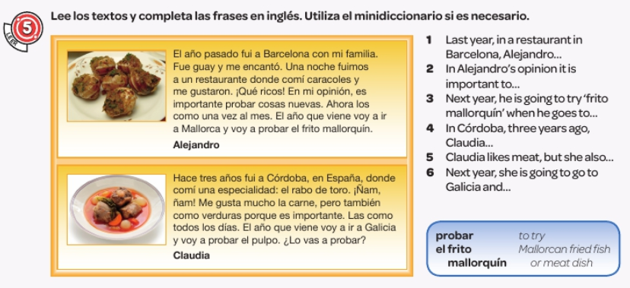

Slide 30
WEEK 6 –
This week is assessment week. Spend some time revising all of the vocab on these slides so far and then email your teacher for the test papers. There are some revision tasks on the next few slides too.

Slide 31
Read the conversations. Write the correct letters and time for each one.

Slide 32
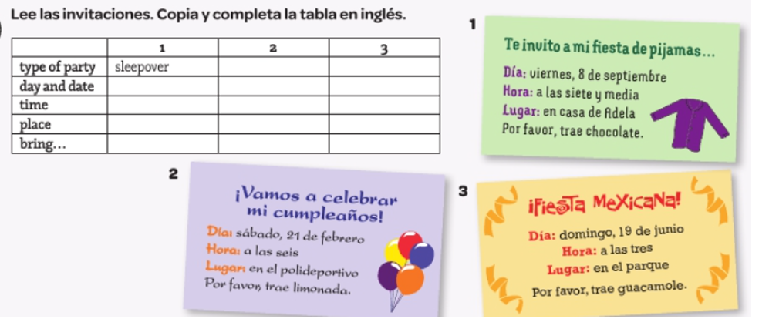
Read the invitations and complete the table in English.

Slide 33
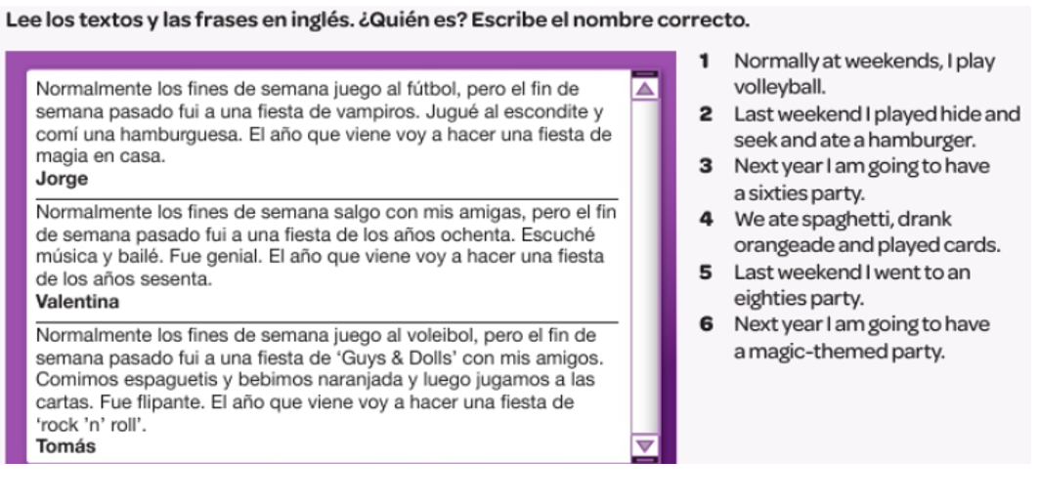
Read the text and the statements 1-6. For each statement write the name of who said it – Jorge, Valentina or Tomás.

Slide 34
WEEK 7 –
Learn about Christmas in Spain by reading the following slides. Then make your own poster or Powerpoint about Christmas in Spain or a Spanish speaking country.
There is a Christmas section on Linguascope in the beginner section too.

Slide 35
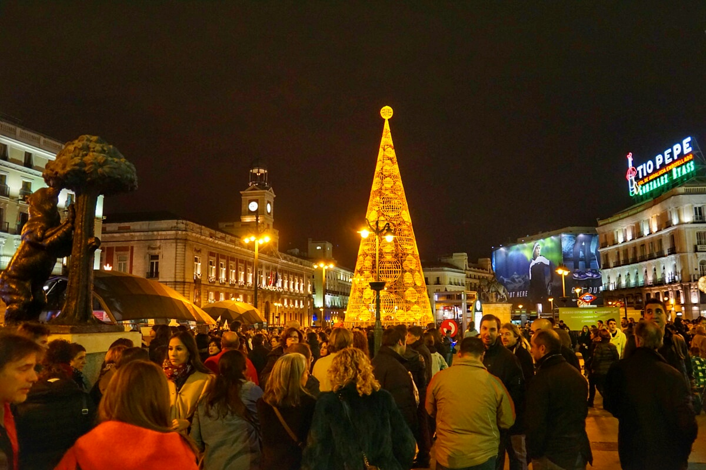
¡Feliz navidad!

Slide 36
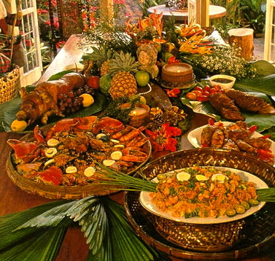
La nochebuena
La nochebuena is the night before Christmas day in Spain. This is when most families eat a large Christmas meal, usually turkey, pork or sea food. El turrón
is similar to nougat and is traditionally
eaten for dessert.
Then people usually go to Mass or
‘La Misa del Gallo’

Slide 37
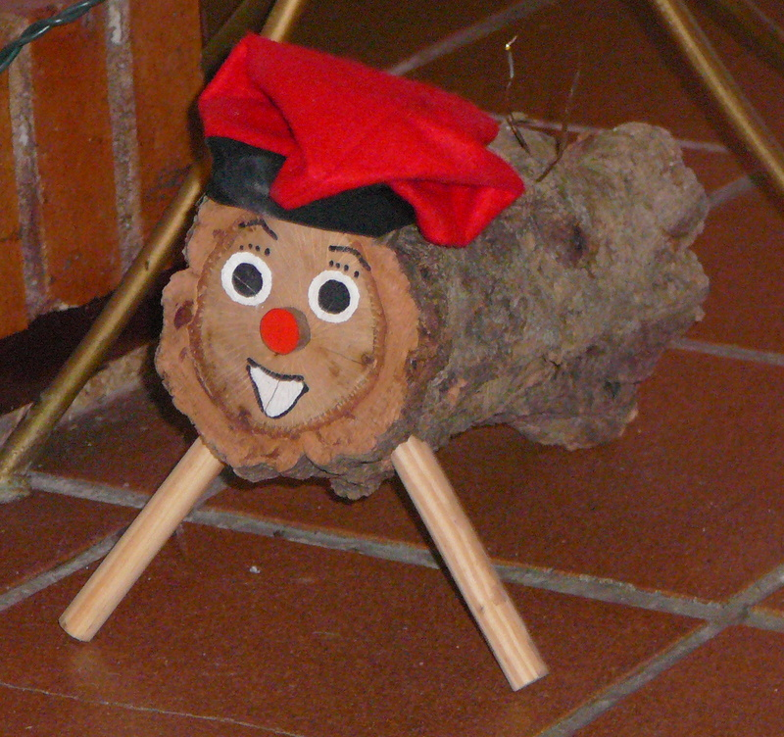
El Día de Navidad
El Día de Navidad is another day for celebrating with family.
There is a tradition of hitting a Christmas log in some parts of Spain. Children hit the log and receive presents from it.

Slide 38
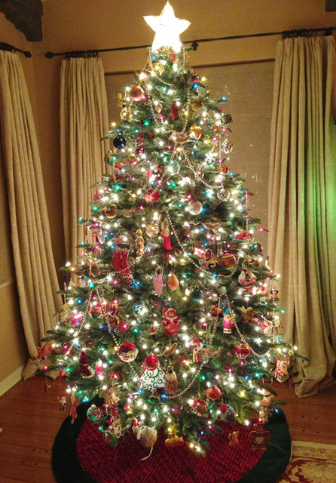
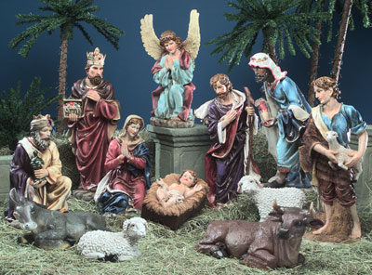
Un portal de Belén
In Spain, most houses display a Nativity scene which displays the scene of the birth of Jesus. What would you expect to see in it?
Some houses will also have a Christmas tree.

Slide 39
El día de los Santos inocentes
28th December is similar to April Fool’s Day in Great Britain. If you trick someone you call them ‘inocente, inocente’.

Slide 40
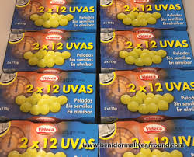
La noche vieja
New year’s eve is called La noche vieja in Spain. People go out to party. At midnight, the bells chime and traditionally everybody eats 12 grapes.

Slide 41
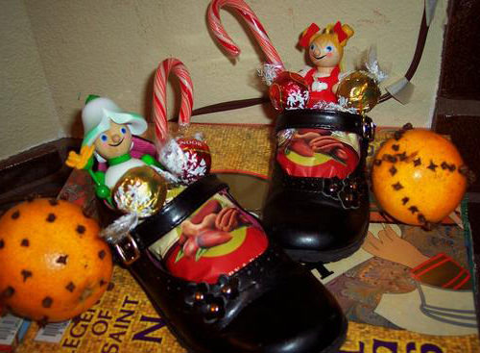
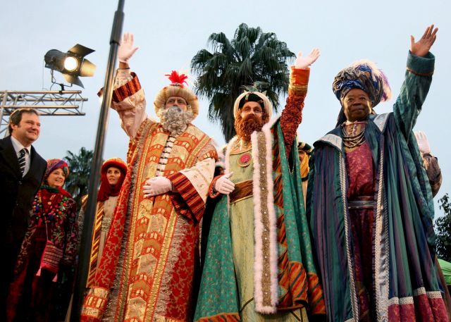
El Día de los Reyes
The 6th of January is one of the most important days in Spain over the Christmas period. On Epiphany, Spanish people receive presents to celebrate when the three kings gave presents to the Baby Jesus.
Children leave out shoes to be filled with presents instead of stockings!
There are the Tres Reyes Magos parades in the streets on the 5th January.

