Slide 1


Year 9 German TERM 2: Echo 2 textbook, chapter 4
If pupils are absent from lessons they should spend time revising and learning vocabulary. All of the vocabulary for this term is on the following slides. First of all, they should recap the vocabulary which they learned the previous week. Then they should start to learn the next section of vocabulary which they have not yet covered in class. This could be done by using the look, cover, write, check method or by making flashcards etc. There are also a few tasks to complete. A plan for the term is on the next slide.
Pupils can also revise vocabulary on Linguascope-
Username is kingshill password is bonjour123
Any new vocabulary they learn can be written in their orange books or on paper.
If pupils wish to do extension work they can access free MFL lessons on the Oak National Academy website:
https://classroom.thenational.academy/subjects-by-key-stage

Slide 2
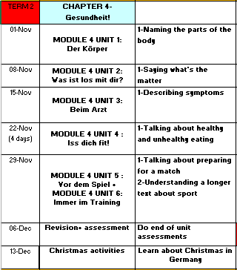

Slide 3
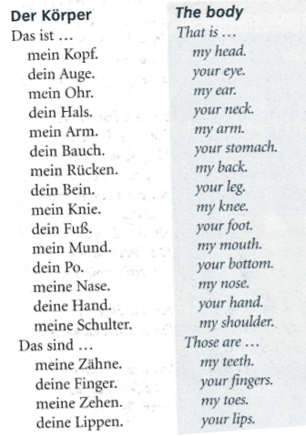
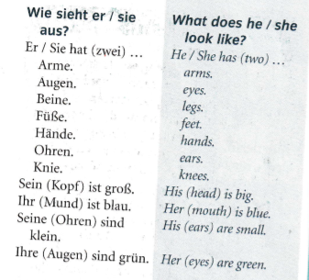
WEEK 1
Copy these words in to your orange book and try and learn them. You could make a body parts poster or label a body too

Slide 4

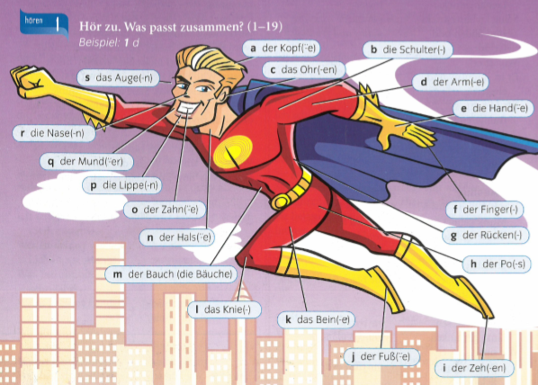
Listen to the recording. Write down 1-19. Which body parts do you hear?
Answer with the letters a-r
The part in brackets after the noun shows you how to make it plural.

Slide 5

Use the vocab to write a description of Zoltog in German.

Slide 6
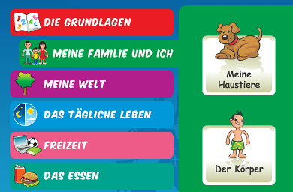
Log in to Linguascope
Username = kingshill
Password = bonjour123
Then have a go at the ‘Körper’ (body) section in the beginner area.

Slide 7
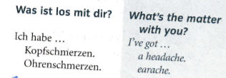
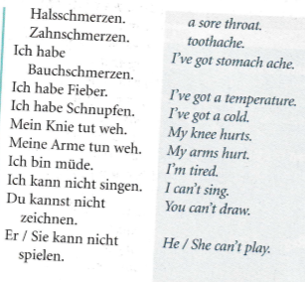
WEEK 2 –
Copy these words in to your orange book and try and learn them.

Slide 8
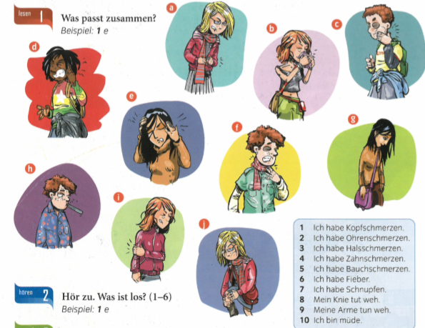
Match up the illness phrases 1-10 with the pictures a-j

Slide 9

Listen to the track. Write down 1-6 and say what is wrong with each person.

Slide 10
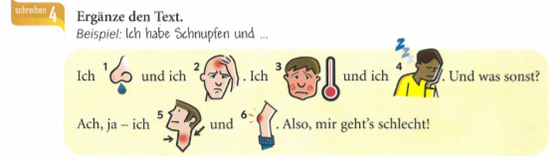
Copy out the text and swap the pictures for words.

Slide 11
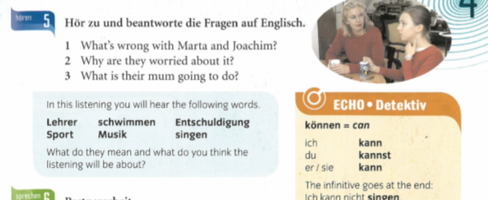
Listen to the track and answer the questions in English.

Slide 12
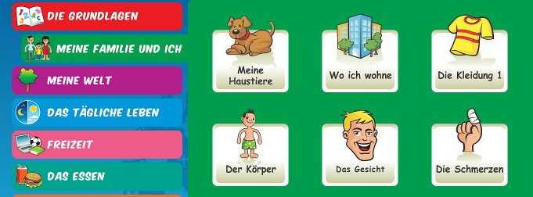
Log in to Linguascope
Username = kingshill
Password = bonjour123
Then have a go at the ‘die Schmerzen’ (aches) section in the beginner area.

Slide 13
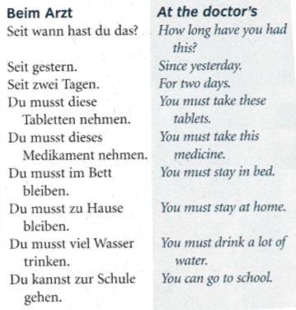
WEEK 3 –
Copy these words in to your orange book and try and learn them.

Slide 14
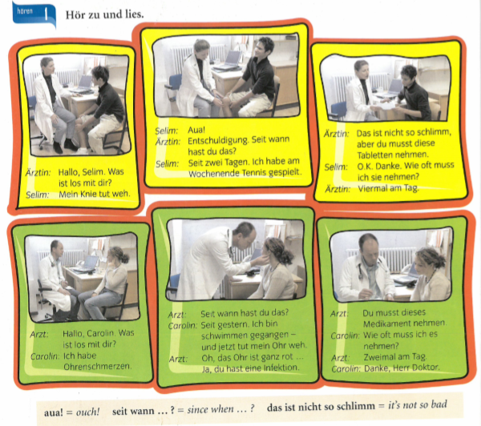
Listen to the track and read along. Try and understand what is wrong with Selim and Carolin.

Slide 15
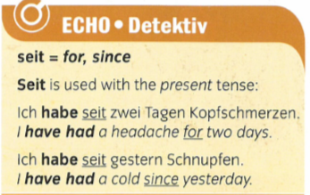
Copy this in to your books

Slide 16
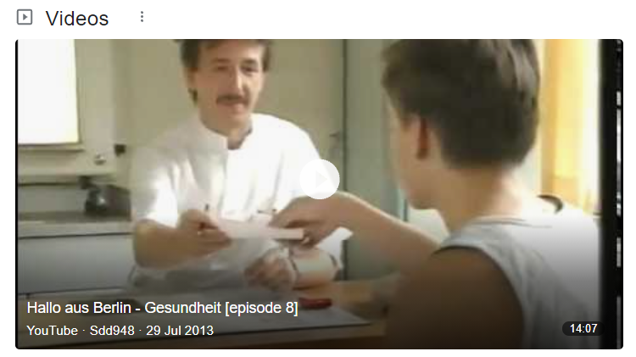
Go on to Youtube and search for ‘Hallo aus Berlin Gesundheit’. Watch the 15 min episode.

Slide 17
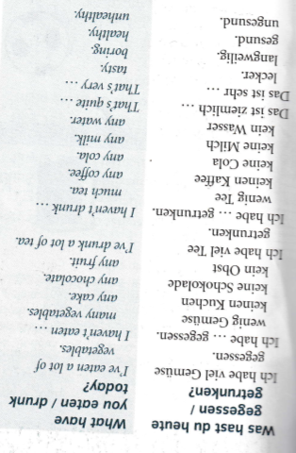
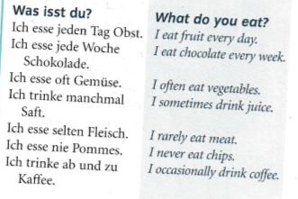
WEEK 4 –
Copy these words in to your orange book and try and learn them.

Slide 18
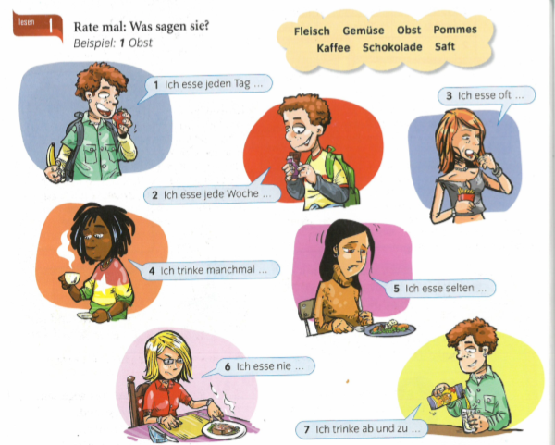
Complete the sentences using the words from the cloud

Slide 19
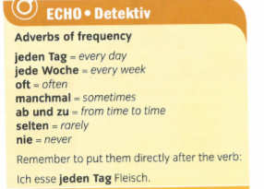
Copy these time phrases in to your book

Slide 20
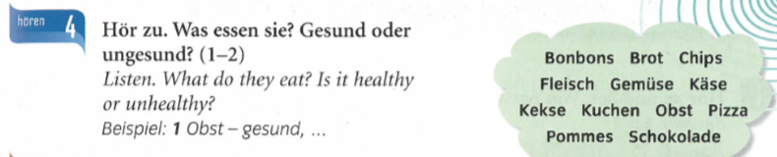

Slide 21
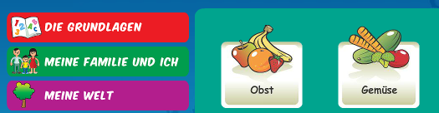
Log in to Linguascope
Username = kingshill
Password = bonjour123
Then have a go at the ‘Obst and Gemüse’ (fruit and veg) sections in the beginner area.

Slide 22
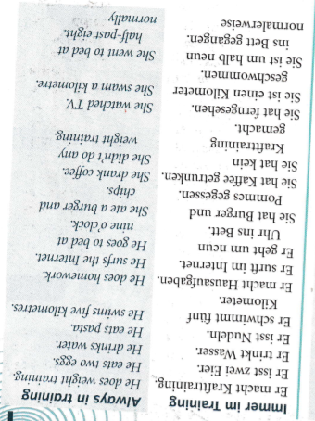
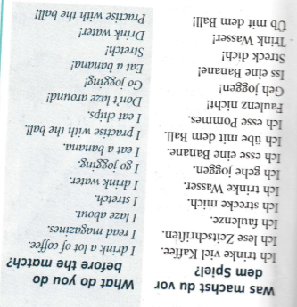
WEEK 5
Copy these words in to your orange book and try and learn them.

Slide 23
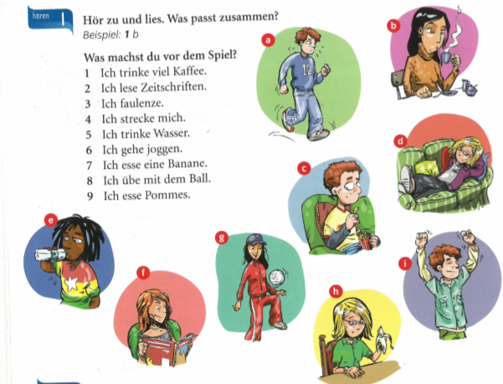
Match up the 9 sentences with the pictures

Slide 24

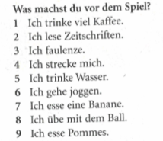
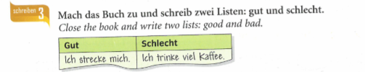
Listen to the recording. Write down 1-4. Which activities from the list do the 4 people like to do? Make a list for each person.

Slide 25
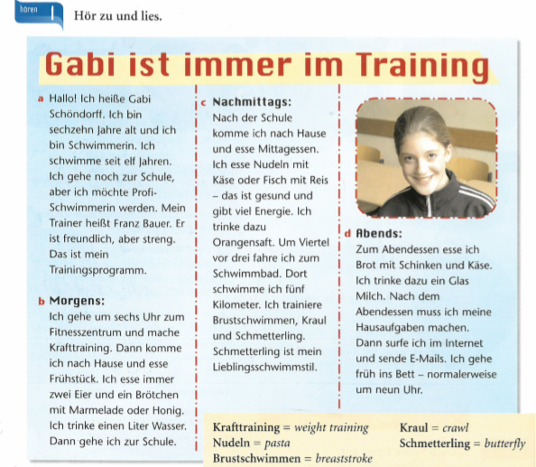
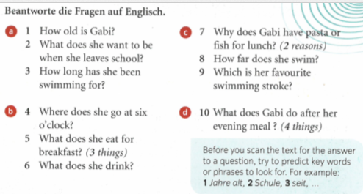
Listen to the recording. Read along. Look up any new words you don’t know using an online dictionary. Then answer the 10 questions in English.

Slide 26
WEEK 6 –
This week is assessment week. Spend some time revising all of the vocab on these slides so far and then email your teacher for the test papers.

Slide 27
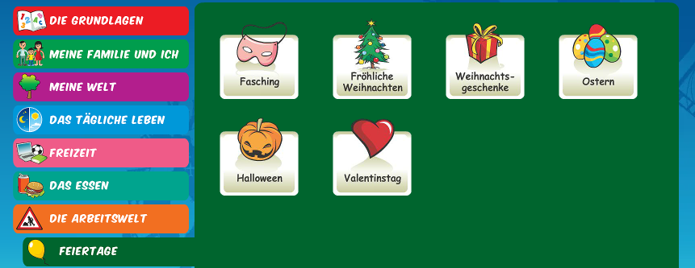
WEEK 7 –
Learn about Christmas in Germany by reading the following slides. Then make your own poster or Powerpoint about Christmas in Germany or do some of the Linguascope Christmas activities in the beginner section.
Username:
kingshill
Password:
bonjour123

Slide 28


Weihnachten in Deutschland
A traditional German
Christmas

Slide 29
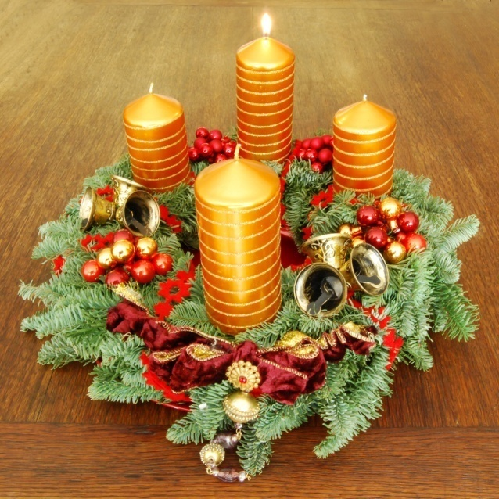
Beginning
At the end of November, families either make or buy an Adventkranz.
The Adventkranz is made of fir twigs and contains 4 candles.
A candle is lit every Sunday leading up to Christmas Eve.

Slide 30
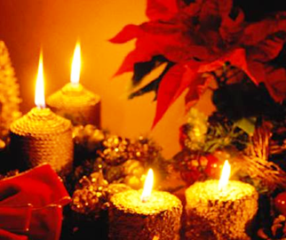
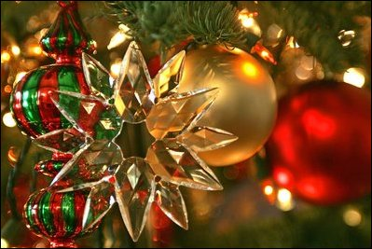
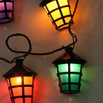
Pre-Christmas
Christmas celebrations start earlier in Germany than in England. About four weeks before Christmas, German families decorate their homes with small lights, lanterns and wreaths.

Slide 31
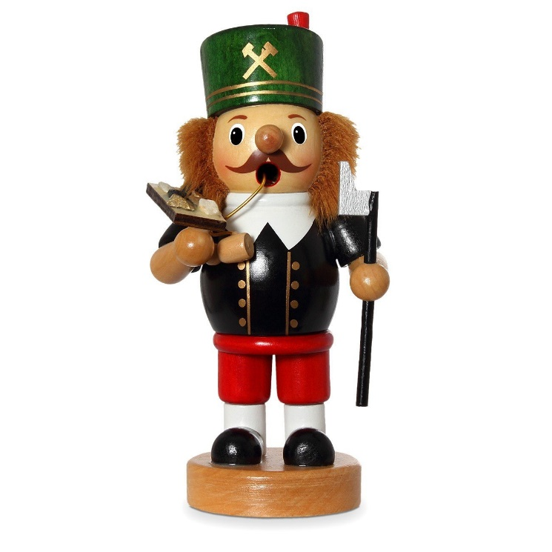
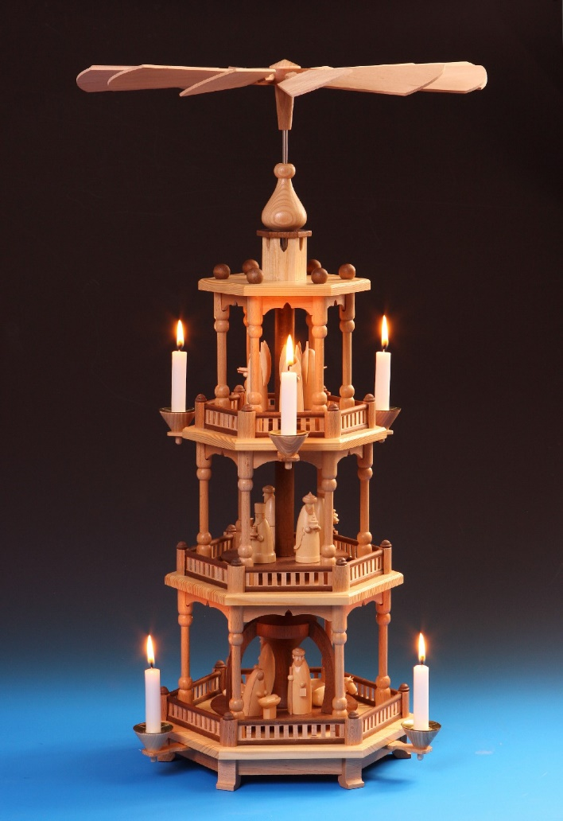
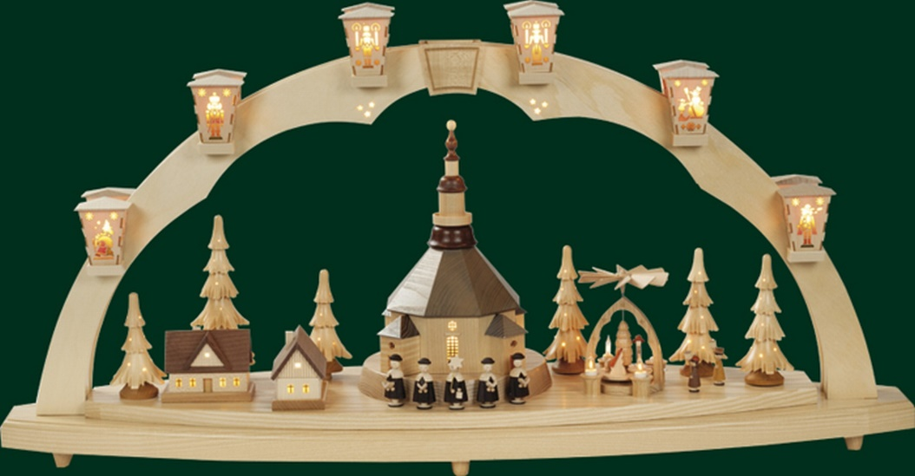
Decorating the home…

Slide 32
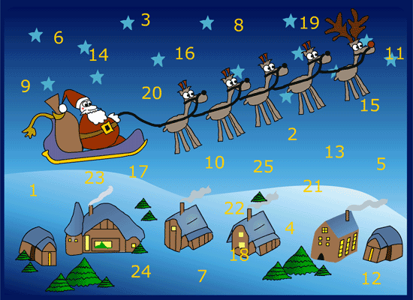
Most German children also have an Adventskalender. These are also popular in England now. For each day up to Christmas, there is a door to be opened. Sometimes behind this door you will find a picture, poem or sometimes a piece of chocolate.

Slide 33
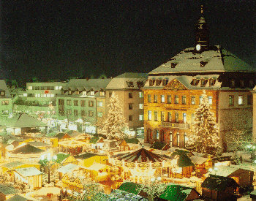
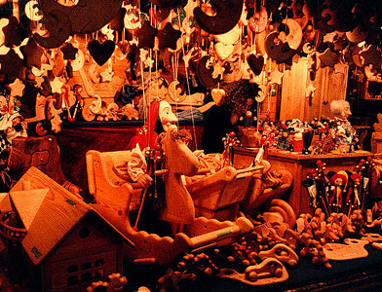
Between the December 6th and 23rd it is the tradition in Germany to visit the Weihnachtsmärkte
  You can buy;
  Food: Bratwurst (sausages), Waffeln (waffles), Glühwein (mulled wine), Crêpes etc.
  Clothes: Scarves, caps, gloves, jumpers etc.
  Christmas decorations.

Slide 34
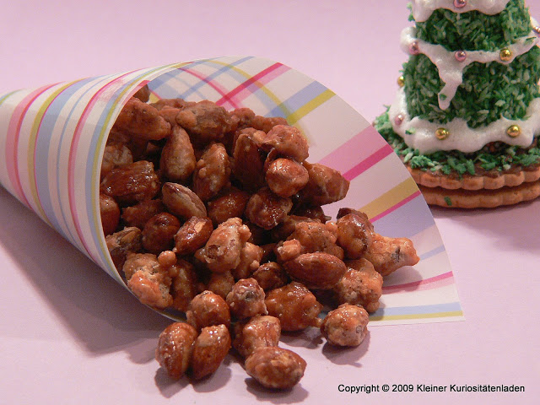
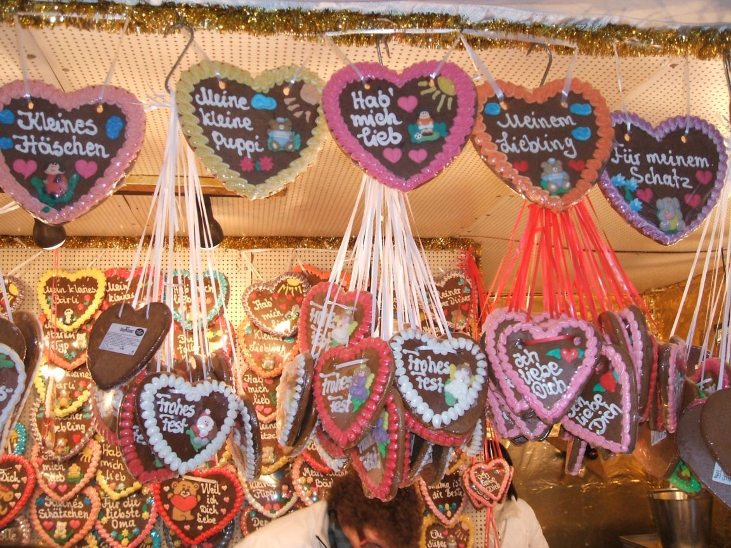
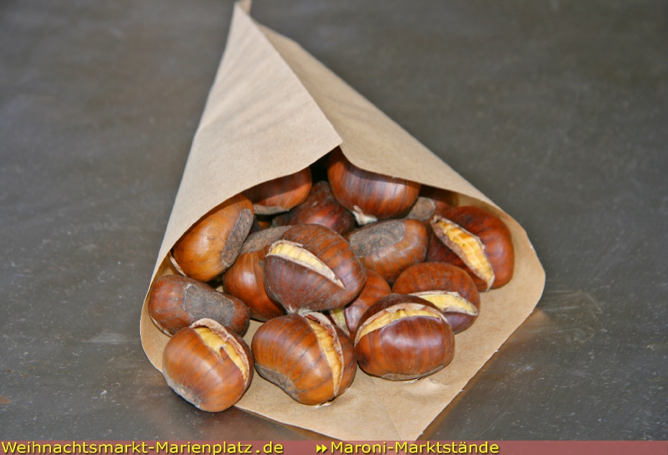
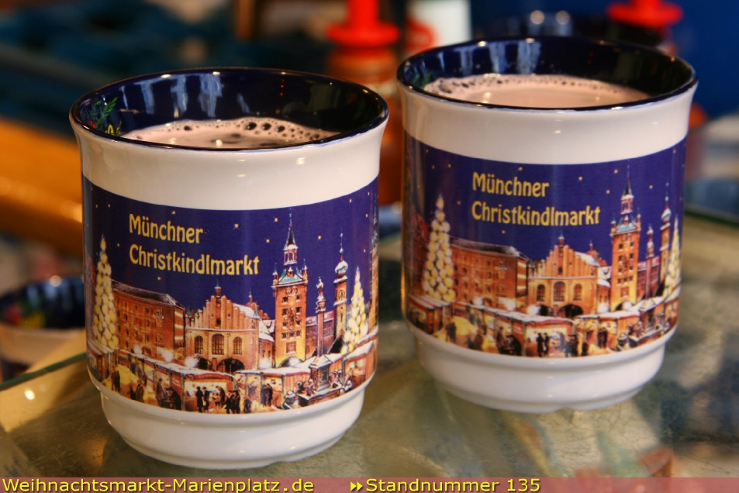
Auf dem Weihnachtsmarkt…
gebrannte Mandeln
Lebkuchen
Maroni
Glühwein

Slide 35
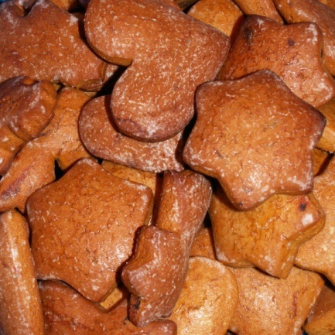
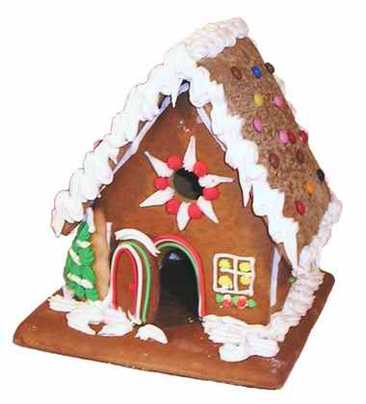
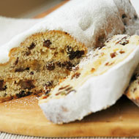
Families often set aside special evenings for baking spiced cakes, cookies and gingerbread houses.
Families also make gifts & decorations. Little dolls of fruit are traditional Christmas toys.
Stollen
Lebkuchen

Slide 36
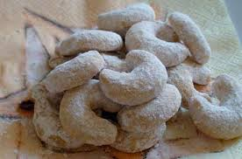
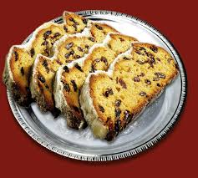
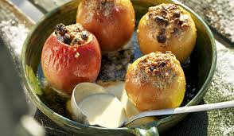
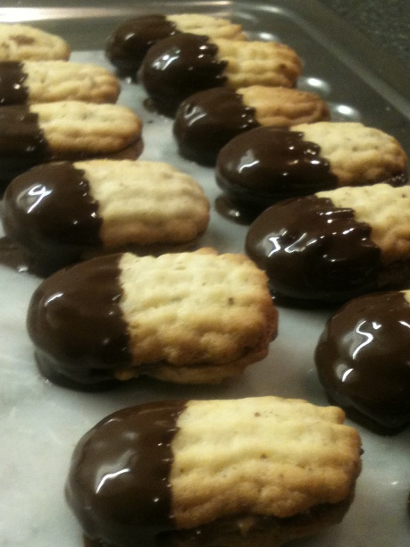


Weihnachtsbäckerei
Vanillekipferl
Stollen
Bratäpfel
Zimtsterne
Bärentatzen
Spekulatius

Slide 37


On the evening of December 5th children leave their shoes or boots outside the front door.
That night, St. Nikolaus visits and fills the shoes with chocolates, fruit, nuts & sweets.

Slide 38





German families celebrate Christmas on the morning of Christmas Eve (Heiligabend).
The family decorates the tree with apples, sometimes with real candles, baubles (Kugeln) and with (Engelshaar) (‘angel’s hair’ – tinsel).
At the top of the tree is a star (Stern) and at the foot of the tree the crib (Krippe).

