Slide 1
Year 8 Spanish TERM 2: Viva 1 textbook, chapter 2
If pupils are absent from lessons they should spend time revising and learning vocabulary. All of the vocabulary for this term is on the following slides. First of all, they should recap the vocabulary which they learned the previous week. Then they should start to learn the next section of vocabulary which they have not yet covered in class. This could be done by using the look, cover, write, check method or by making flashcards etc. It should also be written in their orange book. There are also a few tasks to complete. A plan for the term is on the next slide.
Pupils can also revise vocabulary on Linguascope-
Username is kingshill password is MFL123*
Any new vocabulary they learn can be written in their orange books or on paper.
If pupils wish to do extension work they can access free MFL lessons on the Oak National Academy website:
https://classroom.thenational.academy/subjects-by-key-stage

Slide 2
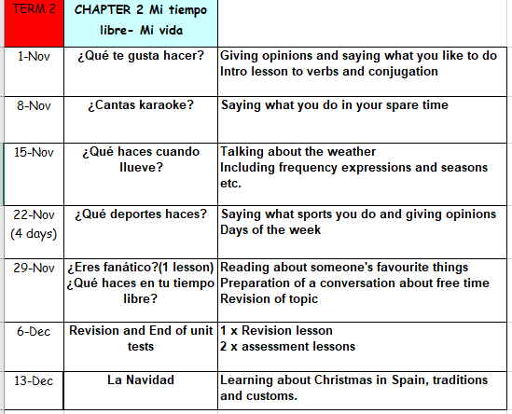

Slide 3
WEEK 1 –
Copy this vocab in to your book and try and learn it

Slide 4
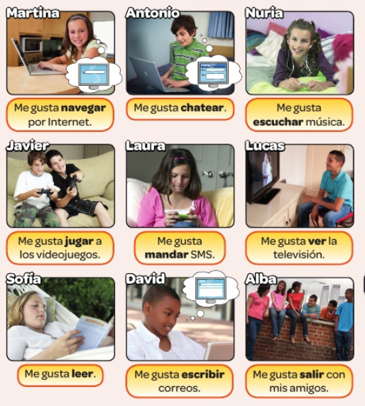
Listen to the recording and look at the pictures. Write 1-9 then write the name of who is talking.

Slide 5
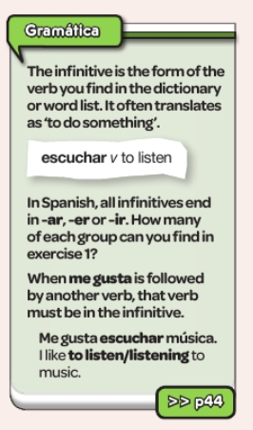
Copy this information in to your orange books and do the activity.

Slide 6
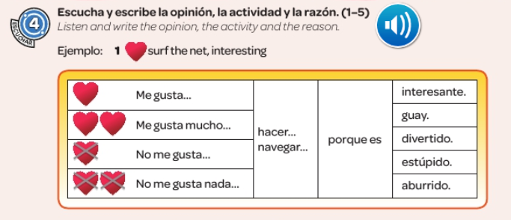

Slide 7
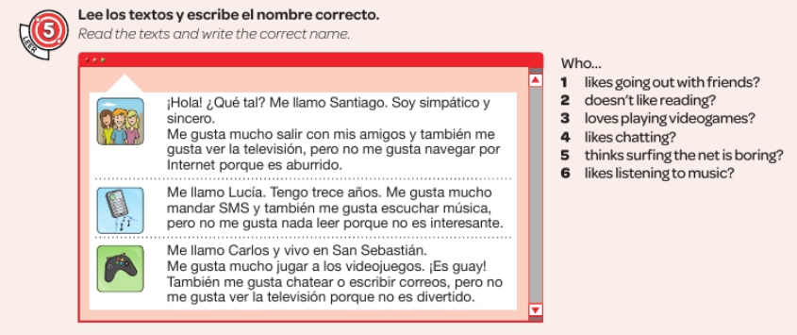

Slide 9
WEEK 2 –
Copy this vocab in to your book and try and learn it

Slide 10
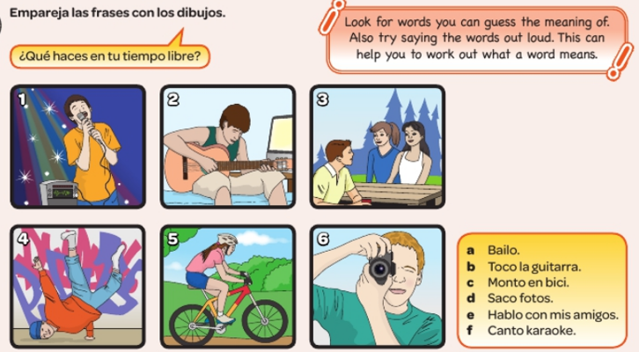
Match the phrases a-f with the pictures

Slide 11
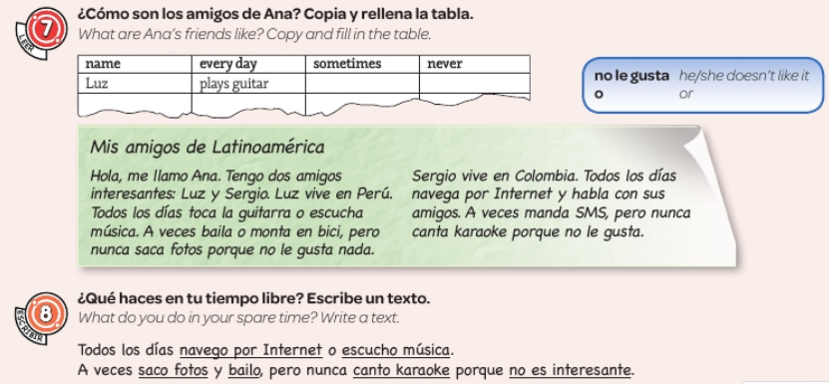

Slide 12
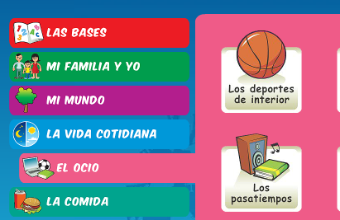
Log in to Linguascope
Then have a go at the ‘los pasatiempos’ (pastimes) section in the beginner area. Make a note of any words.

Slide 13
WEEK 3
Copy this vocab in to your book and try and learn it

Slide 14
Listen to the recording and write down the correct letter.

Slide 15
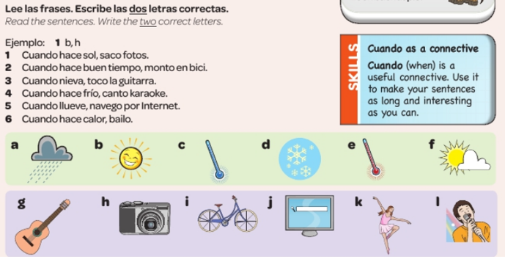

Slide 16
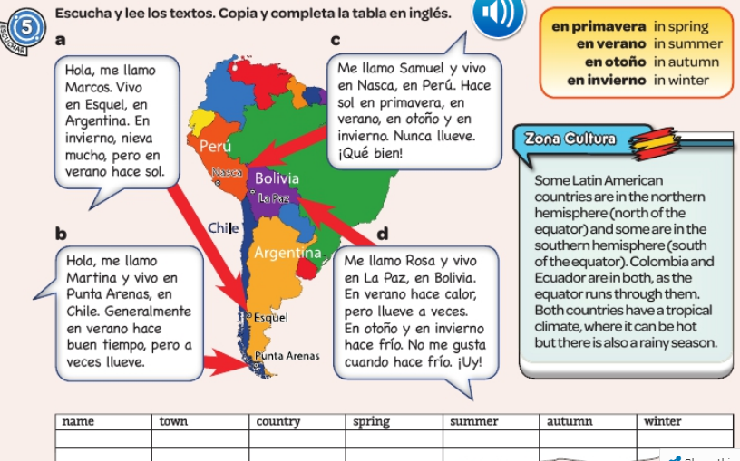
Read the texts. Copy the table and fill it in (in English).

Slide 18
WEEK 4 –
Copy this vocab in to your book and try and learn it

Slide 19
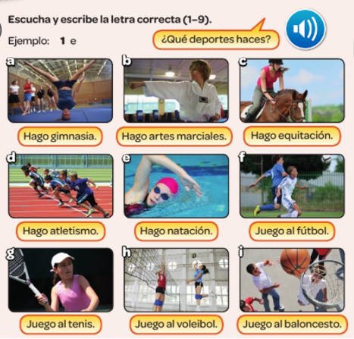
Listen and write the correct letter a-i

Slide 20
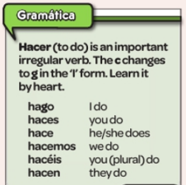
Copy this information in to your book

Slide 21
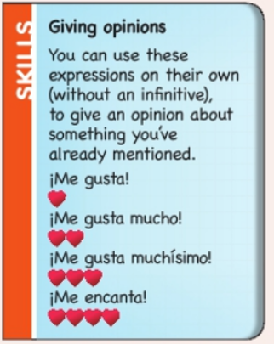
Copy this information in to your book

Slide 22
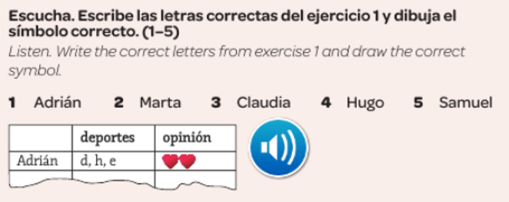

Slide 23
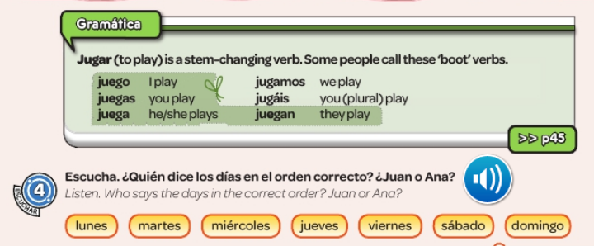

Slide 25
WEEK 5 –
Copy this vocab in to your book and try and learn it

Slide 26
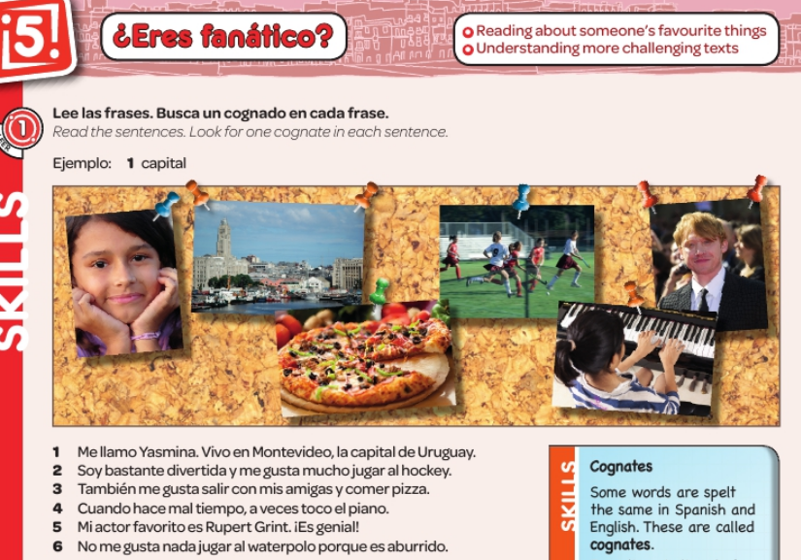

Slide 28
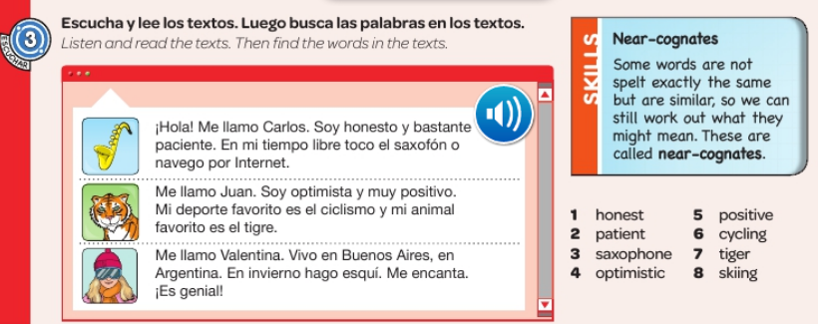

Slide 30
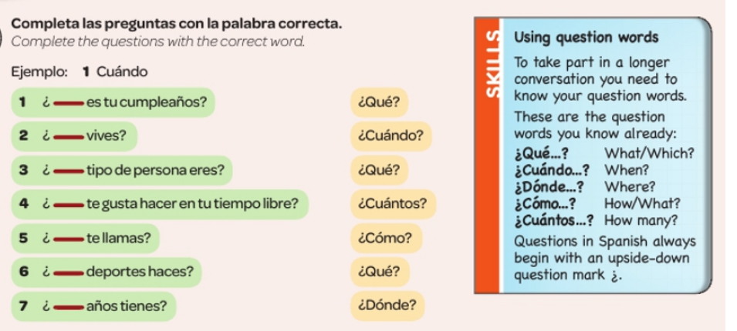

Slide 31
WEEK 6 –
This week is assessment week. Spend some time revising all of the vocab on these slides so far and then email your teacher for the test papers. Also revise the words below.

Slide 32
WEEK 7 –
Learn about Christmas in Spain by reading the following slides. Then make your own poster or Powerpoint about Christmas in Spain or a Spanish speaking country.
There is a Christmas section on Linguascope in the beginner section too.

Slide 33
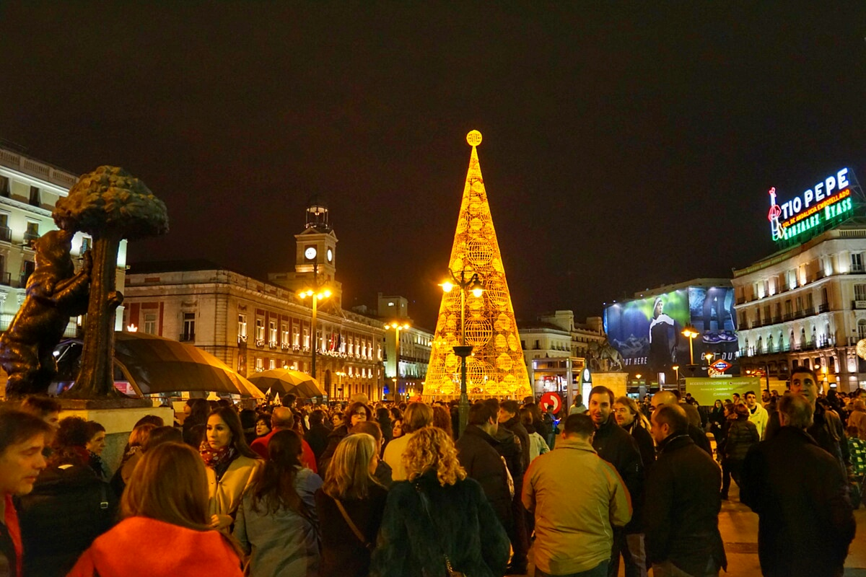
¡Feliz navidad!

Slide 34
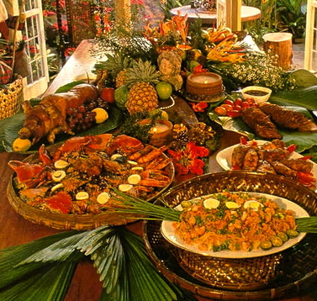
La nochebuena
La nochebuena is the night before Christmas day in Spain. This is when most families eat a large Christmas meal, usually turkey, pork or sea food. El turrón
is similar to nougat and is traditionally
eaten for dessert.
Then people usually go to Mass or
‘La Misa del Gallo’

Slide 35
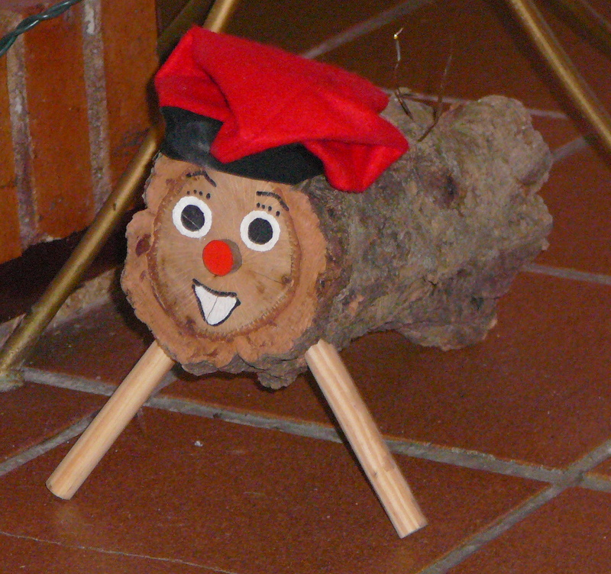
El Día de Navidad
El Día de Navidad is another day for celebrating with family.
There is a tradition of hitting a Christmas log in some parts of Spain. Children hit the log and receive presents from it.

Slide 36
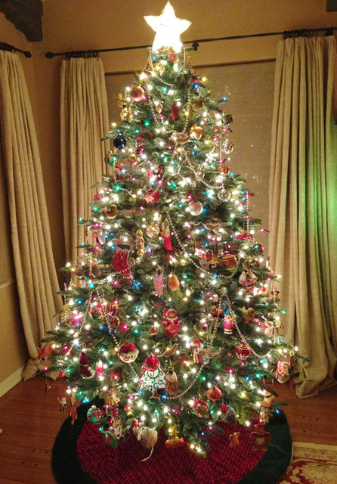
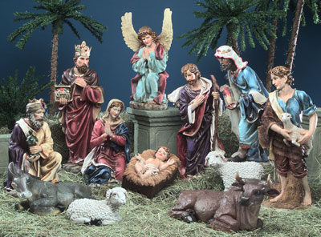
Un portal de Belén
In Spain, most houses display a Nativity scene which displays the scene of the birth of Jesus. What would you expect to see in it?
Some houses will also have a Christmas tree.

Slide 37
El día de los Santos inocentes
28th December is similar to April Fool’s Day in Great Britain. If you trick someone you call them ‘inocente, inocente’.

Slide 38
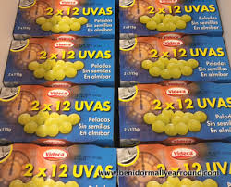
La noche vieja
New year’s eve is called La noche vieja in Spain. People go out to party. At midnight, the bells chime and traditionally everybody eats 12 grapes.

Slide 39
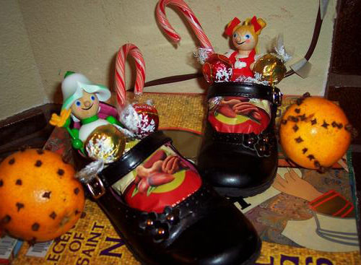
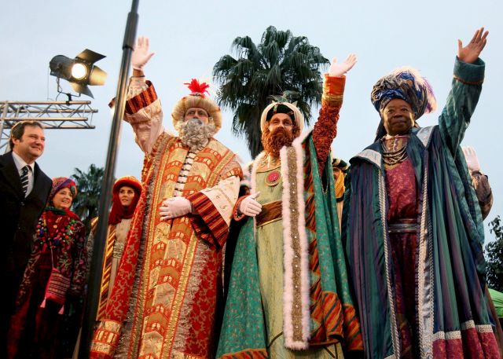
El Día de los Reyes
The 6th of January is one of the most important days in Spain over the Christmas period. On Epiphany, Spanish people receive presents to celebrate when the three kings gave presents to the Baby Jesus.
Children leave out shoes to be filled with presents instead of stockings!
There are the Tres Reyes Magos parades in the streets on the 5th January.

