Slide 1


Year 8 French TERM 2: Studio 1 textbook, chapter 1
If pupils are absent from lessons they should do the activities on the following slides. Then they should spend time revising and learning vocabulary. All of the vocabulary for this term is on the following slides. First of all, they should recap the vocabulary which they learned the previous week. Then they should start to learn the next section of vocabulary which they have not yet covered in class. This could be done by using the look, cover, write, check method or by making flashcards etc. It should also be copied in to their orange books. A plan for the term is on the next slide.
Pupils can also revise vocabulary on Linguascope-
Username is kingshill password is MFL123*
Any new vocabulary they learn can be written in their orange books or on paper.
If pupils wish to do extension work they can access free MFL lessons on the Oak National Academy website:
https://classroom.thenational.academy/subjects-by-key-stage

Slide 2
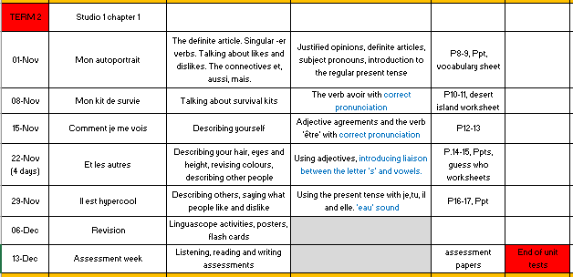

Slide 3
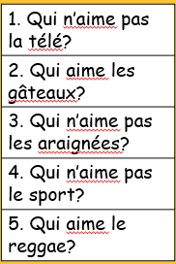
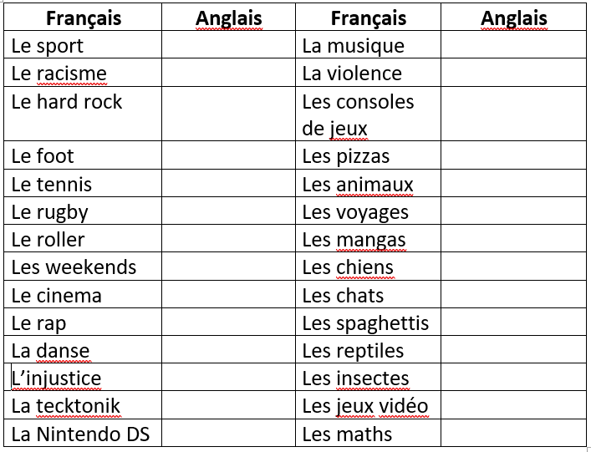
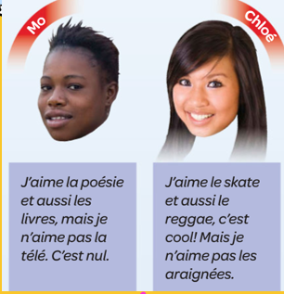
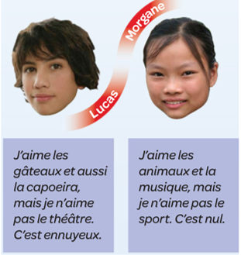
Week 1 – How many of the words in the grid can you guess? Copy it into your book. Then, do the reading activity and answer the questions (Qui – who). Try to learn as much of the vocab on the following slide as you can.
If you are unsure of any words use www.wordreference.com to help you translate them

Slide 4
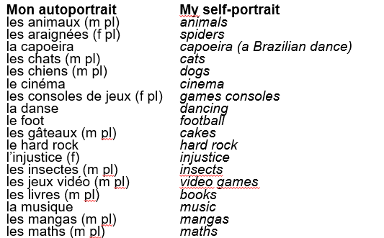
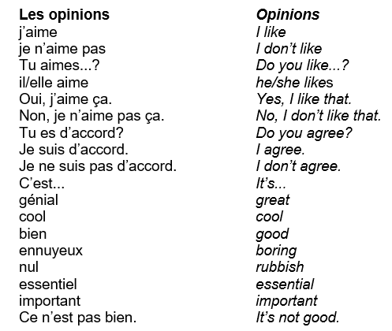
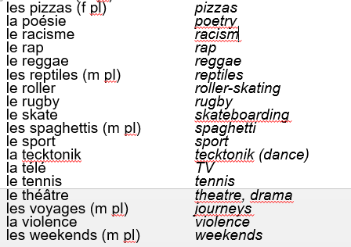

Slide 5
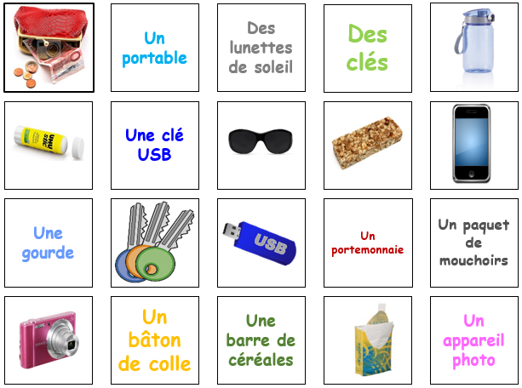
Week 2 – match up the pictures with the words, write them in your book and draw a picture for each one. Copy the verb ‘avoir’ into your book and make some sentences about what you have in your survival kit. Try to learn as much of the vocab on the following slide as you can.
Avoir
J’ai – I have
Tu as – you have
Il / elle a – He / she has

Slide 6
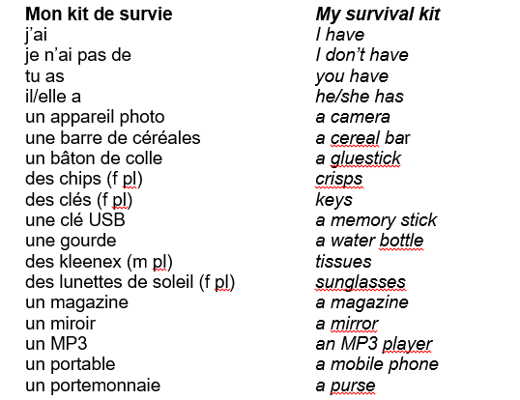
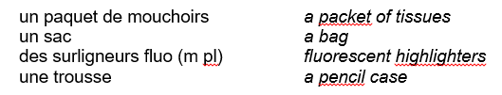

Slide 7
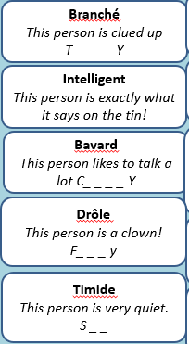
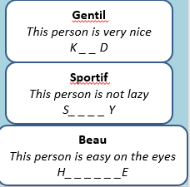
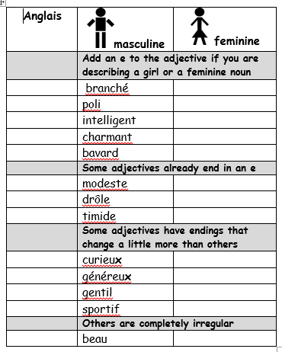
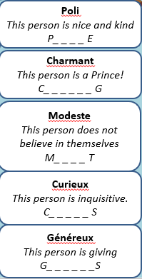
Week 3 – Copy the grid into your book and translate the words into English using the clues to help you. Use the rules on the sheet to make the adjectives feminine. Copy the ‘être’ verb into your book and make some sentences. Try to learn as much of the vocab on the following slide as you can.
Être
Je suis – I am
Tu es – you are
Il / elle est – he / she is

Slide 8
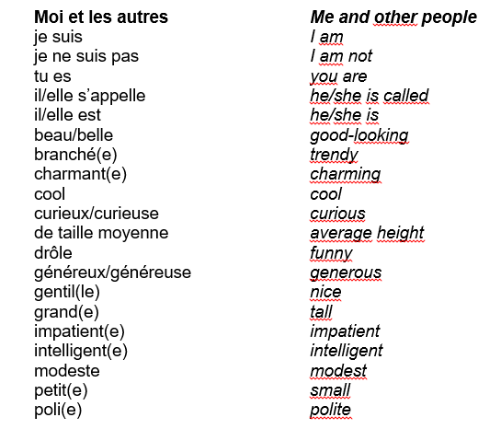

Slide 9
Week 4 – copy the vocab into your book and draw a picture for each expression. Find the translations on the vocab slide in this presentation. Draw 3 people and describe them in French. Try to learn as much of the vocab on the following slide as you can.
J’ai les cheveux…
Courts
Mi-longs
Longs
J’ai les
cheveux…
Bruns
Noirs
Blonds
Roux
Châtain
J’ai les yeux…
Bleus
Verts
Marron
Noirs
Gris
Noisette

Slide 10
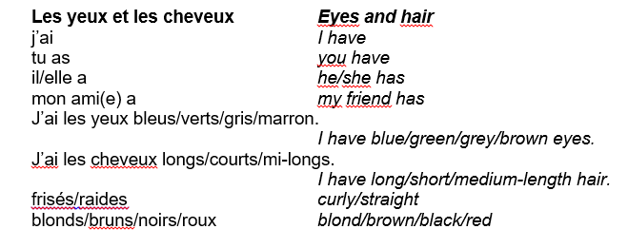

Slide 11
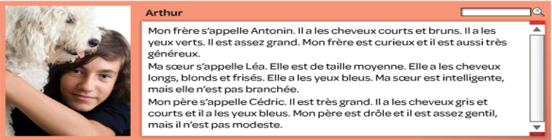

Week 5 – Read the text and fill in the grid in your book. Write a similar text about your family or make one up. Try to learn as much of the vocab on the following slide as you can.

Slide 12
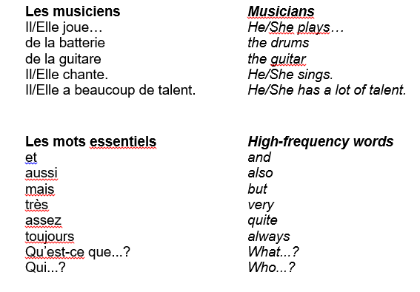

Slide 13
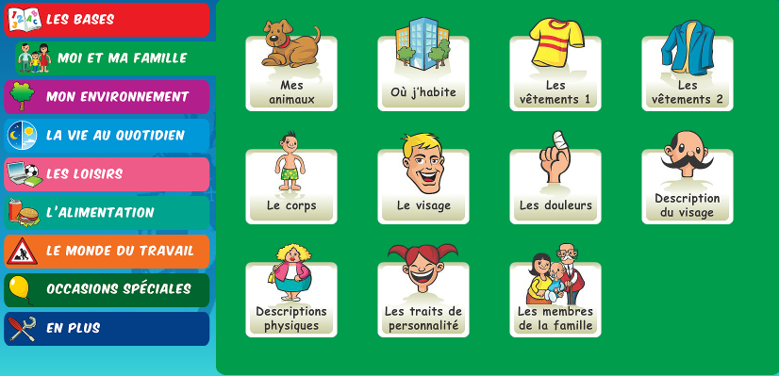
Week 6 – revision week. Make a revision poster about the topics we have covered this term. You can also do some revision activities on linguascope.

Slide 14
