Slide 1
The America’s and Drake’s Circumnavigation, 1577-1580
What was the significance of Drake’s Circumnavigation, both for England and more widely?
Elizabeth
Drake
Spain
France
William Cecil
The Privy Council
Starter:
How would you expect the following to react to Drake’s Circumnavigation?

Slide 2
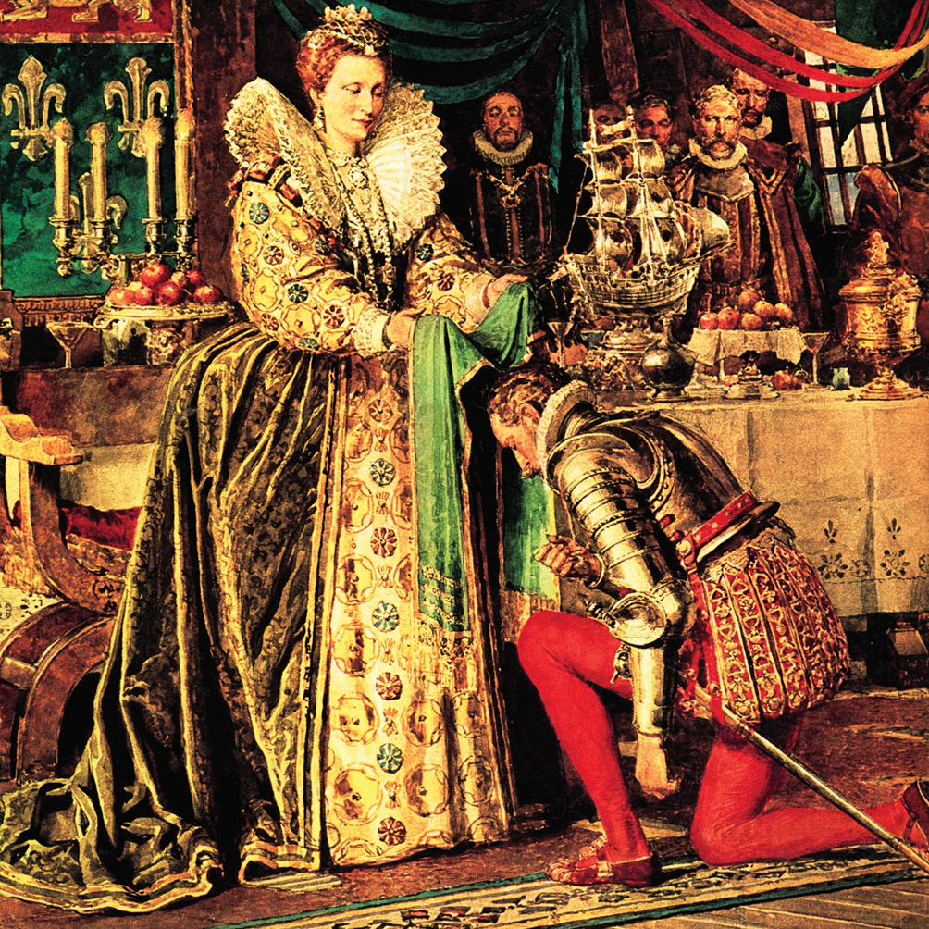
Impacts
On 26 September, Drake finally sailed into Plymouth with 59 remaining crew members and the immensely valuable cargo of treasure and spices.
How Drake was received in England would depend on how the Queen responded to his arrival. The Spanish King knew of Drake’s actions and demanded restitution and punishment. However, Elizabeth realised that Spain would not go to war simply because of Drake, so she decided to back him. She welcomed his treasure, rejected the protests of the Spanish ambassador and had him knighted on the deck of his own ship.
Queen Elizabeth deliberately handed the ceremonial sword to the French ambassador on 4 April 1581, and invited him to knight Drake for her, thus involving France in a blatant insult to Philip of Spain.
Reading this information, write down how Drake’s Circumnavigation affected:
-His own status
-The Queen’s position
-The Spanish
-England’s regional status

Slide 3
Significance of Drake’s Voyages
In your booklet, you now have a series of sources, taken from different time periods.
Next to each of the sources, explain how this proves to be a reason why Drake’s Circumnavigation was significant.
This means that it wasn’t just important at the time, but had lasting importance.

Slide 4
Summary
Using the spider diagram on the next page of the booklet, explain why Drake’s Circumnavigation was so important.
Give examples for each factor, demonstrating the consequences from that factor.

