Slide 1
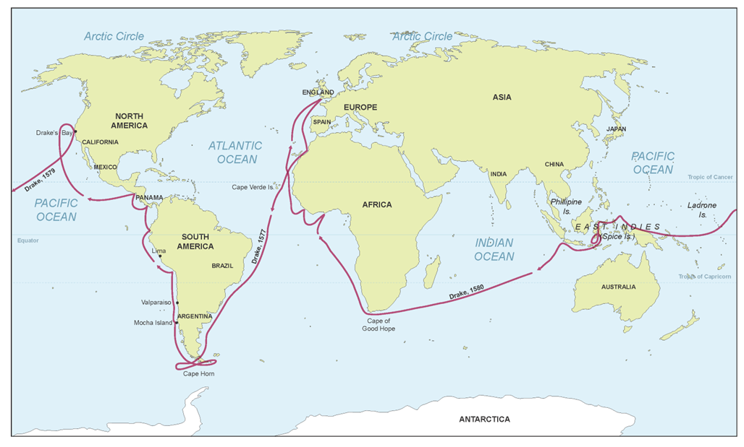
The America’s and Drake’s Circumnavigation, 1577-1580
What does the Circumnavigation tell us about why Drake embarked on his voyage around the world
Starter:
Write down three ideas for each of the following:
Developments of the Early Modern Period to encourage exploration.
Reasons why Drake became a wealthy explorer.
Reasons why Spain were such a powerful country.

Slide 2
Context
Drake set sail from Plymouth in December 1577 with 5 ships.
He would sail South, around the Bay of Biscay, to the West Coast of Africa, across the Atlantic and down the South American coast.
He would then sail up the Magellan Straight (West Coast of South America) and raid all the Spanish ports for gold.
They then stopped in modern-day California, before stopping at a series of Pacific islands, establishing trade connections.
Finally, Drake sailed around the Cape of Good Hope (South Africa), returning up the West Coast of Africa back to Plymouth, with only one ship.
Drake was the first man to successfully circumnavigate the world (and survive).

Slide 3
Understanding about what happened
For today’s lesson, we’re going to look at what happened in the Circumnavigation, and use it to infer why he embarked on the voyage.
We’re going to study each phase of his voyage.
Using each of these phases, we’ll explore why he acted in this way, and therefore assess his objectives.
In your booklet are a series of phases to explore. Read the phase and then write next to it possible motivations, with justification.

Slide 4
Factors
Come up with three main reasons why Drake Circumnavigated the Globe.
Now, provide a list for each of your arguments, of evidence you can take from his voyage.
Using this, reach a judgement. What do you think was the main reason for Sir Francis Drake embarking on his circumnavigation?

