Slide 1
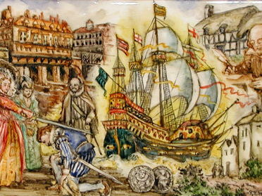
The America’s and Drake’s Circumnavigation, 1577-1580
Context: Why were Spain so powerful in Europe during Elizabeth’s Reign, and why were they a natural Rival to England?
Starter:
Write a list of things you already know about Spain from the Elizabethan England module.

Slide 2
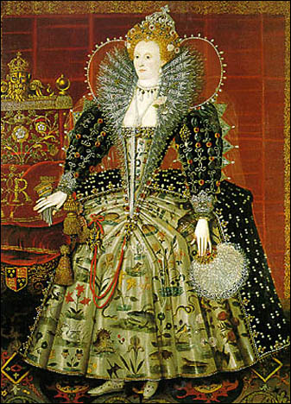
Why were the Spanish so powerful?
Due to the increase in art, technology, theatre, architecture and so much more has led to many Historians calling Elizabethan England a ‘Golden Age’.
However, England’s growth came within broader movements:
The rise of Western Europe as exploration led states
Religious division tearing across Europe.
Spain was at the forefront of much of this.

Slide 3
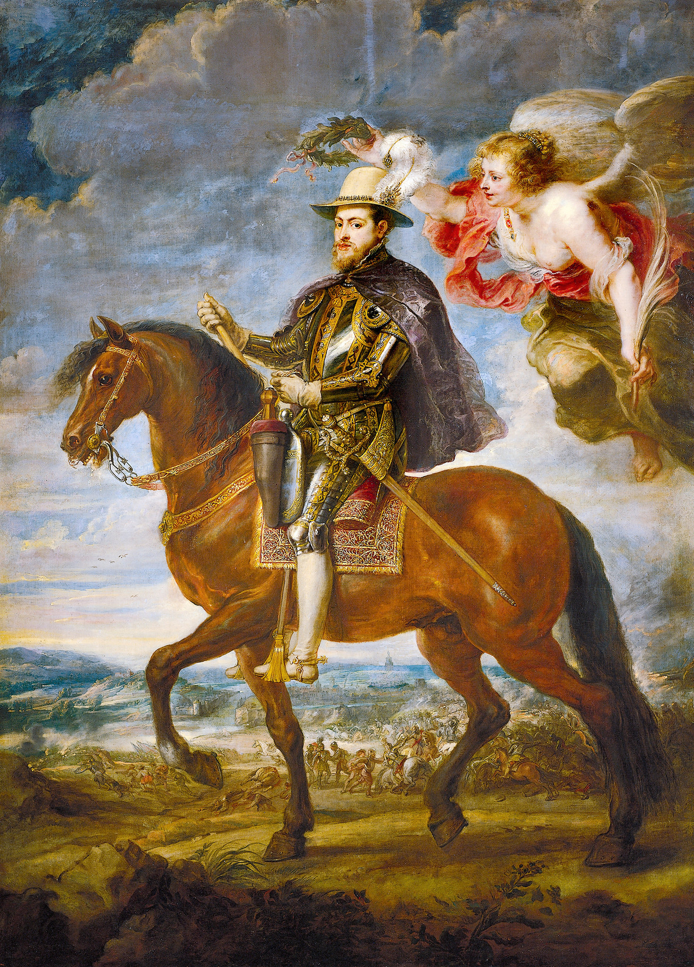
Spain, A Profile
The early modern period is typically said to have started around the late 1400s and ended in the late 1700s. For early modern Spain, it meant the establishment of royal authority, a more unified Spain, the discoveries of the New World, and Spain’s development into a dominant European power.
The late fifteenth to sixteenth century was a decisive period for Spain, in which the country became more unified and expanded its power around the world.
However, during this prosperous period, there was also a lot of suffering. Jewish, Muslim, and Protestant Spaniards experienced harsh oppression under the force of the Spanish Inquisition, while the Spanish colonisation in the New World had deadly consequences for indigenous populations.
Write three reasons why Spain was so powerful in the Early Modern period.

Slide 4
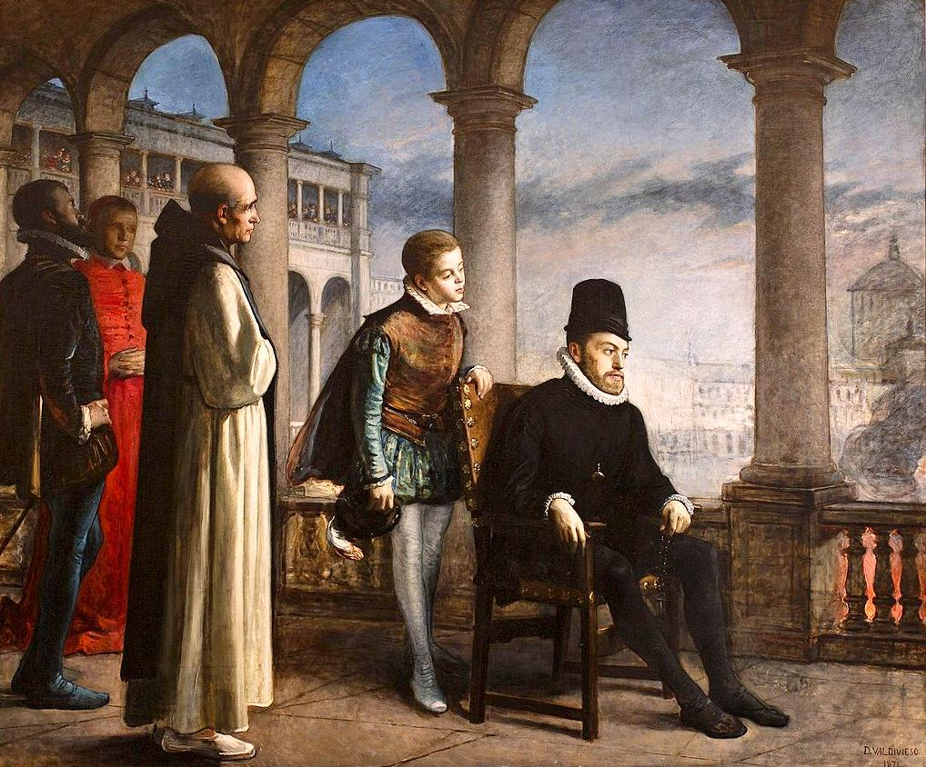
Factors – Why was Spain so Powerful?
The next three pages of your booklet have three different factors describing Spain’s power during the Tudor period.
Read through the context, and the Primary Source.
Then, on the space below answer the questions in the box. Be clear in your points, use examples from the text.

