Slide 1
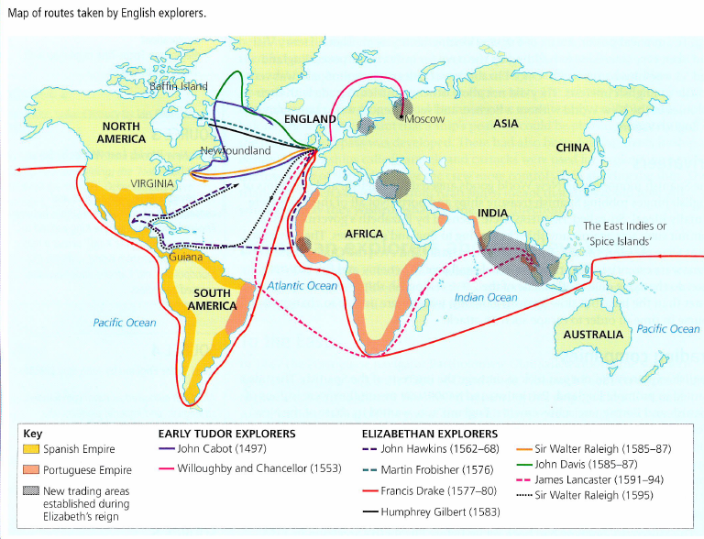
Annotation
Raleigh and Hawkins
Traded with the Americas. Raleigh established colonies (Roanoke fails). Hawkins established Britain’s involvement in slave trade.
Highlight Drake’s route around the world using one colour
Fill in the boxes at the bottom of the page with the information next to the map.
Willoughby and Chancellor
Exploring during time of Mary I. Establish a Northern trade route to Moscow as part of the Muscovy Company.
Cabot/Davies/Gilbert/ Frobisher
Looked for the Northern Passage through Canada. All failed to find one. (Too icy to exist)

Slide 2
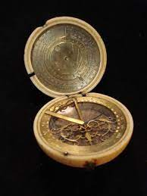
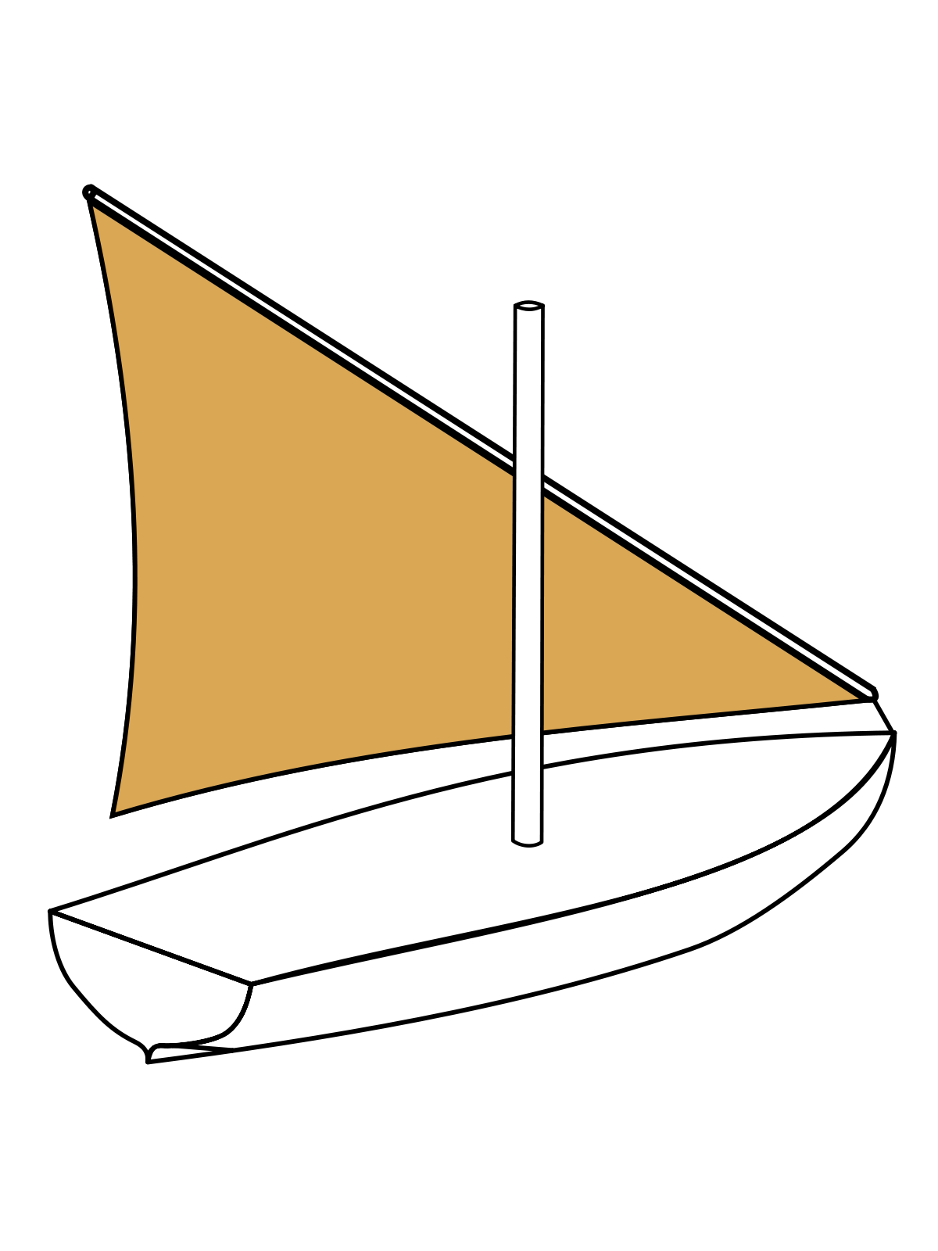
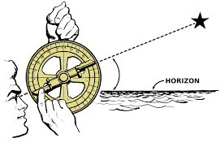
The America’s and Drake’s Circumnavigation, 1577-1580
Drake and Exploration: Who was Sir Francis Drake, and how did he become one of England’s most famous Explorers?
Starter:
What are the terms for the images on this slide?
How are they linked to what we learnt about last lesson?

Slide 3
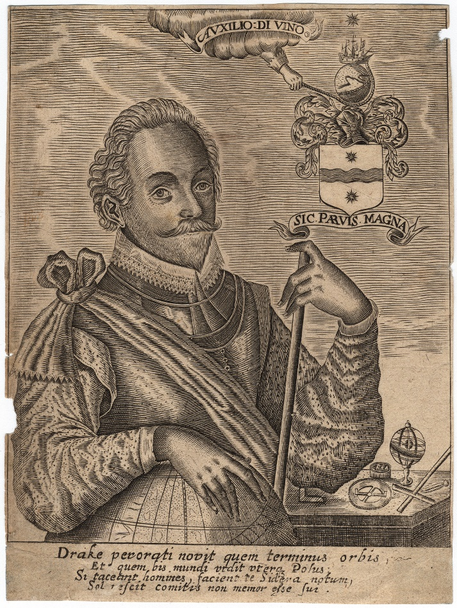
Sir Francis Drake
Based on your analysis of this source. Write down three inferences you can make about Drake’s life.
You may have considered:
-He Circumnavigated the globe
-He mapped the world
-He had a large role in America
-He believed God willed his journey
-He came from humble beginnings and rose through the Chain of Being.
‘Auxilio divino means ‘By Divine Aid’ or ‘With God’s help’. The hand from the cloud is guiding Drake’s ship around a globe. What is the purpose of this?
You have this image of Sir Francis Drake in your booklet.
In your booklet, answer the questions around the source. This is how Drake wanted to be perceived.
This is Drake’s coat of arms. A sea with a sun either side – why? His motto is ‘Sic Parvis Magna’ meaning ‘Great things from small beginnings’ Why?
Drake seems to be looking into the distance calmly. Why is he presenting this way? This is taken from a book about Drake. Why would the author want Drake to look like this?
Drake’s hand rests on the globe, specifically America – why?
These are mapping and navigation tools, including an Astrolabe. Why would the author include these in the image?
This says: ‘Drake knows the limit of the world and which, twice of the world’ Why does it say this?

Slide 4
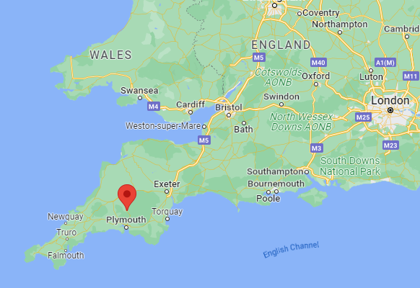
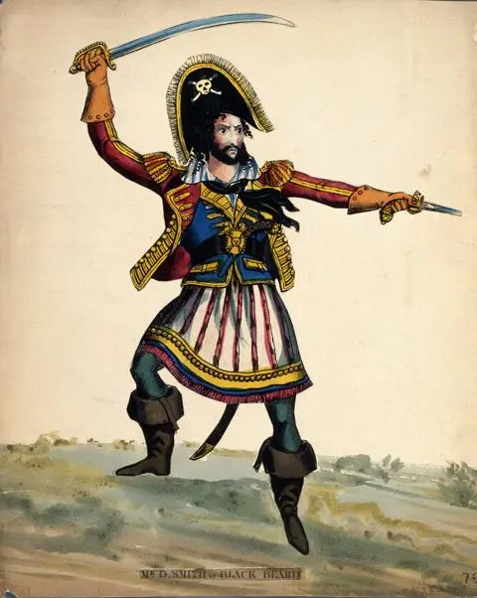
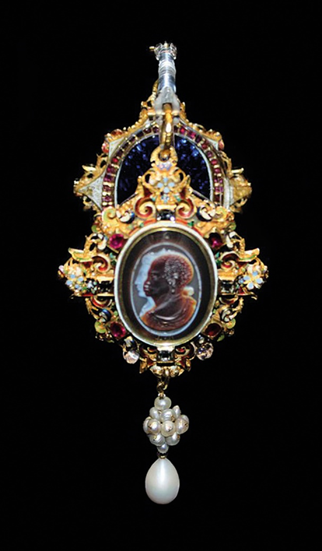
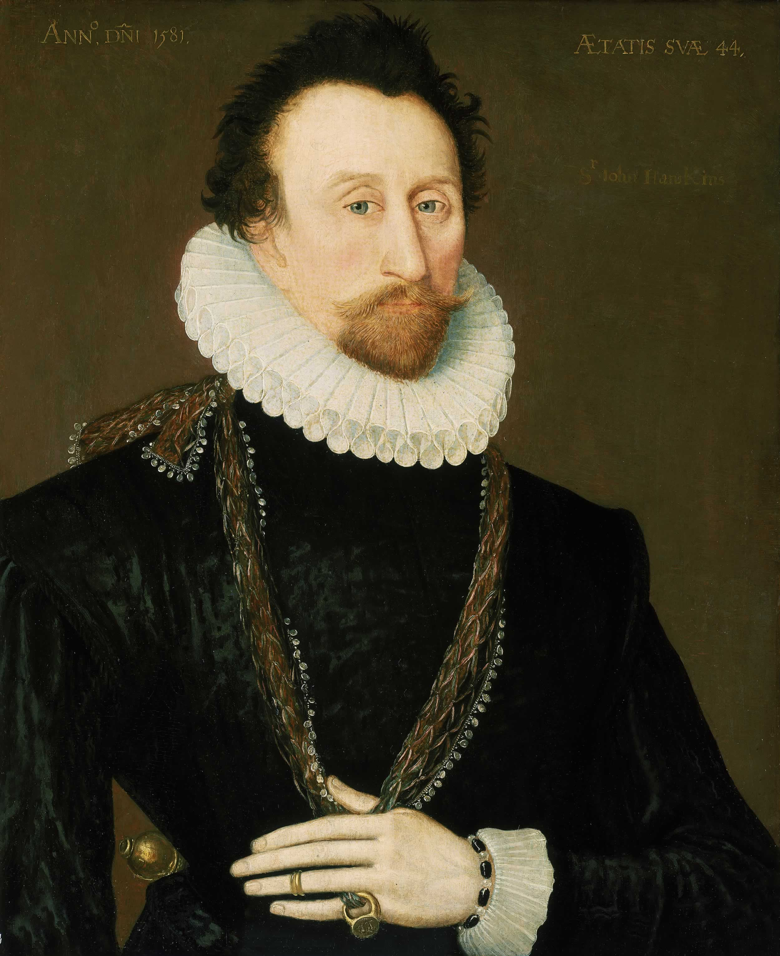
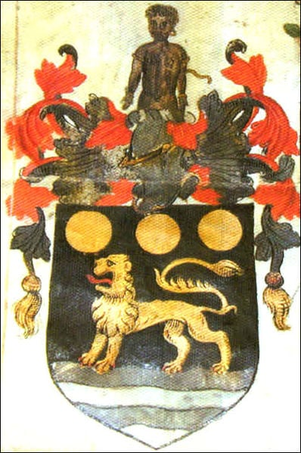
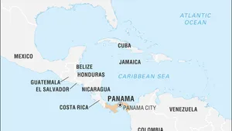
Drake’s Beginnings
On the next page, you have a biography of Drake’s early life.
Highlight and annotate the key points.
Next to your biography are a series of images. Using the biography, write under each image explaining what that is telling us about Drake’s early life.

