Slide 1
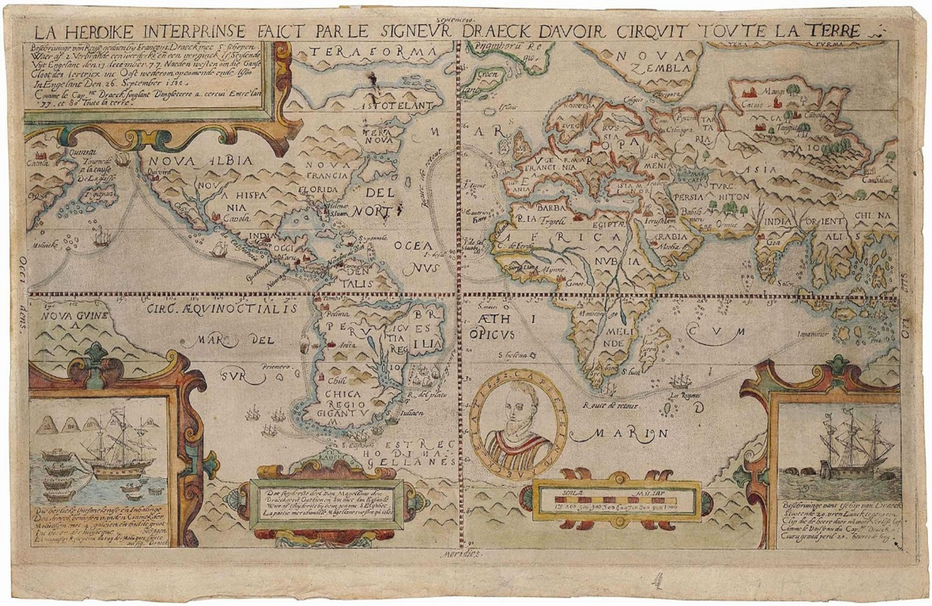
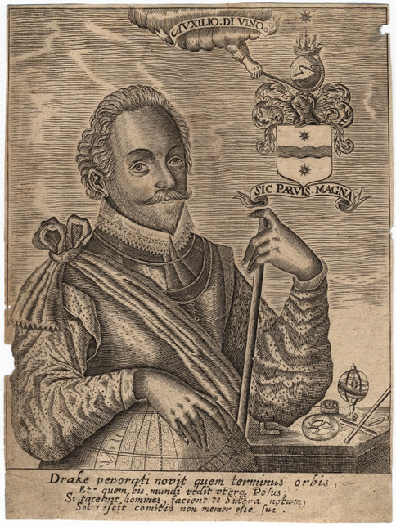
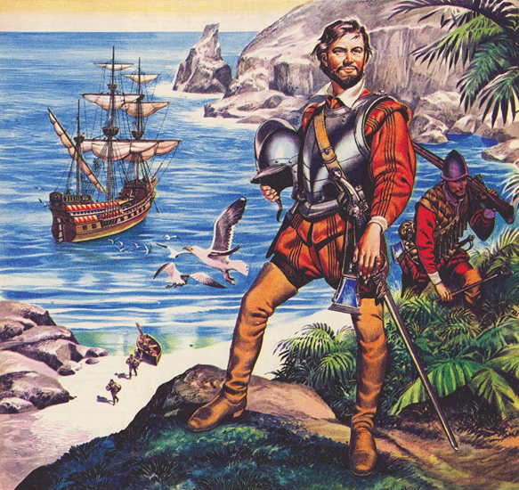
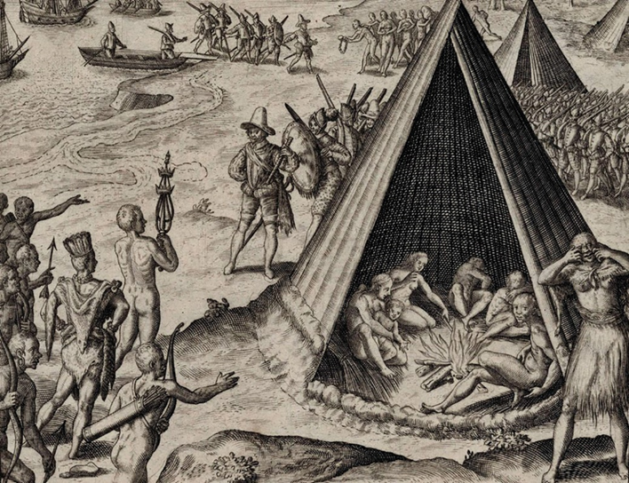
The America’s and Drake’s Circumnavigation, 1577-1580
Introduction: What is the Historic Environment, what is expected, and what are the fundamentals of Elizabethan Exploration?

Slide 2
Booklet
Drake’s Circumnavigation: What is the Historic Environment, what is expected, and what are the fundamentals of Elizabethan Exploration?
For this unit (Ships and Sailors), we’re going to be using a booklet. All of your work will be completed there.
Each lesson has a column along the centre designed for ‘extra notes’. That is intended so you can write anything extra, but everything you need is in the booklet.

Slide 3
Understanding The Historic Environment.
The Historic Environment is 10% of your GCSE. It is definitely going to be your 16 mark question on the Elizabethan England Paper. It should be easy.
Your Historic Environment topic is ‘The America’s and Drake’s circumnavigation’. You need to know about the circumnavigation, as well as being able to link it to the broader Elizabethan England spec.
Your question will explore a second order concept of cause/consequence/change/significance – essentially cause or effect of the circumnavigation. Therefore, we’re going to do the following:
Set the context for the circumnavigation – looking at exploration at the time, and how it developed.
Continue with context, looking at other examples of exploration, both from England and wider Europe – particularly Spain.
Explore the context of Drake, his journey to the circumnavigation. Including his relationship with:
Sir John Hawkins and the Slave Trade
Elizabeth I
Explore the reasons why Drake completed the circumnavigation. We will do a causation exam question on this as practice.
Explore the course of the circumnavigation, looking at his journey to Africa, across the Atlantic, up the Magellan Strait, through the Pacific Islands and returning to Europe.
Assess the significance of the circumnavigation, looking at the consequences of it for both the time and today.
Also applying this to the relationship with Spain, leading tothe Armada.

Slide 4
Questions
We think you’ll be asked one of two types of question: Cause or Consequence
Cause: The basic question: ‘Why did Drake complete the Circumnavigation?’ | Consequence: The basic question: ‘What happened because of Drake’s Circumnavigation?’ (expect the word ‘significant’)
What it’ll look like: ‘The main reason for voyages of exploration in the Elizabethan Period was *insert factor*.’ To what extent does a study of Drake’s Circumnavigation agree with this statement? | What it’ll look like: ‘The main impact of voyages of exploration in the Elizabethan Period was *insert factor*.’ To what extent does a study of Drake’s Circumnavigation agree with this statement?
Factors: -Increased wealth -Increased national reputation -Royal Favour | Factors: -Tensions with Spain -Global Reputation -Increased wealth

Slide 5
Exploration
-To learn more (the Renaissance)
-To improve their personal status
-To improve England’s status (power).
-To acquire wealth and territory.
Now we know about what is expected, let’s set the historical context.
Why would someone explore in Elizabethan England?
Why weren’t Englishmen exploring before this time?
-The Renaissance hadn’t hit England yet
-England was poor, and often at war with itself so too busy.
-Europeans weren’t aware the Americas even existed.

Slide 6
Exploration
Why did exploration happen and what made it possible?
You need two things to make exploration happen:
-The ability to explore
-The want to explore
You have a table in your booklet that you need to fill in.
Ability to explore:
You need to provide examples of technological developments which made exploration possible.
Desire to Explore:
You need to provide examples of the goals which different explorers had, by reading what their voyage sought to achieve.

Slide 7
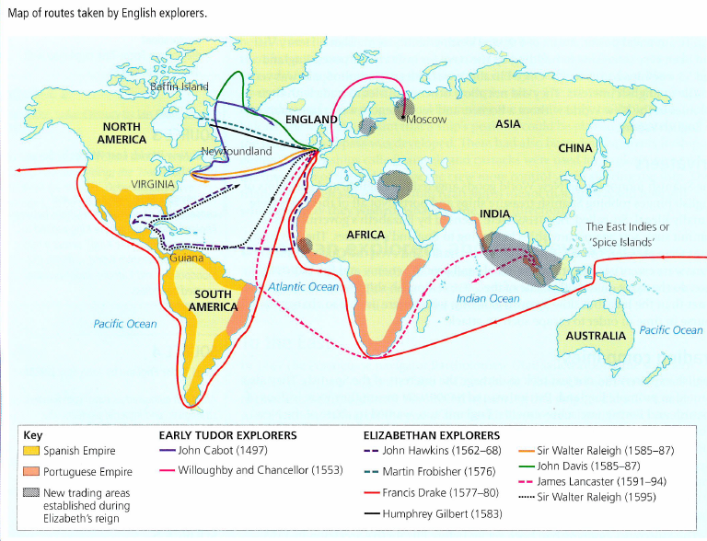
Annotation
You now have the below map.
Using your descriptions of each explorer, annotate your map. What was each explorer trying to achieve?

