Slide 1
Year 11 English Literature Paper Two Revision Booklet
The Secret of Success:
Stop Wishing!
Start Doing!
Name: ___________________________________________
Teacher: ___________________________________________
Class: _____________________________________________

Slide 2
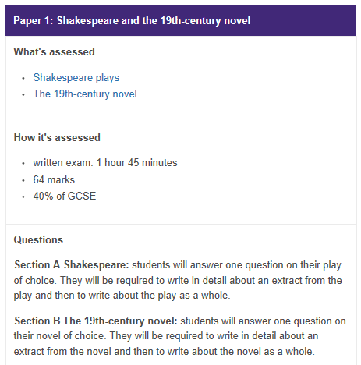
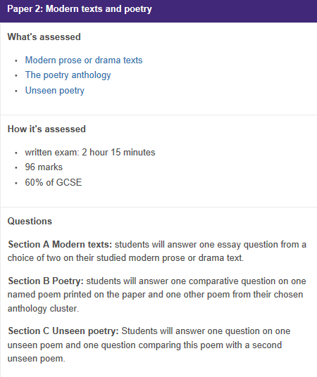
What do your Literature Exams look like?

Slide 3
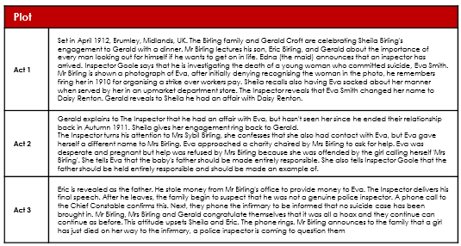
Paper One Tasks and Quotes
Section A: An Inspector Calls
Task One: Summarise what An Inspector Calls is about?
________________________________________________________________________________________________________________________________________________________________________________________________________________________________________________________________________________________________________________________________________________
Task Two: Make a mind map about what happens in each Act
Challenge: Can you link each bullet point to context?

Slide 4
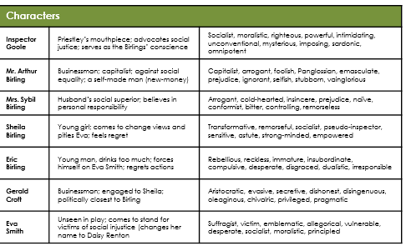
Task Three: Make mind maps about each of the characters
Challenge: Can you add quotes to support your ideas and add how they link to Elizabethan context?
Super Challenge: Can you make mind maps about any of the minor characters?
Task Four: Make mind maps about each of the themes and how they are presented
Challenge: Can you add how each character links to the theme?
Social class and status: Priestley shows that class hierarchies need to change Social responsibility: the interrogation of each of the characters demonstrates the need for change
Personal responsibility: Priestley advocates the need for individuals to accept responsibility for their own actions. It is because Arthur, Sybil and Gerald, shirk this responsibility that the phone rings again at the end of the play, thus warning the characters and audience that they must change their attitude.
Morality: Priestley explores the idea of morality in terms of society, the behaviour of individuals and the treatment of others rather than in a religious sense. However, the seven deadly sins (pride, envy, gluttony, lust, anger, greed and sloth) are evident in the behaviour of the characters and Priestley clearly warns against them.
Time: setting the play in 1912 allows Priestley to distance the audience from the action on stage whilst still teaching them a lesson about learning from mistakes. Priestley exploits the time setting of the play to shape our impression of Birlingthrough dramatic irony. Lines such as ‘fire and blood and anguish’ make reference to the wars experienced by both Priestley and the contemporary audience.
Love: the play begins with the engagement between Sheila and Gerald but Priestley suggests that their relationship is already adversely affected by money , business, gender inequality and deceit.
Inequality: men/women (a patriarchal society leading to misogyny); class (upper and lower social classes are segregated. Money equals power (Capitalism and the focus on money rather than people).
Lies, secrecy and deceit: Priestley suggests that the lives of the upper and middle classes are based on hypocrisy through his depiction of the Birling family.

Slide 5
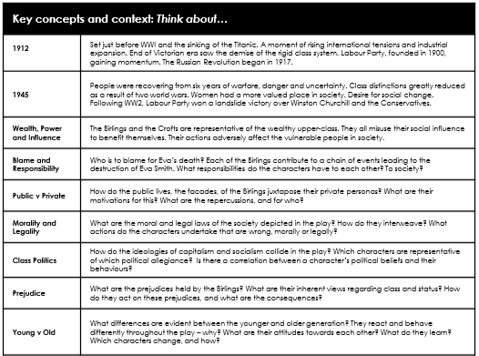
Task Five: Make a mind map about context
Challenge: Can you add how characters link to context?
Super Challenge: Can you also add quotes that link to context?
Can you add your own research about the context for An Inspector Calls into this box?

Slide 6
Task Six: Below are 20 quotes that you should try to remember from the play. Complete the look/cover/write/check for each quote
Quote | Look | Cover | Write | Check
Act One ‘You’re Squiffy’ Sheila to Eric
‘For lower costs and higher prices’ Birling to family
‘Burnt her inside out, of course’ Inspector to family
‘Better to ask for the earth than to take it’ Inspector to Birling
‘She was very pretty and looked as if she could take care of herself’ Sheila
Act Two ‘We often do on the young ones’ Inspector to Mrs Birling
‘He’s only a boy’ Mrs Birling to Inspector
‘I became at once the most important thing in her life’ Gerald to Inspector
‘A girl in her position’ Mrs Birling to the Inspector

Slide 7
Quote | Look | Cover | Write | Check
‘I accept no blame for it at all’ Mrs Birling to Inspector
Act Three ‘I was in that state when a chap easily gets nasty’ Eric to the Inspector
‘There are millions and millions and millions of Eva Smiths and John Smiths’ Inspector to family
‘Taught in fire, blood and anguish’ Inspector to family
‘And it’s what they don’t seem to understand’ Sheila to Eric
It’s what happened to the girl and what we did to her that matters’ Eric to his family
Stage Directions ‘and then it should be brighter and harder’ Lighting when the Inspector arrives
‘impression of massiveness’ about the Inspector
‘but the inspector interposes himself between them and the photograph’
‘cutting in’ The Inspector and Sheila
‘taking charge, masterfully’ The Inspector

Slide 8
Task Seven: Fill in the boxes for the quotes
Challenge: Can you add a perceptive and original meaning for each of the quotes?
Quote | Meaning | Subject Terminol-ogy | Context/Intentions | Effect on audience
Act One ‘You’re Squiffy’ Sheila to Eric
‘For lower costs and higher prices’ Birling to family
‘Burnt her inside out, of course’ Inspector to family
‘Better to ask for the earth than to take it’ Inspector to Birling
‘She was very pretty and looked as if she could take care of herself’ Sheila
Act Two ‘We often do on the young ones’ Inspector to Mrs Birling
‘He’s only a boy’ Mrs Birling to Inspector
‘I became at once the most important thing in her life’ Gerald to Inspector
‘A girl in her position’ Mrs Birling to the Inspector

Slide 9
Quote | Meaning | Subject terminology | Context/intentions | Effect on audience
‘I accept no blame for it at all’ Mrs Birling to Inspector
Act Three ‘I was in that state when a chap easily gets nasty’ Eric to the Inspector
‘There are millions and millions and millions of Eva Smiths and John Smiths’ Inspector to family
‘Taught in fire, blood and anguish’ Inspector to family
‘And it’s what they don’t seem to understand’ Sheila to Eric
It’s what happened to the girl and what we did to her that matters’ Eric to his family
Stage Directions ‘and then it should be brighter and harder’ Lighting when the Inspector arrives
‘impression of massiveness’ about the Inspector
‘but the inspector interposes himself between them and the photograph’
‘cutting in’ The Inspector and Sheila
‘taking charge, masterfully’ The Inspector

Slide 10
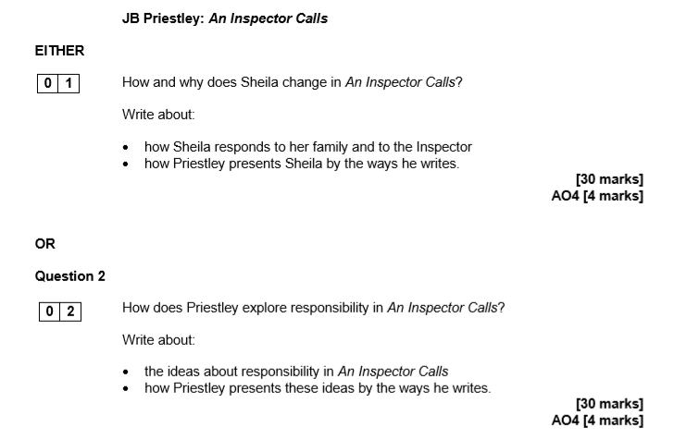

Task 8: On the following pages you will find three example questions. Create plans for them in the boxes provided and then write your answers on additional lined paper.

Slide 11
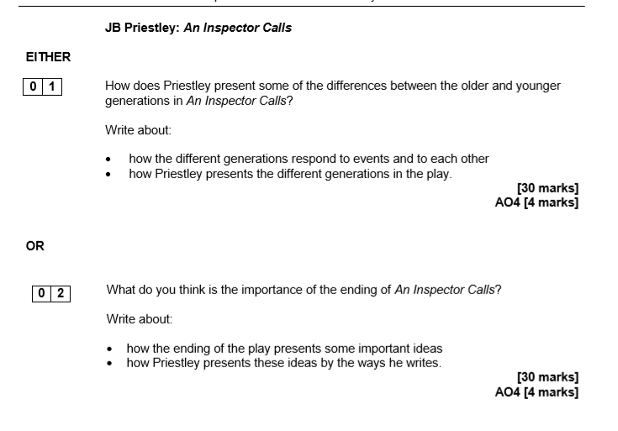
Plan:

Slide 12
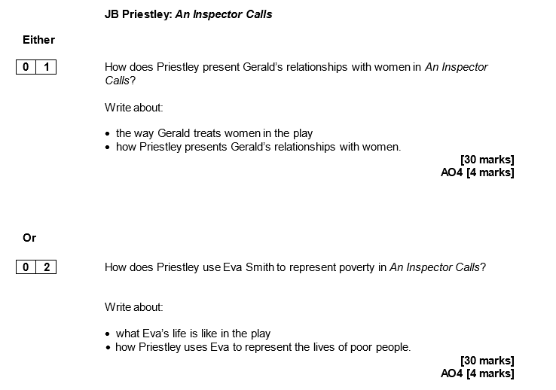
Plan:

Slide 13
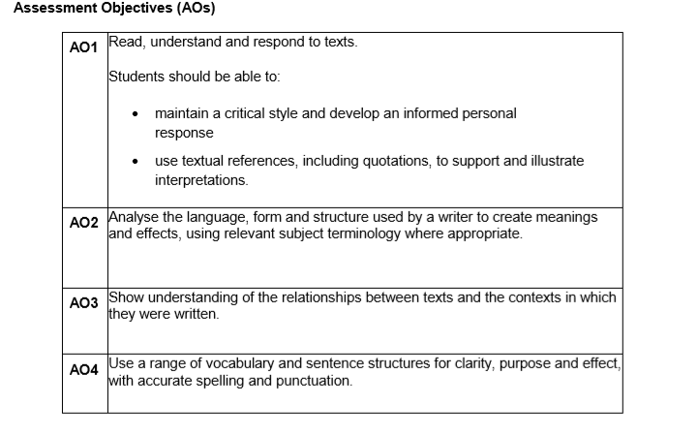
How to write your answer
Tips to success
Aim for three plus paragraphs
Comment on writer’s methods
Use subject terminology
Comment on effect
Comment on intentions
Comment on context
Zoom in on single words and their connotations
Make sure your answer links to the key words in the question
Framework
In this essay I am going to explore…
The theme/character is shown to be…
This is evident in the passage through the use of the line/words such as/[named technique ‘…’
Priestley has used this because…
Priestley has also used the word/[word type] because it has connotations of...
I believe Priestley has presented his ideas this way because…
An audience in 1946 would feel…because…
Life after ww2 was different to when the play was set in 1912 because…
This links to elsewhere in the play when …
This is evident in the line/words such as/ [named technique] ‘…’
Priestley has perhaps used this idea because…

Slide 14
Section C: Unseen Poetry
Part A: Analyse one poem (24 marks)
Part b: Comparison (8 Marks)
How to tackle this part of the exam
This part of the exam is about a poem that you have probably never seen before so here are a few handy hint about how to tackle Section C
Section C Part A (24 Marks)
Task One: Read the question and then the example answer that follows
Question: In To a Daughter Leaving Home, how does the poet present the speaker’s feelings about her daughter
To a Daughter Leaving Home
When I taught you
at eight to ride
a bicycle, loping along
beside you
as you wobbled away
on two round wheels,
my own mouth rounding
in surprise when you pulled
ahead down the curved
path of the park,
I kept waiting
for the thud
of your crash as I
sprinted to catch up,
while you grew
smaller, more breakable
with distance,
pumping, pumping
for your life, screaming
with laughter,
the hair flapping
behind you like a
handkerchief waving
goodbye.
—Linda Pastan

Slide 15
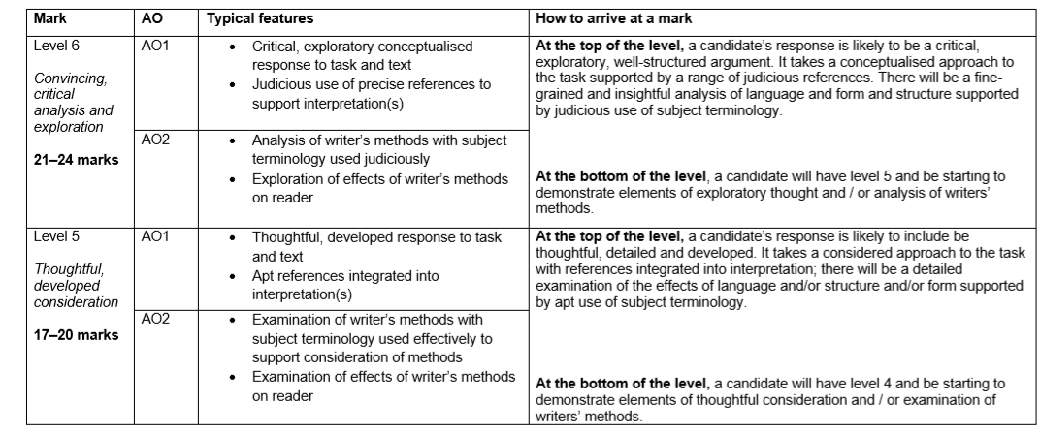
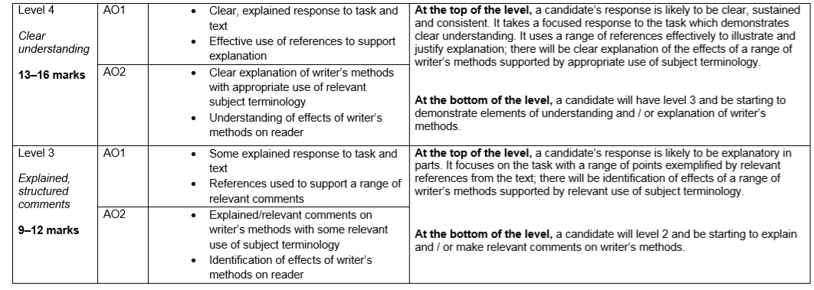
Exemplar response
In this poem, the speaker is the voice of a parent, describing a memory of watching her daughter learn to ride a bike. The mother describes her fear of her daughter coming to harm with the use of ‘loping along beside you’, as if she is terrified of letting go and letting her daughter move away from her. This is then reinforced with the use of ‘wobbled’ to suggest the daughter’s vulnerability and fear that she may come to harm. However, the daughter is confident and shows this through ‘pulled away’ and ‘screaming with laughter’ – she doesn’t appear to have any fear of her new skill and is excited by the ability to ‘pull ahead’ The contrast between the parent and the child is shown through the language used to describe them; the mother’s mouth ‘rounds in surprise’ whereas the daughter is ‘pumping, pumping for your life’
There is a tension between the mother’s reaction to the event and the daughter’s. The use of repetition in ‘pumping, pumping’ suggests the daughter’s desire for independence and freedom, with ‘for your life’ used ambiguously to suggest that the daughter is not only desperate to learn to ride a bike, but also to be an independent person in the world, leading her own ‘life’. While the mother is ‘waiting for the thud’, which is clearly a metaphor for the daughter coming up against a hurdle in her life, the daughter is ‘screaming with laughter’ which suggests that she has a very different attitude towards becoming independent. This phrase almost works as an oxymoron, contrasting ‘screaming’ (which hints at the mother’s internal fear and anxiety) with the daughter’s ‘laughter’. The clash between these two words intensifies the difference between the mother and the daughter’s attitude towards becoming independent.
Overall, the poem uses this event, often seen as a staging post in childhood, as an extended metaphor to explore attitudes about growing up, showing a contrast between the mother’s anxiety and the daughter’s confidence.
Task Two:
Looking at the mark scheme below – what mark would you give this response out of 24?

Slide 16
Task Two: Using the mark scheme explain why you would give the response your chosen mark and then give the response an HTI (How To Improve)
I would give the response ____ out of 24 marks because __________________________________________________________________________________________________________________________________________________________________________
The HTI I would give the response is __________________________________________________________________________________________________________________________________________________________________________
Task Three: Using the tips and support framework below answer the following two sample questions on lined paper.
In part A of Section C you are marked for:
This means that you need to be able to provide a range of points and analyse language in detail.
For a successful answer you need to
Plan
Highlight the key words in the questions
Underline 3+ lines that link to the keyword in the questions
Annotate them with technique and meaning
When writing your response you need to:
Aim for 3 points
Use quotes from the poem to support your ideas
Comment on writer’s methods (what the writer has used to show their ideas/theme)
Comment on meaning
Analyse single words
Use subject terminology
Comment on effect
Support Framework
The poet uses words such as/[named technique]/the line ‘…’
This shows they feel/presents the theme of … because …
The poet has used the word/[word type] ‘…’ because it has connotations of…
The Poet has done this to create a feeling of…
In addition to this, the writer also uses words such as/[named technique]/the line ‘…’
This shows they feel/presents the theme of,...because,,
The poet has used the word/[word type] ‘…’ because it has connotations of…
The poet has done this to create a feeling of…
Over all, I believe the writer has presented their ideas this way because…

Slide 17
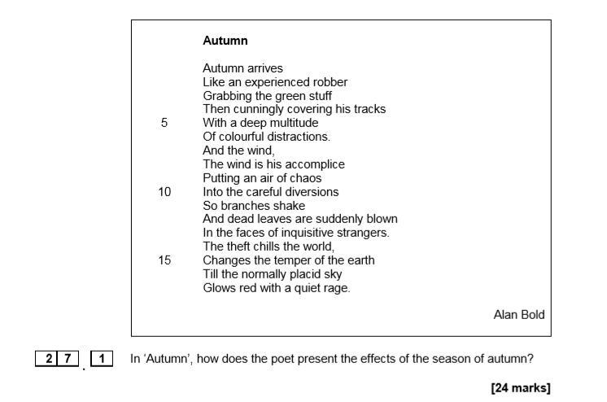
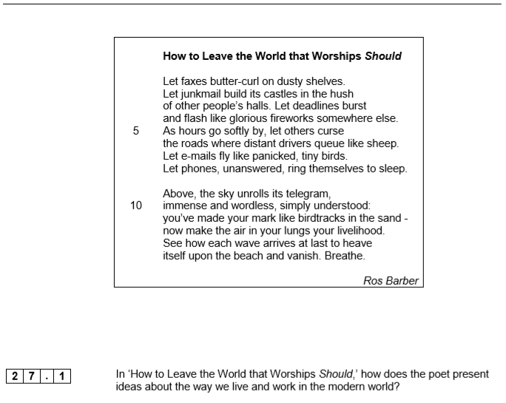
Example Questions

Slide 18
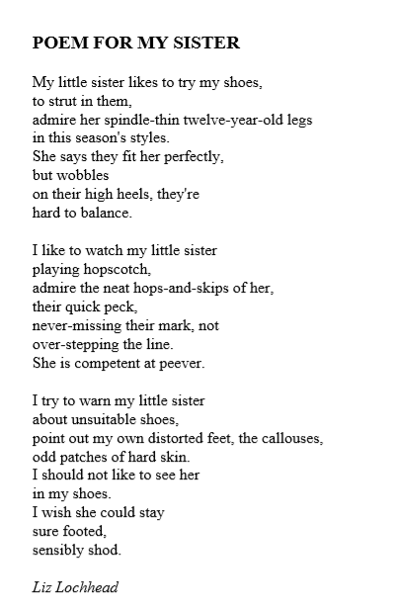
Section C Part B (8 Marks)
This part of the exam is worth only 8 marks so should have the shortest amount of time spent on it.
Task One:
Read the example question and answer.
*To a Daughter Leaving Home is the poem you read the exemplar answer about for Section C Part A
27.2 In Poem for My Sister, and ‘To a Daughter Leaving Home’, the speakers describe watching someone they love grow up. What are the similarities and/or differences between the ways the poets describe these feelings?

Slide 19
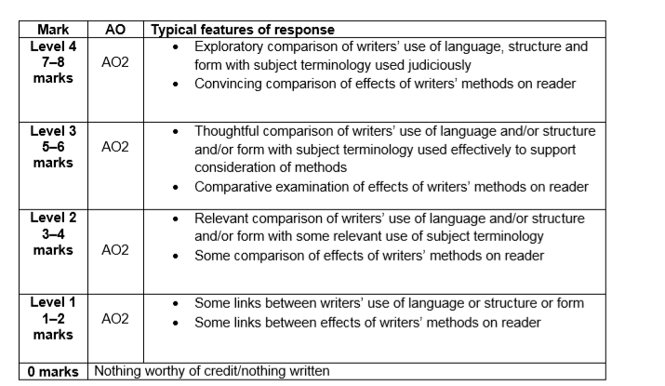
Example Answer
Both of these poems are about the relationship with a young child. However, one of the differences is that in To a Daughter the speaker is her mother, whereas in For my Sister the speaker is the older sister. What the poems have in common is that both of them show that they are worried about the young person and don’t want them to grow up. This is the main similarity between them.
Both of the poems show that the adult world is possibly dangerous. They both use metaphors to show this, with riding a bicycle in the first one and wearing high-heeled shoes in the second one. Both of these metaphors are for ordinary things, but both show that there is danger: ‘wobbled’ is an idea used in both poems to show how innocent and vulnerable the young girls are.
Also, both poems describe the young people as being full of life and enjoying playing. In the first one she is ‘screaming with laughter’ whereas in the second one she is ‘playing hopscotch’. Both of the girls are also shown by the poet to be independent and looking after themselves. The main difference is that one is a mother and one is a sister. However, both of the poems have the same theme and use a metaphor to express this idea of being afraid for the young person as they grow up’
Task Two:
Looking at the mark scheme below – what mark would you give this response out of 8? Explain why you would give it this mark and then give the response an HTI
I would give the response ____ out of 8 marks because ____________________________________________________________________________________________________________________________________________________________________________________________________________________________________________________________
The HTI I would give the response is ____________________________________________________________________________________________________________________________________________________________________________________________________________________________________________________________

Slide 20
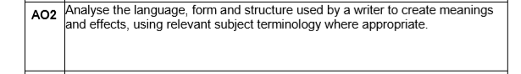
Task Three: Using the tips and support framework below answer the following two sample questions on lined paper.
In part B of Section C you are marked for:
This means that this response is driven by writer’s methods (what they have used) and their effects
You should aim to write about one similarity and one difference.
For a successful answer you need to
Plan
Highlight the key words in the questions
Under line 2+ lines in the second poem that link to the key words in the question
Annotate meaning and technique
Create a table and quickly write a similarity and difference between the poems as this will help structure your answer
When writing your response you need to:
Aim for two comparative points
Use quotes from both poems to support your ideas
Comment on writer’s methods (what the writer has used to show their ideas/theme)
Comment on meaning
Analyse single words
Use subject terminology
Comment on effect
Support Framework
Both poems show…
Poem ‘…’ does this through the use of the line/words such as/[named technique] ‘…’
And this shows…because…
The poet has used the word ‘…’ because…
The effect on the reader is…
Similarly to this, Poem ‘…’ also shows… through the use of the line/words such as/ [named technique] ‘…’
And this also shows … because
The poet has used the word ‘…’ because…
The effect on the reader is….
A difference between the two poems is that…
This is shown in the poem ‘…’ through the use of the line/words such as/[named technique] ‘…’
This shows…because….
The poet has used the word ‘…’ because…
The effect on the reader is…
In contrast, …. Is shown in the poem through the use of the line/words such as/ [named technique] ‘…’
This shows….because…
The poet has used the word ‘…’ because…
The effect on the reader is…
Overall, believe the poem that is most effective in showing their ideas/the theme of…is ‘…’ because….
Similarity | Difference

Slide 21
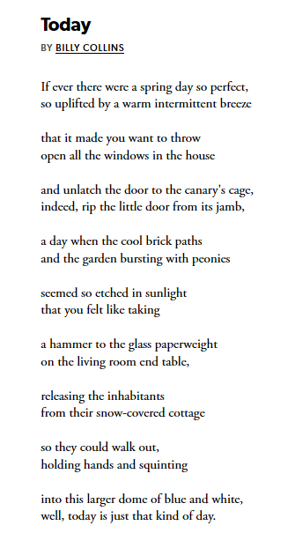
2 7 . 2 In both ‘Today’ and ‘Autumn’ the speakers describe attitudes towards the seasons. What are the similarities and/or differences between the ways the poets present these attitudes? [8 marks]
*Autumn poem is in Section C Part A Example Questions
Plan:
Similarity | Difference

Slide 22
Question 27.2:
In both ‘The Rich Eat Three Full Meals’ and ‘How to Leave the World that Worships Should’, the speakers describe attitudes towards the world around us.
What are the similarities and/or differences between the ways poets present these attitudes?
[8 marks]
*How to Leave the World that Worships should is in Section C Part A Example Questions
Similarity | Difference
The Secret of Success:
Stop Wishing!
Start Doing!

