Slide 1
Year 11 English Literature Paper One Revision Booklet
The Secret of Success:
Stop Wishing!
Start Doing!
Name: ___________________________________________
Teacher: ___________________________________________
Class: _____________________________________________

Slide 2
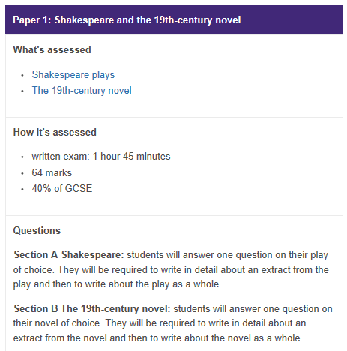
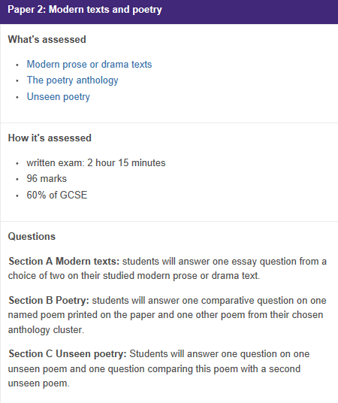
What do your Literature Exams look like?

Slide 3
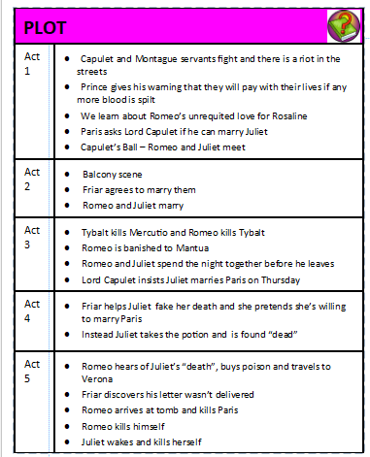
Paper One Tasks and Quotes
Section A: Romeo and Juliet
Task One: Summarise what the play Romeo and Juliet about?
________________________________________________________________________________________________________________________________________________________________________________________________________________________________________________________________________________________________________________________________________________
Task Two: Make a mind map about what happens in each Act
Challenge: Can you link each bullet point to context?

Slide 4
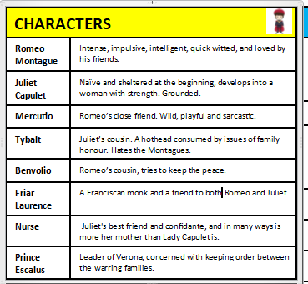
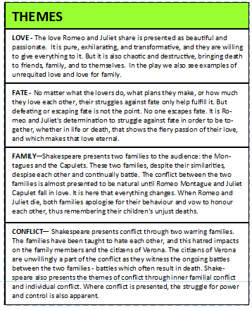
Task Three: Make mind maps about each of the characters
Challenge: Can you add quotes to support your ideas and add how they link to Elizabethan context?
Super Challenge: Can you make mind maps about any of the minor characters?
Task Four: Make mind maps about each of the themes and how they are presented
Challenge: Can you add how each character links to the theme?

Slide 5
Task Five: Make a mind map about context
Challenge: Can you add how characters link to context?
Super Challenge: Can you also add quotes that link to context?
CONTEXT
The role of women in a patriarchal society: Elizabethan England was a society controlled by men. Women were seen as the weaker sex and were expected to be ruled over by men. Women needed to be meek and mild, and most importantly, obedient to their fathers and later their husbands.
Arranged marriages: Marriages amongst the wealthy were arranged by parents, and were not about love. Mostly the marriages were arranged for the purposes of status and power, and improving the social standings of families.
The Catholic setting of the play: The play is set in Italy which is a Catholic country. Religion was extremely important, and marriage vows were sacred – once made, they could not be broken.
Duelling and the concept of honour: Honour was hugely important at the time, and maintaining the honour of your family name was crucial. If you were challenged to a duel and you refused, you would be deemed a coward, thus damaging your honour and the status of your family.
Can you add your own research about the context for Romeo and Juliet into this box?

Slide 6
Task Six: Below are 15 quotes that you should try to remember from the play. Complete the look/cover/write/check for each quote
Quote | Look | Cover | Write | Check
‘Pair of star-crossed lovers take their life;’ Prologue
‘Weaker vessels’ Sampson
‘look upon thy death.’ Tybalt
‘o brawling love, O loving hate,’ Romeo
‘O I am fortune’s fool’ Romeo
‘My grave is like to be my wedding bed’ Juliet
‘She’s the hopeful lady of my earth’ Capulet
‘Hang thee, young baggage’ disobedient wretch’ Capulet
‘Juliet is the sun’ Romeo

Slide 7
Quote | Look | Cover | Write | Check
‘Deny thy father and refuse thy name’ Juliet
‘a plague o’ both your houses’ Mercutio
‘If love be rough with you, be rough with love’ Mercutio
‘These violent delights have violent ends’ Friar Lawrence
‘He’s a flower, in faith, a very flower’ Nurse about Paris
‘O brother Montague, give me thy hand’ Capulet
Task 7: Now you’ve completed learning the quotes can you explain what they mean and add the techniques used?
Challenge: Can you create perceptive and original meanings for them?
Quote | Meaning | Technique | Context | Effect on an Elizabethan audience
‘Pair of star-crossed lovers take their life;’ Prologue
‘Weaker vessels’ Sampson
‘look upon thy death.’ Tybalt
‘o brawling love, O loving hate,’ Romeo

Slide 8
Quote | Meaning | Technique | Context | Effect on an Elizabethan audience
‘O I am fortune’s fool’ Romeo
‘My grave is like to be my wedding bed’ Juliet
‘She’s the hopeful lady of my earth’ Capulet
‘Hang thee, young baggage’ disobedient wretch’ Capulet
‘Juliet is the sun’ Romeo
‘Deny thy father and refuse thy name’ Juliet
‘a plague o’ both your houses’ Mercutio
‘If love be rough with you, be rough with love’ Mercutio
‘These violent delights have violent ends’ Friar Lawrence
‘He’s a flower, in faith, a very flower’ Nurse about Paris
‘O brother Montague, give me thy hand’ Capulet

Slide 9
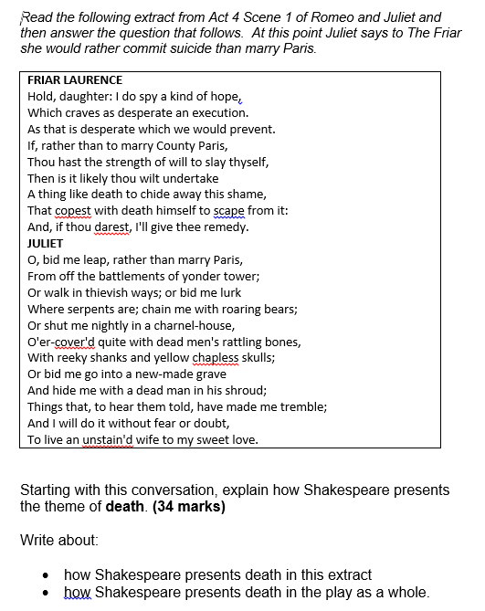
Task 8: On the following pages you will find three example questions. Create plans for them in the boxes provided and then write your answers on additional lined paper.
Plan:

Slide 10
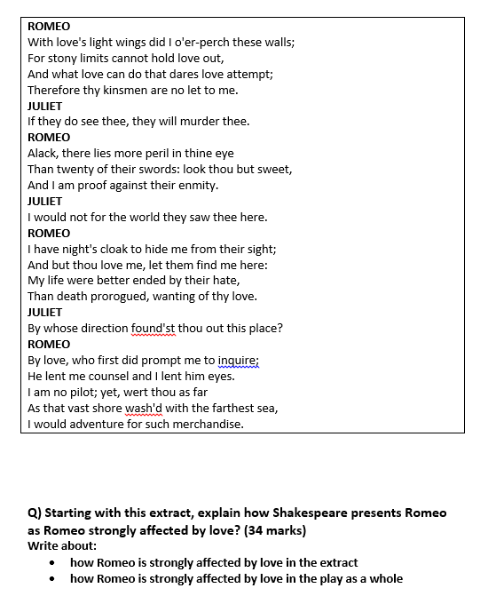
Plan:

Slide 11
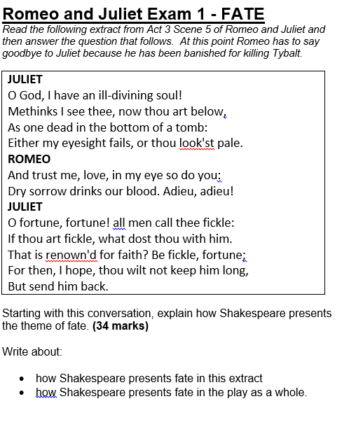
Plan:

Slide 12
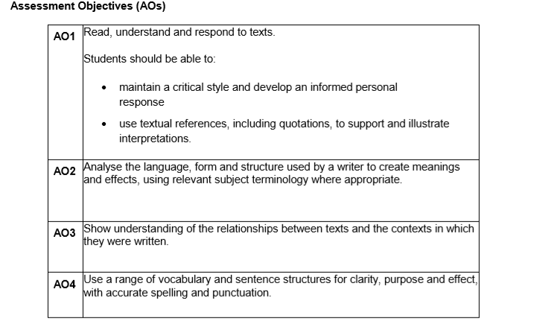
How to write your answer
Tips to success
Aim for three plus paragraphs
Comment on writer’s methods
Use subject terminology
Comment on effect
Comment on intentions
Comment on context
Zoom in on single words and their connotations
Make sure your answer links to the key words in the question
Framework
In this essay I am going to explore…
The theme/character is shown to be…
This is evident in the passage through the use of the line/words such as/[named technique ‘…’
Shakespeare has used this because…
Shakespeare has also used the word/[word type] because it has connotations of...
I believe Shakespeare has presented his ideas this way because…
An Elizabethan audience would feel…because…
Life in Elizabethan times was…
This links to elsewhere in the play when …
This is evident in the line/words such as/ [named technique] ‘…’
Shakespeare has perhaps repeated this idea because…

Slide 13
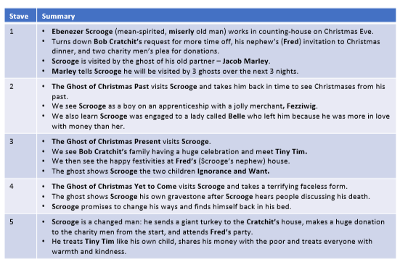
Section B: PAPER ONE
Section B: A Christmas Carol
Task One: Summarise what A Christmas Carol is about
________________________________________________________________________________________________________________________________________________________________________________________________________________________________________________________________________________________________________________________________________________
Task Two: Make a mind map about what happens in each Stave
Challenge: Can you link each bullet point to context?

Slide 14
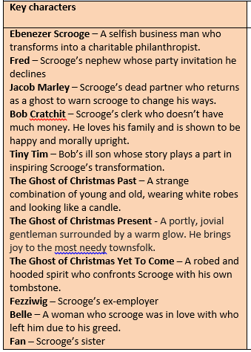
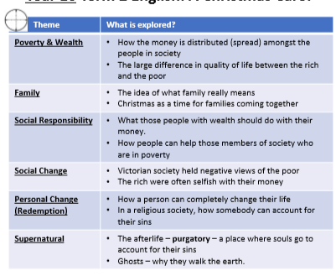
Task Three: Make mind maps about each of the characters
Challenge: Can you add quotes to support your ideas and add how they link to Victorian context?
Super Challenge: Can you make mind maps about any of the minor characters?
Task Four: Make mind maps about each of the themes and how they are presented
Challenge: Can you add how each character links to the theme?

Slide 15
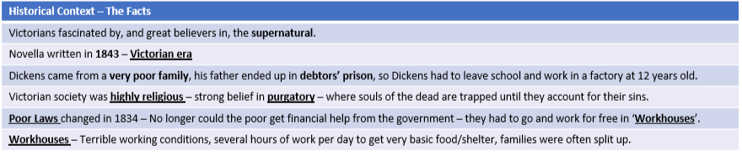
Task Five: Make a mind map about context
Challenge: Can you add how characters link to context?
Super Challenge: Can you also add quotes that link to context?
Can you add your own research about A Christmas Carol into this box?

Slide 16
Task Six: Below are 15 quotes that you should try to remember from the novella. Complete the look/cover/write/check for each quote
Quote | Look | Cover | Write | Check
STAVE ONE ‘I wear the chain I forged in life’ Marley
STAVE ONE ‘As hard and sharp as flint’ Describes Scrooge
STAVE ONE ‘Are there no prisons? Are there no workhouses?’ Scrooge
STAVE ONE ‘Decrease the surplus population’ Scrooge
STAVE ONE ‘The clerk’s fire was so very much smaller’ Narrator
STAVE ONE ‘The cold within him froze his old features’ Describing Scrooge
STAVE ONE ‘What reason do you have to be merry? You’re poor enough!’ Scrooge to Fred
STAVE TWO ‘A golden one.’ Belle to Scrooge
STAVE THREE ‘Scrooge’s offences carry their own punishment.’ Fred about Scrooge
STAVE THREE ‘His wealth is of no good to him. He don’t do any good with it’ Fred

Slide 17
Quote | Look | Cover | Write | Check
STAVE THREE ‘This boy is ignorance. This girl is want’ Ghost of Christmas Present
STAVE FIVE ‘I will honour Christmas in my heart’ Scrooge
STAVE FIVE ‘God bless us, everyone’ Tiny Tim
STAVE FIVE ‘I am as merry as a school boy’ Scrooge
STAVE FIVE ‘He was a second father’ Describing Scrooge and Tiny Tim
Task 7: Now you’ve completed learning the quotes can you explain what they mean and add the techniques used?
Challenge: Can you create perceptive and original meanings for them?
Quote | Meaning | Technique | Context | Effect on a Victorian reader
STAVE ONE ‘I wear the chain I forged in life’ Marley
STAVE ONE ‘As hard and sharp as flint’ Describes Scrooge
STAVE ONE ‘Are there no prisons? Are there no workhouses?’ Scrooge
STAVE ONE ‘Decrease the surplus population’ Scrooge

Slide 18
Quote | Meaning | Technique | Context | Effect on a Victorian reader
STAVE ONE ‘The clerk’s fire was so very much smaller’ Narrator
STAVE ONE ‘The cold within him froze his old features’ Describing Scrooge
STAVE ONE ‘What reason do you have to be merry? You’re poor enough!’ Scrooge to Fred
STAVE TWO ‘A golden one.’ Belle to Scrooge
STAVE THREE ‘Scrooge’s offences carry their own punishment.’ Fred about Scrooge
STAVE THREE ‘His wealth is of no good to him. He don’t do any good with it’ Fred
STAVE THREE ‘This boy is ignorance. This girl is want’ Ghost of Christmas Present
STAVE FIVE ‘I will honour Christmas in my heart’ Scrooge
STAVE FIVE ‘God bless us, everyone’ Tiny Tim
STAVE FIVE ‘I am as merry as a school boy’ Scrooge
STAVE FIVE ‘He was a second father’ Describing Scrooge and Tiny Tim

Slide 19
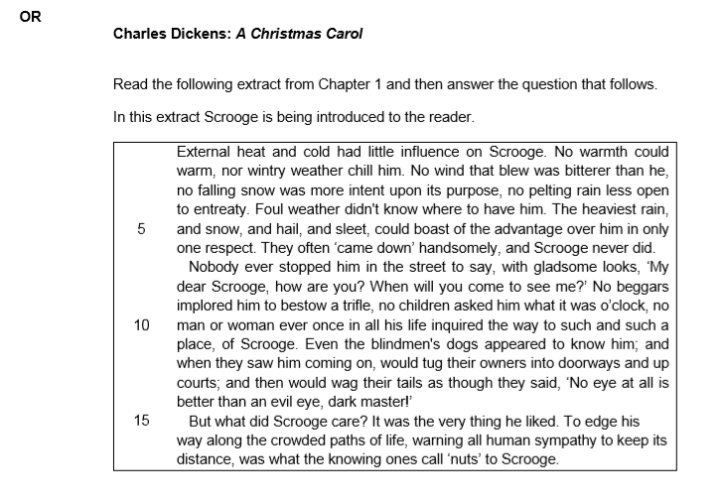
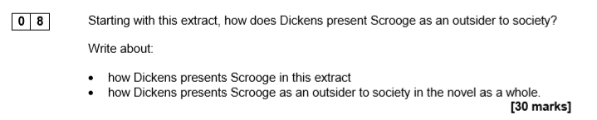

Task 8: On the following pages you will find three example questions. Create plans for them in the boxes provided and then write your answers on additional lined paper.

Slide 20
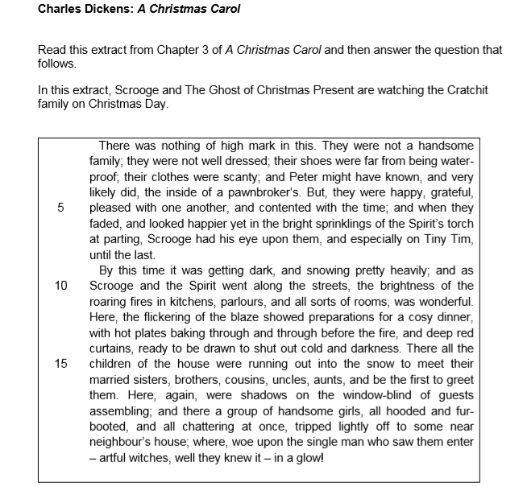
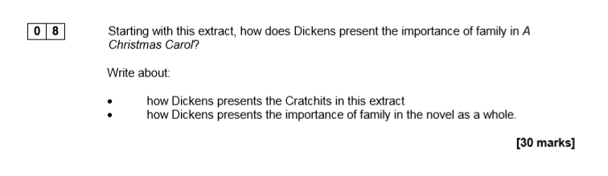

Slide 21
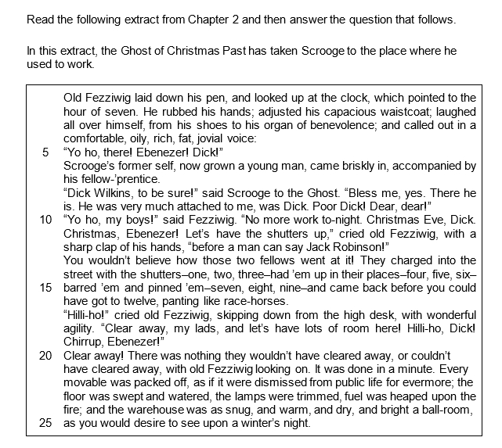
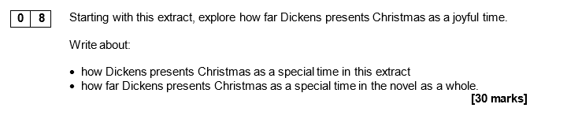


Slide 22
How to write your answer
Tips to success
Aim for three plus paragraphs
Comment on writer’s methods
Use subject terminology
Comment on effect
Comment on intentions
Comment on context
Zoom in on single words and their connotations
Make sure your answer links to the key words in the question
Framework
In this essay I am going to explore…
The theme/character is shown to be…
This is evident in the passage through the use of the line/words such as/[named technique ‘…’
Dickens has used this because…
Dickens has also used the word/[word type] because it has connotations of...
I believe Dickens has presented his ideas this way because…
A Victorian reader would feel…because…
Life in Victorian times was…
This links to elsewhere in the novel when …
This is evident in the line/words such as/ [named technique] ‘…’
Dickens has perhaps repeated this idea because…

