Slide 1
Year 11 English Language Paper One Revision Booklet
The Secret of Success:
Stop Wishing!
Start Doing!
Name: ___________________________________________
Teacher: ___________________________________________
Class: _____________________________________________

Slide 2
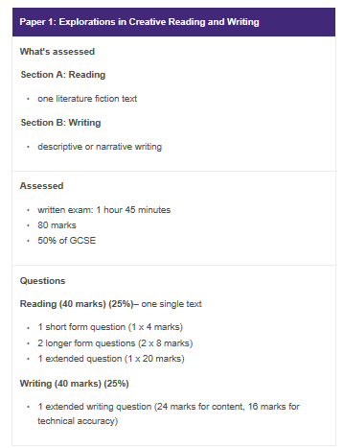
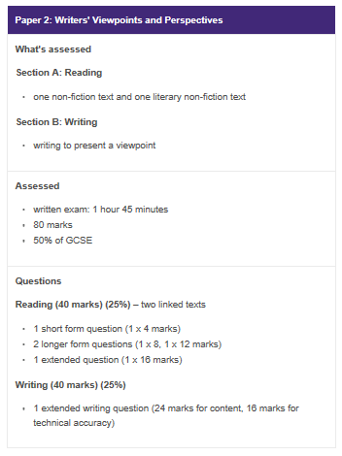
What do your Language exams look like?
This booklet focuses on this exam

Slide 3
STEP ONE: Read the extract
Source A
This extract is from a novel by Yann Martel. In this section the central character, Pi, is on a sinking ship. The ship is carrying the animals belonging to Pi’s father, who owns a zoo.
Life of Pi
Inside the ship, there were noises. Deep structural groans. I stumbled and fell. No harm done. I got up. With the help of the handrails I went down the stairwell four steps at a time. I had gone down just one level when I saw water. Lots of water. It was blocking my way. It was surging from below like a riotous crowd, raging, frothing and boiling. Stairs vanished into watery darkness. I couldn't believe my eyes. What was this water doing here? Where had it come from? I stood nailed to the spot, frightened and incredulous and ignorant of what I should do next. Down there was where my family was.
I ran up the stairs. I got to the main deck. The weather wasn't entertaining any more. I was very afraid. Now it was plain and obvious: the ship was listing badly. And it wasn't level the other way either. There was a noticeable incline going from bow to stern. I looked overboard. The water didn't look to be eighty feet away. The ship was sinking. My mind could hardly conceive it. It was as unbelievable as the moon catching fire.
Where were the officers and the crew? What were they doing? Towards the bow I saw some men running in the gloom. I thought I saw some animals too, but I dismissed the sight as illusion crafted by rain and shadow. We had the hatch covers over their bay pulled open when the weather was good, but at all times the animals were kept confined to their cages. These were dangerous wild animals we were transporting, not farm livestock. Above me, on the bridge, I thought I heard some men shouting.
The ship shook and there was that sound, the monstrous metallic burp. What was it? Was it the collective scream of humans and animals protesting their oncoming death? Was it the ship itself giving up the ghost? I fell over. I got to my feet. I looked overboard again. The sea was rising. The waves were getting closer. We were sinking fast.
I clearly heard monkeys shrieking. Something was shaking the deck, a gaur - an Indian wild ox -exploded out of the rain and thundered by me, terrified, out of control, berserk. I looked at it, dumbstruck and amazed. Who in God's name had let it out?
I ran for the stairs to the bridge. Up there was where the officers were, the only people on the ship who spoke English, the masters of our destiny here, the ones who would right this wrong. They would explain everything. They would take care of my family and me. I climbed to the middle bridge. There was no one on the starboard side. I ran to the port side. I saw three men, crew members. I fell. I got up. They were looking overboard. I shouted. They turned. They looked at me and at each other. They spoke a few words. They came towards me quickly. I felt gratitude and relief welling up in me. I said, "Thank God I've found you. What is happening? I am very scared. There is water at the bottom of the ship. I am worried about my family. I can't get to the level where our cabins are. Is this normal? Do you think-"
One of the men interrupted me by thrusting a life jacket into my arms and shouting something in Chinese. I noticed an orange whistle dangling from the life jacket. The men were nodding vigorously at me. When they took hold of me and lifted me in their strong arms, I thought nothing of it. I thought they were helping me. I was so full of trust in them that I felt grateful as they carried me in the air. Only when they threw me overboard did I begin to have doubts.

Slide 4
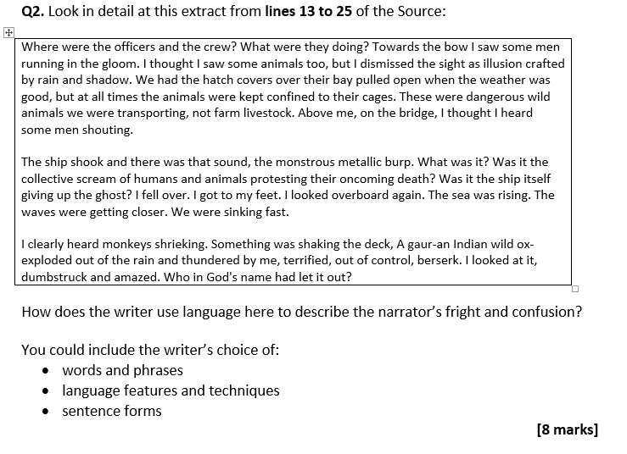
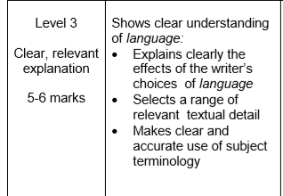
Question One will also ask for information that is clearly stated in the text. The focus of this booklet will be on Questions 2 -4.
Question Two
- This question is about the effect of language
You need to aim for 2 paragraphs
You MUST comment on the connotations of single words
You MUST plan your ideas
Let’s look at an example question about the source you have just read.
Step One: Let’s look at part of the mark scheme
Examine techniques/single words and their meaning
Use quotes from the passage
SOSMAPS/techniques

Slide 5
Paper One is about fiction so the techniques you will be identifying will be descriptive/narrative techniques
Let’s look at the beginning of an example and annotate where it has hit the mark scheme.
The writer creates a sense of fear through their use of alliteration in the line ‘monstrous
metallic burp’ and this creates a sense of fear because the repetition of the harsh m sound
reflects the loud sound that the ship was making. The writer has used the adjective ‘monstrous’
because it conveys how loud and threatening the sound was as it has connotations of being
overwhelming and intimidation. The use of the adjective ‘metallic’ could perhaps reflect a
screeching sound for the reader and therefore suggests not only a sense of fear but also a sense
of discomfort.
Now try your own example…
In addition to this, the writer also creates a feeling of fear through their use of _________ in the line ‘____________________________________’ this creates a sense of fear because_________________________________________________________________________________________________________________________________________________________________________________________________________________________________________________________________________________________________________________
They have used the _____________ ‘____________’ because___________________________________________________________________________________________________________________________________________________________________________________________________________________________________
Challenge: Make sure you add how sentence structure/paragraph length supports what you are saying about the effect of language choices.
Technique | Definition | Example
Simile | When something is like/or as something else
Onomatopoeia | When the word is the same as the sound
Senses | Taste/touch/sight/sound/smell
Metaphor | When something is something else
Alliteration | Two or more words together in a sentence that begin with the same letter
Personification | When you give an object human features
Strong Adjective | Words that describe nouns

Slide 6
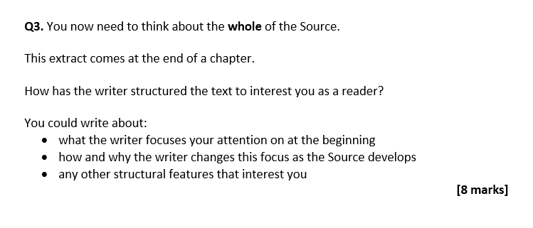
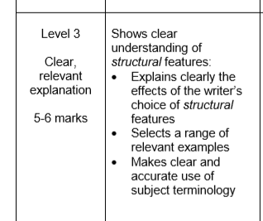
Question Three
This question is about the effect of structure
You need to aim for 2 paragraphs
You MUST comment on the effect of structural features
You MUST comment on the beginning/middle/ end of the passage
What are structural features?
The simplest structural features you can refer to are:
Focus – what does the writer give you information about?
Tone – how does the passage sound in different places?
Flashback – something that happened in the past
Dialogue – speech
Sentence length – have the sentences been shaped for effect?
Paragraph length – has paragraph length been shaped for effect?
Let’s look at an example Question Three
Let’s look at the mark scheme
Write about how structural features are effective for the reader
Use quotes from the text to support your ideas
Focus, tone, flashback, dialogue…

Slide 7
Let’s look at what we focus on throughout the language and label where our focus is at the beginning/middle and end of the passage?
Now let’s look at an example opening and annotate where it has hit the mark scheme
The opening of the passage is effective in engaging the reader because it encourages them to
focus on the narrator and his experiences in the ship. They introduce us to the narrator’s sense
of fear through their use of rhetorical questions ‘What was this water doing here? Where had it
come from?’ The use of these simple sentences reflect the feeling of breathlessness and panic
the narrator is feeling and therefore create a sense of unease for us as readers. The reader is
encouraged to read on due to the suspense that this description creates.
Now try your own example:
In the middle of the passage the writer’s use of __________ questions is continued and therefore a tone of ___________ is created. This is done through the use of the line ‘______________________________________________________________________’
Thie creates a feeling of panic because____________________________________________________________________________________________________________________________________________________.
The writer also draws our focus to the description of the animal and _____________________________________________________________________________
This is done through the use of the line ‘____________________________________________’
This would encourage the reader to _______________________________________________________________________________________________________________________________________________________________________________________________________________________________________.
Finally, the writer finishes the passage with the use of a ____________ sentence in the line ‘___________________________________________________________________________’
The writer has finished their opening this way because ________________________________________________________________________________________________________________________________________________________________________________________________________________________________________________________________________________________________________________________________________________
Challenge: Can you evaluate why the writer might have chosen to use a first person narrator? How might this change the effect for the reader?
Question Four
This question is about evaluating a statement
You must refer to the statement
You must use evidence from the passage to support your ideas
You must comment on writer’s methods
You must comment on effect on the reader
You need to aim to write at least 3 PEA

Slide 8
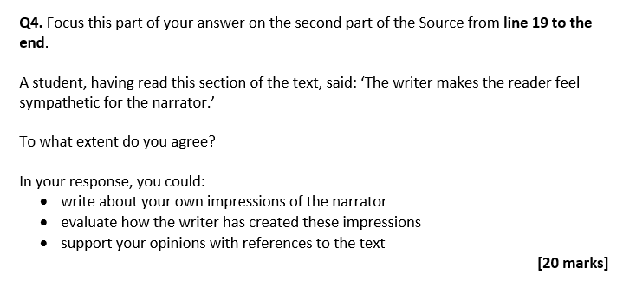
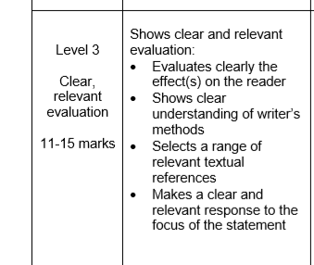
Let’s look at an example Question Four
Let’s look at the mark scheme
How does the source sound? Make the reader feel?
What has the writer used to show their ideas?
Used quotes from the passage
Keep referring to ‘I agree with the statement because…’
Draw a box round line 19 to the end
Underline/highlight any information that makes you feel sympathy for the narrator
Let’s look at an example response and annotate where it has hit the mark scheme
I agree with the statement that the reader feels sympathy for the narrator due to the
writer’s use of simple sentences such as ‘The waves were getting closer. We were sinking
fast’ This enables the reader to feel sympathy for the narrator because the simple sentences
could reflect a theme of breathlessness they reflect how quickly every thing is happening. The
use of ‘closer’ and ‘sinking’ highlight the power of the water and the reader feels sorry for the
rising sense of panic the narrator must be feeling. The use of the verb ‘sinking’ shows that the
narrator is about to drown and allows the reader to feel sympathy for the reader due to his
deadly situation.

Slide 9
Now give it a go…
In addition to this, I also agree with the statement because of the writer’s use of _________
‘____________________________________________________________________________’
This makes the reader feel sympathy for the narrator because __________________________________________________________________________________________________________________________________________________________________________________________________________________________________________
The writer has used the ________ ‘_________’ because __________________________________________________________________________________________________________________________________________________________________________________________________________________________________________
I also agree with the statement because of the ________ ‘____________________________________________________________________________’
This enables the reader to feel sympathetic towards the narrator because __________________________________________________________________________________________________________________________________________________________________________________________________________________________________________
The writer has used the _________ ‘_________’ because
__________________________________________________________________________________________________________________________________________________________________________________________________________________________________________
Finally, the writer is also encourage to feel sympathy for the narrator through the use of the ________ in ‘_________________________________________________________________’
This enables the reader to feel sympathy for the narrator because __________________________________________________________________________________________________________________________________________________________________________________________________________________________________________
The writer has used the ________ ‘_________’ because __________________________________________________________________________________________________________________________________________________________________________________________________________________________________________
The Secret of Success:
Stop Wishing!
Start Doing!

Slide 10
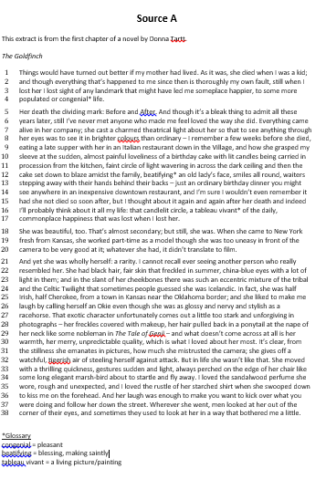

Slide 11
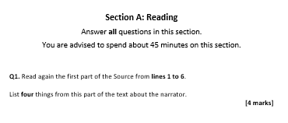
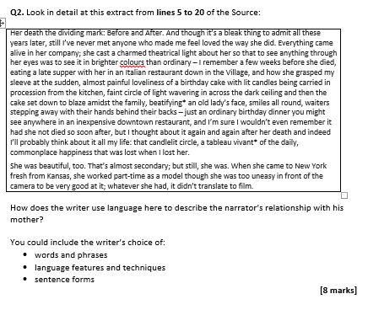

Slide 12
