Slide 1
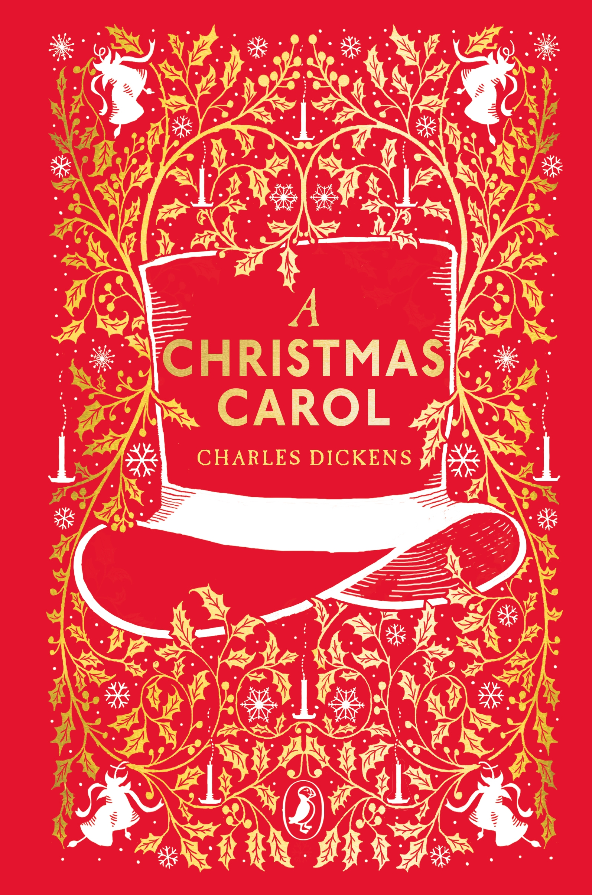
A Christmas Carol Links
Various film versions can be found through the link below:
https://online.clickview.co.uk/search?query=a%20christmas%20carol
Audio versions of the novella can be found below if you want to have them as you read along
https://www.youtube.com/results?search_query=a+christmas+carol+audiobook

