Slide 1

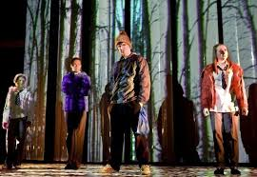
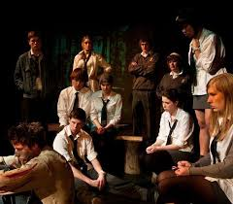
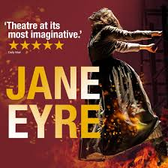
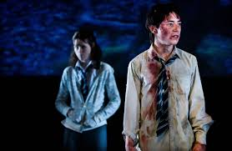
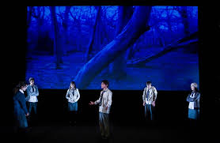

Name:
Theatre Evaluation and Analysis
Revision Booklet

Slide 2
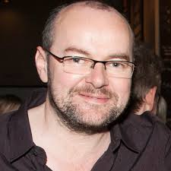
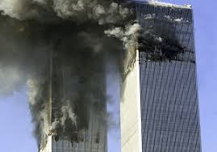
Context-
Dennis Kelly
When asked what inspired Kelly to write DNA:
‘It was to do with Western Foreign policy. At the time we were becoming increasingly scared of terrorism. I felt that our fear meant we were in danger of over reacting and curbing our own liberties and the liberties of others. I began to ask myself whether its right to sacrifice the individual for the many- which is a central question in the play. It’s not about bullying or anything like that, as the real bullying takes place before the play starts. The characters are struggling with how far they should go to protect the group- how many wrongs can you do to for a greater purpose.
When you are performing/directing a play it's important to understand the playwright's intentions & the reasons he/she have written the play.
DNA was written is 2007, when the growing threat of terrorism in Britain was causing anxiety. Two major terror attacks that contributed to this fear were the September 11th 2001 and the London bombings in 2005.
Do some research on the 2007 times. What did they wear? What were the fears?

Slide 3


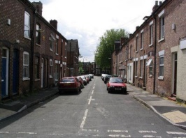
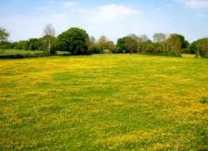
Act one mark and Jan discuss that someone is ‘dead’ and this throws the audience into the middle of the action. Leah talks and Phil eats, Leah wants answers to know what Phil is thinking. John Tate is clearly stressed and tries to keep control over the group by using fear and threats. Richard threatens his leadership but this is suppressed. When mark and Jan arrive they explain to the group their version of events leading up to Adam falling onto the grille. They try to justify the action by saying Adam was laughing. Phil finally speaks and devises a plan to frame a non- existent person. Leah is trying to get Phil's attention.
Themes
Gangs
Control
Violence
Innocence & justice
Humanity
Power
Morality
Sadism
guilt
Characters
Mark and Jan These characters act as the ‘chorus’ or narrators. They throw the audience directly into the action at the beginning of each Act and are useful as they fill in any blanks for us.
Leah is a moral character and tries to reason with many of the characters. She is sensible and able to think for herself and speak her mind. However, she still falls under the leadership of Phil.
Phil the boyfriend of Leah, although on stage in many scenes, Phil rarely speaks. Usually his action involves eating.
John Tate only appears in Act 1 Scene 3. He leads through using fear to control others. However, he is visibly falling apart during Act 1 Scene 3 as he panics and is unable to control those around him or the situation.
Cathy From very early on in the play, Cathy is shown to have no remorse about the groups’ actions. She finds the situation ‘exciting’ and ‘better than ordinary life’.
Richard first appears to be a strong character. Although he stands up to John Tate, he is eventually put in his place
Brian is the weakest link. The other characters must see him as weak and vulnerable and someone the police believe could be a victim. In order for their story to stick, the police must believe this.
Danny is presented as a sensible character and appears as an opposite to the rest of the characters.
Lou will follow whoever the leader is at the time. She is a ‘yes’ woman and will do as she is told. She is controlled by fear
Adam is our victim.
Act two Leah is still trying to get Phil's attention. The police have found a man that fits the description of the man Phil concocted because Cathy used her initiative to find a man that matches the description. The plan has gone wrong. Brian is refusing to go into the police station to identify the man who is being framed. Phil threatens him with being taken up to the grille if he doesn’t go. Brian goes. Leah tries to get Phil's attention again. This time she has déjà vu.
Act three By act 3 scene 3 Cathy is ‘second in command’ as she is charged with killing Adam. A conversation takes place between her and Phil despite Leah's attempts to be heard she is ignored by them both.
DNA
By Dennis Kelly
Act four Jan and mark reveal someone has ‘ gone’ this turns out to be Leah. Richard tries to convince Phil to re-join the group. He tries to gain his attention in a similar way to Leah. Phil does not speak. He also does not eat. Richard tells him what has happened to the rest of the group. Richard appears to have taken the place of Leah as he sits in the field with Phil. His speak and monologue takes the same structure as Leah.
Locations
Woods
Street
Field

Slide 4


Part 1
1
2
3
4
Jan and Mark: A Street
Leah and Phil : A field
Lou, Jon Tate Danny and all – A wood
Leah and Phil – A field
Part 2
5
6
7
8
Jan and Mark: A Street
Leah and Phil : A field
Lou, Jon Tate Danny and all – A wood
Leah and Phil : A field

Slide 5
What happens ? Part 3
1
2
3
4
Jan and Mark: A Street
Leah and Phil : A field
ALL and ADAM – A wood
Leah and Phil – A field
Part 4
5
6
7
8
Jan and Mark: A Street
Phil and Richard : A field

Slide 6
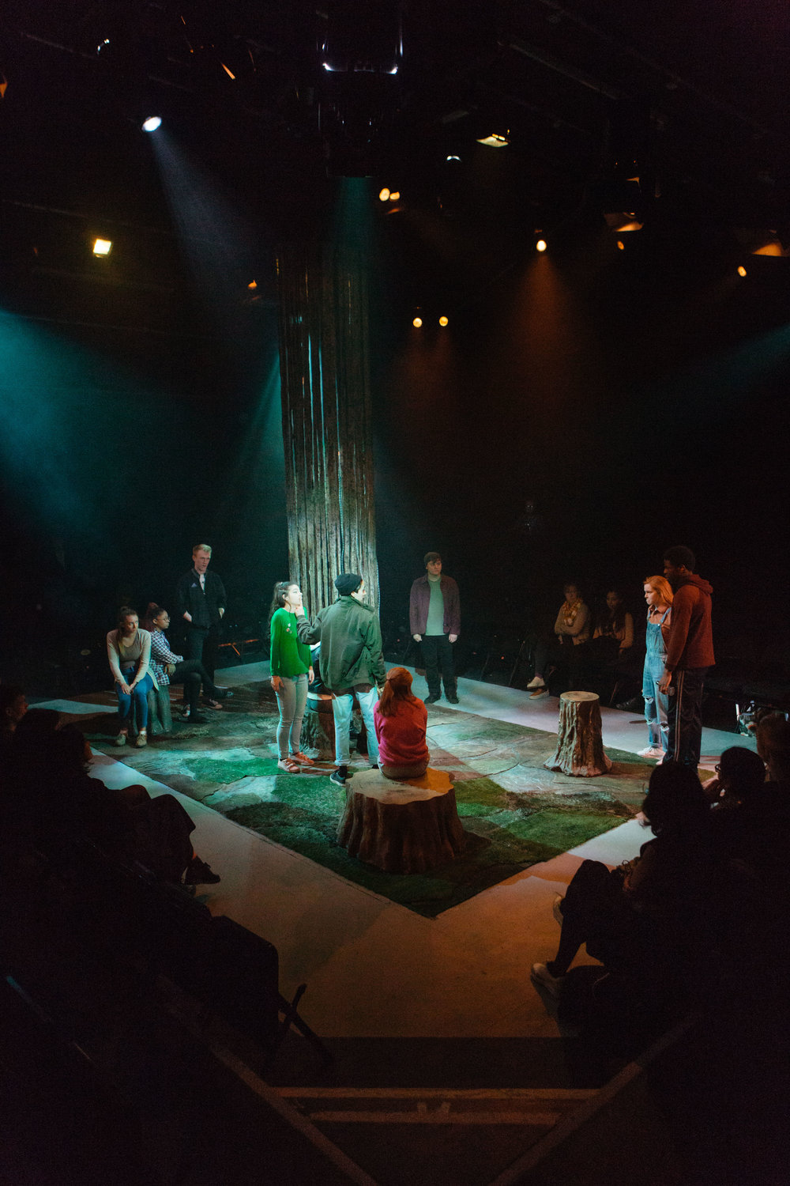
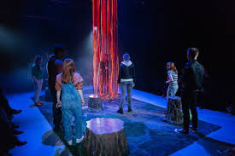
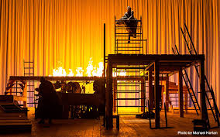
DNA Set
Set Designer
The set was originally performed end on at The National with a cyclorama and a very minimal/ symbolic set.
Why did the set designer create such a simple set?
……………………………………………………………………………………………………………………………………………………………………………………………………………………………………………………………………………………………………………………………………………………………………………………
In which scene was the set used in the most effective way and why?
……………………………………………………………………………………………………………………………………………………………………………………………………………………………………………………………………………………………………………………………………………………………………………………………………………………………………………………………………………………………………………………………………………………………………………………………………………………………………………………………………………………………………………………………………………………………………………………………………………………………………………………………………………………………………………………………………………………………………………………………..
How did the use of PROJECTIONS effect the atmosphere?
…………………………………………………………………………………………………………………………………………………………………………………………………………………………………………………………………………………………………………………………………………………………………………………..
What didn’t work as well about the set? How would you improve it?
………………………………………………………………………………………………………………………………………………………………………………………………………………………………………………………………………………………………………………………………………………………………………………………………………

Slide 7

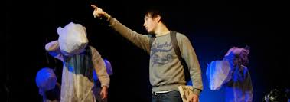
DNA Set
Set Designer
There are no blackouts or stage hands to change the scenery. Props and stage props are brought on by the cast . Props CAN BE used to symbolise meaning to the audience.
Name a prop or stage prop and explain how it impacted the audience.
………………………………………………………………………………………………………………………………………………………………………………………………………………………………………………………………………………………………………………………………………………………………………………………………………………………………………………………………………………………………………………………………………………
Name a scene in which the set impacted the intended meaning of the scene and explain how.
……………………………………………………………………………………………………………………………………………………………………………………………………………………………………………………………………………………………………………………………………………………………………………………………………………………………………………………………………………………………………………………………………………………………………………………………………………………………………………………………………………………………………………………………………………………………………………………………………………………………………………………………………………………………………………………………………………………………………………………………..
How did the set change throughout the performance and what did the changes represent?
………………………………………………………………………………………………………………………………………………………………………………………………………………………………………………………………………………………………………………………………………………………………………………………………………………………………………………………………………………………………………………………………………………………………………………………………………………………
………………………………………………………………………………………………………………………………………………………………………………………………………………………………………………………………………………………………………………………………………………………………………

Slide 8

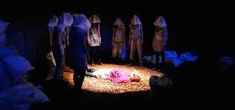
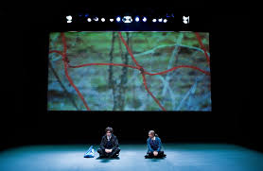
LIGHTING- KEY WORDS
Key Word | Definition
Gobo
Backlight
Uplight
Blackout
Gel
Flood
Spotlight
Portable Lighting
Cross fade
Barndoors

Slide 9
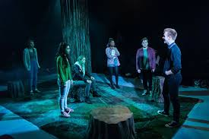
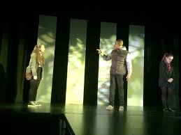
DNA Lighting
Lighting Designer
What are you going to do? A cyclorama lit using many different gels, with the colours representing many different meanings and locations? Fixed lights or even portable? Special effects such as strobes or Gobos?
Name a way in which colour can be used in a scene to represent something to the audience.
……………………………………………………………………………………………………………………………………………………………………………………………………………………………………………………………………………………………………………………………………………………………………………………
In which scene could the lighting most impact the audience and why?
……………………………………………………………………………………………………………………………………………………………………………………………………………………………………………………………………………………………………………………………………………………………………………………………………………………………………………………………………………………………………………………………………………………………………………………………………………………………………………………………………………………………………………………………………………………………………………………………………………………………………………………………………………………………………………………………………………………………………………………………..
How could the lighting of the cyclorama impact the audience?
…………………………………………………………………………………………………………………………………………………………………………………………………………………………………………………………………………………………………………………………………………………………………………………..
What concerns do you have about the lighting? How would you improve it?
………………………………………………………………………………………………………………………………………………………………………………………………………………………………………………………………………………………………………………………………………………………………………………………………………

Slide 10
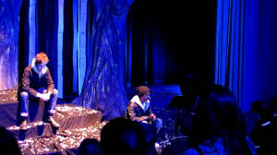
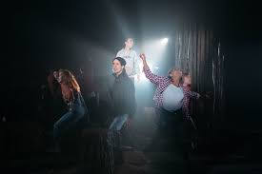
DNA Lighting
Lighting Designer
The lighting can be used to set the scene of the many locations used in DNA especially when the set cannot. Gobo’s are used to create shadows on the cyclorama and spotlights are used to highlight important moments. Barndoors create sharp lines on specific lights.
How could using PHONES lighting impact the audience?
……………………………………………………………………………………………………………………………………………………………………………………………………………………………………………………………………………………………………………………………………………………………………………………………………………………………………………………………………………………
Name a scene in which the lighting could impact the intended meaning of the scene and explain how
……………………………………………………………………………………………………………………………………………………………………………………………………………………………………………………………………………………………………………………………………………………………………………………………………………………………………………………………………………………………………………………………………………………………………………………………………………………………………………………………………………………………………………………………………………………………………………………………………………………………………………………………………………………………………………………………………………………………………………………………..
How did lighting show the 4 locations within DNA?
………………………………………………………………………………………………………………………………………………………………………………………………………………………………………………………………………………………………………………………………………………………………………………………………………………………………………………………………………………………………………………………………………………………………………………………………………………………
………………………………………………………………………………………………………………………………………………………………………………………………………………………………………………………………………………………………………………………………………………………………………

Slide 11
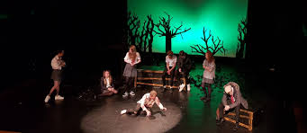
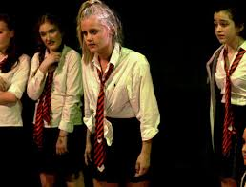
SOUND- KEY WORDS
Key Word | Definition
Volume
Sound Cue
Surround Sound
Diegetic Sound
Non- Diegetic sound
Echo
Live music
Ambient Sound

Slide 12
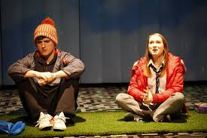
DNA Sound
A SOUNDTRACK is heard throughout the performance. The music is a mix of ambient music and very modern.
Music Director
Name a moment in which the music could show location and setting.
……………………………………………………………………………………………………………………………………………………………………………………………………………………………………………………………………………………………………………………………………………………………………………………
In which scene could the music have the most impact on the audience and why?
……………………………………………………………………………………………………………………………………………………………………………………………………………………………………………………………………………………………………………………………………………………………………………………………………………………………………………………………………………………………………………………………………………………………………………………………………………………………………………………………………………………………………………………………………………………………………………………………………………………………………………………………………………………………………………………………………………………………………………………………..
How did the music effect the mood and atmosphere?
……………………………………………………………………………………………………………………………………………………………………………………………………………………………………………………………………………………………………………………………………………………………………………………………………………………………………………………………………………………………………
What didn’t work as well about the music? How would you improve it?
………………………………………………………………………………………………………………………………………………………………………………………………………………………………………………………………………………………………………………………………………………………………………………………………………

Slide 13
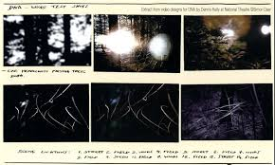
DNA Sound
Much of the sound is non diegetic and created using soundtracks. Thediegetic sounds are traffic, phones, TV, BIRDS ETC.
What sound effects and what effect does it have?
…………………………………………………………………………………………………………………………………………………………………………………………………………………………………………………………………………………………………………………………………………………………………………………………………………………………………………………………………………………………………………………………………………………………………………………………………………………………………………………………………………………………………………………………………………………………………………………………………………………………………………………………………………………………………………………………………………………………………………………………………………………………………………………………………………………………………………………………………………………………
Name a scene in which the sound creates mood and atmosphere and explain how?
……………………………………………………………………………………………………………………………………………………………………………………………………………………………………………………………………………………………………………………………………………………………………………………………………………………………………………………………………………………………………………………………………………………………………………………………………………………………………………………………………………………………………………………………………………………………………………………………………………………………………………………………………………………………………………………………………………………………………………………………..
Which sounds are associated with Bertha and what do they represent?
………………………………………………………………………………………………………………………………………………………………………………………………………………………………………………………………………………………………………………………………………………………………………………………………………………………………………………………………………………………………………………………………………………………………………………………………

Slide 14
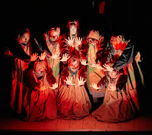
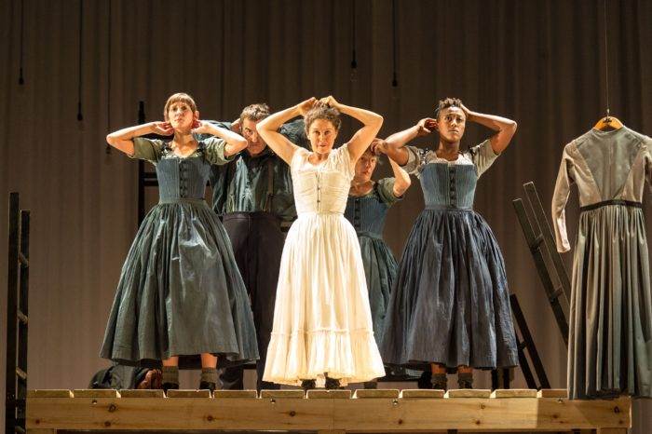
COSTUME- KEY WORDS
Key Word | Definition
Colour
Hat/ Hair
Era/ Time Period
Economics/ condition
Shoes/ Status
Embellish-ments
Material
Make up

Slide 15
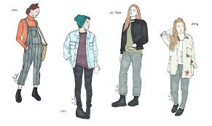
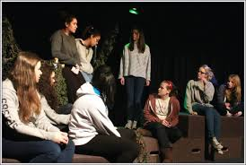
DNA Costume
Costume Designer
The costumes in DNA reflect the time period whilst also having a twist. The designer needed to think about the practicalities of the actors moving around the stage and how to show their characters
Describe the garments of one character’s costume, thinking about colour, material and condition.
……………………………………………………………………………………………………………………………………………………………………………………………………………………………………………………………………………………………………………………………………………………………………………………..................................................................................................................................................................................................................................................................................................................................................................................................................................................................................................................................................................................................................................
Why does Leah have all of her costume changes on stage and how have her costumes been designed for this?
……………………………………………………………………………………………………………………………………………………………………………………………………………………………………………………………………………………………………………………………………………………………………………………………………………………………………………………………………………………………………………………………………………………………………………………………………………………………………………………………………………………………………………………………………………………………………………………………………………………………………………………………………………………………………………………………………………………………………………………………..
What would you improve about the costumes? Why?
………………………………………………………………………………………………………………………………………………………………………………………………………………………………………………………………………………………………………………………………………………………………………………………………………

Slide 16
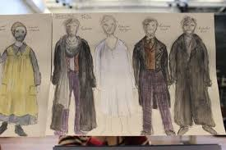
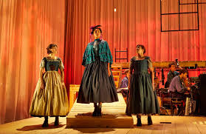
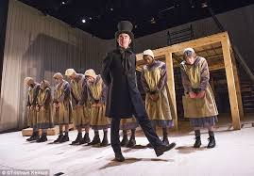
Jane Eyre Costume
Costume Designer
Katie Sykes
The Colours of the costumes for the poorer characters are dreary and reflect the working class people of the Victorian times. The rich characters wear more vibrant colours and richer materials to show their higher class. Bertha wears a deep red. Jane’s strength can be seen in the costume choices.
Name a garment that helped an actor to multi role and explain why.
……………………………………………………………………………………………………………………………………………………………………………………………………………………………………………………………………………………………………………………………………………………………………………………………………………………………………………………………………………………………...
Explain how a characters costume represented the time period, personality and status of the character?
……………………………………………………………………………………………………………………………………………………………………………………………………………………………………………………………………………………………………………………………………………………………………………………………………………………………………………………………………………………………………………………………………………………………………………………………………………………………………………………………………………………………………………………………………………………………………………………………………………………………………………………………………………………………………………………………………………………………………………………………..
Describe a costume that shows a characters status and explain why.
………………………………………………………………………………………………………………………………………………………………………………………………………………………………………………………………………………………………………………………………………………………………………………………………………………………………………………………………

Slide 17
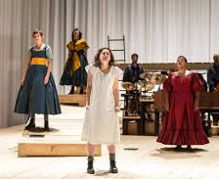
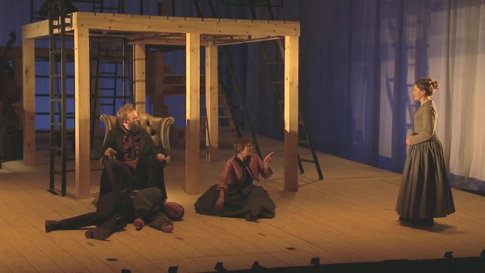
CHARACTERISATION- KEY WORDS vocal expression
Key Word | Definition
Emphasis
Accent
Tone
Pause
Pace
Projection
Pitch

Slide 18
CHARACTERISATION- KEY WORDS – physical expression
Key Word | Definition
Facial Expression
Levels of Tension
Audience Awareness
Gesture
Posture/ Proxemics
Eye Contact
Gait
Status
Stillness
BLOCKING

Slide 19
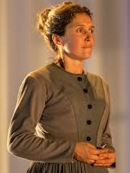
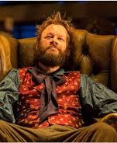
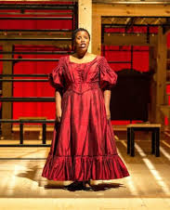
Jane Eyre Characters
The actors within Jane Eyre portray the emotions, personality traits and status of the characters through their facial expressions, voice and extreme physicality. The play is very physically taxing, with actors climbing up and down ladders and running around the stage.
Madeleine Worrall
Jane Eyre
Felix Hayes
Rochester
Bertha is Rochester's first wife and she lives in Thornfield's attic, locked up and managed by Grace Poole. Bertha is mad, jealous, bitter and malicious, as she sets fire to Rochester's bed whilst he is sleeping and rips Jane’s veil. Bertha is often seen in the background and sings to show her and other’s mood. Bertha sets fire to Thornfield - her final act of madness.
From the beginning of the play, Jane is a strong-willed, passionate and outspoken young girl. Jane regularly speaks out against the cruel treatment of her cousin, John and her aunt, Mrs Reed. This results in Jane becoming isolated and alienated in the house, as she endures her punishments alone. When Jane moves to Lowood School, her life appears to be similar, as she has to endure horrible taunts and punishments from Mr Brocklehurst. However, it is at Lowood Jane finds true friendship and love. Here, Jane is very loyal and kind towards Helen Burns, her best friend. When Helen dies, she is heartbroken and lost.
Jane is plain and doesn't see herself as a beauty. Nonetheless, she manages to fall in love with Rochester, and eventually Rochester confesses his love for Jane. They plan to marry but their plans are thwarted when it is revealed Rochester already has a wife. Jane suffers more heartbreak and vows to leave Thornfield, as she cannot sacrifice her integrity and principles to live with a man she loves but cannot marry. She leaves, sacrificing her chance of happiness. Jane becomes homeless and finds refuge at the Rivers' home. The play ends with Jane finding happiness, as she and Rochester have a baby girl, mirroring the opening scene.
Rochester is the master of Thornfield Hall and as a consequence, has a large fortune. He is aloof, intelligent, rugged and witty. We first meet him when he falls off his horse, accusing Jane of being at fault. Rochester demands that Jane spends time with him, and they spend their evenings arguing and discussing topical issues. His rugged appearance makes him appear wilder, echoing his personality. Jane begins to fall in love with him.
Rochester brings Blanche Ingram to the house, wanting Jane to become jealous and declare her love for him. When she doesn't, he appears angry and flirts all the more - manipulating Jane's and Blanche's emotions. Rochester finally declares his love for Jane, stating they must get married straight away. When, at the altar, it is revealed that Rochester is already married, he becomes angry and self-pitying as he is bound to Bertha, a 'mad-woman'. He wants Jane to stay with him, selfishly pleading to her and declaring his love. She leaves him.
When Jane returns to Rochester, she discovers that Rochester lost his sight and Thornfield Hall during a fire that Bertha caused. He cries when he hears Jane's voice, demonstrating his true love for Jane.
Melanie Marshall
Bertha Mason

Slide 20
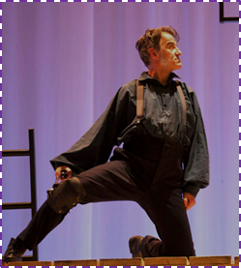
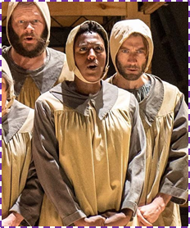

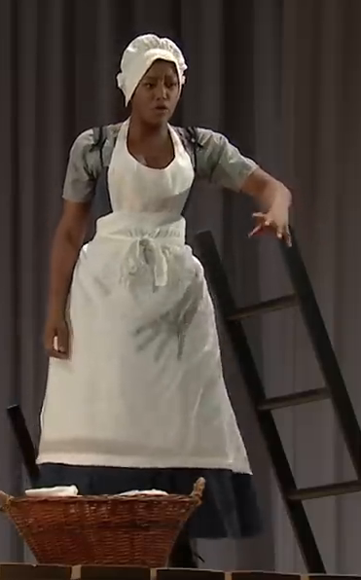
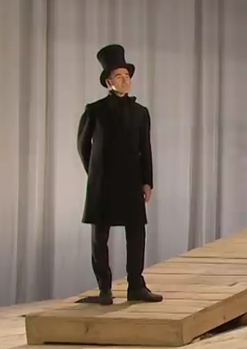
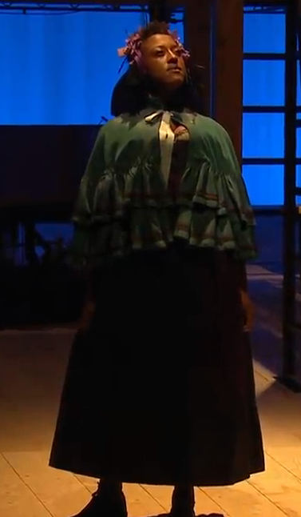
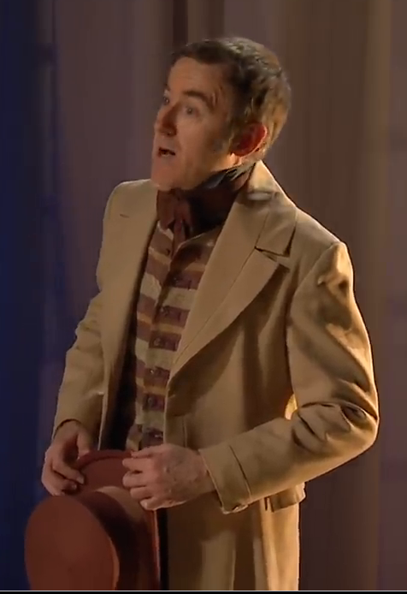
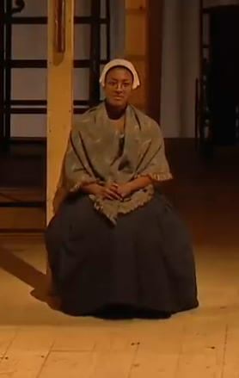
Jane Eyre Characters
Many actors within Jane Eyre multi-role as specific characters and also members of the chorus. They use changes in costume and characterisation to make it clear that they are playing a different character.
Craig Edwards
Simone Saunders
Blanche Ingram is Rochester's 'love interest' and arrives at Thornfield with the intention of marrying Rochester. Blanche is beautiful, clever and witty. It is through these traits that she attempts to become Mrs Rochester of Thornfield. She does not love Rochester and only wants to marry him for his wealth and fortune.
Mr Brocklehurst is the supervisor of Lowood School. He is mean, vindictive and enjoys making the girls quiver in his presence. He enjoys the power he has and enjoys doling out punishments.
Pilot
Bessie
Pilot is Rochester’s dog but is played by a human. The audience has to use suspension of disbelief to imagine him as the dog but his use of voice and movement help us to imagine this. He adds an element of comedy to the play.
Bessie is Jane's nursemaid and it is her job to look after Jane. Bessie is an inconsistent character, as her feelings for Jane change throughout the course of the play. At times, Bessie can be kind and loving towards Jane, whereas, on other occasions, she can scold and punish Jane for no apparent reason.
Mr Brocklehurst
Blanche Ingram
Richard Mason is Bertha’s brother. During a visit to Thornfield, he is injured by his mad sister. After learning of Rochester’s intent to marry Jane, Mason sends the solicitor Briggs in order to thwart the wedding and reveal the truth of Rochester’s prior marriage.
Diana Rivers is the sister of St John. She is very kind, loyal and loving, as she cares for Jane throughout her illness, offering her a place to live when she has nowhere else to go. She tries to convince Jane to marry
St John.
Mason
Diana Rivers

Slide 21
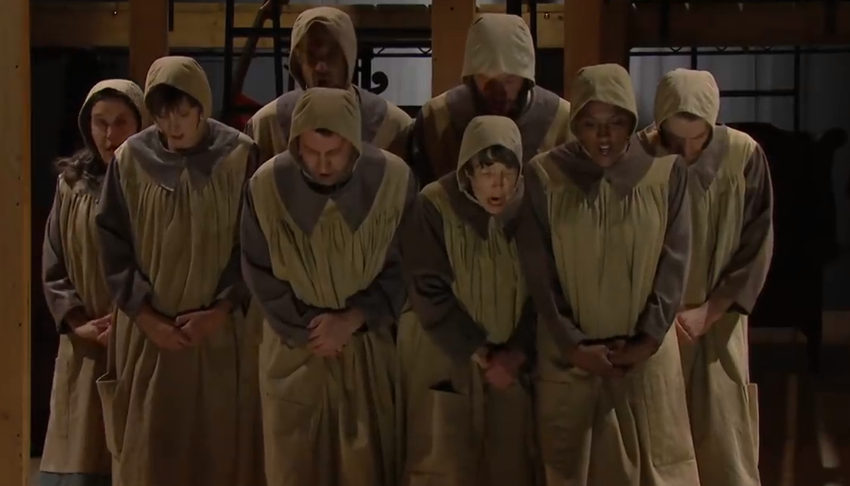
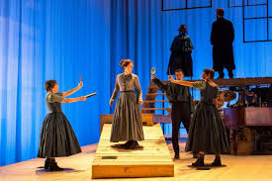
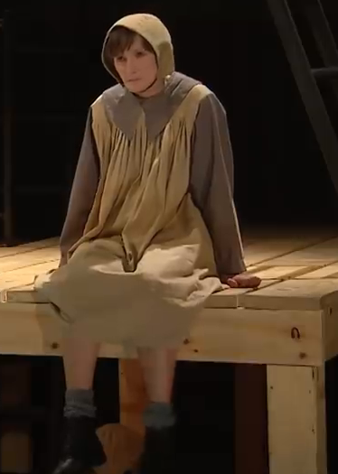
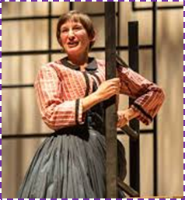
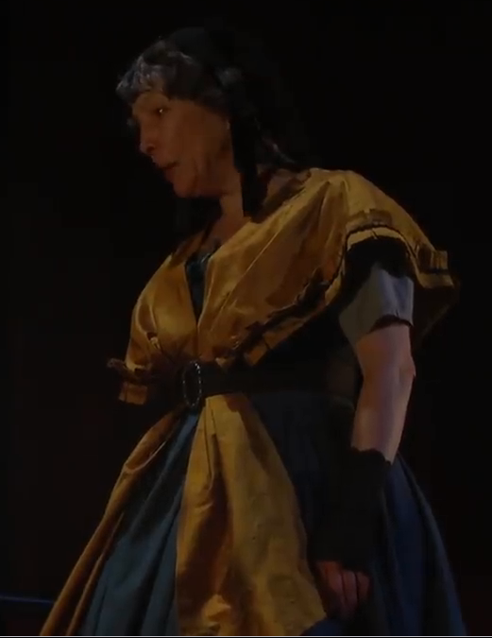
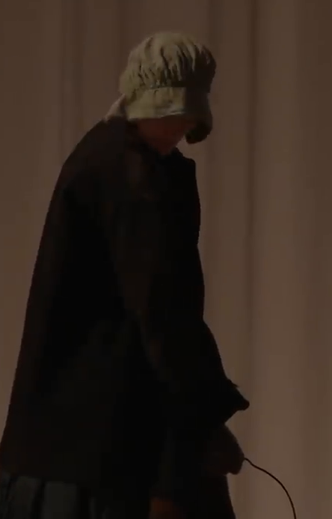
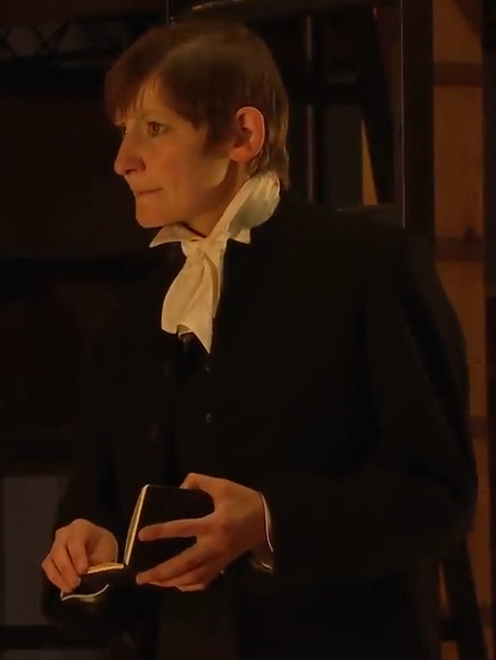
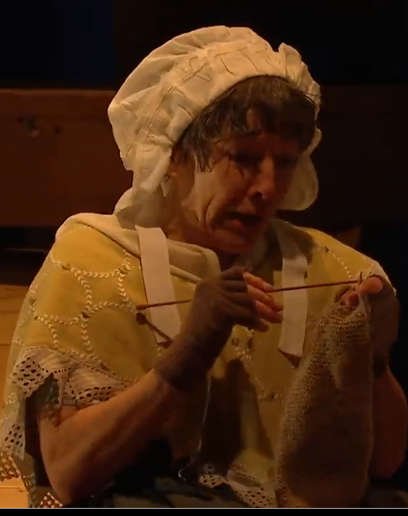
Jane Eyre Characters
Felix Hayes and the band also multirole as the chorus, although less often. The chorus play Jane’s cousins, the students at Lowood, others on the stage coach, Jane’s inner thoughts etc. The actors also multi role in different genders when needed.
Maggie Tagney
Laura Elphinstone
Mrs Reed is Jane's aunt and she looks after Jane at Gateshead. Mrs Reed is cruel towards Jane, offering her little happiness and punishing her relentlessly. She punishes Jane by locking her in the Red Room and forbidding anyone to let her out. Mrs Reed idolises her children, John, Georgiana and Eliza, making them selfish, egotistical and arrogant.
Grace Poole is Bertha Mason’s keeper at Thornfield, whose carelessness frequently allows Bertha to escape. When Jane first arrives at Thornfield, Mrs. Fairfax attributes to Grace all evidence of Bertha’s misdeeds.
Helen Burns
Adele
Helen Burns is Jane's only friend at Lowood School. Helen is honest, pious, loyal and compassionate. She is continuously victimised by her teachers and regularly takes the punishment without voicing her opinions. This confuses Jane, as she wishes Helen would stand up for herself.
Adele is Rochester's ward and she stays at Thornfield under Rochester's instructions. Adele is more focused on fashion and presents rather than her studies. Adele is quite fanciful and does not take her studies seriously. Adele respects and loves Jane.
Mrs Reed
Grace Poole
St John (pronounced Sinjin) is the minister that helps Jane recover after leaving Thornfield. He is the opposite of Rochester, cold, repressed and pious and asks Jane to go to India with him as his wife not because he loves her but because he needs a wife like her.
Mrs Fairfax is the housekeeper at Thornfield Hall. She likes to keep the house in order, ensuring everything is clean and organised for Rochester, the master of the house. Mrs Fairfax is very organised, welcoming and expects her team to keep their place and position.
Mrs Fairfax
St John Rivers

Slide 22



Jane Eyre
Characterisation
Director Sally Cookson
Movement Director Dan Canham
Describe a moment when an actor used their voice effectively.
……………………………………………………………………………………………………………………………………………………………………………………………………………………………………………………………………………………………………………………………………………………………………………………
Explain how an actor shows a contrast in characters when multi rolling?
……………………………………………………………………………………………………………………………………………………………………………………………………………………………………………………………………………………………………………………………………………………………………………………………………………………………………………………………………………………………………………………………………………………………………………………………………………………………………………………………………………………………………………………………………………………………………………………………………………………………………………………………………………………………………………………………………………………………………………………………..
Describe a moment when an actor used their physicality effectively.
……………………………………………………………………………………………………………………………………………………………………………………………………………………………………………………………………………………………………………………………………………………………………………………………………………………………………………………………………………………………………
Which moment of characterisation would you direct differently and why ?
………………………………………………………………………………………………………………………………………………………………………………………………………………………………………………………………………………………………………………………………………………………………………………………………………………………….

Slide 23




Jane Eyre
Characterisation
Director Sally Cookson
Movement Director Dan Canham
How did the extremely physical nature of the show effect the actors performance?
……………………………………………………………………………………………………………………………………………………………………………………………………………………………………………………………………………………………………………………………………………………………………………………………………………………………………………………………………………………………....................................................................................................................
In one scene from the play, explain how two actors showed a change in relationship?
……………………………………………………………………………………………………………………………………………………………………………………………………………………………………………………………………………………………………………………………………………………………………………………………………………………………………………………………………………………………………………………………………………………………………………………………………………………………………………………………………………………………………………………………………………………………………………………………………………………………………………………………………………………………………………………………………………………………………………………………..
How did the actor Craig Edwards make us believe he was a dog?
…………………………………………………………………………………………………………………………………………………………………………………………………………………………………………………………………………………………………………………………………………………………………………………………………………………………

Slide 24

DIRECTORS DECISIONS- KEY WORDS
Key Word | Definition
Artistic Intention
Historical Romance Drama
Adaptation
Conventions of a Genre
Non-Naturalistic
Naturalistic
Drama Conventions
Multi role
Thought track
Suspension of Disbelief
Physical Theatre
Dream Sequence
Transitions

Slide 25

Jane Eyre
Director’s Decisions
Director
Sally Cookson
The director is in charge of the artistic intention for the play, how the play will be adapted from the text, how it will look, sound and feel. The performance was devised by the cast and crew but Cookson made the final decisions to ensure her artistic intention was met.
What genre is Jane Eyre and how do we know?
………………………………………………………………………………………………………………………………………………………………………………………………………………………………………………………………………………………………………………………………………………………………………………………………………………………………………………………………
Describe a moment in the play where design or characterisation are used to demonstrate the genre. ……………………………………………………………………………………………………………………………………………………………………………………………………………………………………………………………………………………………………………………………………………………………………………………………………………………………………………………………………………………………………………………………………………………………………………………………………………………………………………………………………………………………………………………………………………………………………………………………………………………………………………………………………………………………………………………………………………………………………………………………..
Name a moment in the play that demonstrates a Naturalistic style and explain why .………………………………………………………………………………………………………………………………………………………………………………………………………………………………………………………………………………………………………………………………………………………………………………………………………………………………………………………………………………………………………………………………
Name a moment in the play that demonstrates a non naturalistic style and explain why.
………………………………………………………………………………………………………………………………………………………………………………………………………………………………………………………………………………………………………………………………………………………………………………………………………………………………………………………………………………………………………………………………

Slide 26




Jane Eyre
Director’s Decisions
Director
Sally Cookson
There were many decisions that made the play non-naturalistic but gave a clear message to the audience. Drama conventions and interesting use of transitions helped to create mood and atmosphere, increasing the pace of what was once a static novel.
Describe a moment when a drama convention is used on stage.
……………………………………………………………………………………………………………………………………………………………………………………………………………………………………………………………………………………………………………………………………………………………………………………………………….
How did the director use blocking and design to transition between scenes?
……………………………………………………………………………………………………………………………………………………………………………………………………………………………………………………………………………………………………………………………………………………………………………………………………………………………………………………………………………………………………………………………………………………………………………………………………………………………………………………………………………………………………………………………………………………………………………………………………………………………………………………………………………………………………………………………………………………………………………………………..
What impact did the convention have on the audience?
………………………………………………………………………………………………………………………………………………………………………………………………………………………………………………………………………………………………………………………………………………………………………………………………………………………………………………………………………………………………………………………

Slide 27
Essay Structure and Advice
You will be asked to write an essay based on the live performance you have seen.
Plan out the structure you will use before you start.
Paragraph 1-3
Point- Make a point that links to your question.
Evidence- Describe the moment in the play where this is evident.
Explain- Explain the impact that this decision by the director, designer or performer on the audience (you)
Introduction- A few sentences about the live production you saw, when and where you saw it and your initial impressions
Conclusion- A few sentences that link to the question and tie your points together.
Use and show understanding of as many Drama key words as you can.
Use the names of the cast and crew to show understanding of job roles.
Use lots of creative adjectives- Not just ‘effective’ but mesmerising, exhilarating, tense etc.
Advice
Be specific- not ‘he used good facial expressions’ but instead ‘he furrowed his brow and clenched his jaw to show…’
If the question says evaluate, you must include a negative. Something that if you were the director, designer or performer, you would do differently.
Make a clear point in each paragraph and provide evidence from the play.

Slide 28
Theatre Evaluation and Analysis
Use the notes that you have made in this booklet and the advice from the previous page to answer the following mock questions.
1- Evaluate the decisions made by the director within the live performance that you watched and their impact on the audience.
2- Analyse how the design elements of the live production you watched impacted the audience.
3- Evaluate how successfully two actors in the live production you saw portrayed change in their relationship throughout the play.
4- Name the genre and style of the live production you saw and analyse how it was portrayed to the audience.
5- Evaluate how the use of lighting and sound in your live production created mood, atmosphere and location on stage.

