Slide 1
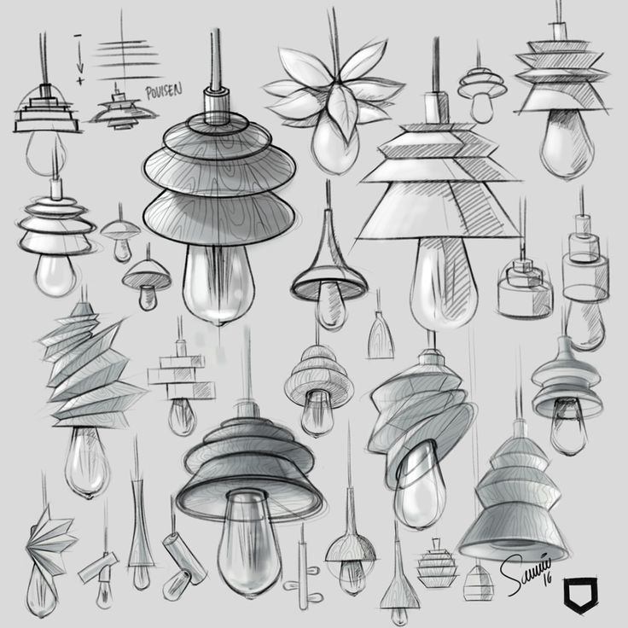
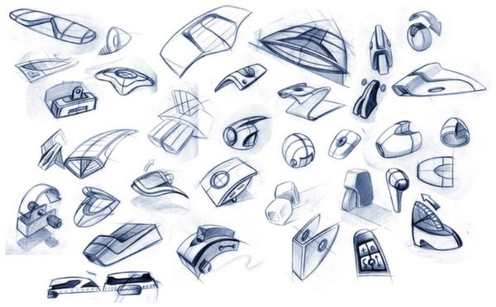
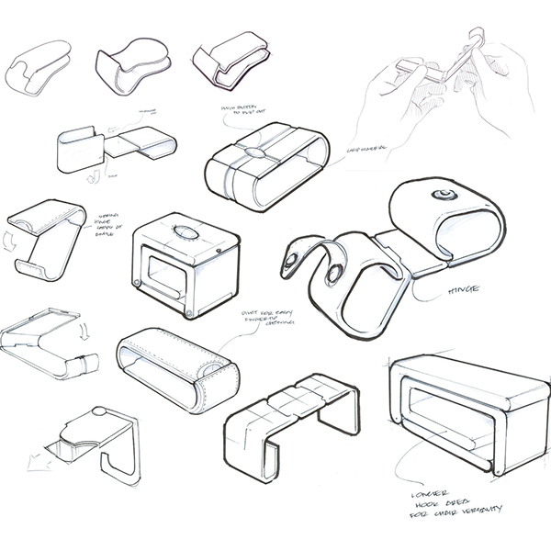
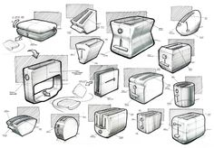
Concept ideas from research and investigation
Concept Ideas

Slide 2
Design Ideas Annotation -
Number each design and write what it is
Write what has inspired it and how you have adapted the shapes, textures and patterns into a design concept of your own.
Write what design movement your design is most styled like – Memphis, Organic, Art Deco, High Tech etc
Label all the features - unique selling points, target user, intended environment of use
materials could be used
Colour
Finish – Natural, gloss, matt, shiny, varnish, paint, vinyl stickers
Possible making / construction method
Brief specific annotations – 3D sculpture
Is it a objet d’art, award/trophy, paperweight?
What would the theme be for an award/trophy, i.e. most creative design, best made design etc
Brief specific annotations – Container
1. What will it contain / store / display?
How it is easy to clean
Brief specific annotations – Clock
Is it free standing or wall mounted?
How will you be able to tell the time i.e. with using numbers or shapes where the numbers would be?
Brief specific annotations – Mirror
Is it free standing or wall mounted?
Will you include engraving into the mirrored acrylic and what would it be and where would it go?
Brief specific annotations – Light
Is it free standing or wall mounted or ceiling mounted?
Will there be a switch on the cable to turn it on and off?
Will it be filament bulb and plug or LED’s?
Will the light be used for directing light to a specific place or more ambient mood lighting?
Brief specific annotations – small item of furniture
How it is easy to clean
Could it be made to make it flat pack and easy to move around the home if needed?
Design Ideas – Secondary Research: Design Movement, Designer and Product Analysis

Slide 3
Design development
Suggestion - Select 2 of your best design ideas
Develop your best two designs and for each one draw 4-5 different aesthetic(the look) developments
Fully explain all aspects of each development.
What has changed?
Has it improved the design?
Does it meet the specifications in your speck check grid?
Design Development
DEVELOPING A DESIGN
ADD – add bits to the design
SUBTRACT – take bits away from the design
SQUASH – make bits smaller in the design
STRETCH – make bits bigger in the design

Slide 4
Design development 5
Design Development of Initial Idea number
Design development 1
Stretch
Make something(s) bigger in your initial idea
What has changed?
Has it improved the design?
Add something(s) to your initial idea
My original initial idea
Design development 4
What has changed?
Has it improved the design?
Squash
Make something(s) smaller in your initial idea
Design development 2
Subtract
take away something(s) from your initial idea
Mirror
Repeat something(s) from your initial idea
What has changed?
Has it improved the design?
Design development 3
What has changed?
Has it improved the design?
What has changed?
Has it improved the design?

Slide 5
Week 9-12 (4 week)
Making methods experimentation
Suggestion –
Include screen shots of how you created your CAD file if you use the laser cutter
Include images of what making methods you used,
Explain around your photos –
What have you done?
What tools / equipment / machinery have you used?
How have you used them?
Why did you use them – What part / or whole section are you practicing making?
What are the H&S considerations?
Did you encounter any problems and how did you overcome them?
Is the method of making right for what you trying to realise? – Are you pleased with the results?
What are your next steps? – Do you need to change your making approach before the assessed period?
Laser cutting
Using the mitre saw
Using the table router
Cutting a practice joint – lap joint using chisel / tenon saw
Joining wood using PVA / nails / screws
Cutting / shaping / filing acrylic using scroll saw / file / wet and dry paper
Making Methods Experimentation and Materials Experimentation
Gluing acrylic together using tensol cement
Polishing acrylic using the polishing mop
Cutting wood using tenon / coping / scroll saw
Materials experimentation
Suggestion –
Include images, samples of the materials you may use. Explain reasons for choice, good points, bad points, suitable finish
Vacuum forming
Wood laminating
Using the wood lathe / metal lathe

Slide 6
Week 9-12 (4 week)
Design experimentation
Photo
Photo
Photo
Photo
What is it?
How did you make it (tools, techniques, materials, health and safety) ?
What do you think of the outcome?
What further developments does it need?
What is it?
How did you make it (tools, techniques, materials, health and safety) ?
What do you think of the outcome?
What further developments does it need?
Photo
Photo
Photo
Photo
What is it?
How did you make it (tools, techniques, materials, health and safety) ?
What do you think of the outcome?
What further developments does it need?
What is it?
How did you make it (tools, techniques, materials, health and safety) ?
What do you think of the outcome?
What further developments does it need?

Slide 7
Week 9-12 (4 week)
Write the title Making Methods and Materials Experimentation Around your photos answer the following
1.What are you doing in the photo? What does the photo show? This is a photograph I took of….
The materials, tools, equipment and techniques I used are…
To work safely I needed to…
2. What did you learn from doing it? I found it easy / difficult to make because…
To get ideas about…
To get me thinking about…
To show what I have learned…
To explore the idea of….
To examine the shape form / texture / pattern of…
To analyse the style of…
To try the technique of…
To practice…
To develop my skills in…
3. What did you find out from doing this making experimentation – is it a process you will use again to make your objet d’art / container / planter / paper weight? I am pleased with the way…
One good part of the work is…
The best feature of the work is…
I am not happy with…
One area I could improve is…
The least successful part of the work is…
I wish I had…
4. What did you find out about the materials – did they cut, shape, finish like expected? I made it using…
I found it easy / difficult to use because…
5. What are your next steps? Will you use the same method or change making methods and materials to make your design?
I improved my skills in..
I got better at…
I have a better understanding of…
Next I will try…
The making methods I will use are…
The materials I will use are…

