Slide 1
A Computer System (Hardware)
Input Devices
Processing Devices
Output Devices
Storage Devices

Slide 2
Hardware & Software
Hardware is the name given to the physical parts of a computer system (if you can pick it up and throw it, it’s hardware!)
Software is the name given to the programmes that make the hardware work.
A complete computer system must have both hardware and software to work.

Slide 3
Categories of Hardware
Input devices are used to enter data into a computer system or give instructions. E.g. keyboards, mice, webcam, microphone etc.
Output devices are used to get information out of a computer system. E.g. screen, printer, speaker etc.
Storage devices allow data to be stored for later use. E.g. hard disc, memory stick, CD, DVD etc.
Communications devices allow computers to communicate with each other. E.g. network cards (NICs), routers, switches, modems etc.
Processors these follow the instructions provided in the software. These make the hardware work.

Slide 4
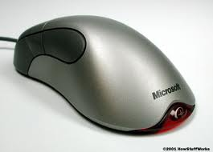
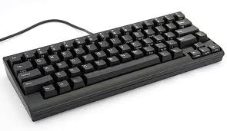
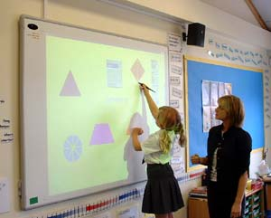
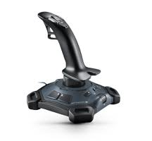
Input Devices
Most common are keyboards and mice.
Other input devices can be used when required.

Slide 5
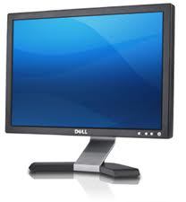
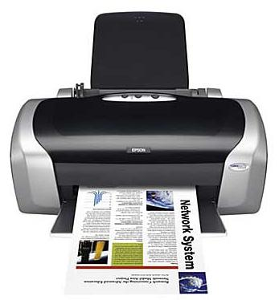
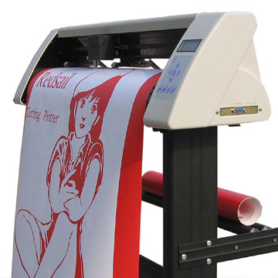
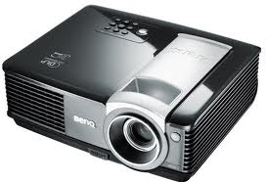
Output Devices
Most common are flat screens and printers (though there are many different types of each!).
Other output devices can be used when required.

Slide 6
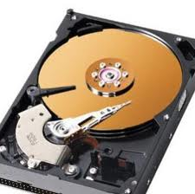
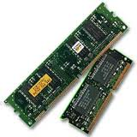
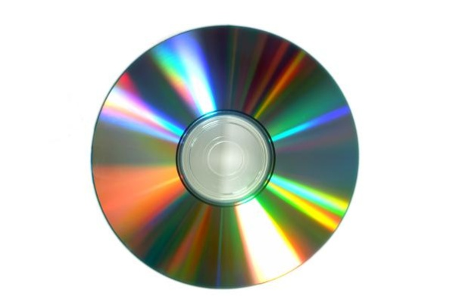
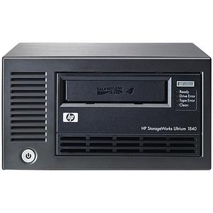
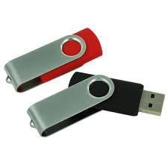
Storage Devices
Most common are main memory, hard discs and compact disks.
Other storage devices can be used when required. Some have advantages of massive capacity, speed or portability

Slide 7
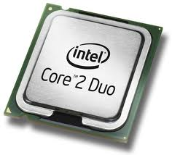
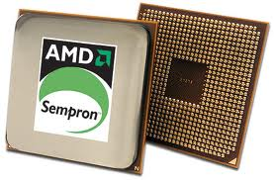
Processors
These follow the instructions given by software. A 3GHz processor will execute 3,000 million instructions per second!

Slide 8
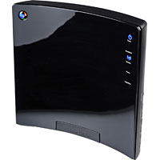
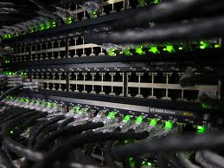
Communication Devices
Most common are routers and switches.
These allow computers to be connected to networks, or networks to be connected to other networks. They can be designed to work with physical (bounded) media like copper cable or fibre optic, or unbounded media like wifi.

