Slide 1
Lesson 6:
Putting it all together
Year 8 – Intro to Python programming
Notes:
Last updated 16-04-21
Resources are updated regularly — the latest version is available at: ncce.io/tcc.
This resource is licensed under the Open Government Licence, version 3. For more information on this licence, see ncce.io/ogl.

Slide 2
Starter activity
Guess my lucky number: multiple attempts
lucky = 13
print("Can you guess my lucky number?")
guess = int(input())
if guess == lucky:
print("Amazing, you guessed it")
else:
print("Sorry, it’s not", guess)
print("Nice playing with you")
1. Pick a lucky number .
2. Ask the user to guess .
3. Display feedback to the user .
4. Say goodbye .
Which of these program segments will need to be repeated if the user is allowed multiple guesses?

Slide 3
Starter activity
Guess my lucky number: multiple attempts
lucky = 13
print("Can you guess my lucky number?")
guess = int(input())
if guess == lucky:
print("Amazing, you guessed it")
else:
print("Sorry, it’s not", guess)
print("Nice playing with you")
Pick a lucky number
↺
Ask the user to guess .
Display feedback to the user .
Say goodbye
Which of these program segments will need to be repeated if the user is allowed multiple guesses?

Slide 4
Objectives
In this lesson, you will...
Use three control structures (sequence, selection, and iteration) to build a more complex program
Use Boolean variables, operators, and expressions
Take a quiz, to assess what you have learnt

Slide 5
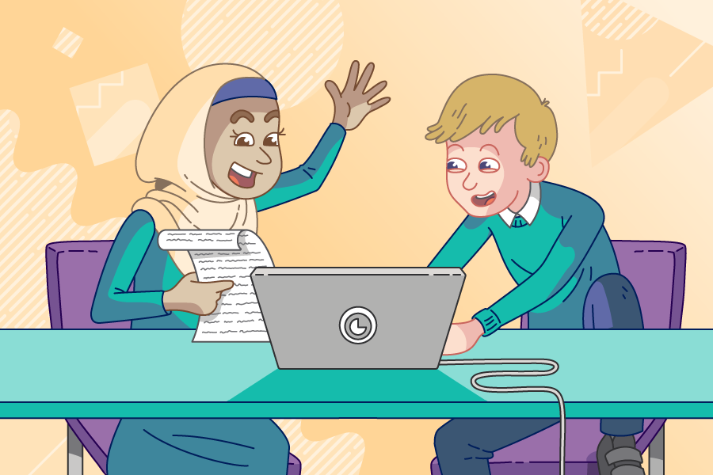
Activity 1
Lucky number revisited
Use pair programming .
Driver
Control the keyboard and mouse.
Navigator
Provide support and instructions.
Alternate between roles.

Slide 6
Activity 1
Guess my lucky number: multiple attempts
lucky = 13
print("Can you guess my lucky number?")
guess = int(input())
if guess == lucky:
print("Amazing, you guessed it")
else:
print("Sorry, it’s not", guess)
print("Nice playing with you")
Pick a lucky number
↺
Ask the user to guess .
Display feedback to the user .
Say goodbye
Live coding (ncce.io/py-lucky-6)

Slide 7
Activity 1
Guess my lucky number: run your program
lucky = 13
guessed = False
while guessed == False:
print("Can you guess my lucky number?")
guess = int(input())
if guess == lucky:
print("Amazing, you guessed it")
else:
print("Sorry, it’s not", guess)
print("Nice playing with you")
Faced with an error? Here are some things that you will need to check:
Is the F in False capitalised?
Does the condition use == to check if the value of guessed is False?
Have you remembered the colon : after the condition in while?
Have you used indentation, to indicate which statements belong to the while block?
↺
Tip: Press the ‘Stop’ button or try Control+C to terminate your program.

Slide 8
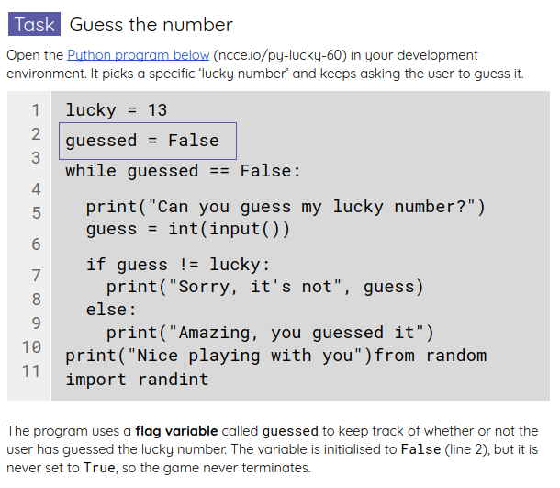
Activity 2
Lucky number revisited
Start from your current program.
Complete the tasks in your worksheet to build a more complete ‘Guess the number’ game.

Slide 9
Activity 2
Logical operators in Python
You can use these operators to combine logical expressions.
Examples
not negation
and conjunction
or disjunction
not a == 1
b > 10 and c <= d
e == 10 or f != 1
Expressions formed using these operators evaluate to either True or False.

Slide 10
Summative assessment
Assessment
You will now take a quiz, to assess your learning throughout this unit.
Good luck!
Notes:
Select 15–20 closed-form questions, making sure that the unit learning objectives are covered, and ask learners to answer them.

Slide 11
Summative assessment: feedback
Assessment
Notes:
It might be beneficial to use an online tool for the quiz. These tools provide instant visual summaries of learners’ answers to each question, which will help you provide immediate whole-class feedback, pinpoint any remaining misconceptions, and focus your explanations.

Slide 12
Unit takeaways
Summary
On a sticky note, write:
One thing that impressed you
One thing that you learnt
(and that you’ll remember)
And one thing that you didn’t really enjoy
Notes:
Ask learners to use sticky notes to record their main takeaways from the unit. Ask them to write one thing that impressed them, one thing that they learnt, and one thing that they didn’t particularly enjoy.

Slide 13
Summary
In this lesson, you...
Used three control structures (sequence, selection, and iteration) to build a more complex program
Used Boolean variables, operators, and expressions
Took a quiz, to assess what you have learnt

Slide 14
Summary
In this unit, you...
Explored what basic programming structures look like in Python
Built your first Python programs

