Slide 1
Lesson 5:
Round and round
Year 8 – Intro to Python programming
Notes:
Last updated: 20-04-21
Resources are updated regularly — the latest version is available at: ncce.io/tcc.
This resource is licensed under the Open Government Licence, version 3. For more information on this licence, see ncce.io/ogl.

Slide 2
Starter activity
Making predictions
count = 3
print(count)
count = count-1
print(count)
Question .
What will this program display when it is executed?
There is no valid value for count. This will result in an error.
It will print 2.
It will print 3.
It will print 3 and then 2.
1
2
3
▹
4

Slide 3
Starter activity
Making predictions
count = 3
print(count)
count = count-1
print(count)
Assignments are not equations.
Assignments are instructions to be executed.
This is an instruction to:
evaluate the expression count-1 and
assign the value back to count
(replacing the previous value).
This is an instruction to:
decrease the value of count by 1.
?

Slide 4
Starter activity
Making predictions: answer
count = 3
print(count)
count = count-1
print(count)
Question .
What will this program display when it is executed?
2
State .
Output .
count
3
3
count
2
2

Slide 5
Objectives
In this lesson, you will...
Use iteration (while statements) to allow the flow of program execution to include loops
Use variables as counters

Slide 6
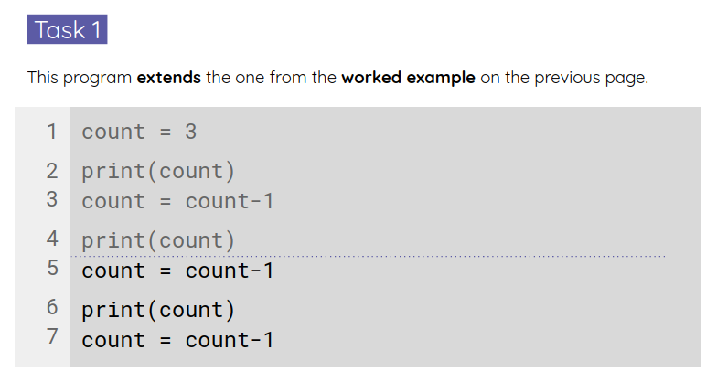
Activity 1
Count
count = 3
print(count)
count = count-1
print(count)
count = count-1
print(count)
count = count-1
Question .
What will this extended program display when it is executed?
The previous program
ended here.
Use your worksheet to answer.
Then, move on to the next tasks.

Slide 7
Activity 1
Count: walk-through
count = 3
print(count)
count = count-1
print(count)
count = count-1
print(count)
count = count-1
Question .
What will this extended program display when it is executed?
State .
Output .
count
3
3
count
2
2
count
1
1
count
0

Slide 8
Activity 1
Count: iterative
count = 3
print(count)
count = count-1
print(count)
count = count-1
print(count)
count = count-1
count = 3
while count >= 1:
print(count)
count = count-1

Slide 9
Activity 1
Count: solutions
count = 3
while count >= 1:
print(count)
count = count-1
count = 10
while count >= 1:
print(count)
count = count-1
print("Lift off!")
count = 1
while count <= 20:
print(count)
count = count+3

Slide 10
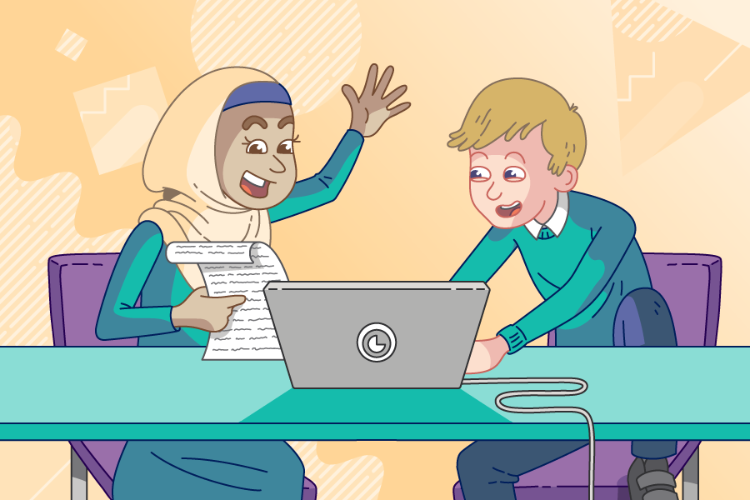
Activity 2
Times tables practice
Use pair programming .
Driver
Control the keyboard and mouse.
Navigator
Provide support and instructions.
Alternate between roles.

Slide 11
Activity 2
Times tables practice: a single question
from random import randint
a = randint(2,12)
b = randint(2,12)
Generate two random integers a and b .
print(a, "times", b, "=")
answer = int(input())
Ask the user for the product of a and b .
product = a * b
Calculate the correct answer .
if answer == product:
print("That is correct")
else:
print("I am sorry")
print(a, "times", b, "is", product)
Check the user’s answer and provide feedback .

Slide 12
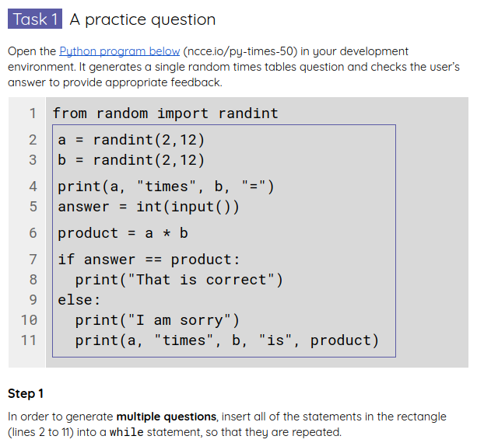
Activity 2
Times tables practice: multiple questions
Start from your current program.
Complete the tasks in your worksheet to build a more complete times tables practice game.

Slide 13
Activity 3
Some code reading
from random import randint
rolls = 0
sixes = 0
while rolls < 10:
dice = randint(1,6)
if dice == 6:
sixes = sixes + 1
rolls = rolls + 1
from random import randint
rolls = 0
sixes = 0
while sixes < 10:
dice = randint(1,6)
if dice == 6:
sixes = sixes + 1
rolls = rolls + 1
The only difference between these two programs is the condition in the while loop. When does each loop terminate?

Slide 14
Summary
In this lesson, you...
Next lesson, you will...
Used iteration (while statements) to allow the flow of program execution to include loops
Apply what you’ve learnt and
use iteration even more!
Take a quiz, to assess what you’ve learnt
Used variables as counters

