Slide 1
Lesson 4:
More branches
Year 8 – Intro to Python programming
Notes:
Last updated: 20-04-21
Resources are updated regularly — the latest version is available at: ncce.io/tcc.
This resource is licensed under the Open Government Licence, version 3. For more information on this licence, see ncce.io/ogl.

Slide 2
Starter activity
Strange weather
print("Where do you live?")
location = input()
print("Weather in", location, "now?")
weather = input()
How would you extend this program to give advice to the user on how to dress depending on the weather?
Provide a rough outline of what your Python code would look like.
Give advice for when the weather is
cloudy, rainy, or snowy.
In any other case, display a generic message.
Discuss in pairs and write an answer together.

Slide 3
Objectives
In this lesson, you will...
Explore how selection can handle more than two possible branches
Use iteration (while statements) to allow the flow of program execution to include loops

Slide 4
Activity 1
Selection
if :
These versions of selection
check one condition and select one out of two branches to follow.
What if there are more than two cases in the problem?
What if there are multiple branches ?
condition
block of statements
if :
else:
condition
block of statements
Think of the weather example:
“Give advice for when the weather is cloudy, rainy, or snowy.”
block of statements

Slide 5
Activity 1
Multi-branch selection
if :
elif :
else:
Multi-branch selection (if, elif, else)
checks successive conditions and
selects one out of multiple branches to follow.
condition
block of statements
condition
You will need an if block with elif blocks:
when there are more than two mutually exclusive paths for your program to follow.
block of statements
block of statements
You can use multiple elif blocks.
The else and its block are optional.
You can nest anything inside the blocks of statements, even more if statements.

Slide 6
Activity 1
Strange weather
print("Where do you live?")
location = input()
print("Weather in", location, "now?")
weather = input()
Extend this program using elif, to give advice to the user on how to dress depending on the weather.
Give advice for when the weather is:
cloudy, rainy, or snowy.
In any other case, display a generic message.
Live coding (ncce.io/py-weather-40)

Slide 7
Activity 1
Strange weather: sample solution
if weather == "cloudy":
advice = "No sunglasses"
elif weather == "rainy":
advice = "Get an umbrella"
elif weather == "snowy":
advice = "Mittens and earmuffs"
else:
advice = "No particular advice"
print(advice)

Slide 8
Activity 1
Strange weather: executing the program
if weather == "cloudy":
advice = "No sunglasses"
elif weather == "rainy":
advice = "Get an umbrella"
elif weather == "snowy":
advice = "Mittens and earmuffs"
else:
advice = "No particular advice"
print(advice)
State .
False
weather
"rainy"
True
advice
"Get an umbrella"
Output .
Get an umbrella

Slide 9
Activity 1
Strange weather: executing the program
if weather == "cloudy":
advice = "No sunglasses"
elif weather == "rainy":
advice = "Get an umbrella"
elif weather == "snowy":
advice = "Mittens and earmuffs"
else:
advice = "No particular advice"
print(advice)
State .
False
weather
"clear"
False
advice
"No particular advice"
False
Output .
No particular advice

Slide 10
Activity 1
Retrieving the weather
from ncce.weather import description
print("Where do you live?")
location = input()
weather = description(location)
print("The weather is", weather)
This modified program retrieves the weather online, instead of asking the user.
Note The weather module and its functions are not standard Python components.
Open the modified program in your development environment (ncce.io/py-weather-42).
Run it a few times and enter different locations around the world.

Slide 11
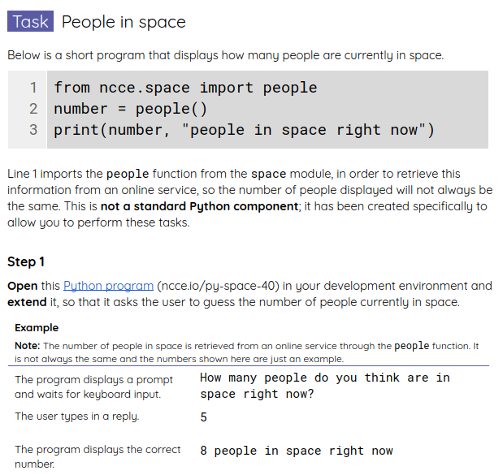
Activity 2
People in space
You will be given a program that displays how many people are currently in space.
Note: The number is retrieved from an online service. It is not always the same.
Extend this program so that it asks the user to guess this number.
Use your worksheet.

Slide 12
Activity 2
People in space: sample solution
from space import people
number = people()
print("How many people...")
guess = int(input())
if guess < number:
print("It's actually more than that.")
elif guess > number:
print("It's actually less than that.")
else:
print("That's right!")
print(number, "people in space now")
Retrieve the number of people in space .
Prompt the user to guess .
Check the answer and provide feedback .
Display the number of people in space .

Slide 13
Activity 3
Something missing
print("What’s your name?")
name = input()
print("Hello", name)
This program greets the user by name.
What if... .
we wanted to repeat the process until a specific name is entered?
Many of our programs have sections that could be repeated
e.g. checking the weather for multiple locations, and a number guessing game with many guesses.

Slide 14
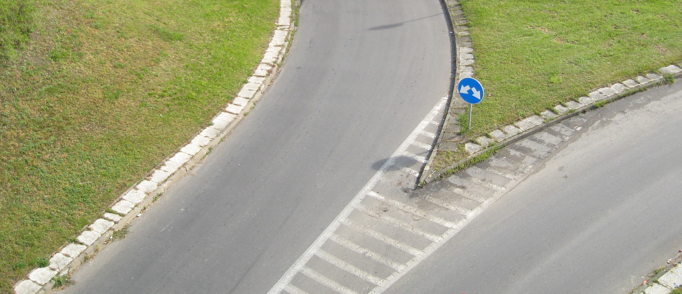
Activity 3
Iteration
When your programs repeat actions, checking for a terminating condition at the beginning of each new loop
Notes:
Image source: https://commons.wikimedia.org/wiki/File:Mini-roundabout_sign,_Comber,_June_2010.JPG

Slide 15
Activity 4
Iteration
while :
condition
block of statements
while True:
block of statements

Slide 16
Activity 4
Iteration
while :
You will need a while statement:
when your program needs to repeat actions while a condition is satisfied.
condition
block of statements

Slide 17
Activity 4
Example: a (surreal) iterative program
print("What’s your name?")
name = input()
while name != "Hedy":
print("Try again Hedy")
name = input()
print("Hello", name)
Question Can you predict what the outcome of running this program will be?
Tip: while block These statements are to be repeated.
Tip: while condition This condition is checked at the beginning of each loop.
Answer This program will keep asking the user for their name, until the name is "Hedy", at which point it will display a greeting (ncce.io/py-you-4).

Slide 18
Activity 4
Iteration: step-by-step execution
print("What’s your name?")
name = input()
while name != "Hedy":
print("Try again Hedy")
name = input()
print("Hello", name)
State .
name
"Margaret"
True
Input/Output .
What’s your name?
User types Margaret
Try again Hedy
User types Ada

Slide 19
Activity 4
Iteration: step-by-step execution
print("What’s your name?")
name = input()
while name != "Hedy":
print("Try again Hedy")
name = input()
print("Hello", name)
State .
name
"Ada"
True
Input/Output .
What’s your name?
User types Margaret
Try again Hedy
User types Ada
Try again Hedy
User types Hedy

Slide 20
Activity 4
Iteration: step-by-step execution
print("What’s your name?")
name = input()
while name != "Hedy":
print("Try again Hedy")
name = input()
print("Hello", name)
State .
name
"Hedy"
False
Input/Output .
What’s your name?
User types Margaret
Try again Hedy
User types Ada
Try again Hedy
User types Hedy
Hello Hedy

Slide 21
Activity 4
Subtle points
print("What’s your name?")
name = input()
while name != "Hedy":
print("Try again Hedy")
name = input()
print("Hello", name)
Question .
What difference will it make if the line in red is removed?
It will make no difference.
There’s no initial value for name:
an error will occur when checking the condition in while.
There’s no initial value for name:
an error will occur when executing print.
There’s no initial value for name:
the program will execute normally.
⨯
1
▹
2
3
4

Slide 22
Activity 4
Subtle points
print("What’s your name?")
name = input()
while name != "Hedy":
print("Try again Hedy")
name = input()
print("Hello", name)
Question .
What difference will it make if the line in red is removed?
(Assume the first name is not "Hedy".)
It will make no difference.
The value for name is never modified:
an error will occur when checking the condition in while.
The value for name is not modified:
the program will never terminate.
⨯
1
2
▹
3

Slide 23
Homework
Answer the questions in your homework sheet.

Slide 24
Summary
In this lesson, you...
Next lesson, you will...
Explored how selection can handle more than two possible branches
Used iteration (while statements) to allow the flow of program execution to include loops
Use iteration (while statements) to allow the flow of program execution to include loops
Use Boolean variables, operators, and expressions
Use variables as counters and flags

