Slide 1
Lesson 3:
At a crossroads
Year 8 – Intro to Python programming
Notes:
Last updated: 19-04-21
Resources are updated regularly — the latest version is available at: ncce.io/tcc.
This resource is licensed under the Open Government Licence, version 3. For more information on this licence, see ncce.io/ogl.

Slide 2

Starter activity
Something missing
print("What’s your name?")
user = input()
print("Hello", user)
What if... .
you wanted the program to recognise one particular name and treat it differently?
print("Best film ever?")
film = input()
print(film, "is my favourite too!")
What if... .
you wanted the program to react enthusiastically only to a particular film?
print("Year of birth?")
birth_year = int(input())
age = 2020 - birth_year
print("You are", age, "years old")
What if... .
you wanted the program to display a comment that depends on the user’s age range?

Slide 3
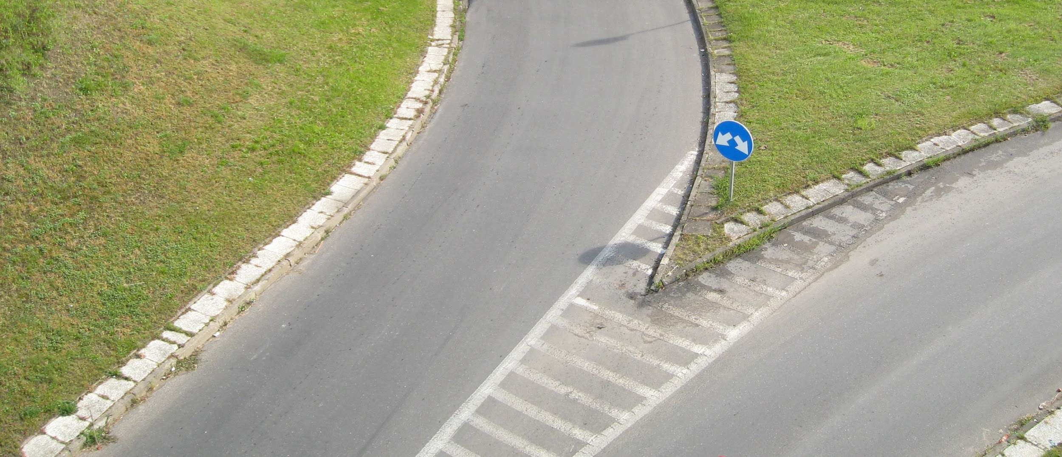
Starter activity
Selection
When your programs check conditions and select the path of action that they will follow accordingly
Notes:
Image source: https://upload.wikimedia.org/wikipedia/commons/d/d3/Gda%C5%84sk_Zaspa_-_road_junction_%28ubt%29.jpg

Slide 4
Objectives
In this lesson, you will...
Use selection (if statements) to control the flow of program execution between branches
Introduce elements of randomness into your programs

Slide 5
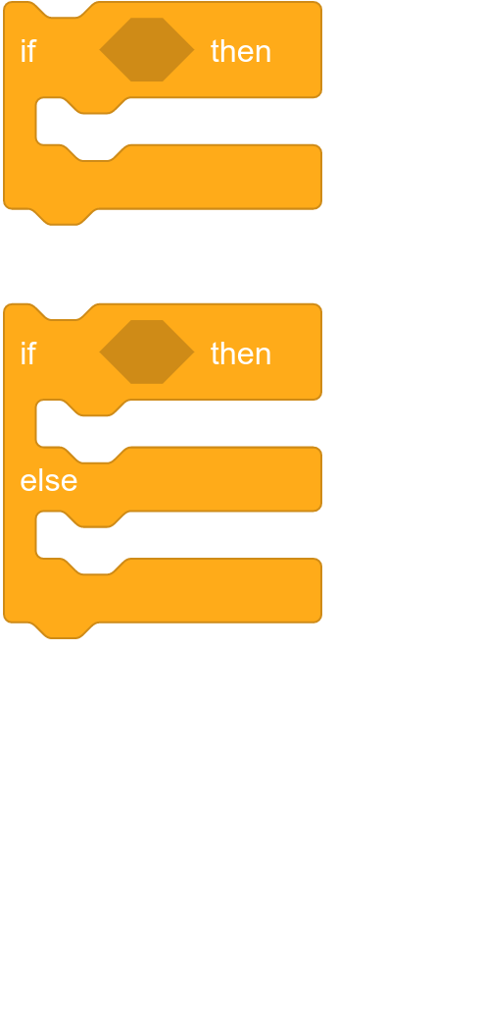
Activity 1
Selection
if :
condition
block of statements
if :
else:
condition
block of statements
block of statements

Slide 6
Activity 1
Selection
if :
You will need an if or an if, else:
when there is more than one possible path for your program to follow.
condition
block of statements
if :
else:
condition
block of statements
block of statements

Slide 7
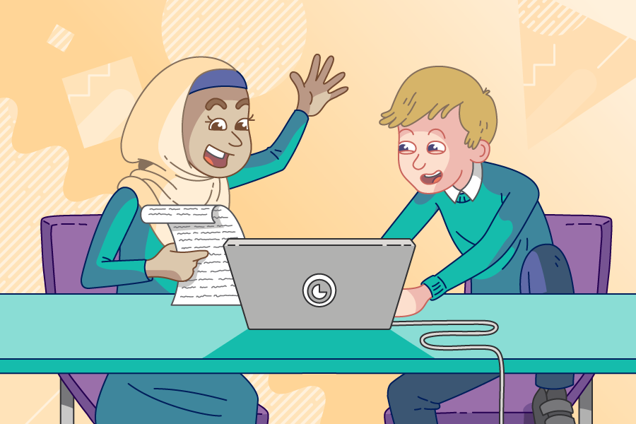
Activity 1
Selection in Python: Greeting
Use pair programming .
Driver
Control the keyboard and mouse.
Navigator
Provide support and instructions.
Alternate between roles.

Slide 8

Activity 1
Selection in Python: Greeting
print("What’s your name?")
user = input()
print("Hello", user)
Extend this program to recognise one particular name and treat it differently.
Live coding (ncce.io/py-greeting-30)

Slide 9
Activity 1
Selection in Python: commentary
print("What’s your name?")
user = input()
if user == "Elizabeth":
print("Good morning Your Majesty")
else:
print("Hello", user)
The condition will check if the value of user is equal to the string "Elizabeth".
The expression user == "Elizabeth" will evaluate to either True or False.
This is the if block, i.e. the code that will be executed if the condition is True.
This is the else block, i.e. the code that will be executed if the condition is False.
Only one of these blocks will be executed, depending on the value of the condition.

Slide 10
Activity 1
Selection in Python: beware of syntax
if user == "Elizabeth":
print("Good morning Your Majesty")
else:
print("Hello", user)
Syntax pitfalls .
It’s if and else. No capitals.
✔
✔
A colon : is always required after the
if condition and after else.
✔
Use indentation to indicate which statements ‘belong’ to the if block and the else block.
The == operator checks for equality.
The single = is only used in assignments.
✔
user is a variable. Don’t use quotes.
"Elizabeth" is a string literal. It needs quotes.
✔

Slide 11
Activity 1
Relational operators in Python (comparisons)
You can use these operators to compare the values of expressions.
Examples
== equal to
!= not equal to
< less than
<= less than or equal to
> greater than
>= greater than or equal to
a == 1 Does a equal 1?
b != c Are b and c different?
d < 3 Is d less than 3?
d <= 3 Is d at most 3?
d > 10 Is d greater than 10?
d >= 10 Is d at least 10?
Expressions formed using these operators evaluate to either True or False.
You can also use these operators to compare alphanumeric values (strings).

Slide 12
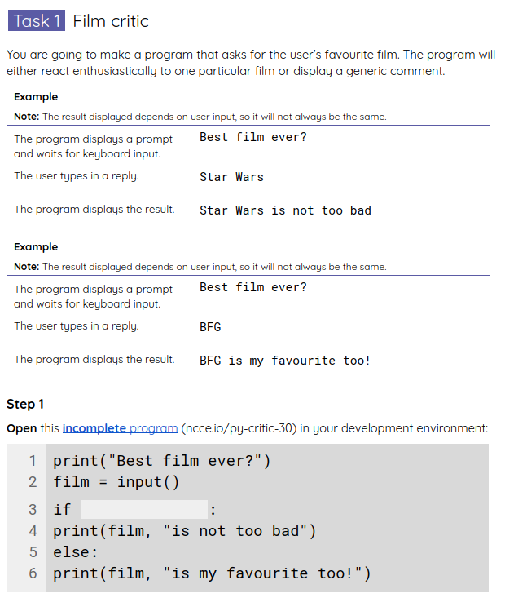
Activity 2
Practise using selection
Extend some of the programs that we’ve built so far to use selection.
Use your worksheet.

Slide 13
Activity 2
Practise using selection: example solutions
print("Best film ever?")
film = input()
if film != "BFG":
print(film, "is not too bad")
else:
print(film, "is my favourite too!")

Slide 14
Activity 2
Practise using selection: example solutions
lucky = 13
print("Guess my number:")
guess = int(input())
if guess == lucky:
print("Amazing, you guessed it")
else:
print("Sorry, it’s not", guess)
print("My lucky number is", lucky)
print("Nice playing with you")

Slide 15
Activity 3
Lucky number: labels
lucky = 13
print("Guess my number:")
guess = int(input())
if guess == lucky:
print("Amazing, you guessed it")
else:
print("Sorry, it’s not", guess)
print("My lucky number is", lucky)
print("Nice playing with you")
Pick a lucky number .
Prompt the user to guess .
Check answer and provide feedback .
Say goodbye .

Slide 16
Activity 3
Lucky number: executing the program
lucky = 13
print("Guess my number:")
guess = int(input())
if guess == lucky:
print("Amazing, you guessed it")
else:
print("Sorry, it’s not", guess)
print("My lucky number is", lucky)
print("Nice playing with you")
State .
lucky
13
guess
13
True
Input/Output .
Guess my number:
User types 13
Amazing, you guessed it
Nice playing with you

Slide 17
Activity 3
Lucky number: executing the program
lucky = 13
print("Guess my number:")
guess = int(input())
if guess == lucky:
print("Amazing, you guessed it")
else:
print("Sorry, it’s not", guess)
print("My lucky number is", lucky)
print("Nice playing with you")
State .
lucky
13
guess
7
False
Input/Output .
Guess my number:
User types 7
Sorry, it’s not 7
My lucky number is 13
Nice playing with you

Slide 18
Activity 4
Randomness
lucky = 13
print("Guess my number:")
guess = int(input())
if guess == lucky:
print("Amazing, you guessed it")
else:
print("Sorry, it’s not", guess)
print("My lucky number is", lucky)
print("Nice playing with you")
What if... .
you wanted a program that didn’t always pick the same lucky number?
Live coding (ncce.io/py-lucky-31)

Slide 19
Activity 4
Randomness
from random import randint
lucky = randint(1,20)
print("Guess my number:")
guess = int(input())
if guess == lucky:
print("Amazing, you guessed it")
else:
print("Sorry, it’s not", guess)
print("My lucky number is", lucky)
print("Nice playing with you")
Modules (or libraries) .
They extend what our programs can do by providing additional functions. .
Importing: “from the random module, the program will need the randint function”
Function call: Invoke the randint function, to return a random integer.
The (comma-separated) arguments 1 and 20 specify the range for the random integer.

Slide 20
Activity 4
Randomness
from random import randint
diceroll =
print("You rolled a", diceroll)
Question .
You are making a dice rolling game. Fill in the gap to complete the program.
int(input())
1 to 6
pick random (1) to (6)
randint(1,6)
1
2
3
▹
4

Slide 21
Activity 4
Randomness
from random import randint
diceroll = randint(1,6)
print("You rolled a", diceroll)
Question .
When this program is executed, what will its output be?
You rolled a diceroll
You rolled a randint(1,6)
You rolled a and a random integer ranging from 1 to 6
It is not possible to know the output without executing the program
1
2
▹
3
4

Slide 22
Activity 4
Randomness
from random import randint
diceroll = randint(1,6)
print("You rolled a", diceroll)
Type this program in your development environment.
Run it a few times to see that a random dice roll is displayed each time.

Slide 23
Activity 5
Subtle points
diceroll = 3
if diceroll > 3:
print(diceroll, "is a large roll") else:
print(diceroll, "is a small roll")
print("Yet you rolled a", diceroll)
True or false? .
Whenever this program is executed, it will produce the same output.
True
What will this output be?
True or false? .
The instruction highlighted will always be executed.
True

Slide 24
Activity 5
Subtle points
from random import randint
diceroll = randint(1,6)
if diceroll > 3:
print(diceroll, "is a large roll") else:
print(diceroll, "is a small roll")
print("Yet you rolled a", diceroll)
True or false? .
Whenever this program is executed, it will produce the same output.
False
True or false? .
The instruction highlighted will always be executed.
False

Slide 25
Activity 5
Subtle points
from random import randint
coin = randint(0,1)
if coin == 0:
result = "heads"
print(result)
else:
result = "tails"
Question .
When this program is executed, what will its output be?
Either 0 or 1
Either heads or nothing
Either heads or tails
heads
1
▹
2
3
4

Slide 26
Summary
In this lesson, you..
Next lesson, you will...
Used selection (if statements) to control the flow of program execution
Introduced elements of randomness into your programs
Explore how selection can handle more than two possible branches
Introduce iteration (while statements) to allow the flow of program execution to include loops

