Slide 1
Lesson 2:
Crunching numbers
Intro to Python programming
Notes:
Last updated 16-04-21
Resources are updated regularly — the latest version is available at: ncce.io/tcc.
This resource is licensed under the Open Government Licence, version 3. For more information on this licence, see ncce.io/ogl.

Slide 2
Starter activity
Make predictions (think, pair, share)
lucky = 13
print("My lucky number is", lucky)
Question .
What will be the output of print when this program is executed?
My lucky number is lucky
My lucky number is 13
It is not possible to know the output without executing the program
There is an error in the program
1
▹
2
3
4
True or false? .
This program will always produce the same output, whenever it is executed.
True

Slide 3
Starter activity
Make predictions (think, pair, share)
print("My lucky number is", lucky)
lucky = 13
Question .
What will be the output of print when this program is executed?
My lucky number is lucky
My lucky number is 13
It is not possible to know the output without executing the program
There is an error in the program
1
2
3
▹
4
During program execution, a variable must have been assigned a value before that value
is referenced.

Slide 4
Starter activity
Make predictions (think, pair, share)
print("What’s your name?")
user = input()
print("Hello", user)
Question .
What will be the output of print when this program is executed?
Hello user
Hello and whatever the user has typed on the keyboard
It is not possible to know the output without executing the program
There is an error in the program
1
▹
2
3
4
True or false? .
This program will always produce the same output, whenever it is executed.
False

Slide 5
Objectives
In this lesson, you will...
Use arithmetic expressions to calculate values
Use variables to store and reference values
Follow walk-throughs of code and keep track of variable values
Write programs that receive numerical input from the keyboard

Slide 6
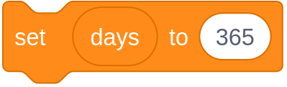
Activity 1
Assignments
days = 365
print(days, "days in a year")
Assignments are not equations.
This assignment does not mean that the days variable always equals 365.
Assignments are instructions to be executed.
This is an instruction to assign the value 365 to the days variable.
A subsequent assignment can assign a new value to the days variable, replacing the previous value.

Slide 7
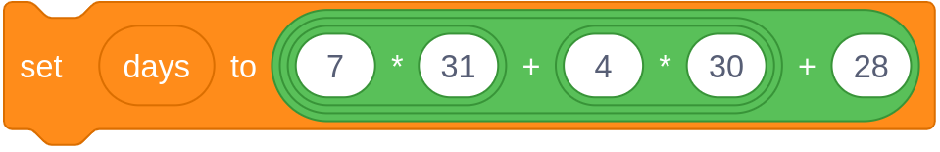
Activity 1
Assignments with expressions
days = 7 * 31 + 4 * 30 + 28
print(days, "days in a year")
You can use expressions in assignments.
This is an instruction to evaluate the expression on the right
and then assign the value to the days variable on the left.
Tip: Read assignments from right to left.
A subsequent assignment can assign a new value to the days variable, replacing the previous value.

Slide 8
Activity 1
Arithmetic operators (in Python)
You can use these operators to form arithmetic expressions.
Examples
+ addition
- difference
* multiplication
/ division
a + 1 a plus 1
b - c b minus c
3 * d 3 times d
9 / 4 9 divided by 4 (value: 2.25)
// integer division
% remainder of integer division
** exponentiation
15 // 2 quotient of 15÷2 (value: 7)
15 % 2 remainder of 15÷2 (value: 1)
2 ** 8 2 to the power of 8 (value: 256)

Slide 9
Activity 1
Referring to variables
days = 7 * 31 + 4 * 30 + 28
quad = 4 * days + 1
print(quad, "days in four years")
An expression can refer to the values of variables.
To evaluate this expression, the days variable must have been assigned a value.
During program execution, a variable must have been assigned a value before that value is referred to.

Slide 10
Activity 1
The machine
executes the code
days = 7 * 31 + 4 * 30 + 28
quad = 4 * days + 1
print(quad, "days in four years")
Current instruction .
365
Evaluate the expression
and assign the value to days.
Calculate the days in a year.
?
State .
days
365
Output .

Slide 11
Activity 1
The machine
executes the code
days = 7 * 31 + 4 * 30 + 28
quad = 4 * days + 1
print(quad, "days in four years")
Current instruction .
1461
Evaluate the expression
and assign the value to quad.
Calculate the days in four years.
?
State .
days
365
quad
1461
Output .

Slide 12
Activity 1
The machine
executes the code
days = 365
quad = 4 * days + 1
print(quad, "days in four years")
Current instruction .
Display the value of quad
and the literal "days in four years".
Display the result.
?
State .
days
365
quad
1461
Output .
1461 days in four years

Slide 13
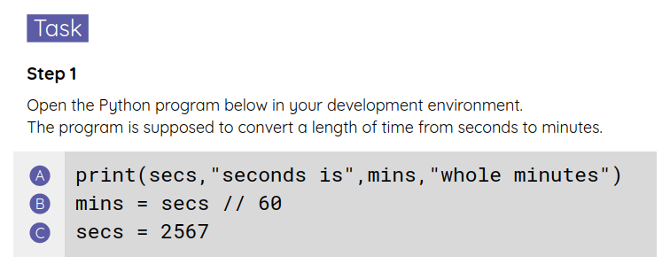
Activity 1
Order matters
You will be given a program that is supposed to convert a length of time from seconds to minutes.
Rearrange (change the order of) the statements, so that the program runs to completion without errors.
Use your worksheet.

Slide 14
Activity 2
Subtle points
number = 5
double = 2 * number
number = 15
Question .
What will be the value of double, after executing line ?
10
30
Line is not a valid assignment: number already has a value
A
A
▹
1
2
3
A
Why .
Line only affects the number variable.
The value of double is not ‘updated’.
A

Slide 15
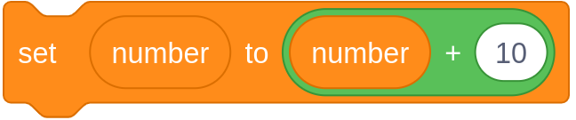
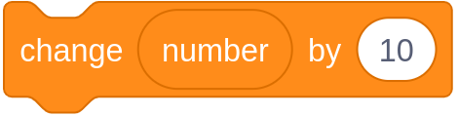
Activity 2
Subtle points
number = 5
number = number + 10
Question .
What will be the value of number, after executing line ?
5 and 15
15
There are no valid values for number
Line is not a valid assignment: number already has a value
A
A
1
▹
2
3
4
A
Why .
The expression number + 10 is evaluated
and the result is assigned to number.
The previous value of number is replaced.

Slide 16

Activity 3
Calculate age from year of birth
Use pair programming .
Driver
Control the keyboard and mouse.
Navigator
Provide support and instructions.
Alternate between roles.

Slide 17

Activity 3
Calculate age from year of birth
print("Year of birth?")
birth_year = input()
age = 2023 - birth_year
print("You are", age, "years old")
Create a program that asks the user for their birth year and calculates their age.
Live coding
age = 2023 - birth_year
TypeError: unsupported operand type(s) for -: 'int' and 'str'

Slide 18
Activity 3
Calculate age from year of birth: commentary
print("Year of birth?")
birth_year = input()
age = 2020 - birth_year
print("You are", age, "years old")
The input function always returns what the user typed as a string, i.e. a piece of text.
The text returned by input is assigned to the birth_year variable:
It is not possible to subtract a piece of text from a number, hence the error.
what the call to input returns
"2008"
birth_year
"2008"

Slide 19
Activity 3
Calculate age from year of birth: commentary
print("Year of birth?")
birth_year = int(input())
age = 2020 - birth_year
print("You are", age, "years old")
The input function always returns what the user typed as a string: a piece of text.
This value is passed to the int function, which returns the corresponding integer.
The expression is evaluated and the result is assigned to the age variable.
what the call to input returns
"2008"
birth_year
2008
age
12

Slide 20
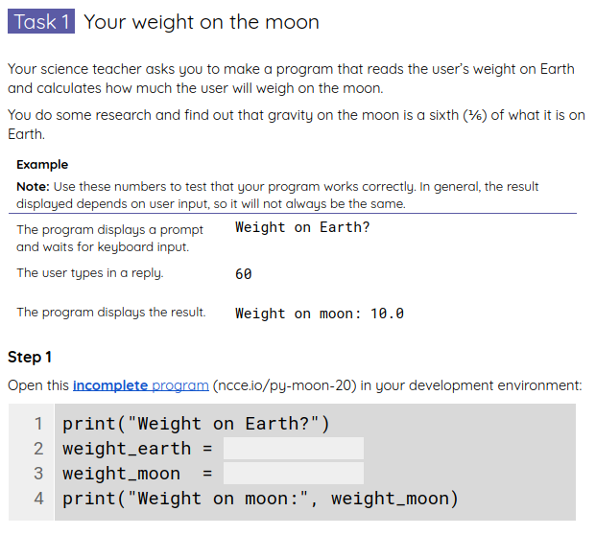
Activity 4
How to input numbers
Work on programs that receive numerical input from the keyboard and process it.
Use your worksheets.

Slide 21
Activity 4
How to input numbers: solutions
print("Weight on Earth?")
weight_earth = int(input())
weight_moon = weight_earth / 6
print("Weight on moon:", weight_moon)

Slide 22
Activity 4
How to input numbers: solutions
print("How old are you?")
age = int(input())
dog_years = age * 7
print("You are", dog_years, "years old in dog years")

Slide 23
Homework
Answer the questions in your homework sheet.

Slide 24
Summary
In this lesson, you...
Next lesson, you will...
Used arithmetic expressions to calculate values
Used variables to store and reference values
Followed walk-throughs of code and kept track of variable values
Wrote programs that receive numerical input from the keyboard
Use selection (if statements) to control the flow of program execution
Introduce elements of randomness into your programs

