Slide 1
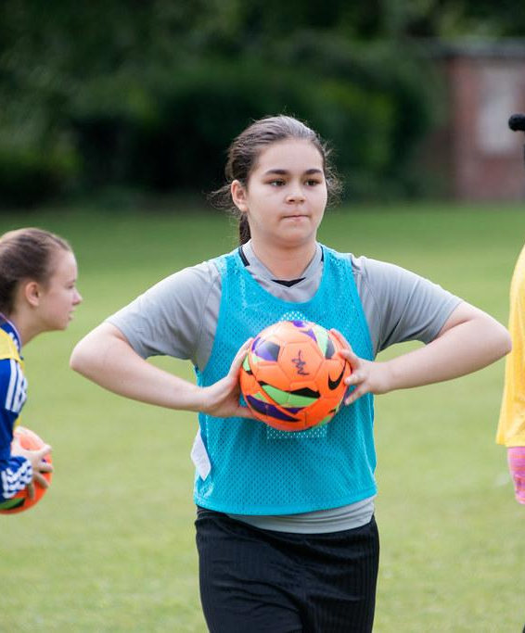
APPLYING THE PRINCIPLES OF SPORT AND ACTIVITY
BTEC TECH AWARD
COMPONENT 3
This Photo by Unknown Author is licensed under CC BY-NC-ND

Slide 2
INTRODUCTION
Leading an effective and engaging activity session can promote lifelong activity. Understanding the theory behind how to be a successful sports leader will give you a solid base to lead sessions that meet a variety of needs of others.
In this component, you will develop knowledge of the attributes of successful sports leaders. You will then explore the physical and psychological benefits that you could experience when taking part in leadership sessions.
You will develop an understanding of how sports leaders can provide appropriate activities for selected target groups. You will develop transferable skills such as communication, planning and organisation, which will support your progression to further vocational or academic qualifications.

Slide 3
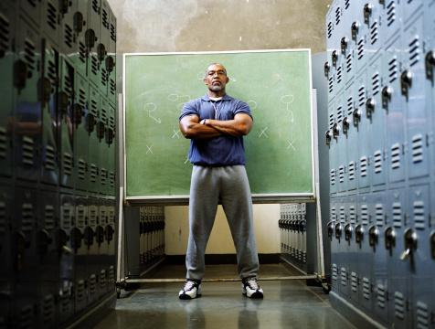
A UNDERSTAND THE FUNDAMENTALS OF SPORT AND ACTIVITY LEADERSHIP
A successful leader requires many attributes to ensure performers understand and engage with physical activity.
THINK – PAIR - SHARE
Think of as many good leaders as possible. What skills and qualities do they have that make them effective?

Slide 4
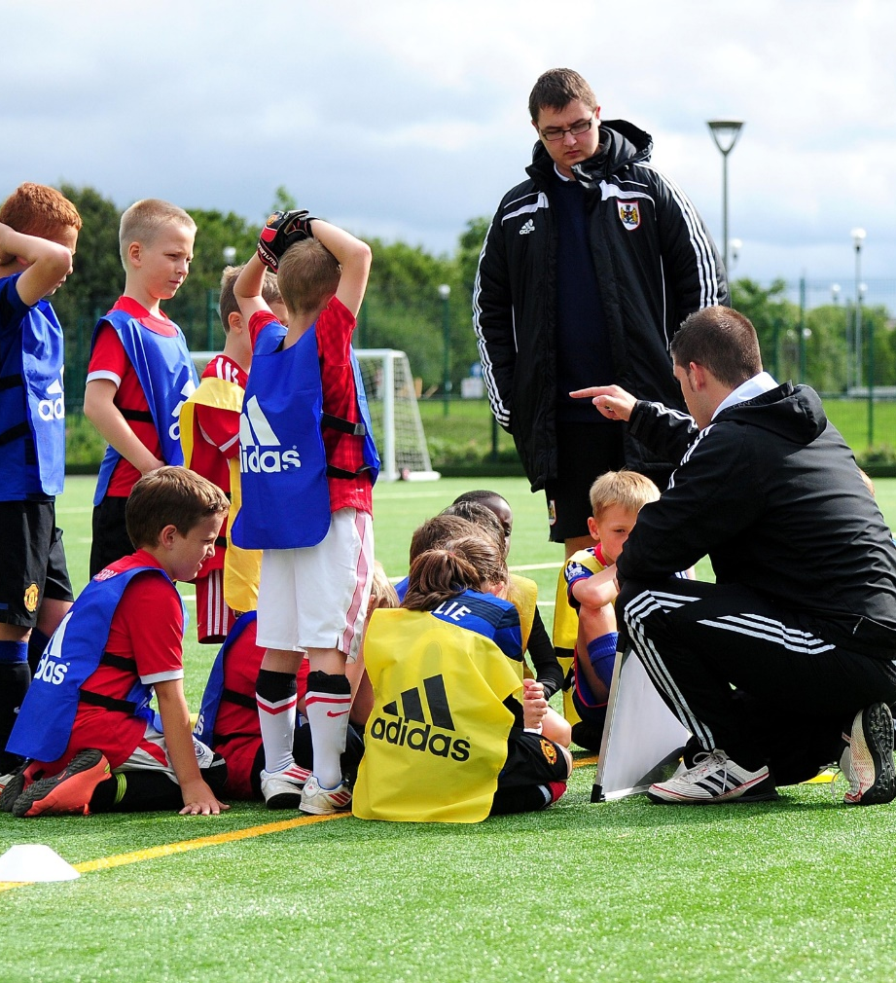
ATTRIBUTES OF A LEADER
COMPONENT 3
Key skills and qualities can be developed but for some individuals it comes naturally. Leaders will always have strengths and weaknesses but an ability to use the right skills at the right time is vital.

Slide 5
ATTRIBUTES OF A LEADER
Communication - This can be verbal or non-verbal.
Verbal communication How a leader speaks to performers is very important. Here are a few points to consider:
Tone of voice – pitch of voice can convey feelings i.e. happy or angry.
Volume – clarity and concise is key.
Use of appropriate vocabulary – too much technical language towards beginners will be overwhelming.
Distance – when addressing a group leaders should be an appropriate distance away so as not to invade someone’s personal space.

Slide 6
ATTRIBUTES OF A LEADER
Non-verbal communication Body language can be used to imply a message to a group of performers.
Appropriate body language – A person stood up straight shows they are interested and concentrating on a person.
Gestures – Hand signals can convey a clear message or instruction.
Facial expressions – This can reinforce what is being said. If verbal feedback is positive a smile would be expected to go alongside this.
Demonstrations – This can be much quicker than explaining a skill to a group.
Eye contact – This can help to hold attention and focus.

Slide 7
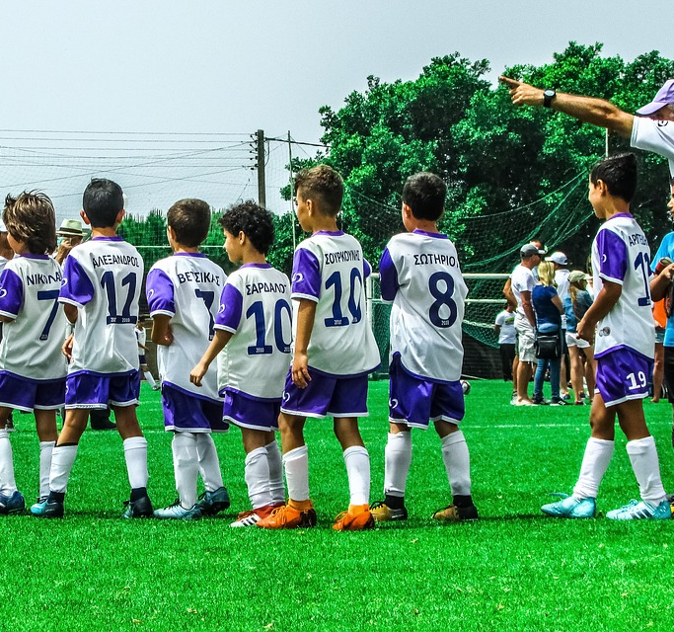
COMPONENT 3
ATTRIBUTES OF A LEADER
Often a leader will need to adapt their style of communication based on the needs of different groups of performers. Each target group will respond differently. Young children require an easier to understand and softer tone than a group of professional athletes.

Slide 8
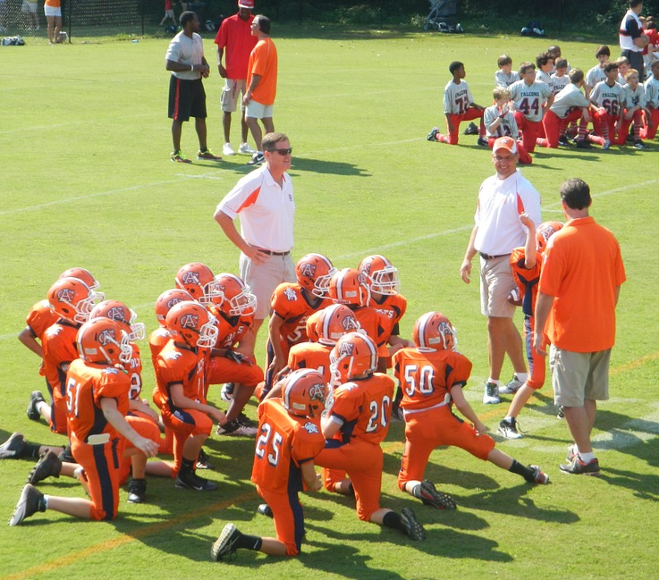
ATTRIBUTES OF A LEADER
Active listening
By engaging with a group of performers and listening carefully, leaders will understand the individual’s better. In addition to this it helps if:
Eye contact is made
Reacting to comments – i.e. nodding
Asking questions
Repeating back to the participant your understanding of what was said.

Slide 9
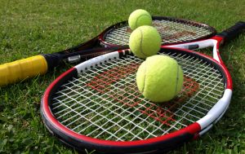
ATTRIBUTES OF A LEADER
Organisation
A successful leader should be organised and plan sessions in advance. A plan shows the structure of the session, types of activities, intended outcomes and timings. It will also indicate the resources needed.
Pre-session – this should involve collecting and checking of all equipment. Safety checks of the goal posts and ball inflation are just two essential checks of a football coach.
Notes:
Photo (Tennis): © Stock.xchng. http://www.sxc.hu/photo/1064561

Slide 10
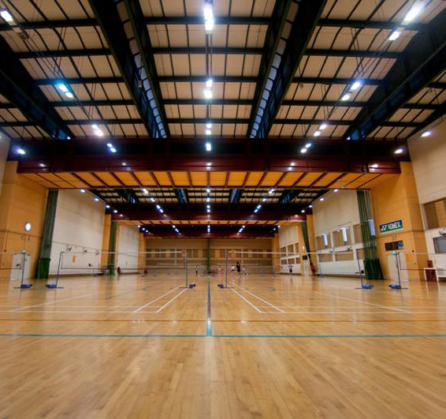
COMPONENT 3
ATTRIBUTES OF A LEADER
Post-session – all equipment, in good working order, should be stored away safely. Once completed, a final check of the facility will ensure it is in a fit state for the next leader. i.e. drinks spillages are mopped up.

Slide 11
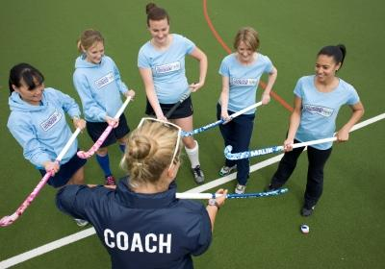
ATTRIBUTES OF A LEADER
Activity structure
The session should contain a level of challenge and intensity to push the participants and motivate throughout. This might begin by learning a skill in isolation and move onto a pressurised practice with opposition.
Progression should only be introduced when performers are able to. The intensity and time of session can also increase as confidence and ability improves.

Slide 12
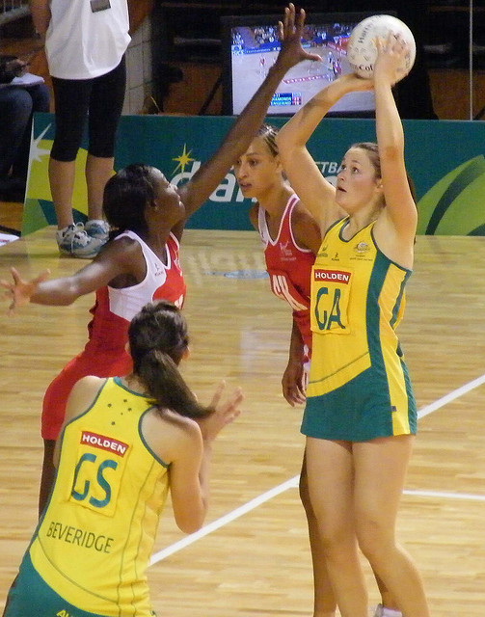
COMPONENT 3
ATTRIBUTES OF A LEADER
Knowledge of the activity being delivered
A good sports leader should have a high level of activity specific knowledge. This includes information on:
The technical and tactical demands of the sport
Specific fitness requirements for specific sports
Laws, rules and regulations of the sports
Treatment of basic sports injuries and first aid techniques.
Notes:
Photo (Netball): © paddynapper on Flickr. This image is reproduced under the terms of the Creative Commons License 3.0. http://www.flickr.com/photos/28990363@N05/2935994114/

Slide 13
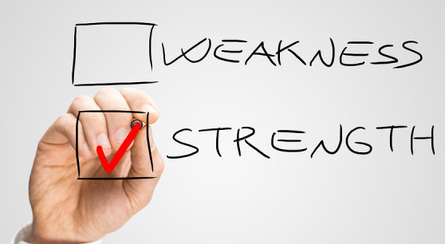
ATTRIBUTES OF A LEADER
Evaluation
This is a honest review of how a session went. A leader should conduct a self-evaluation in order to consider strengths and weaknesses.
It is also good practice to get feedback from the participants and/or a mentor to gain different perspectives.

Slide 14
ATTRIBUTES OF A LEADER
Target setting
Once a full evaluation is conducted a leader should find areas for development. Targets can be created using the popular method below:
S – Specific
M – Measurable
A – Achievable
R – Realistic
T – Time-Related

Slide 15
COMPONENT 3
ATTRIBUTES OF A LEADER
Sports leader development
Many coaches and leaders will take part in National Governing Body (NGB) courses to improve their understanding and range of skills. This will help to achieve any set target moving forward.
Participant development
Sports leaders will advise performers how to set SMART targets in order to improve.

Slide 16
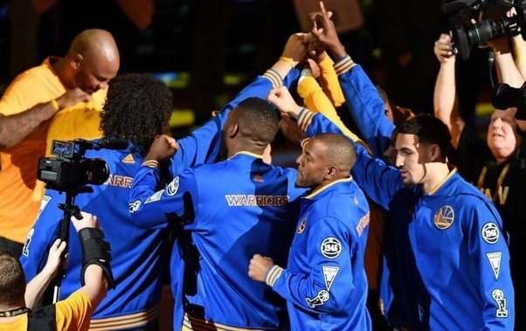
ATTRIBUTES OF A LEADER
Depending on your role within a team your scope for leadership can change. Captaincy is often awarded to an individual based on the following qualities:
Key qualities of leaders in sport:
Leadership style
The right personality
Inspires confidence
Empathy
Motivational/enthusiastic

Slide 17
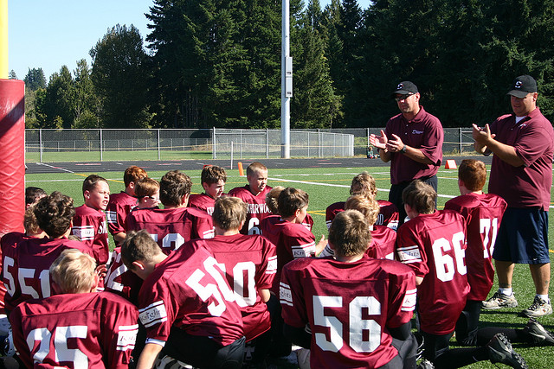
ATTRIBUTES OF A LEADER
The most successful leaders have specific qualities that appear to always produce the best out of individuals/teams.
Encouraging enthusiasm
Participants are not always keen to take part in sport. It is vital that any leader shows a keenness to have everyone participate and deliver a fun session.

Slide 18
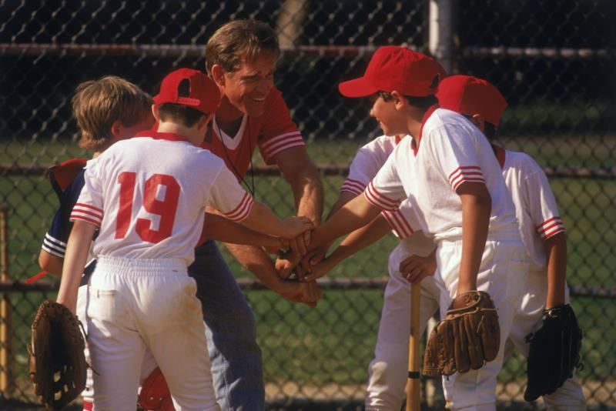
ATTRIBUTES OF A LEADER
Motivation
Intrinsic motivation should come from the performer so this can be difficult for a leader to generate. However, a fun and enjoyable session will cultivate the right environment for this.
THINK – PAIR - SHARE
What ways could a leader provide extrinsic motivation to a performer?

Slide 19
ATTRIBUTES OF A LEADER
Extrinsic motivation can be provided by a leader in the following ways:
Goal setting – short or long term set with the SMART principle.
Rewards – to recognise achievement in the form of badge, certificates or medals.
Feedback – participant feedback will ensure they know how to improve.
Praise – verbal or non-verbal feedback will encourage participants to perform their best.

Slide 20
ATTRIBUTES OF A LEADER
Inspires confidence
A sports leader should plan and deliver appropriate activities to motivate and inspire participants to continue lifelong activity even after the session has finished. This will improve both physical and mental health of participants.
Physical activity as a method of preventing illnesses is a good way for the government to save on NHS costs.

Slide 21
ATTRIBUTES OF A LEADER
Personality This is the unique characteristics of an individual. Knowledge about your own personality is important to ensure you get the most out of participants. i.e. calm, nervous, shy & outgoing.
Personalities are often described by how introverted or extroverted the individual is.
Introverts - tend to be quiet, shy, thoughtful and enjoy own company.
Extroverts - are more loud, sociable, talkative and excitable.

Slide 22
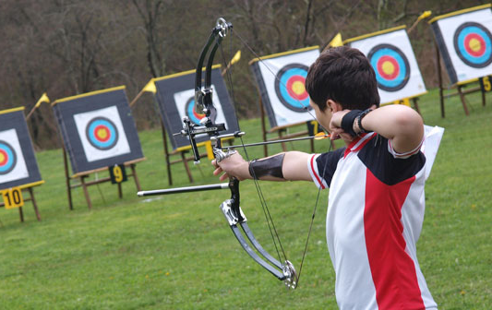
ATTRIBUTES OF A LEADER
Whether you are more of an introvert or extrovert can affect the type of sport you like to play. Introverts are usually shy. They perform better at lower arousal levels. Too much stimulation will cause them to be over-aroused and they will not perform well.
Introverts tend to like sports which require:
Concentration
Precision
Self-motivation
Intricate closed skills
Low arousal levels
Individual performances/routines
ARCHERY

Slide 23
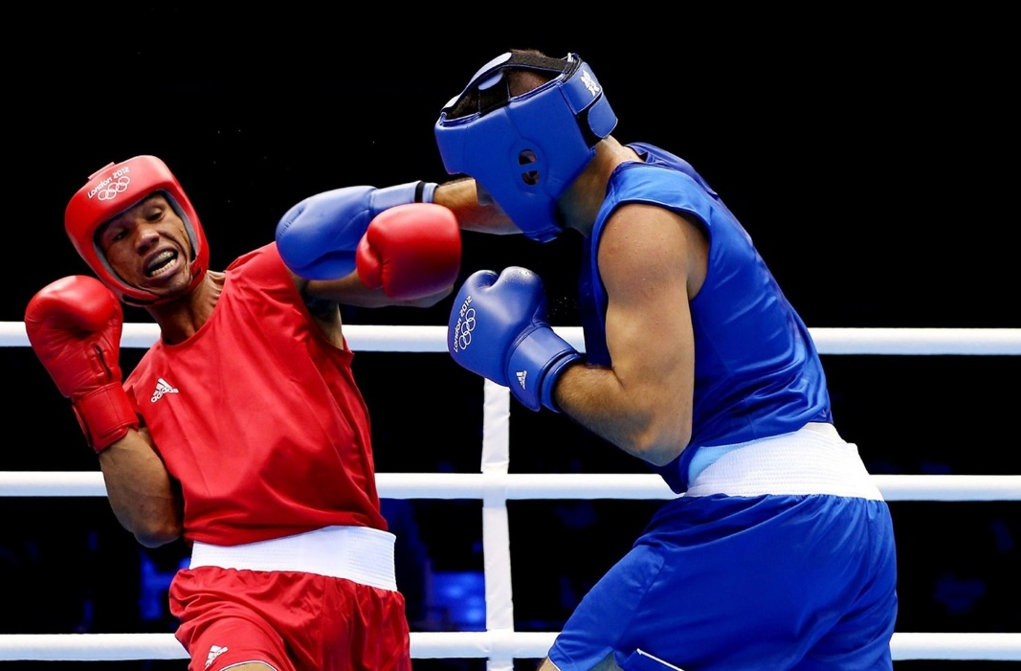
ATTRIBUTES OF A LEADER
Extroverts are socially outgoing. They need high arousal levels to perform. Coaches and team mates need to keep them 'excited' about performing. They prefer team games with open skills and lots of unpredictability.
BOXING
Extroverts prefer sports which are:
Exciting
Team sports
Fast paced
High arousal levels
Large, simple motor skills
Low concentration

Slide 24
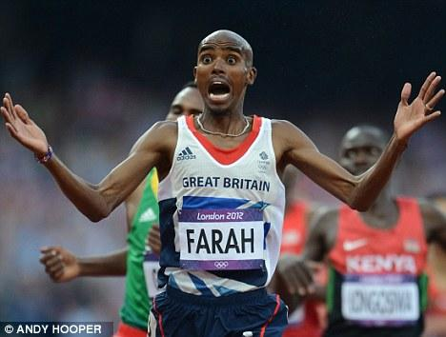
ATTRIBUTES OF A LEADER
Type A and type B personalities
Type A personalities are self-critical and are more likely to be stressed and emotional. However, these individuals are more competitive and goal-orientated and hate losing.
Type B personalities
These individuals are generally more relaxed and calmer than type A. They are less aggressive and are not frustrated easily.

Slide 25
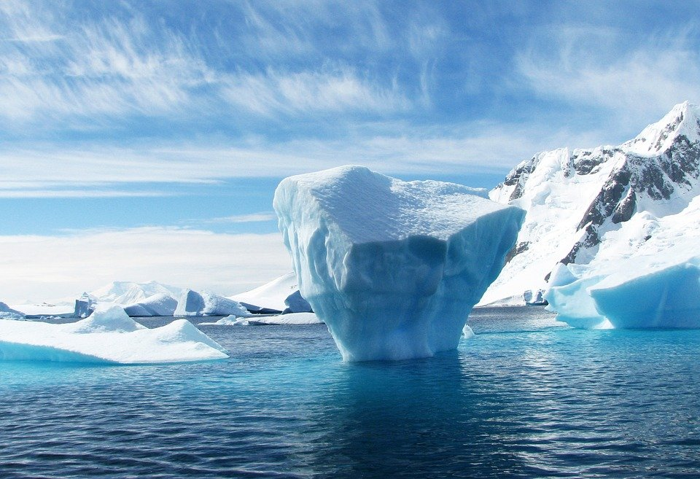
ATTRIBUTES OF A LEADER
Measuring personality
This can be done through observations or via questionnaires. There are two commonly used questionnaires:
Eysenck’s Personality Inventory (EPI)
Profile of Mood States (POMS)
TRY THIS
Why not try the personality test here?
EPI TEST

Slide 26
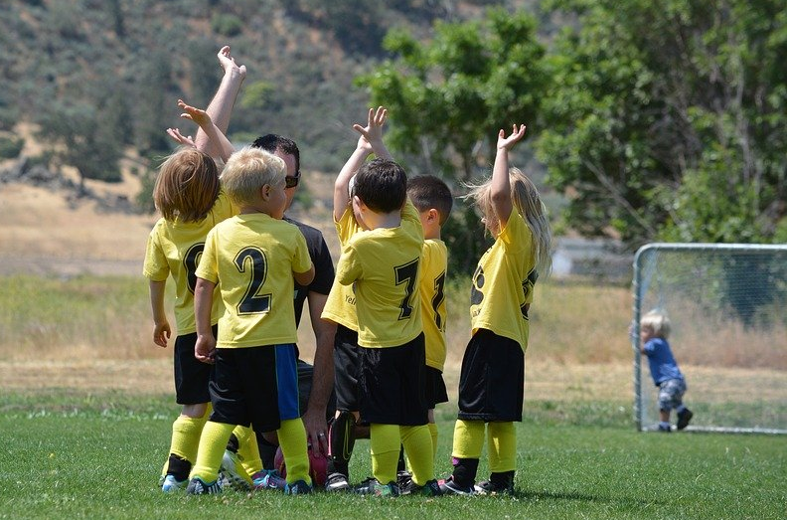
ATTRIBUTES OF A LEADER
A leader’s personality can influence how they develop in different ways and use different leadership styles. They will have strengths and weaknesses, but attributes can be transferable.
THINK – PAIR - SHARE
What different leadership styles have you come across?

Slide 27
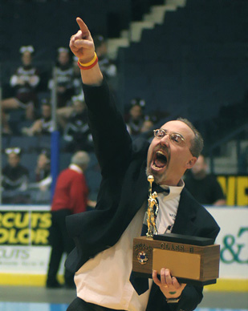
ATTRIBUTES OF A LEADER
There are a number of different types of leadership style all have advantages and disadvantages given the context they are used in.
1. Autocratic – this type of leader likes to be the sole decision maker, focusses on completing goals, ignores opinions of others and dictates tasks.

Slide 28
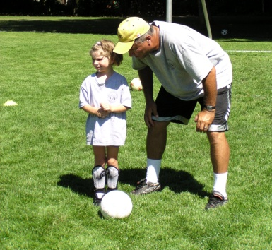
ATTRIBUTES OF A LEADER
2. Democratic – this leadership styles involves sharing responsibilities, collaborates when making decisions and is a concerned coach.
3. Laissez-faire – hands off approach, turns control over to players, players make the decisions, leads to the lowest productivity and improvement.

Slide 29
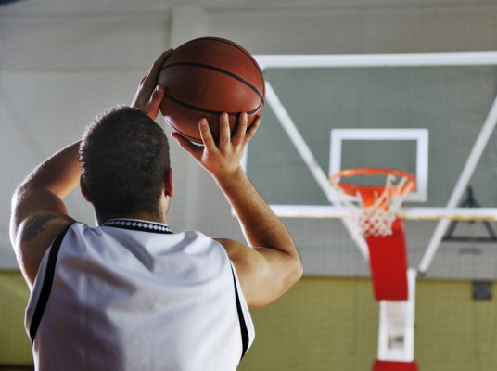
THE BENEFITS OF PARTICIPATION
It is important to understand the benefits that exercise gives to different target groups. This can be physical or psychological.
Physical – Short term benefits
Increased blood flow to muscles – blood is re-directed to areas of need. i.e. muscles
Increased muscle temperature – muscle contractions create movement and several by-products, one of which is heat.
Increased heart rate – this is a response to the oxygen demand at muscle sites.

Slide 30
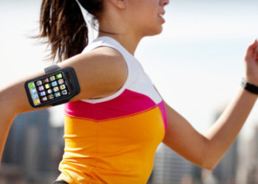
THE BENEFITS OF PARTICIPATION
Physical
4. Increased range of movement at a joint – Synovial fluid at major joints in the body helps to lubricate the joint. This allows free movement.
5. Cool down – this aids the removal of waste products and slowly returns the body to resting state.

Slide 31
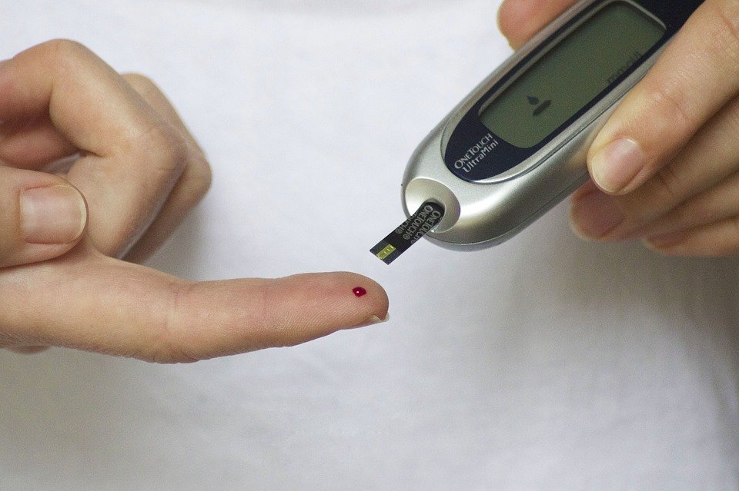
THE BENEFITS OF PARTICIPATION
Physical - Cardiorespiratory long term benefits:
Exercise will reduce the risk of type 2 diabetes. This is where a person cannot regulate their blood sugar levels. This is due to a lack of insulin in the body.
Type I diabetes usually occurs in children although the cause of why is not yet full understood.
Type II diabetes usually affects adults brought on from eating a diet high in sugar. Exercise and positive dietary changes can prevent the need for medical intervention.

Slide 32
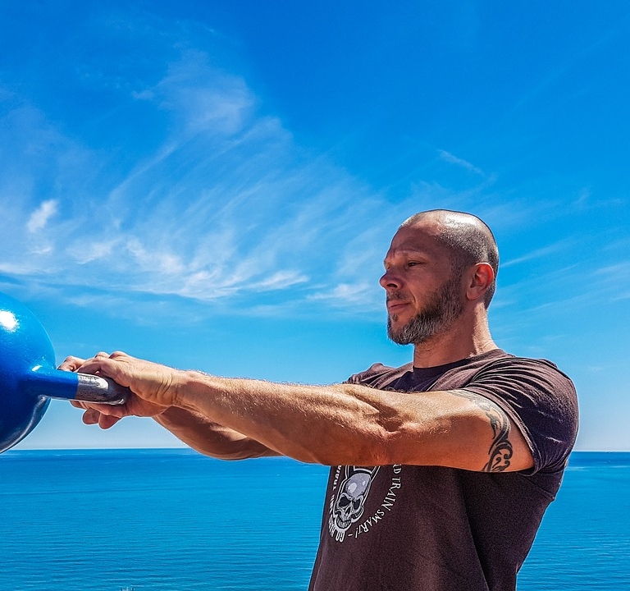
THE BENEFITS OF PARTICIPATION
Regular exercise can reduce the risk of hypertension. This is commonly known as blood pressure. The following conditions are linked to hypertension:
Coronary Heart Disease (CHD)
Stroke
Heart Attack

Slide 33
THE BENEFITS OF PARTICIPATION
Coronary Heart Disease (CHD) – This is caused from atherosclerosis (a build up of fatty deposits that form on artery walls) It slowly narrows the lumen and reduces the ability of blood to flow easily through the vessels. As a result blood pressure builds up and the likelihood of blood clots are increased.
CHD is a disease which can lead to angina and heart attacks.
Notes:
Photos: © Stock.xchng.

Slide 34
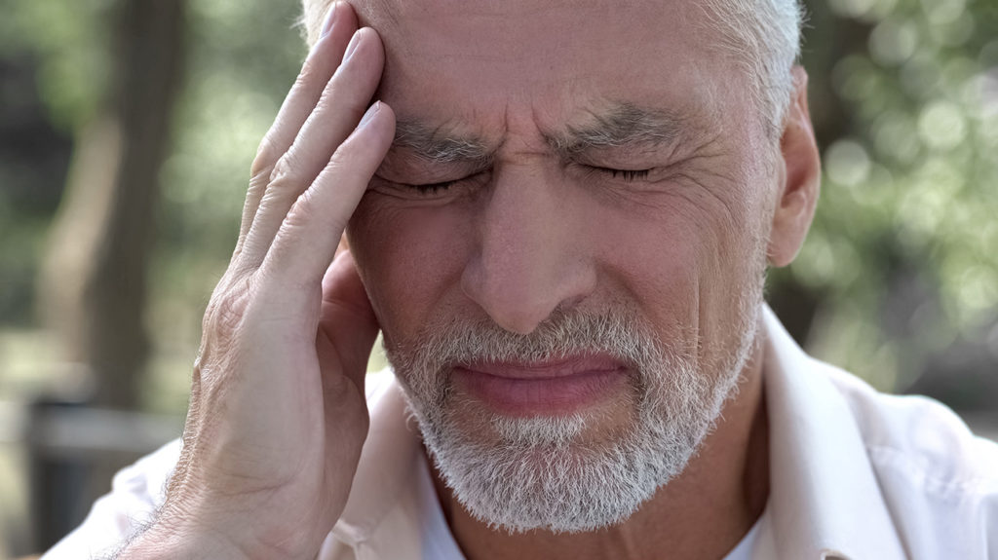
THE BENEFITS OF PARTICIPATION
A stroke is where the blood supply to the brain is cut off. They can result in death or long term speech and muscle issues. This weakness or spasticity in muscles can cause mobility issues.

Slide 35
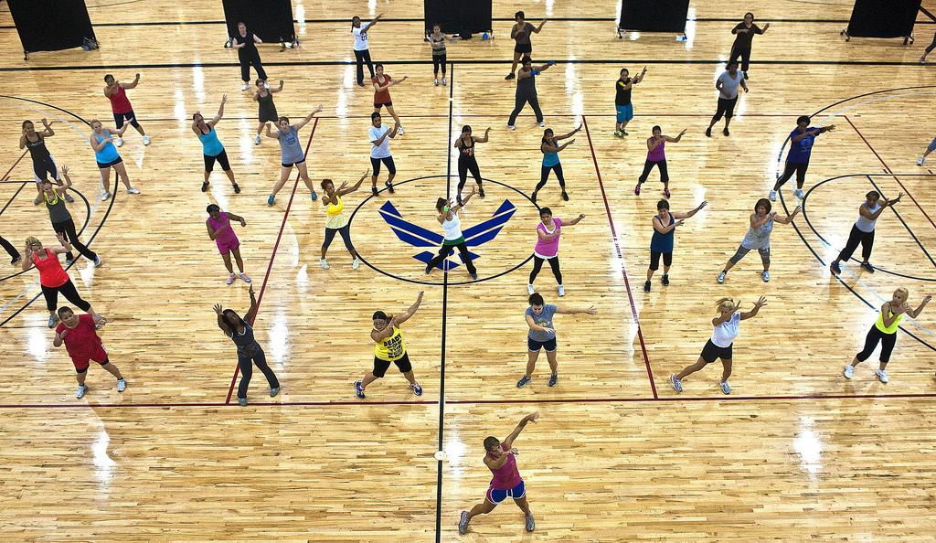
THE BENEFITS OF PARTICIPATION
Physical – Musculoskeletal long term benefits:
This refers to the muscular and skeletal system in the body. Weight bearing exercise will help to produce benefits to these systems.
Reduced the risk of osteoporosis
This is a disease in which the density of bones is decreased resulting in a fragile structure. The risk of fractures are high. Osteoporosis can be prevented with a balanced diet, particularly vitamin D and weight bearing exercise.

Slide 36
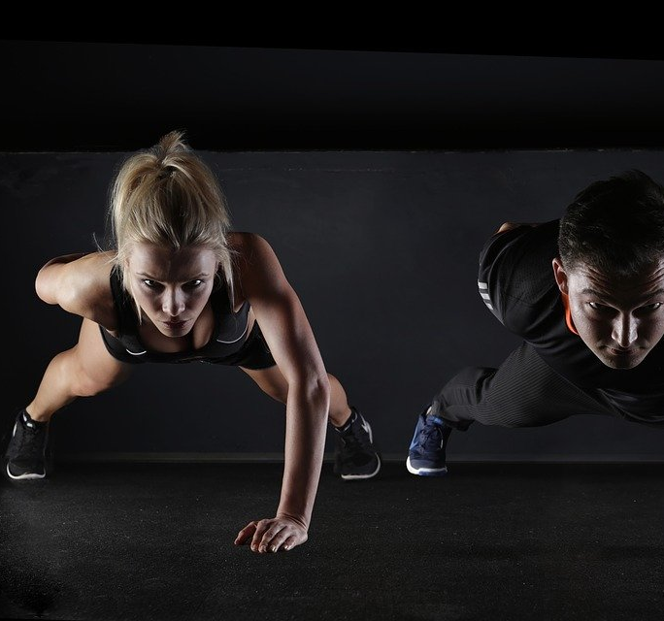
COMPONENT 3
THE BENEFITS OF PARTICIPATION
Reduce the risk of joint injury
Exercise will strengthen ligaments and tendons around a joint. This means they will be able to withstand forces more readily.

Slide 37
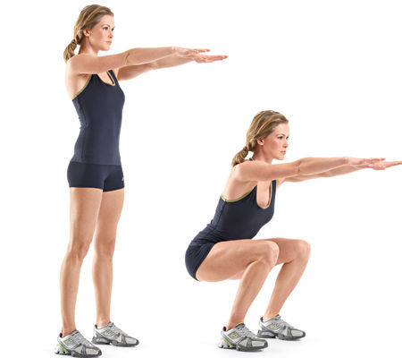
THE BENEFITS OF PARTICIPATION
Reduce the risk of poor posture through increased strength of core -
A slouched posture can lead to back pain, migraines and an increased risk of a slipped disc.
Posture can be improved through resistance exercises that focus on the abdominals, back muscles and pelvis.

Slide 38
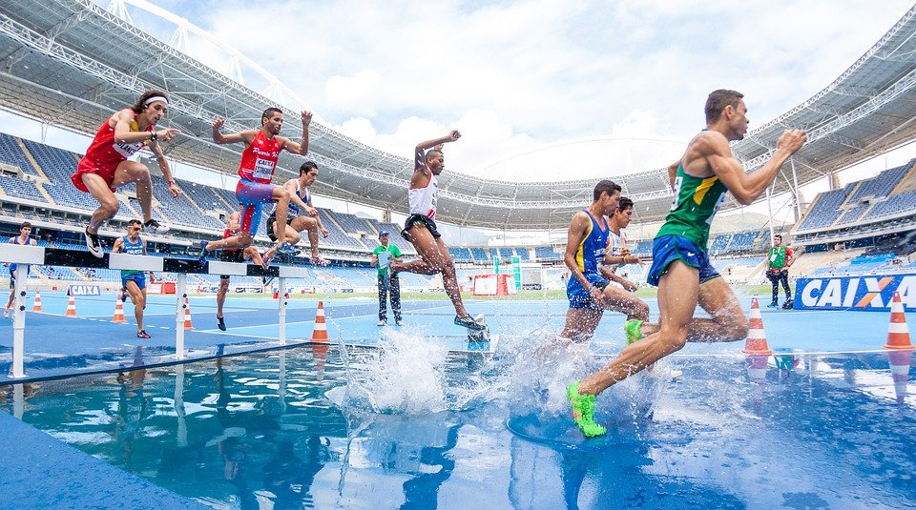
THE BENEFITS OF PARTICIPATION
Physical – Flexibility benefits
A better flexibility of joint will support the completion of everyday tasks. i.e. reaching to the top of a cupboard.
If a person has limited flexibility when playing sport they may pick up injuries more easily.

Slide 39
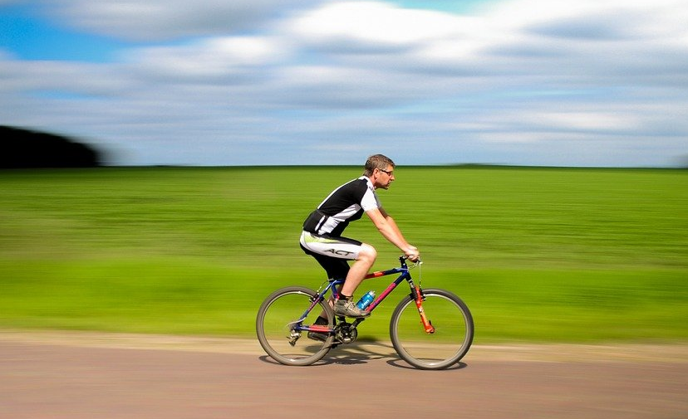
THE BENEFITS OF PARTICIPATION
Psychological benefits
1. Increased intrinsic motivation to continue – The more a person participates, the more it becomes something they enjoy intrinsically rather than for external reward.
2. Improved concentration and effort in the session
The more regular an individual participants the more into it they become, thus increasing effort levels.

Slide 40
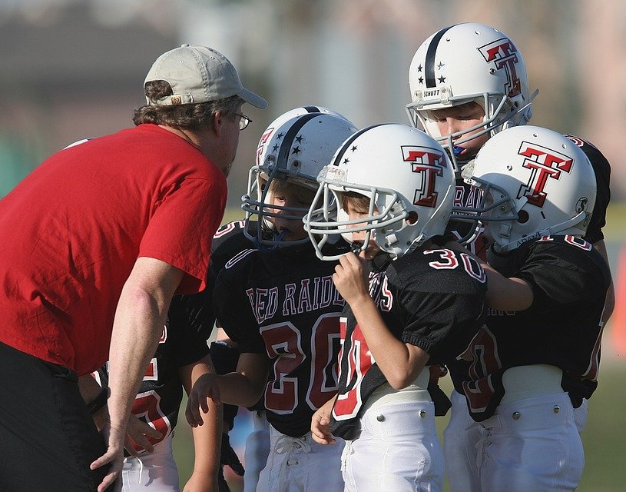
THE BENEFITS OF PARTICIPATION
3. Increased motivation – regular participants will result in a better fitness level and higher motivation. This is often goal linked.
4. Extrinsic motivation by the leader – many participants will develop a positive rapport with a session leader due to the use of timely rewards.

Slide 41
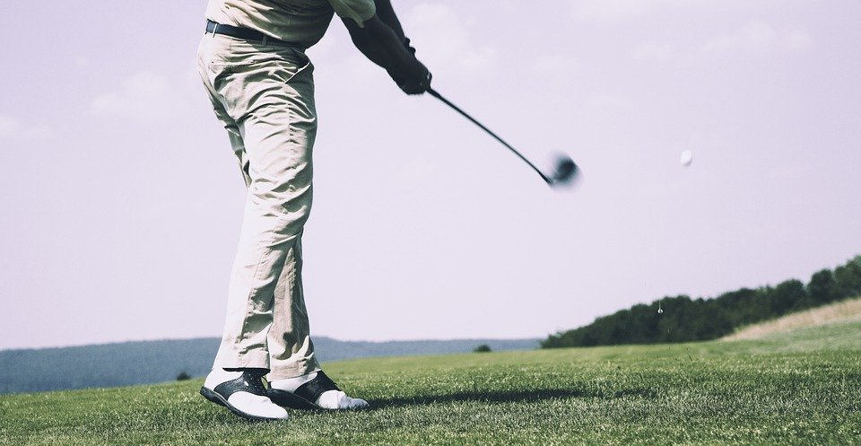
THE BENEFITS OF PARTICIPATION
5. Release of serotonin and endorphins – sport and physical activity releases endorphins which relieve feelings of pain and improve mood. Depression isnot common in children due to higher activity levels.
6. Increased self-confidence – this is as a result of becoming good at a particular activity. Beginners often need confidence boosting as skill level and success are still low.

Slide 42
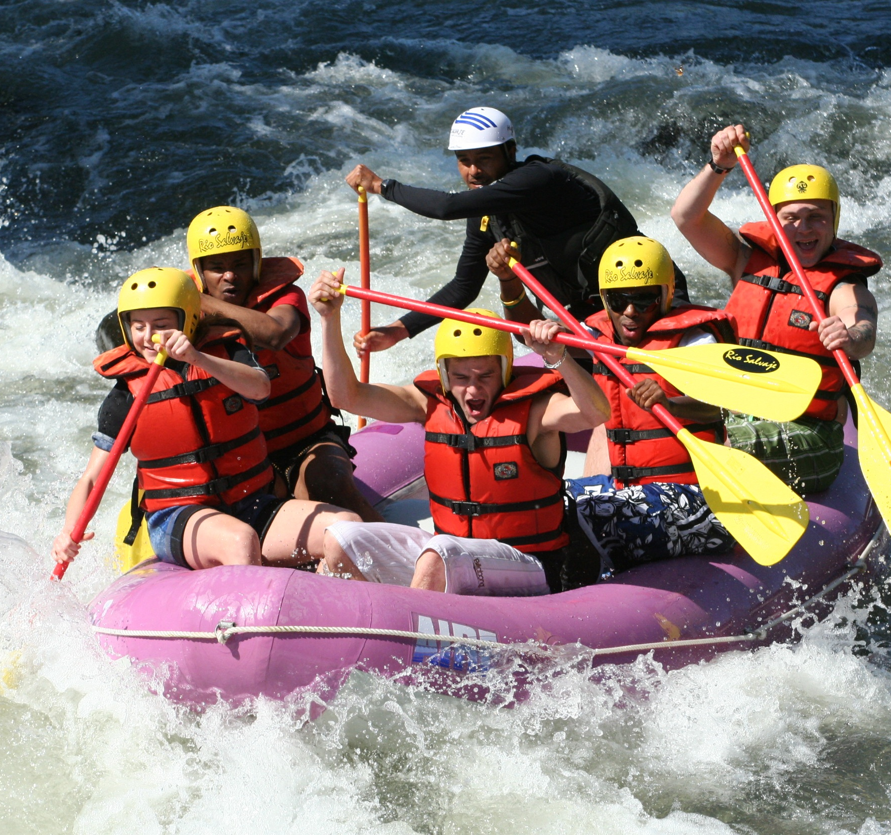
APPLY IT!
What has stuck with you?
Name 3 skills of a leader.
Why types of communication might a leader use?
Describe the different personality types and discuss which one is more effective.
What are some of the short term benefits of exercise?
USE:
THINK. PAIR. SHARE.

Slide 43
LEARNING AIM A – ASSIGNMENT TASK
Task A:
You need to select a sports leader and research the attributes that they possess. You should focus on: skills, qualities, personality and leadership style. Create a presentation to explain how the leader you have selected demonstrates the different skills and qualities that you have researched and use lots of examples to support your presentation. Also mention the short and long term benefits of exercise on the body.
USE YOUR ASSIGNMENT CRITERIA

