Slide 1
Sports clothing and Equipment

Slide 2
What do you know?
Chat with the person next to you and come up with as many different ideas for sports clothing and equipment as you can.
What categories do we need to consider?

Slide 3
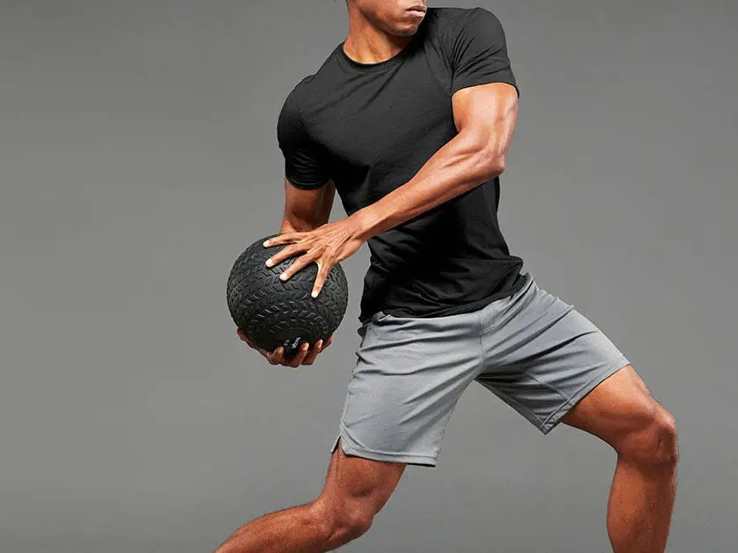
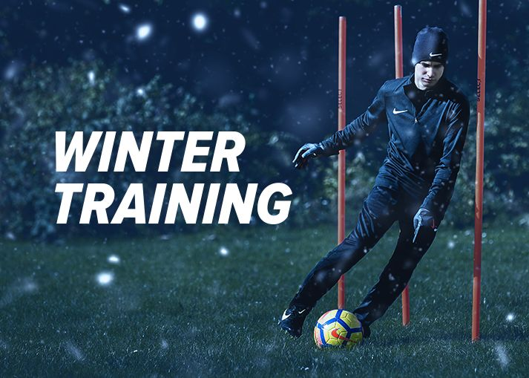
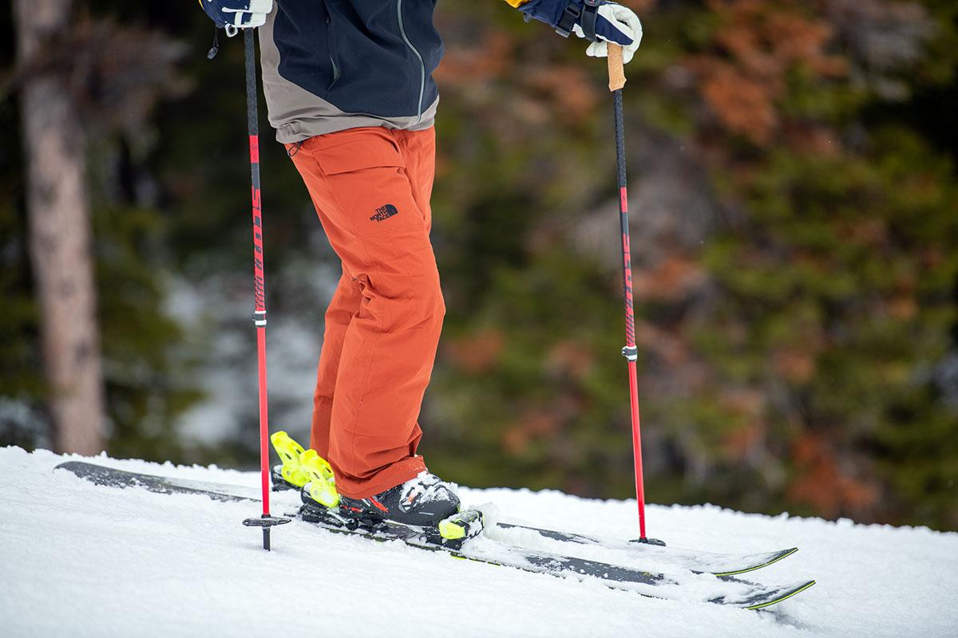
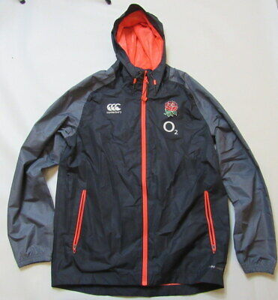
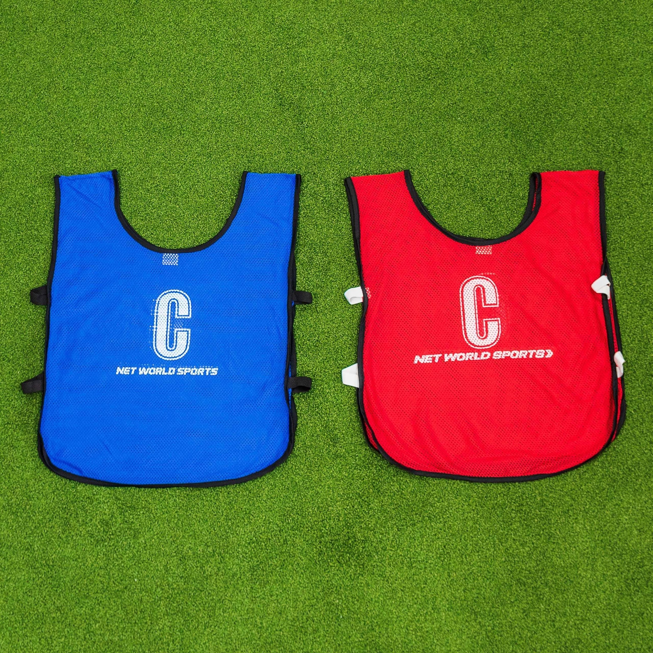
Clothing
Sports kit (e.g. shorts, t-shirt – stretchy material that doesn’t rip easily)
Waterproof clothing (e.g. Rain coats, waterproof ski trousers)
Training clothing (e.g. Bibs – so you know which team the players are on).

Slide 4
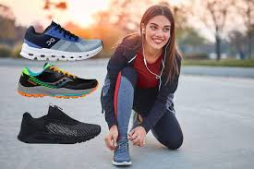
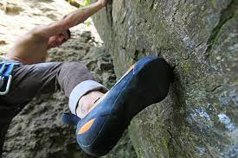
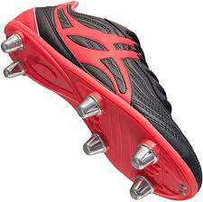
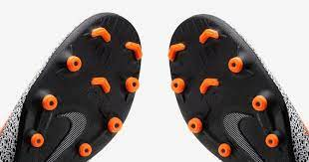
Footwear
Trainers (e.g. Running trainers – comfortable and lightweight)
Studded boots
Rugby rounded studs
Football grass studs
Football moulded blades for artificial surfaces or dry ground
Sport specific footwear (e.g. rock climbing shoes – extra grip, pointed toes)

Slide 5
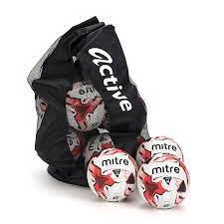
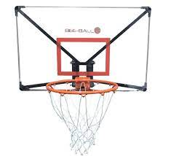
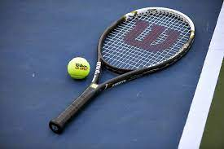
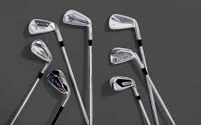
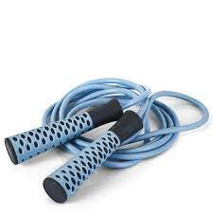
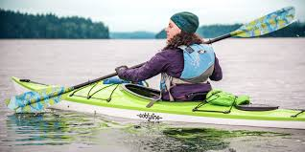
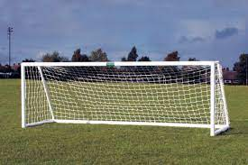
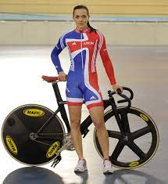
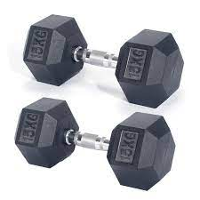
Sport-specific equipment
Participation equipment (e.g. balls, rackets, golf clubs)
Travel-related equipment (e.g. kayak, bike/cycling)
Scoring equipment
(e.g. goalposts, basketball nets)
Fitness training equipment
(e.g. dumbbells, skipping rope).

Slide 6
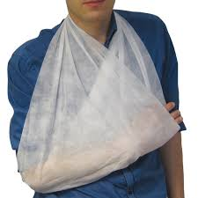
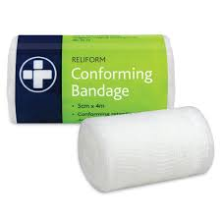
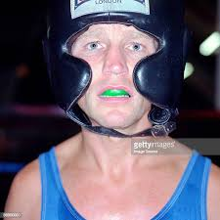
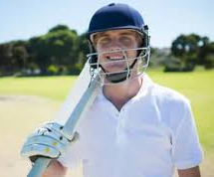
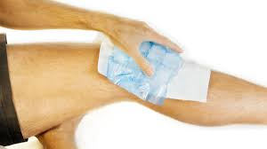
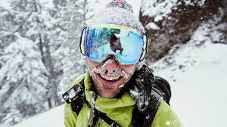
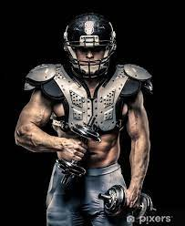
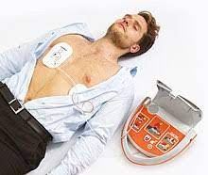
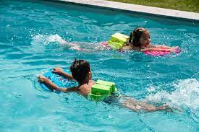
Protection and safety equipment
Head protection (Cricket helmet, boxing head-guard)
Mouth protection (Gum-shield for Rugby/Boxing)
Eye protection (Ski goggles)
Body protection (American football, Cricket pads)
Floatation devices (For swimming)
First aid equipment
Ice packs
Bandages
Defibrillator

Slide 7
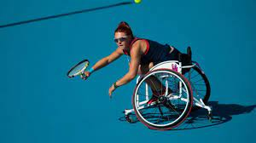
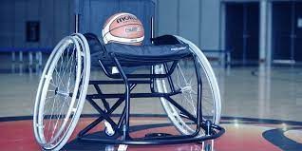
Equipment for people with disabilities or assistive technology
Wheelchairs
e.g. Adapted wheelchair for wheelchair Tennis/Basketball/Rugby.
Slanted wheels for better balance/to stop it from tipping over.

Slide 8
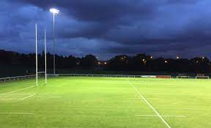
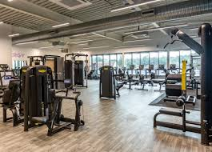
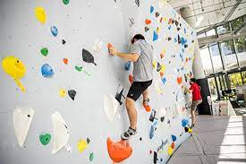
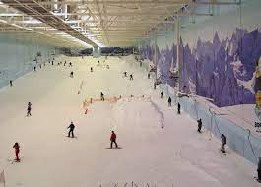
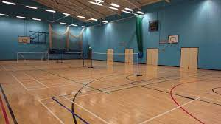
Facilities
Outdoor facilities
Outdoor pitches
Climbing walls
Artificial snow domes.
Indoor facilities
Sports halls
Gyms

Slide 9
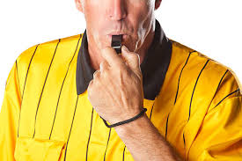
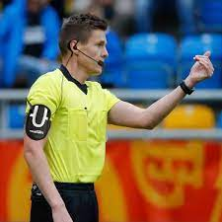
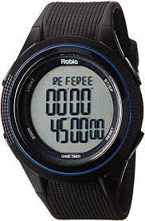
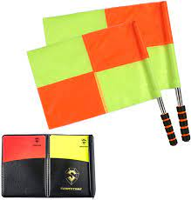
Officiating equipment
Whistle
Microphone
Earpiece
Watch
Cards
Flags

Slide 10
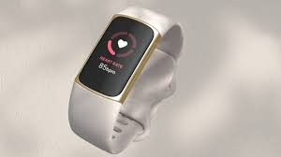
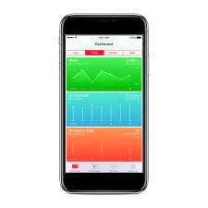
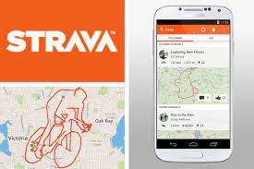
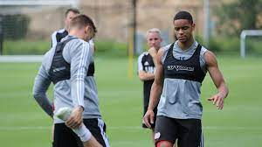
Performance analysis
Smart watches
Heart rate monitors
Applications (fitness tracking, e.g. Strava)

