Slide 1
Year 9 Spanish TERM 5: Viva 3 textbook, chapter 2
If pupils are absent from lessons they should spend time revising and learning vocabulary. All of the vocabulary for this term is on the following slides. First of all, they should recap the vocabulary which they learned the previous week. Then they should start to learn the next section of vocabulary which they have not yet covered in class. This could be done by using the look, cover, write, check method or by making flashcards etc.
Pupils can also revise vocabulary on Linguascope-
Username is kingshill password is mfl123*
Any new vocabulary they learn can be written in their orange books or on paper.
If pupils wish to do extension work they can access free MFL lessons on the Oak National Academy website:
https://classroom.thenational.academy/subjects-by-key-stage

Slide 2
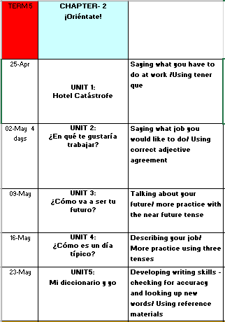

Slide 3
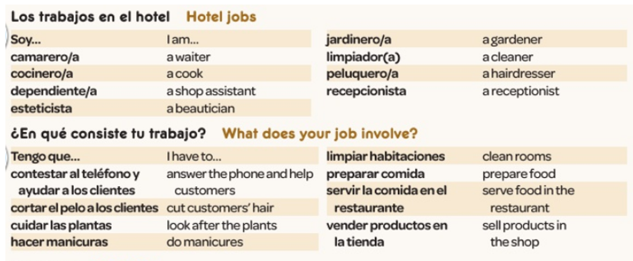
WEEK 1 – w/c 25th April
Read through the vocabulary for this week and spend a good amount of time trying to learn it. There are more words on the next slide too. You will need these words to complete the tasks on the next few slides.

Slide 5
Copy out the grammar information below

Slide 6
Match up the jobs with the pictures.
1
2
3
4
5
6
7
Notes:
Students match the jobs to the pictures

Slide 7
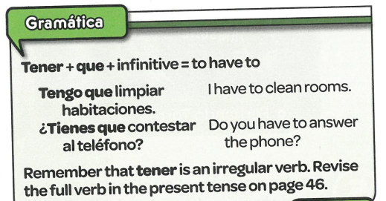
Copy out the grammar information below.

Slide 8
Match the 8 job descriptions to the pictures a-h below.

Slide 9
Translate the phrases in to English.
E.g.
1. I have to prepare food.

Slide 10
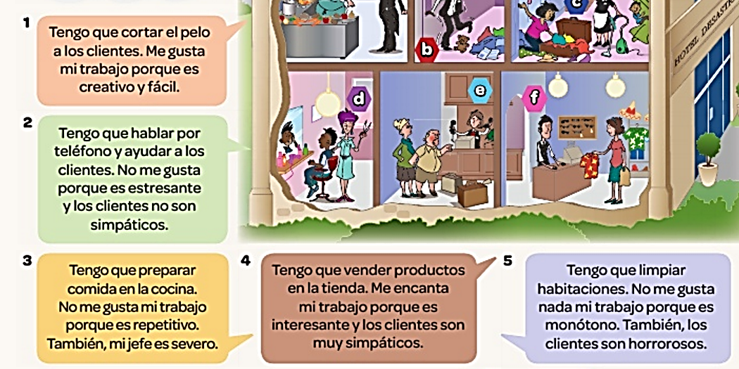
Read the 5 job descriptions and match them to the jobs a-f.
Notes:
Reading activity –

Slide 11
Copy out the table. Listen to the recording. Complete the table in English

Slide 12
WEEK 2 – w/c 2nd May
Read through the vocabulary for this week and spend a good amount of time trying to learn it. There are more words on the next slide too. You will need these words to complete the tasks on the next few slides.

Slide 14
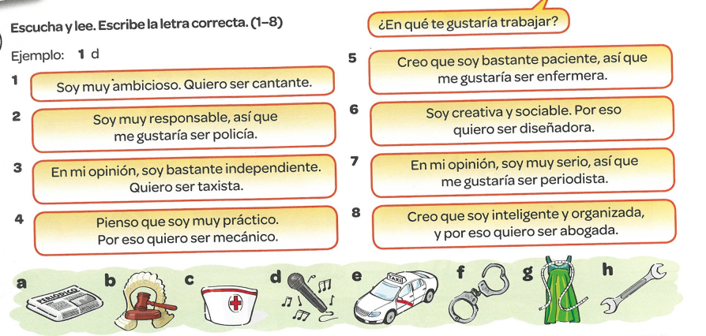
Match the sentences with the pictures. Example, 1d

Slide 15
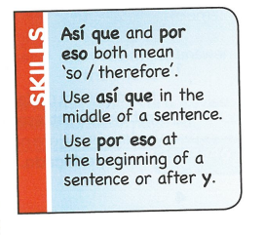
Copy the following information:

Slide 16
Copy the table and listen to the recording. What is their character like and what job would they like to do? Complete the table in Spanish.

Slide 17
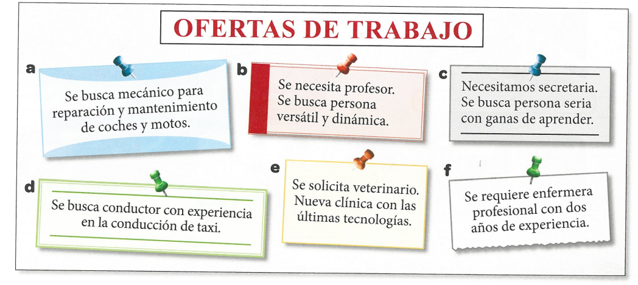
Read the adverts. Match the people to the correct job. There are two adverts too many.

Slide 18
WEEK 3 – w/c 9th May
Read through the vocabulary for this week and spend a good amount of time trying to learn it. You will need these words to complete the tasks on the next few slides.

Slide 19
Listen to the recording. Write 1-4.
What are their future plans?
Example, 1 g…
Each of the 4 people have 2 plans

Slide 20
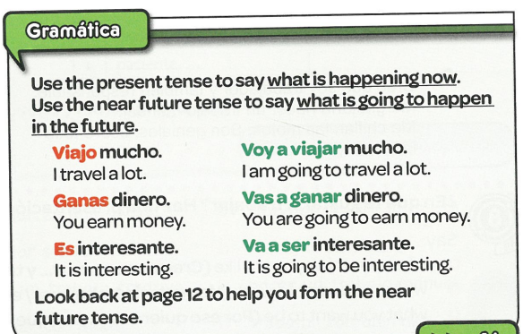
Copy out the following grammar:

Slide 21
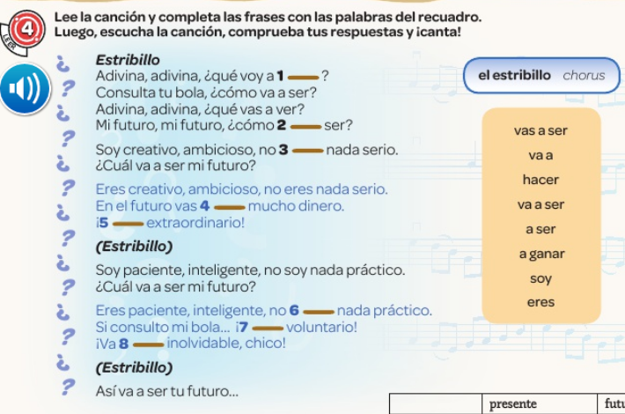
Listen to the song. Fill in the missing words from the box on the right

Slide 22
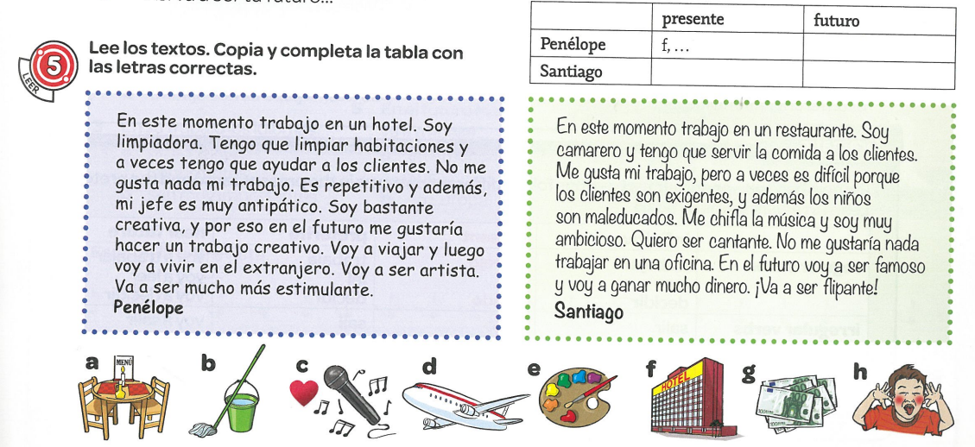
Read the texts. Copy and complete the table with the correct letters a-h

Slide 23
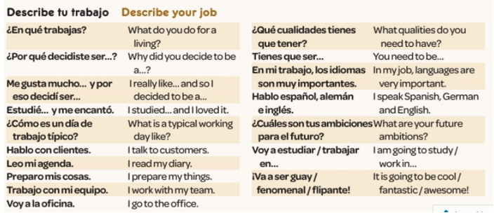
WEEK 4 – w/c 16th May
Read through the vocabulary for this week and spend a good amount of time trying to learn it. You will need these words to complete the tasks on the next few slides.

Slide 24
Copy out the table. Fill in the correct English verb next to the Spanish ones.
Español | Inglés
Ser
Decidir
Ir
Diseñar
Salir
Hablar
Tener
Estudiar
Trabajar
Español | Inglés
Ser
Decidir
Ir
Diseñar
Salir
Hablar
Tener
Estudiar
Trabajar
To have
To be
To study
To go out
To work
To go
To design
To speak
To decide

Slide 25
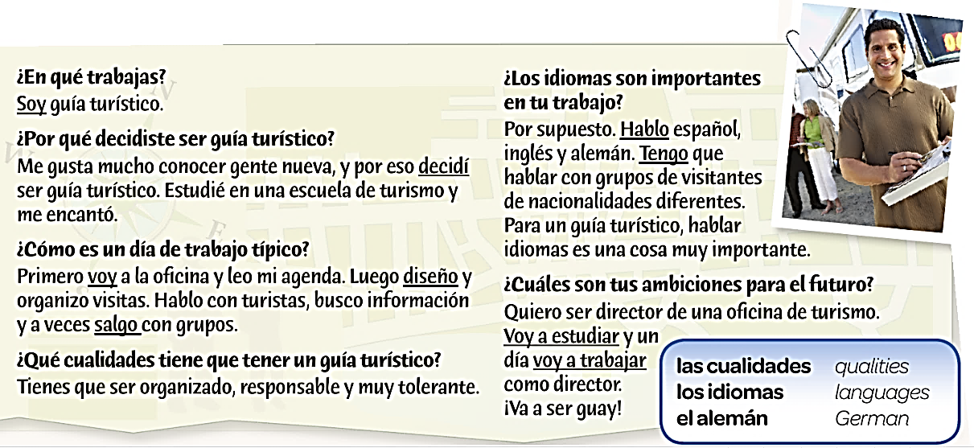
Hint
Use the verbs from the starter to help!
Look at the underlined verbs. Can you figure out what they mean?

Slide 26
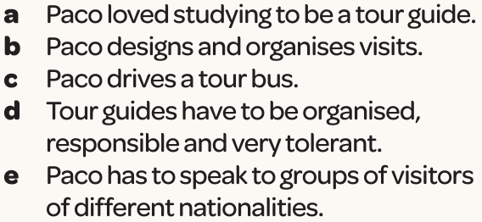
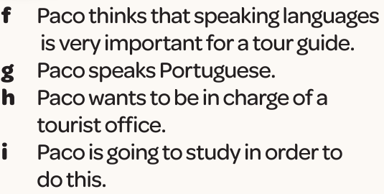
Which two statements aren’t mentioned in the text above?

Slide 27
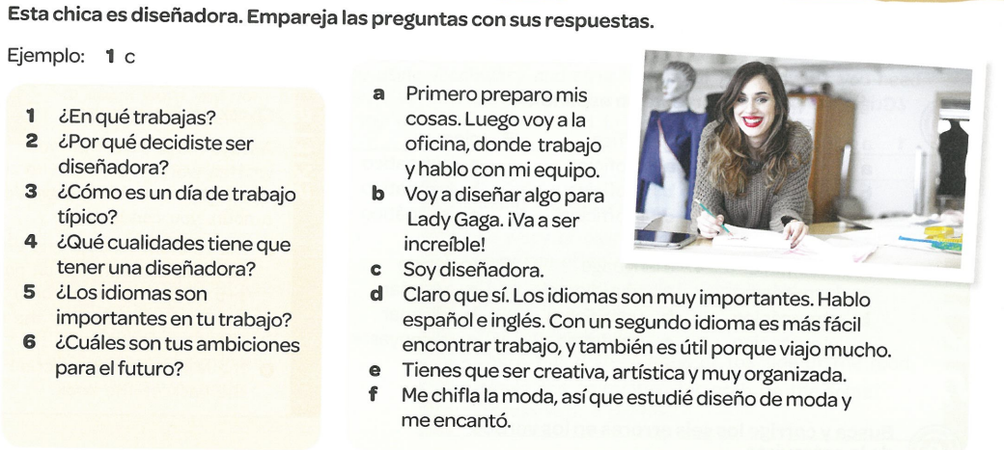
This person is a designer. Match the questions with her answers. Example, 1c

Slide 28
WEEK 5 – w/c 23rd May
There are only a few new words to look at this week. You will need to refer to the vocabulary sheet in your book or the vocabulary on the previous slides to help you with the revision tasks on the following slides.

Slide 29
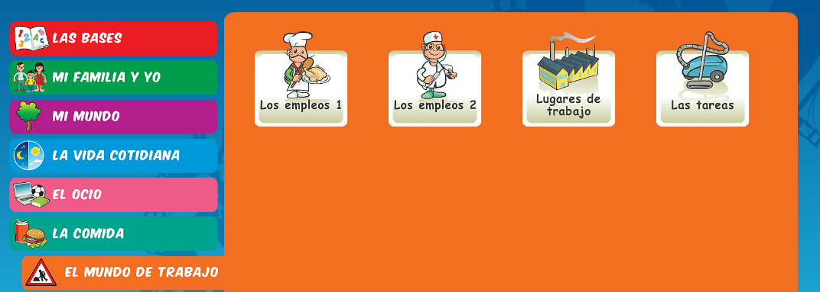
Log on to Linguascope and practise work and jobs vocabulary. Look in the beginner section):
Username – kingshill password – mfl123*

Slide 30
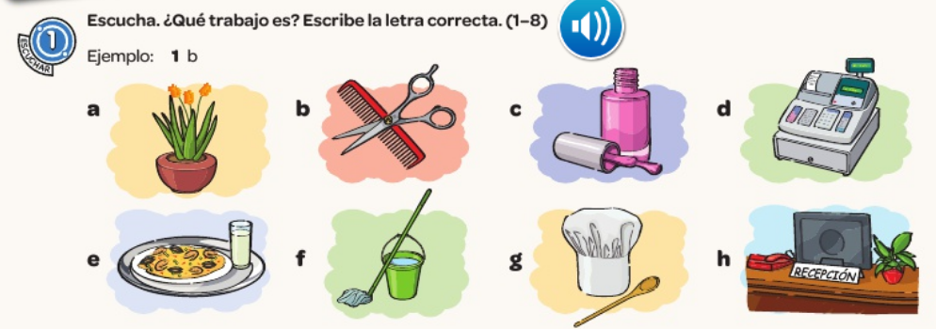
Listen to the recording. Which job is being described. Example – 1b

Slide 31
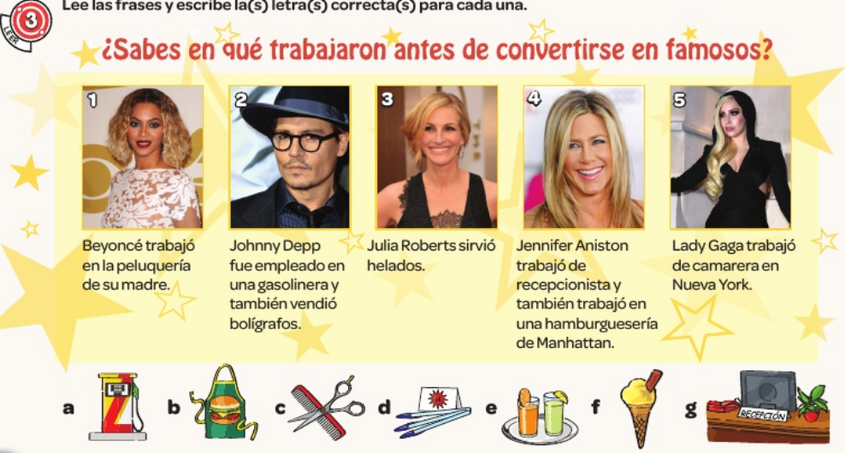
Read about the jobs these celebrities had before they were famous. Then match them to the pictures a-g below

Slide 32
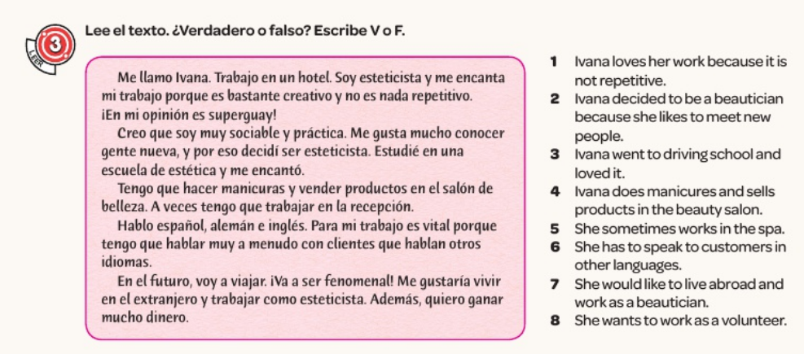
Read the text and then say if the 8 statements are true or false.

