Slide 1
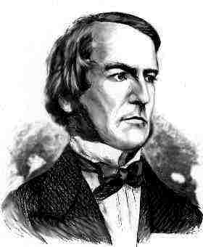
Binary logic
Lesson Objectives:
To understand the functions of logic gates.
2. To apply gained knowledge to answer a number of example questions.
George Boole,
(1815-1864)
Did you know?
George Boole Inventor of the idea of binary logic. He was born in Lincoln, England and he was the son of a shoemaker in a low class family.
Notes:
About G. Boole:
http://www.google.co.uk/imgres?imgurl=http://library.thinkquest.org/C0126120/boole.jpg&imgrefurl=http://
http://www.kerryr.net/pioneers/boole.htm

Slide 2
Binary Logic Intro
You now know that all forms of information (text, pictures, colours, sounds, etc.) are represented in computers as binary numbers.
Inside the processor there are electronic circuits called logic gates that are used to make changes to these numbers.

Slide 3
Binary Logic Intro
Binary information is carried around the computer as electrical signals on wires.
The wires that bring electric pulses into a logic gate are called inputs.
A single wire carries away the output of a logic gate.
The 3 most basic kinds of logic gate are called NOT, AND and OR.

Slide 4
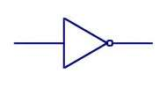
NOT gates
A NOT gate has one input and one output. If there is a 1 going into the circuit a 0 will come out. If there is a 0 going into the circuit a 1 will come out. This can be shown in a truth table:
Input | Output
0 | 1
1 | 0
In circuit diagrams, this is the symbol for a NOT gate

Slide 5
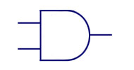
AND gates
An AND gate has two inputs and one output. Only a 1 arriving on both inputs produces 1 for output. This can be shown in truth table:
Input A | Input B | Output
0 | 0 | 0
0 | 1 | 0
1 | 0 | 0
1 | 1 | 1
In circuit diagrams, this is the symbol for an AND gate

Slide 6
OR gate
An OR gate has two inputs and one output. A 1 arriving on either of the two inputs produces an output of 1. This can be shown in truth table:
Input A | Input B | Output
0 | 0 | 0
0 | 1 | 1
1 | 0 | 1
1 | 1 | 1
In circuit diagrams, this is the symbol for a OR gate

Slide 7
Combined Circuits
The outputs from logic gates can be recombined and fed into other logic gates as new inputs!
In this way, binary numbers can be processed or changed.
This diagram shows an AND gate and an OR gate feeding into another OR gate
1
0
If the inputs are as shown then the combined output will be 1
0
1
1
1
0

Slide 8
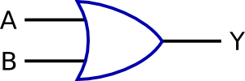
Here’s how combined logic gates could be used to set up a burglar alarm system
BEDROOM
SENSOR
ON or OFF ?
OR
GATE
AND
GATE
FRONT ROOM
SENSOR
BURGLAR
ALARM
ALARM SWITCHED ON?

