Slide 1
Chapter 3a – Fitness Testing
Learning outcomes:
ALL should be able to describe the parts of a warm up and a cool down
MOST should be able to describe the benefits of warming up and cooling down

Slide 2
Warming up and cooling down
Learning outcomes:
ALL should be able to describe the parts of a warm up and a cool down
MOST should be able to describe the benefits of warming up and cooling down

Slide 3
Parts of a warm up
Overall aim – to increase the amount of oxygen to the working muscles
Gradual pulse raising activity
Stretching
Skill based practice
Mental preparation

Slide 4
Parts of a cool down
Overall aim – gradual reduction in intensity
Maintain elevated breathing and heart rate, e.g. jogging
Stretching

Slide 5
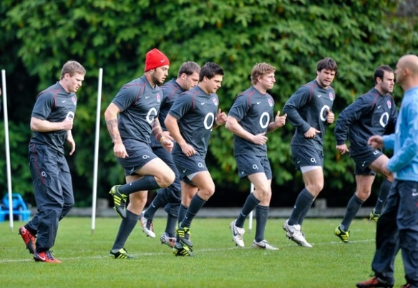
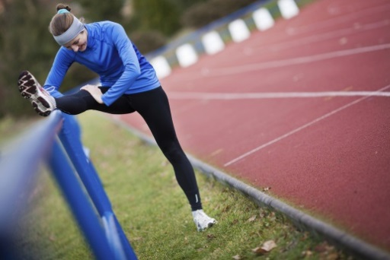
Benefits of a warming up
Increase in body temperature
Range of movement increased
Gradual increase of effort to full pace
Psychological preparation
Practice of movement skills
Injury prevention

Slide 6
Benefits of a cooling down
Allow body to recover
Removal of lactic acid, CO2, waste products
Prevent muscle soreness, DOMS

Slide 7
Health and fitness
ALL should be able to define the terms health and fitness.
MOST should be able to describe the relationship between them.

Slide 8
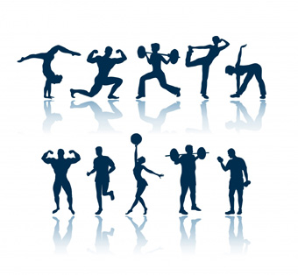
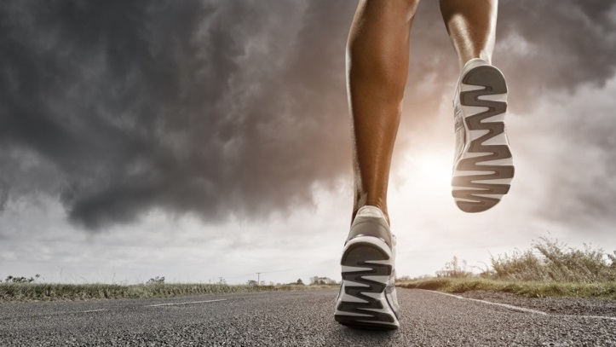
Health and Fitness
LO1 – ALL should be able to define the terms health and fitness
LO2 – MOST should be able to describe the relationship between them
TASK – what is the difference?

Slide 9
Health
LO1 – ALL should be able to define the terms health and fitness
LO2 – MOST should be able to describe the relationship between them
Definition –
A complete state of physical, mental and social wellbeing and not merely the absence of disease or infirmity.

Slide 10
Fitness
LO1 – ALL should be able to define the terms health and fitness
LO2 – MOST should be able to describe the relationship between them
Definition –
The ability to meet or cope with the demands of the environment.

Slide 11
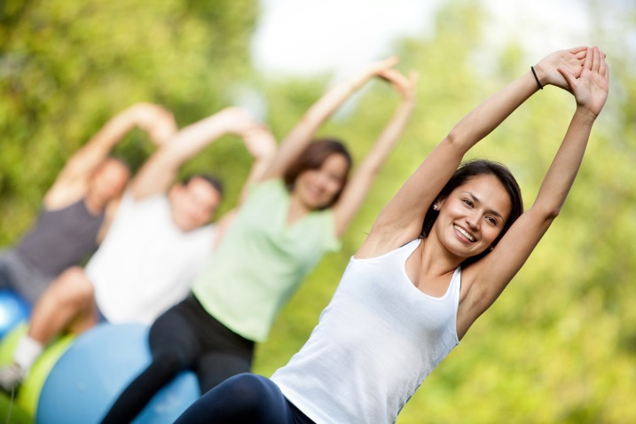
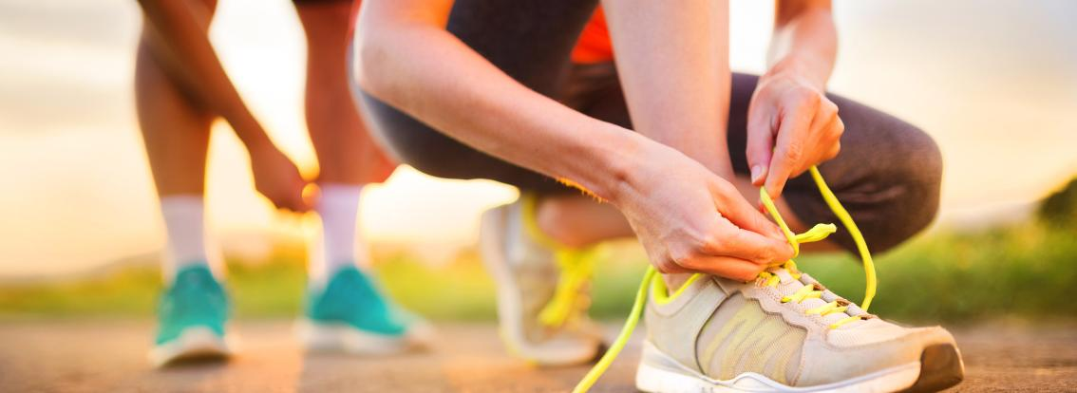
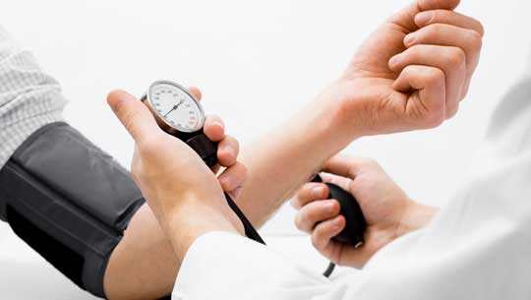
TASK
LO1 – ALL should be able to define the terms health and fitness
LO2 – MOST should be able to describe the relationship between them
Which of the following pictures represent ‘health’ and which ones represent ‘fitness’?

Slide 12
Relationship between health & fitness
LO1 – ALL should be able to define the terms health and fitness
LO2 – MOST should be able to describe the relationship between them
When you are fit you are physically healthy. Being unhealthy doesn’t necessarily mean you are unfit.
Poor health can mean you are too unwell to improve your fitness. By improving your fitness you can improve physical health. For example, swimming can relieve back pain.
All individuals require a general level of health and fitness to carry out everyday tasks, e.g. climbing the stairs
Can you think of any other relationship between health and fitness?
e.g. Mental Health linked to physical performance / fitness …

Slide 13
Fitness components
ALL should be able to define each of the fitness components
MOST should be able to apply each of the fitness components to a sporting example

Slide 14
TASK
Consider your own sport…
Can you identify any components of fitness that may be important for your own sport?
Can you describe what they mean?
Can you explain and justify why they are useful within your sport?

Slide 15
LO1. ALL should be able to define each of the fitness components
LO2. MOST should be able to apply each of the fitness components to a sporting example
Agility
Speed
Strength
Balance
Fitness Components
Reaction time
Cardiovascular
endurance
(aerobic power)
Power/explosive
strength
(anaerobic power)
Coordination
Muscular
endurance
Flexibility

Slide 16
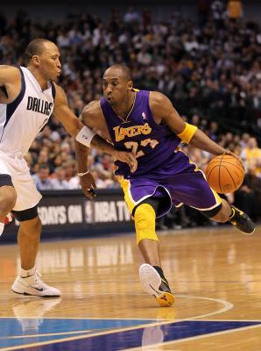
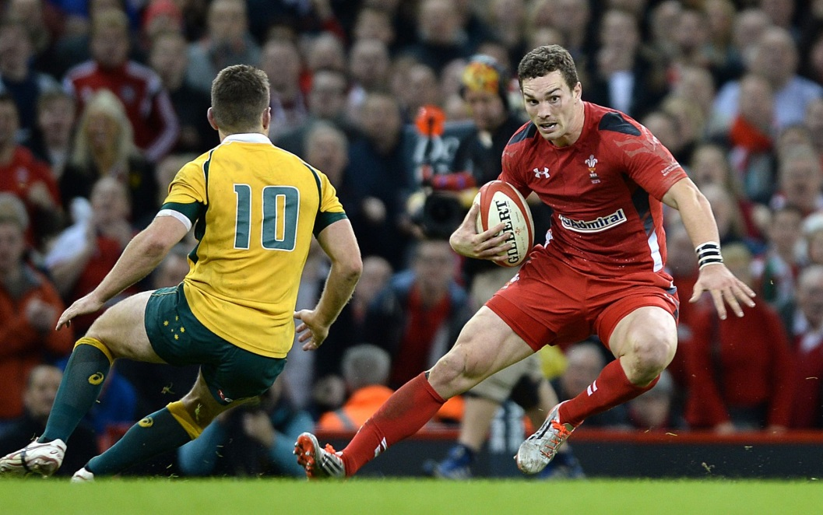
AGILITY
LO1. ALL should be able to define each of the fitness components
LO2. MOST should be able to apply each of the fitness components to a sporting example
Definition –
Ability to move and change direction at speed, whilst maintaining control.
Can you apply this to a sporting example?

Slide 17
BALANCE
LO1. ALL should be able to define each of the fitness components
LO2. MOST should be able to apply each of the fitness components to a sporting example
Definition –
The ability to keep the body stable by maintaining the centre of mass over the base of support.
Two types of balance –
Static (no movement)
Dynamic (movement)
Can you apply this to a sporting example?

Slide 18
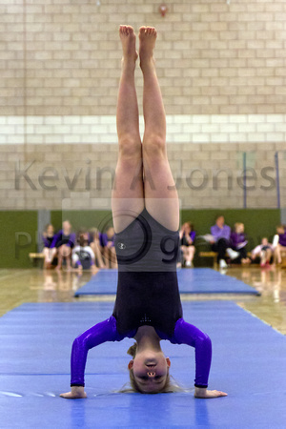
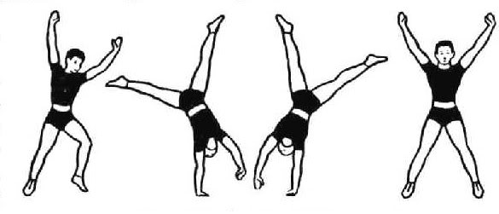
BALANCE
LO1. ALL should be able to define each of the fitness components
LO2. MOST should be able to apply each of the fitness components to a sporting example

Slide 19
CARDIOVASCULAR ENDURANCE
LO1. ALL should be able to define each of the fitness components
LO2. MOST should be able to apply each of the fitness components to a sporting example
Also known as ‘aerobic power’.
Definition –
Ability of the heart and lungs to supply oxygen to the working muscles.
Can you apply this to a sporting example?

Slide 20
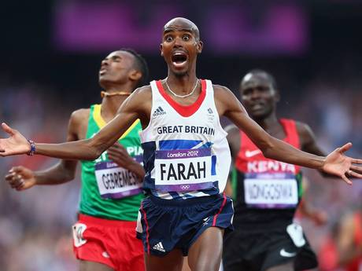
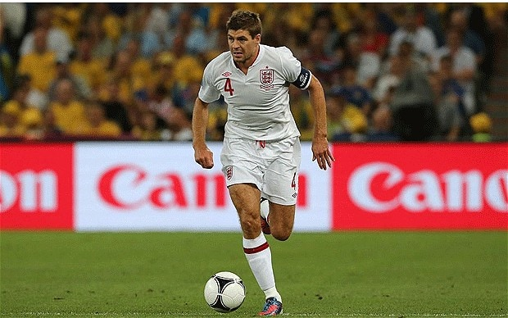
CARDIOVASCULAR ENDURANCE
LO1. ALL should be able to define each of the fitness components
LO2. MOST should be able to apply each of the fitness components to a sporting example
Also known as ‘aerobic power’.
Definition –
Ability of the heart and lungs to supply oxygen to the working muscles.
Can you apply this to a sporting example?

Slide 21
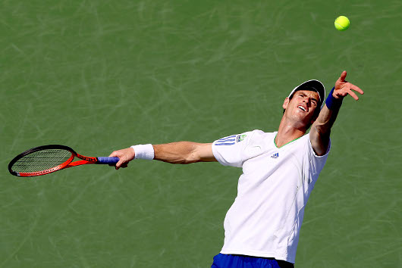
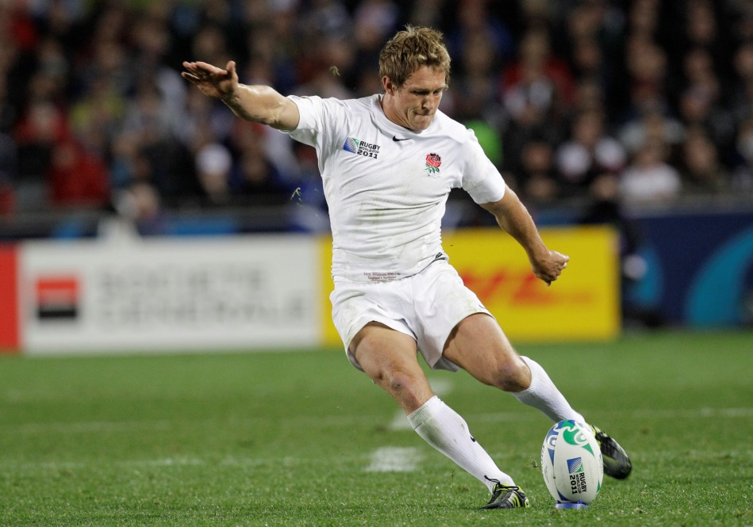
COORDINATION
Learning Outcomes – be able to
1. Define of three components of fitness and relate these to sporting examples
2. Name and describe the fitness test for each component of fitness
Definition –
The ability to use two or more different parts of the body together, smoothly and efficiently.
Can you apply this to a sporting example?

Slide 22
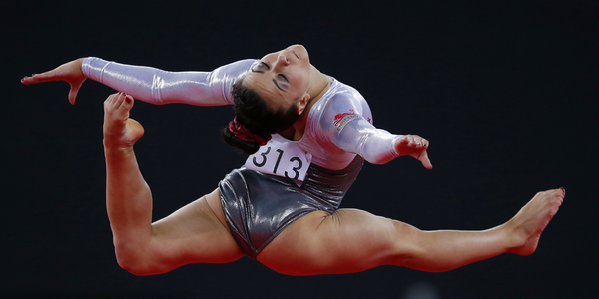
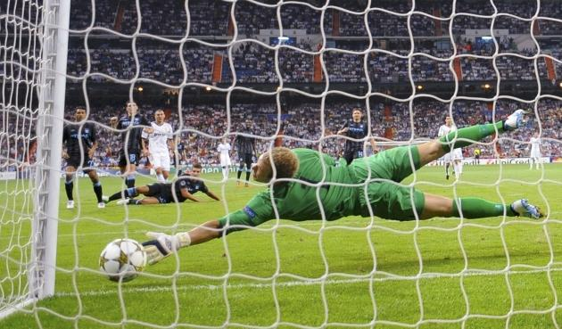
FLEXIBILITY
Learning Outcomes – be able to
1. Define of three components of fitness and relate these to sporting examples
2. Name and describe the fitness test for each component of fitness
Definition –
The range of movement around a joint.
Can you apply this to a sporting example?

Slide 23
Let’s check our recall…
TASK 1 – complete the definitions mini test
TASK 2 – add in any corrections from your class notes
TASK 3 – reflect on your understanding/recall and set one target for improvement

Slide 24
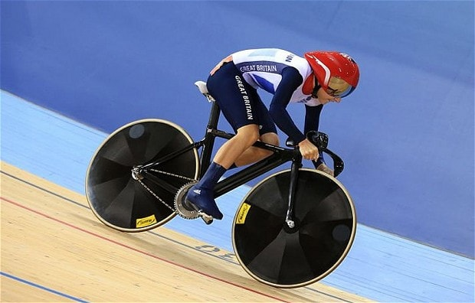
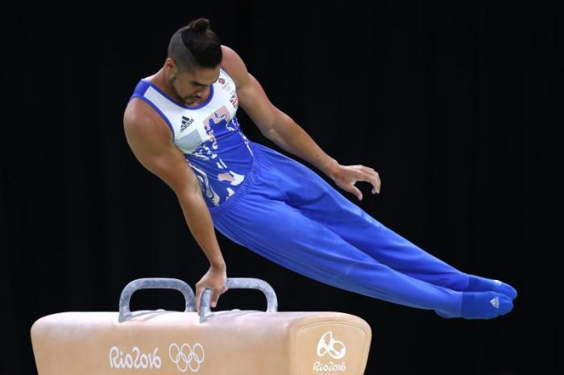
MUSCULAR ENDURANCE
Learning Outcomes – be able to
1. Define of three components of fitness and relate these to sporting examples
2. Name and describe the fitness test for each component of fitness
Definition –
The ability of a muscle or muscle group to undergo repeated contractions, avoiding fatigue (similar to dynamic strength).
Can you apply this to a sporting example?

Slide 25
POWER
Learning Outcomes – be able to
1. Define of three components of fitness and relate these to sporting examples
2. Name and describe the fitness test for each component of fitness
Also known as explosive strength/anaerobic power
Definition –
A combination of maximum speed and maximum strength
Power = strength X speed
Can you apply this to a sporting example?

Slide 26
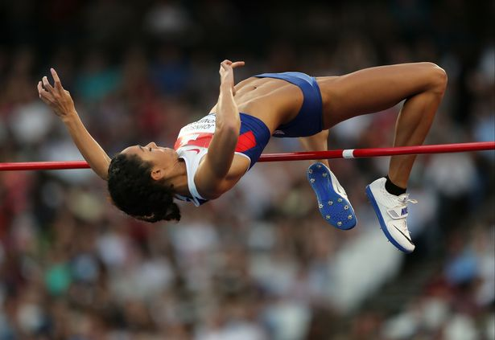
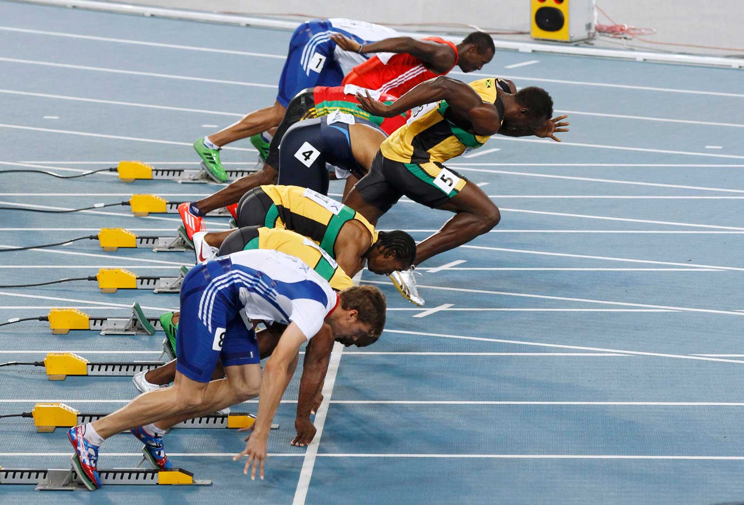
POWER
Learning Outcomes – be able to
1. Define of three components of fitness and relate these to sporting examples
2. Name and describe the fitness test for each component of fitness
Can you apply this to a sporting example?

Slide 27
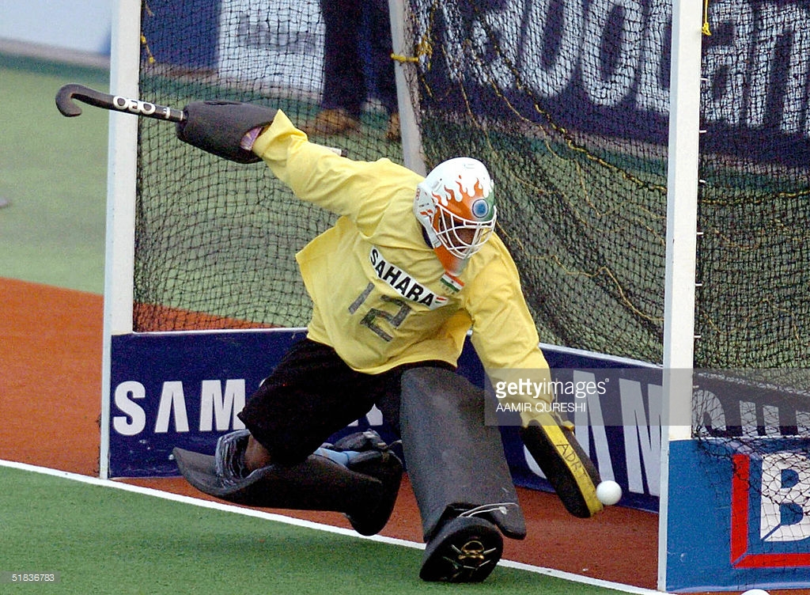
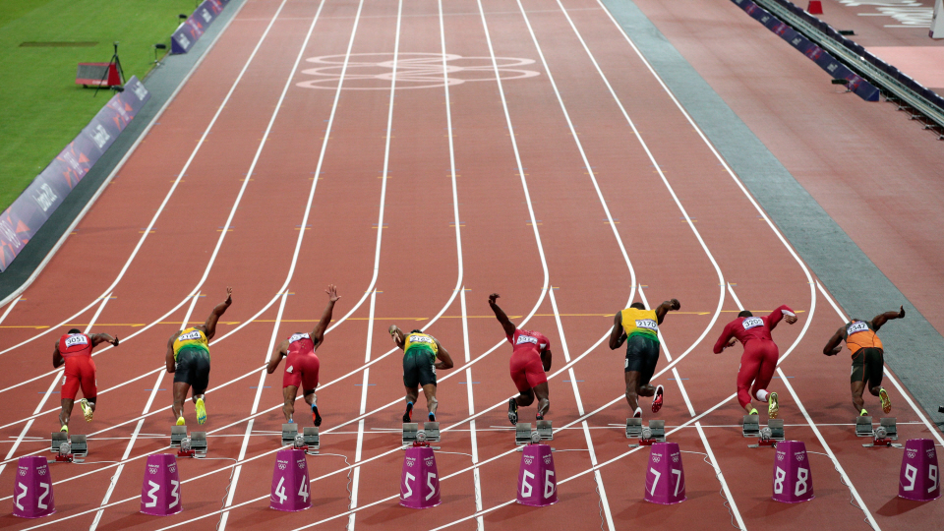
REACTION TIME
Learning Outcomes – be able to
1. Define of three components of fitness and relate these to sporting examples
2. Name and describe the fitness test for each component of fitness
Definition –
The time taken to respond to a stimulus.
Can you apply this to a sporting example?

Slide 28
Quick Task
Consider each of the fitness components that we have covered so far…
Evaluate yourself for each of the fitness components (rate yourself out of 10)
Justify the importance of them for your main sport
Extension – how could coordination and flexibility be tested?

Slide 29
STRENGTH
Learning Outcomes – be able to
1. Define of three components of fitness and relate these to sporting examples
2. Name and describe the fitness test for each component of fitness
Definition –
Ability to overcome resistance.
Four types of strength –
Maximal strength
Static strength
Explosive strength
Dynamic strength

Slide 30
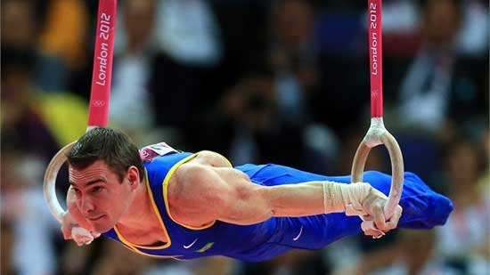
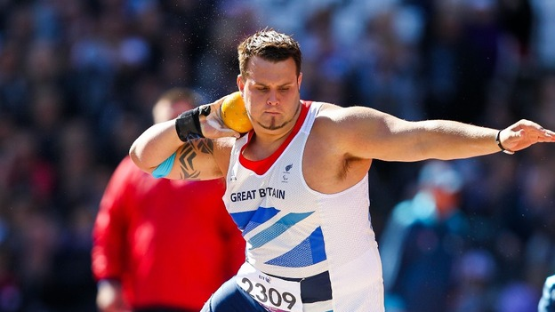
STRENGTH
Learning Outcomes – be able to
1. Define of three components of fitness and relate these to sporting examples
2. Name and describe the fitness test for each component of fitness
Definition –
Ability to overcome resistance.
Four types of strength –
Maximal strength
Static strength
Explosive strength
Dynamic strength

Slide 31
STRENGTH
Learning Outcomes – be able to
1. Define of three components of fitness and relate these to sporting examples
2. Name and describe the fitness test for each component of fitness
Maximal strength
Greatest force possible in a single maximum muscle contraction

Slide 32
STRENGTH
Learning Outcomes – be able to
1. Define of three components of fitness and relate these to sporting examples
2. Name and describe the fitness test for each component of fitness
2. Static strength
Amount of force exerted on an object you cannot move.

Slide 33
STRENGTH
Learning Outcomes – be able to
1. Define of three components of fitness and relate these to sporting examples
2. Name and describe the fitness test for each component of fitness
3. Explosive strength
Amount of force exerted in one quick muscle contraction.

Slide 34
STRENGTH
Learning Outcomes – be able to
1. Define of three components of fitness and relate these to sporting examples
2. Name and describe the fitness test for each component of fitness
4. Dynamic strength (similar to muscular endurance)
Amount of force that can be exerted repeatedly by a muscle.

Slide 35
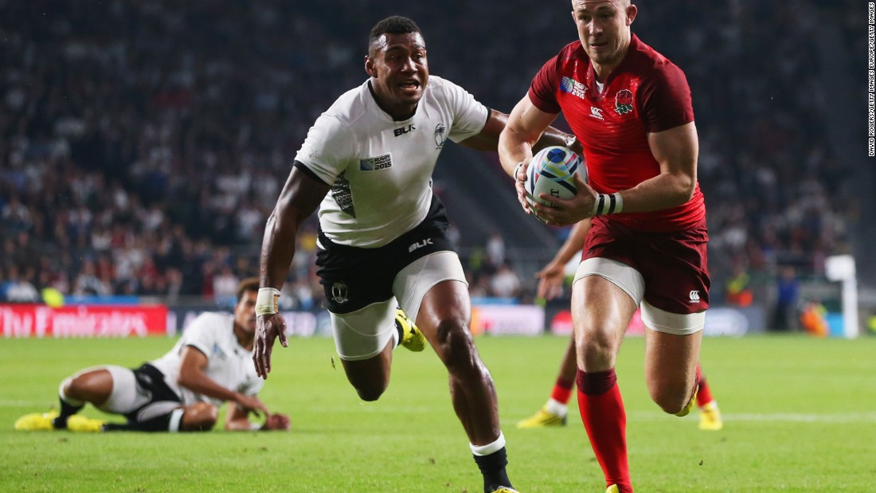
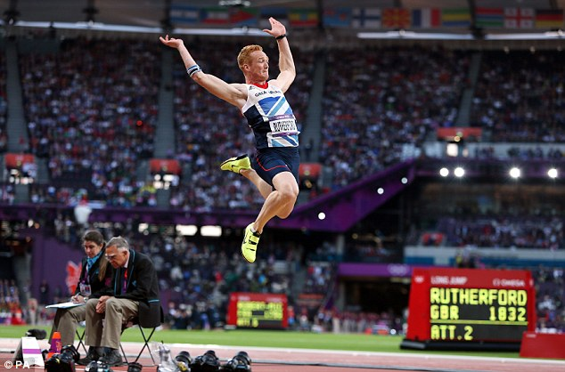
SPEED
Learning Outcomes – be able to
1. Define of three components of fitness and relate these to sporting examples
2. Name and describe the fitness test for each component of fitness
Definition –
The maximum rate at which an individual is able to perform a movement in a period of time.
Can you apply this to a sporting example?

Slide 36
Data
ALL should be able to identify two types of data
MOST should be able to describe how data can be collected for fitness testing

Slide 37
LO1 – ALL should be able to identify two types of data
QUANTITATIVE
QUALITATIVE
Focuses on measuring things
Involves numbers
Gives you an objective answer
Focuses on understanding things
Involves descriptions/opinions
Gives you an subjective answer

Slide 38
Fitness Testing
ALL should be able to describe the fitness test for agility and balance.
MOST should be able to evaluate if the fitness tests are relevant to performers in different sporting activities.

Slide 39
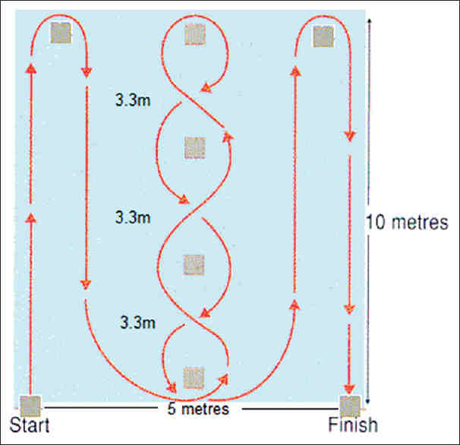
FITNESS TESTING
LO1 – ALL should be able to describe the fitness test for agility and balance.
LO2 – MOST should be able to evaluate if the fitness tests are relevant to performers in different sporting activities.
Agility
The Illinois Agility Test

Slide 40
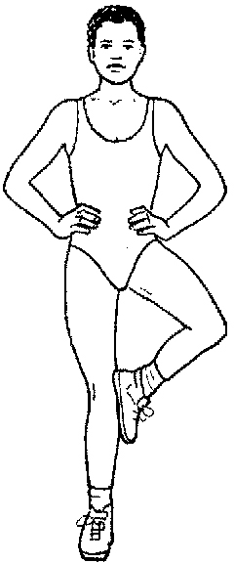
FITNESS TESTING
LO1 – ALL should be able to describe the fitness test for agility and balance.
LO2 – MOST should be able to evaluate if the fitness tests are relevant to performers in different sporting activities.
Balance
The Stork Balance Test

Slide 41
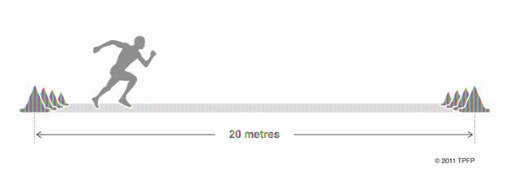
FITNESS TESTING
LO1 – ALL should be able to describe the fitness test for agility and balance.
LO2 – MOST should be able to evaluate if the fitness tests are relevant to performers in different sporting activities.
Cardiovascular endurance (aerobic power)
The Multi Stage Fitness Test

Slide 42
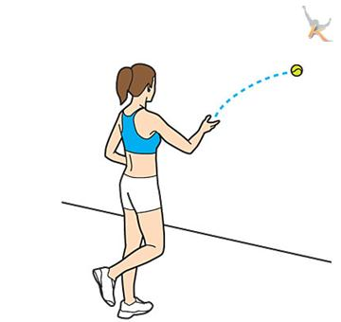
FITNESS TESTING
LO1 – ALL should be able to describe the fitness test for agility and balance.
LO2 – MOST should be able to evaluate if the fitness tests are relevant to performers in different sporting activities.
Coordination
The Wall Toss Test

Slide 43
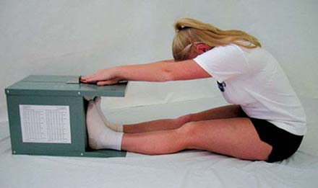
FITNESS TESTING
LO1 – ALL should be able to describe the fitness test for agility and balance.
LO2 – MOST should be able to evaluate if the fitness tests are relevant to performers in different sporting activities.
Flexibility
The Sit and Reach Test

Slide 44
FITNESS TESTING
LO1 – ALL should be able to describe the fitness test for agility and balance.
LO2 – MOST should be able to evaluate if the fitness tests are relevant to performers in different sporting activities.
Muscular endurance
The Sit-Up Bleep Test

Slide 45
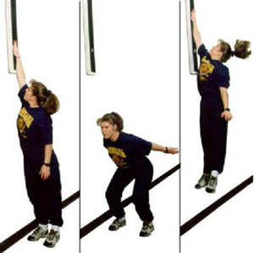
FITNESS TESTING
Learning Outcomes – be able to
1. Define of three components of fitness and relate these to sporting examples
2. Name and describe the fitness test for each component of fitness
Power/explosive strength
The Vertical Jump Test

Slide 46
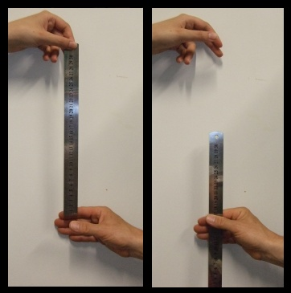
FITNESS TESTING
Learning Outcomes – be able to
1. Define of three components of fitness and relate these to sporting examples
2. Name and describe the fitness test for each component of fitness
Reaction Time
The Ruler Drop Test

Slide 47
Application
Apply knowledge of the fitness components and fitness testing.
Reflect on your own progress so far this term (knowledge, understanding, recall).

Slide 48
APPLY IT
Learning Outcomes – be able to
Apply knowledge of the fitness components & fitness testing
Reflect on your own progress so far this term (knowledge, understanding, recall)
Complete the table:
Fitness Component | Definition | Specific sporting example
Agility | Ability to change direction at speed, whilst maintaining control. | Dodging around a player in netball to get the ball.
Balance
Cardiovascular endurance (aerobic power) |  | TIP – describe the skill within a sport

Slide 49
APPLY IT
Learning Outcomes – be able to
Apply knowledge of the fitness components & fitness testing
Reflect on your own progress so far this term (knowledge, understanding, recall)
Balance
Cardiovascular endurance (aerobic power)
Coordination

Slide 50
APPLY IT
Learning Outcomes – be able to
Apply knowledge of the fitness components & fitness testing
Reflect on your own progress so far this term (knowledge, understanding, recall)
Complete the following exam style question:
Identify and explain two components of fitness that would be useful for an 800m track runner. (4 marks)
Scrutinise the question:
Identify (state), explain (why)
How are the marks broken down?
2 x 2

Slide 51
APPLY IT
Learning Outcomes – be able to
Apply knowledge of the fitness components & fitness testing to sporting examples & exam qu’s
Reflect on your own progress so far this term (knowledge, understanding, recall)
Award one mark for stating an appropriate component of fitness and one further mark for describing why it would be useful (2x2).
Muscular endurance or dynamic strength/to be able to work continuously without tiring throughout the race.
Explosive strength or power/to get a fast start to the race.
Cardiovascular endurance (aerobic power)/the heart and lungs can maintain energy supply efficiently throughout the race.
Speed/to sprint at the end of the race.
Coordination/limbs working together to produce a fluent and efficient running action.
Balance/staying upright when running around other competitors.
Reaction time/getting a good start to the race.

Slide 52
APPLY IT
Learning Outcomes – be able to
Apply knowledge of the fitness components & fitness testing to sporting examples & exam qu’s
Reflect on your own progress so far this term (knowledge, understanding, recall)
Complete the following exam style question:
Identify and explain two components of fitness that would be useful for an 800m track runner. (4 marks)
Reflection:
WWW – what went well
EBI – even better if

Slide 53
APPLY IT
Learning Outcomes – be able to
Apply knowledge of the fitness components & fitness testing to sporting examples & exam qu’s
Reflect on your own progress so far this term (knowledge, understanding, recall)
Complete the following exam style question:
Describe how to carry out the Illinois Agility Test. Evaluate the effectiveness of this fitness test for two sporting activities. (6 marks)
Scrutinise the question
Describe (what does it look like)
Evaluate (advantages, disadvantages)
How are the marks broken down?
2 marks for describing, 4 marks for evaluating two activities (2x2)

Slide 54
APPLY IT
Learning Outcomes – be able to
Apply knowledge of the fitness components & fitness testing to sporting examples & exam qu’s
Reflect on your own progress so far this term (knowledge, understanding, recall)
Award two marks for describing the Illinois Agility Test.
Use a tape measure to set the cones up in the correct format.
Lie facing down on the floor. When the assistant says go, begin running.
Run around the cones using the exact route.
The time (in seconds) will stop when you pass the last cone.
Award four marks for evaluating the effectiveness in two sporting activities (2x2).
Very useful for games players – rugby – side stepping around players
Not useful for cross country runners/weight lifters – not required to change direction at speed

Slide 55
Exam question
Describe how to carry out the Illinois Agility Test. Evaluate the effectiveness of this fitness test for two sporting activities. (6 marks)
Evaluate the effectiveness…

Slide 56
APPLY IT
Learning Outcomes – be able to
Apply knowledge of the fitness components & fitness testing to sporting examples & exam qu’s
Reflect on your own progress so far this term (knowledge, understanding, recall)
Complete the following exam style question:
Describe how to carry out the Illinois Agility Test. Evaluate the effectiveness of this fitness test for two sporting activities. (6 marks)
Reflection:
WWW – what went well
EBI – even better if

Slide 57
Fitness Testing
ALL should be able to describe the fitness test for agility and balance.
MOST should be able to evaluate if the fitness tests are relevant to performers in different sporting activities.

Slide 58
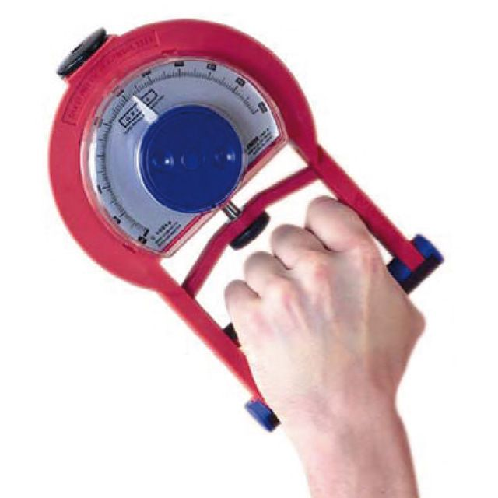
FITNESS TESTING
Learning Outcomes – be able to
1. Define of three components of fitness and relate these to sporting examples
2. Name and describe the fitness test for each component of fitness
Explosive Strength
Handgrip dynamometer

Slide 59
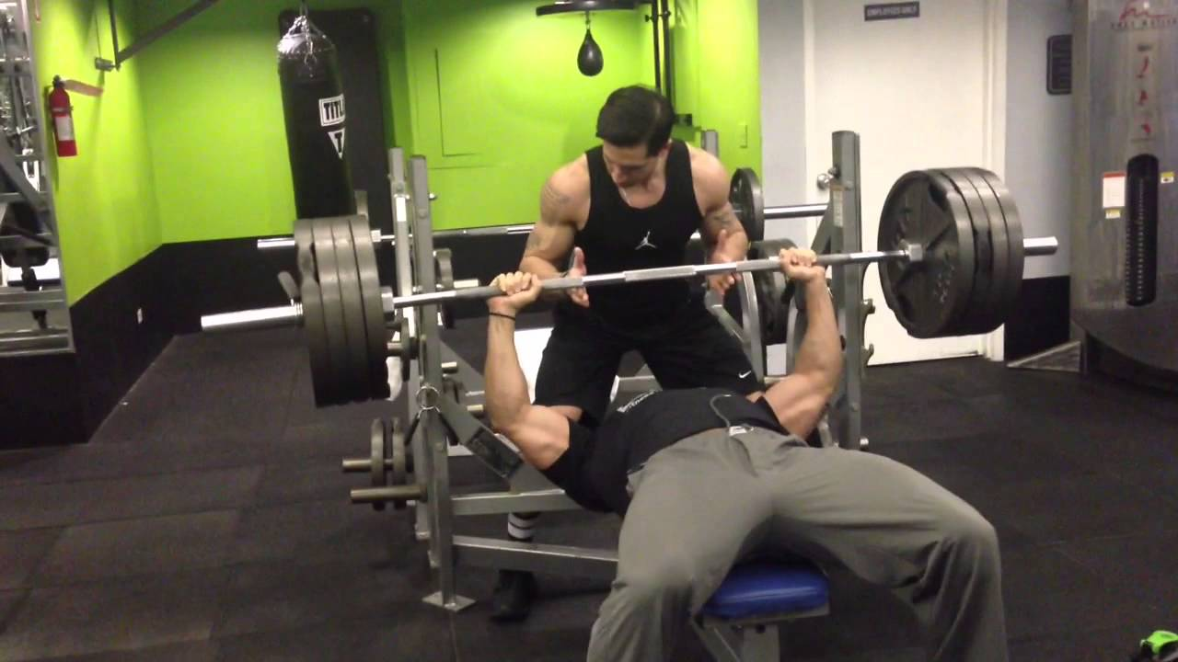
FITNESS TESTING
Learning Outcomes – be able to
1. Define of three components of fitness and relate these to sporting examples
2. Name and describe the fitness test for each component of fitness
Maximal Strength
One rep max test

Slide 60
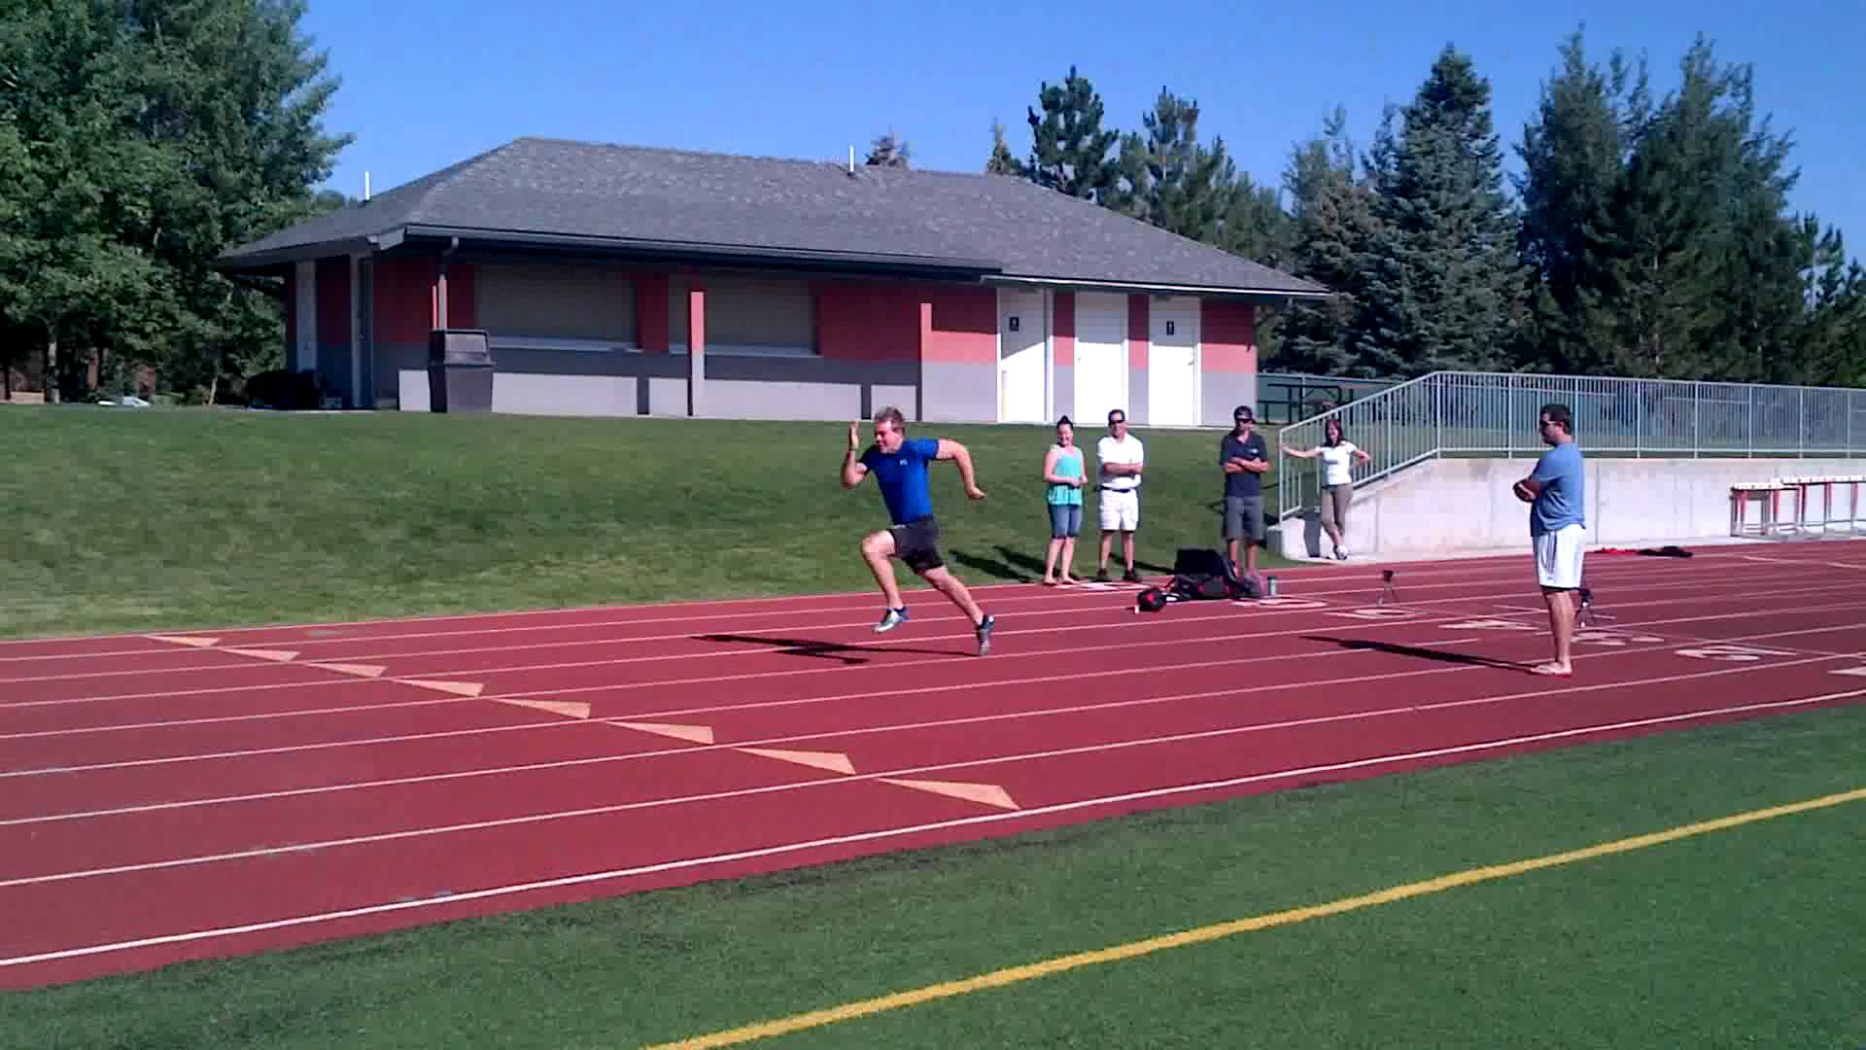
FITNESS TESTING
Learning Outcomes – be able to
1. Define of three components of fitness and relate these to sporting examples
2. Name and describe the fitness test for each component of fitness
Speed
The 30 metre sprint test

Slide 61
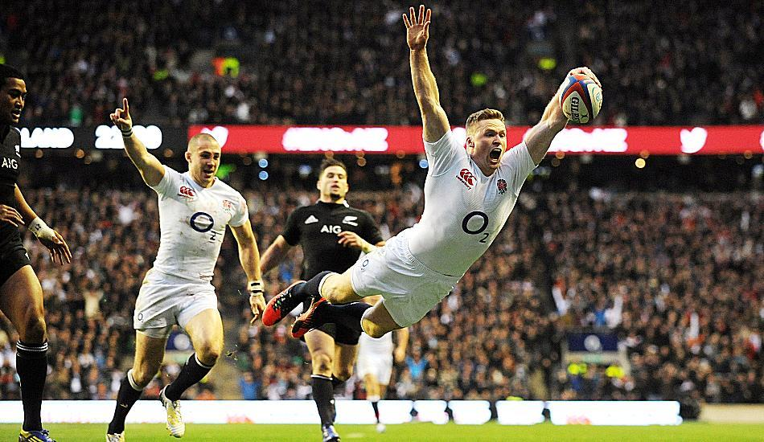
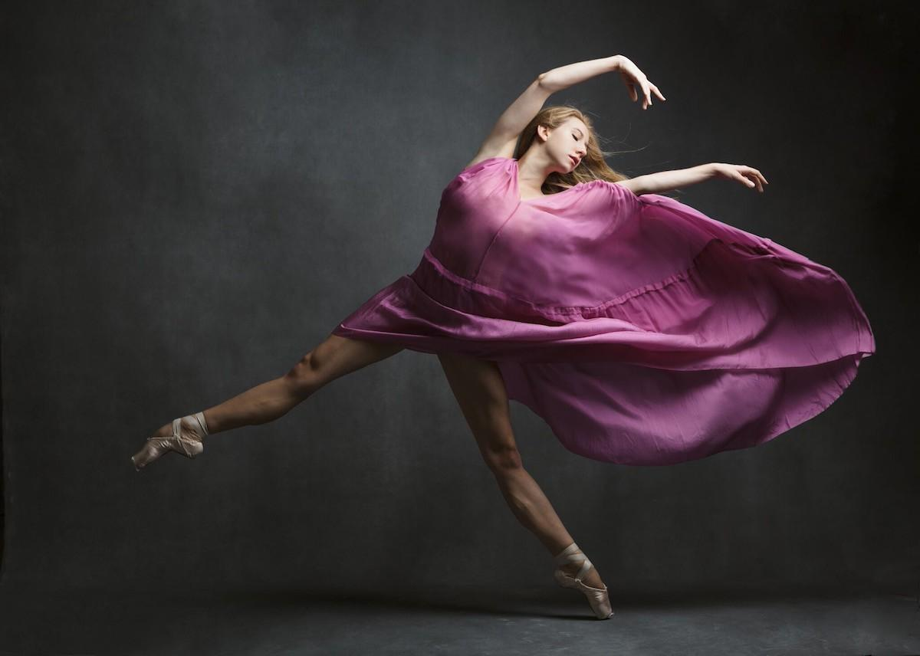
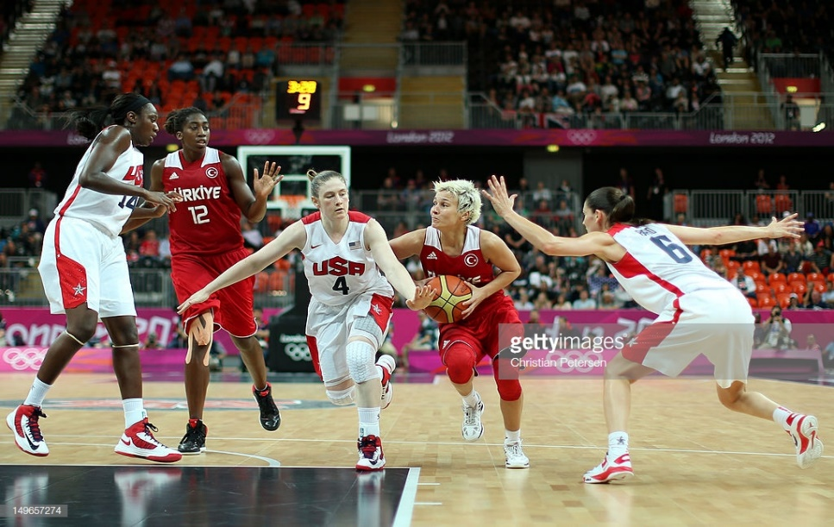
Apply it
Evaluate whether or not the fitness tests are relevant to performers in different sporting activities.

Slide 62
Reasons and limitations of fitness testing
ALL should be able to describe the reasons and limitations of fitness testing

Slide 64
REASONS for fitness testing
Allows you to identify strengths and weaknesses, which can inform training requirements.
Establishes a starting point, which allows monitoring of any improvements.
Provides variety when planning your training.
Provides a motivation for improvement.

Slide 65
LIMITATIONS of fitness testing
Tests can be too general and not sport specific
Tests do not replicate the movements in most sports
Tests are conditioned and do not replicate competitive situations
Measuring of results may be inaccurate
Some tests require motivation
Tests must be carried out using exact procedure, otherwise reliability of results may be questionable.

Slide 66
Application
MOST should be able to apply knowledge of the fitness components to an extension question using the IDEA technique.
ALL should be able to reflect on your application of the IDEA technique.

Slide 67
Apply it – name all of the fitness components and identify the fitness test for each one
Agility
Illinois Agility Test
Speed
30m Sprint Test
Static & Dynamic
Strength
Balance
Stork Test
Fitness Components &
Fitness Tests
Explosive Strength
Handgrip Dynamometer
Cardiovascular
Endurance
Multistage Fitness Test
Maximal Strength
One Rep Max Test
Coordination
Wall Toss Test
Reaction Time
Ruler Drop Test
Flexibility
Sit and Reach Test
Muscular
Endurance
Sit-Up Bleep Test
Power
Vertical Jump Test

Slide 68
Immediate, Short Term & Long Term Effects of Exercise
MOST should be able to describe the immediate, the short and long term effects of exercise during exercise

Slide 69
Effects of Exercise
Learning Outcomes
Identify the immediate effects of exercise during exercise
Identify the short term effects of exercise (24-36 hours)
Identify the long term effects of exercise (months/years)
Immediate effects
Short term effects (24-36 hours)
Long term effects (months/years)

Slide 70
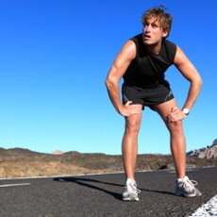
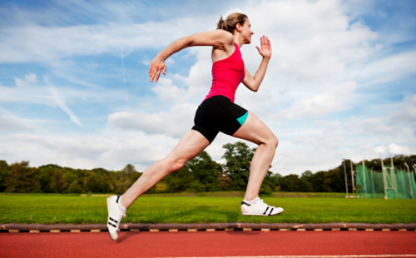
Immediate effects of exercise
Learning Outcomes
Identify the immediate effects of exercise during exercise
Identify the short term effects of exercise (24-36 hours)
Identify the long term effects of exercise (months/years)
Increase in heart rate
Increase in body temperature
Skin goes red
Sweating
Increase in deep breathing

Slide 71
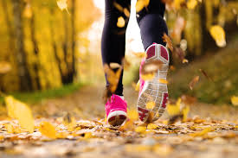
Short term effects of exercise (24-36 hours)
Learning Outcomes
Identify the immediate effects of exercise during exercise
Identify the short term effects of exercise (24-36 hours)
Identify the long term effects of exercise (months/years)
Feel tired, very fatigued
Muscle cramps
Muscles will ache
DOMS
Nauseous
Light headed

Slide 72
Long term effects of exercise (months, years)
Learning Outcomes
Identify the immediate effects of exercise during exercise
Identify the short term effects of exercise (24-36 hours)
Identify the long term effects of exercise (months/years)
Heart will increase in size (cardiac hypertrophy)
Resting heart rate will be lower (bradycardia)
Muscles will increase in size (hypertrophy)
Body shape will change
Improvements in specific components of fitness
Strength
Stamina
Muscular endurance

Slide 73
CW - progression check (can you recall today’s content?
Identify the immediate effects of exercise during exercise
Identify the short term effects of exercise (24-36 hours after exercise)
Identify the long term effects of exercise (months, years of exercising – link directly to the components of fitness)

Slide 74
Is agility needed for a netball player? Justify your answer. (2marks)
Name a sport that requires participants to have good reaction time? ( 2 marks)
What is balance, and using examples why it is needed to play team games (4 marks)

