Slide 1
Year 8 Spanish TERM 1: Viva 1 textbook, chapter 1
If pupils are absent from lessons they should spend time revising and learning vocabulary. All of the vocabulary for this term is on the following slides. First of all, they should recap the vocabulary which they learned the previous week. Then they should start to learn the next section of vocabulary which they have not yet covered in class. This could be done by using the look, cover, write, check method or by making flashcards etc.
Pupils can also revise vocabulary on Linguascope-
Username is kingshill password is bonjour123
Any new vocabulary they learn can be written in their orange books or on paper.
If pupils wish to do extension work they can access free MFL lessons on the Oak National Academy website:
https://classroom.thenational.academy/subjects-by-key-stage

Slide 3
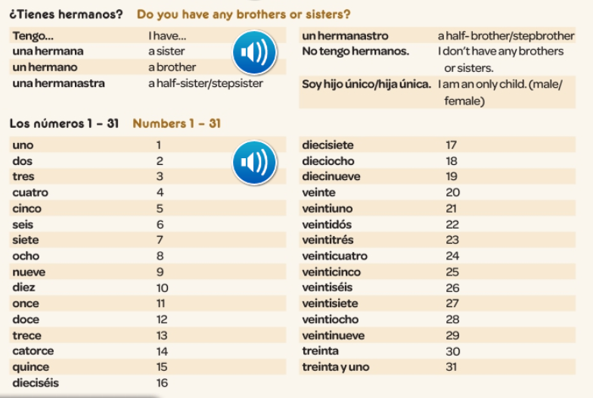

Slide 4
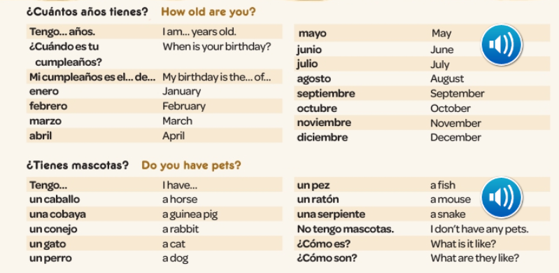

Slide 5
