Slide 1
Year 11 Spanish TERM 1: Viva GCSE textbook, chapter 6+ part of chapter 7
If pupils are absent from lessons they should spend time revising and learning vocabulary. All of the key vocabulary for this term is attached to this PowerPoint. First of all, they should recap the vocabulary which they learned the previous week. Then they should start to learn the next section of vocabulary which they have not yet covered in class. This could be done by using the look, cover, write, check method or by making flashcards etc. They can also do some of the reading activities found on that page. Pupils should also email their teacher to check if there is any essential classwork they need to complete.
Pupils can also revise vocabulary on Quizlet or Linguascope-
Linguascope username is kingshill password is bonjour123
Any new vocabulary they learn can be written in their orange books or on paper.
If pupils wish to do extension work they can access free MFL lessons on the Oak National Academy website:
https://classroom.thenational.academy/subjects-by-key-stage

Slide 2
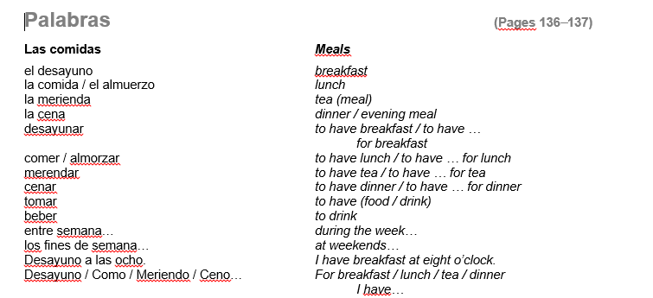

Slide 3
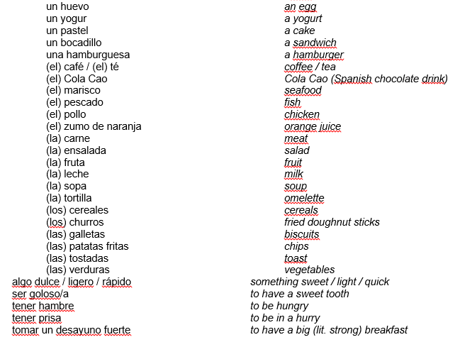

Slide 4
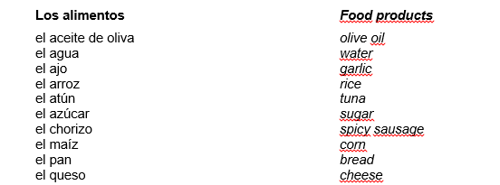

Slide 5
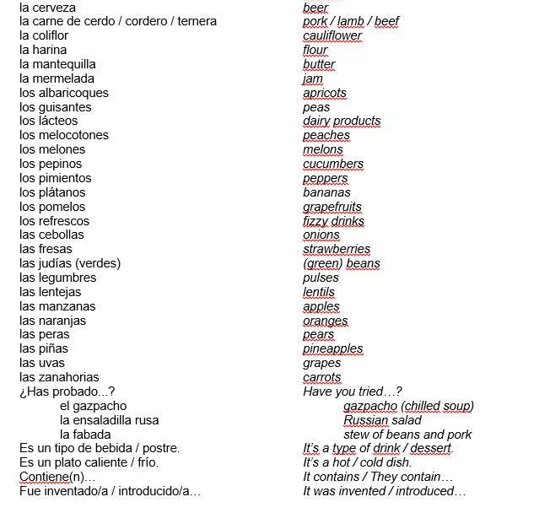

Slide 6
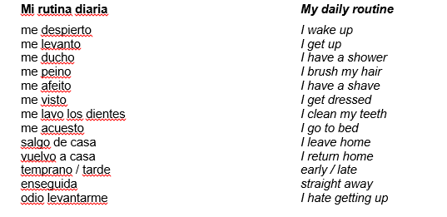

Slide 7
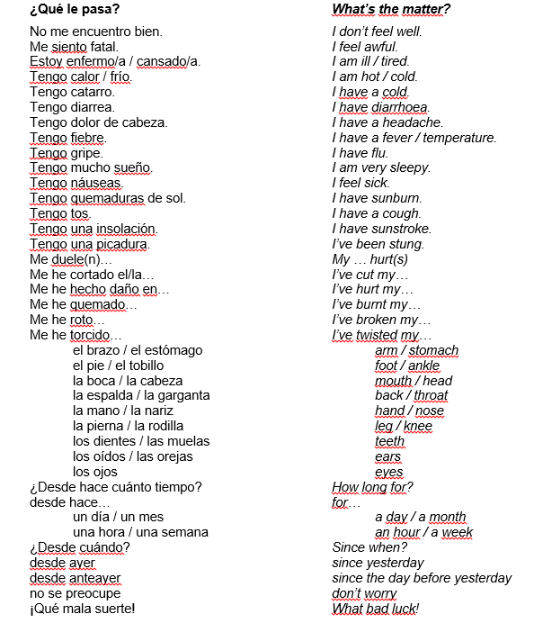

Slide 8
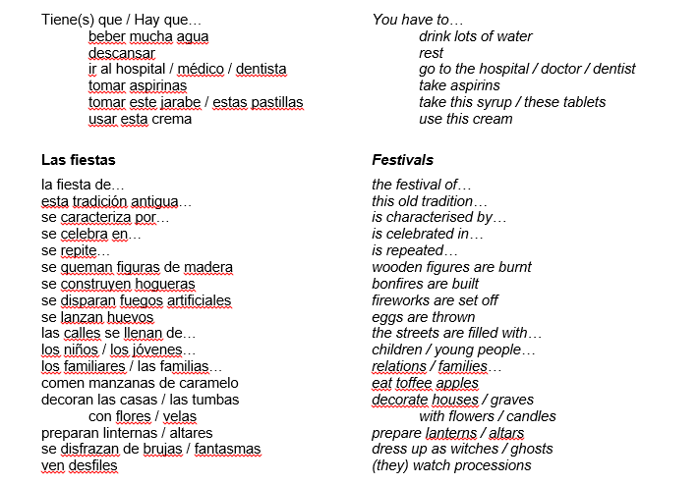

Slide 9
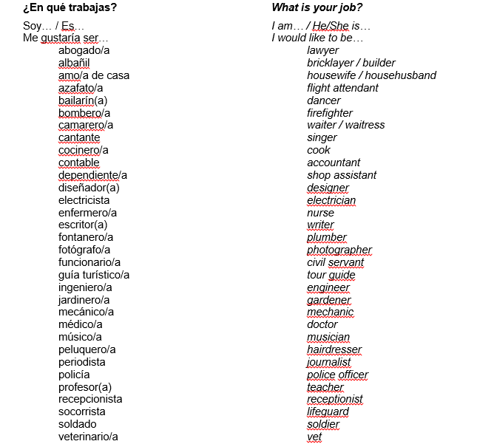

Slide 10
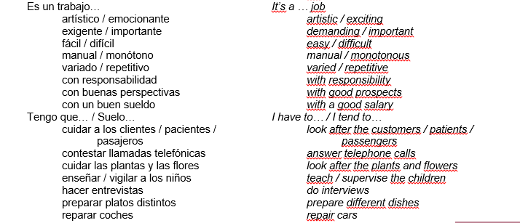

Slide 11
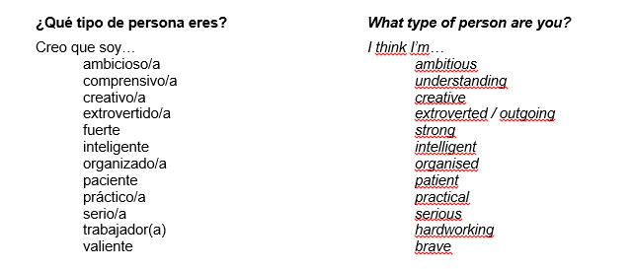

Slide 12
