Slide 6
Lesson 4
Create 2 still images that symbolise “friendship”. One must show a difficult moment in friendship. Abstract and/ or naturalistic.
Characterisation: focussing on the physical demands of playing a young child. Story talk through park, playing, confident/ shy/ what kind of family/ interests. Freeze and thought track.
Listen to the song “Kids Game”p.32 follow the words in the text. Read the scene that follows between Linda, Sammy, Mickey and Edward. Stereotype?

Slide 8
Lesson 5
EXPLORATIVE STRATEGY – Cross cutting to show contrast.
Use cross cutting to show contrast in the following scenes:
The policeman taking Eddy home and the policeman taking Mickey home.
And
2) Eddy’s school and Mickey’s school.
What does cross cutting between these scenes teach us about Mickey and Eddy?

Slide 9
What did the explorative strategy of cross cutting help you understand about the lives of Mickey and Eddy?
What do these 2 scenes make you realise about “class”?

Slide 10
Lesson 6
Act 5, scene 1 from ‘Guess Who?’ to ‘Go on…eat it before I hit y’.’
Annotate this scene using vocal expression and physical direction.
Write a diary entry from either Mickey or Eddie explaining what they felt during this exchange

Slide 11
.
Read the rest of the play. This is the basic plot:
• Mickey does a job for Sammy, gets arrested.
• Eddie gets a job for the Council.
• Mickey becomes depressed and addicted to sleeping pills while in prison.
• Eddie becomes more and more successful.
• Linda goes to Eddie for support and help. Mrs Lyons tells Mickey about them. He sees them together. He breaks down.
Mickey goes to see Eddie (with a gun) – police are called and two shots are fired. The two boys are dead.
“So did you hear the story of the Johnston twins?” – we return to the beginning. It is “bookended” or a cyclical narrative
Prepare a short sequence of images, that charts the boy’s relationship up to the end of the play. They must include a symbolic moment and at one point the boys should come out of the image and directly address the audience, with their thoughts and feelings.
Choose one of the songs from the soundtrack to be played in the back ground.

Slide 12
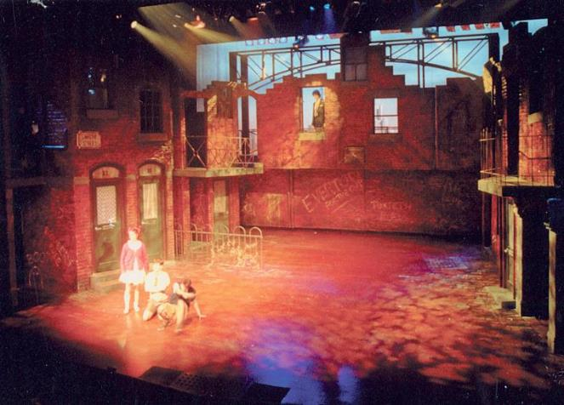
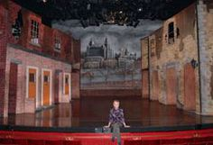
Extension – Blood Brothers set – research and create your own set design

Slide 13
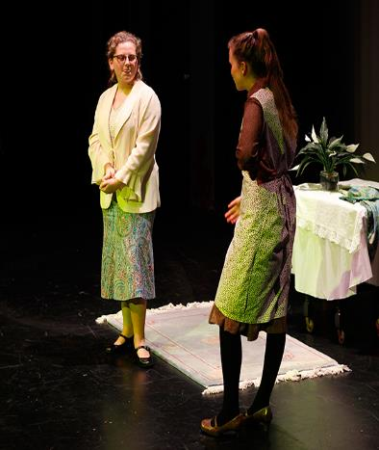
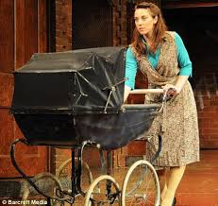
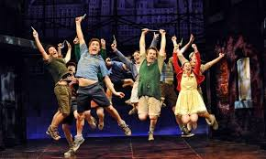
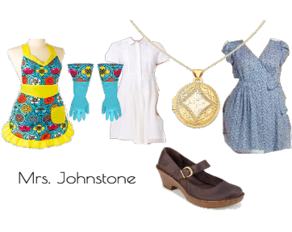
Extension – Blood Brothers Costumes

Slide 14
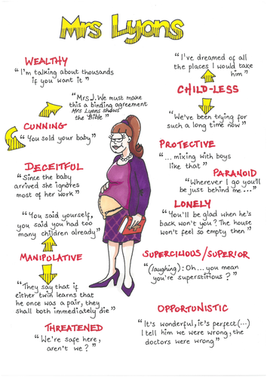
Design costumes for Mrs Lyons and Mrs Johnstone – how can the costumes communicate the characters?

Slide 15
Extension – Blood Brothers Lighting

Slide 16
