Slide 1
“Blood Brothers” Script attached

Slide 2
Lesson 1
Pre Study tasks
What does it mean to have a Blood Brother?
Discuss thoughts on adoption? Create a for and against argument
Discuss thoughts on giving a baby up for adoption?
Is it better to be born into a rich or poor family? Why?

Slide 3
The Prologue
Narrator:
So did y’ hear the story if the Johnstone twins?
As like each other as two new pins,
Of one womb born, on the self same day,
How one was kept and one given away?
An’ did you never hear how the Johnstones died?
Never knowing that they shared one name,
Till the day they died, when a mother cried
“My own dear sons lie slain.”
An’ did y’ never hear of the mother, so cruel,
There’s a stone in place of her heart?
Then bring her on and come judge for yourselves
How she came to play this part.

Slide 4
.
The role of the Narrator – comments on the action/ always there/ sees everything (compare with the role of Greek Chorus in Greek Tragedy)
Annotate his opening speech to make it:
Sinister
Sympathetic
Gossipy
Bored
Shocked
Frightening / Foreshadowing

Slide 6
Newspaper headlines-
“Twin Brothers In Shoot Out, Both Die”
“Police Drawn Into Twin Brother’s Dispute”
“Misunderstanding Leads To Tragedy”
“He’s Your Brother” Shouts Mum But Too late”
Discussion-
What might have happened to lead up to such a terrible thing?
Who else might be involved?
Prepare five plot lines that explain one possible reason behind the headlines. Write a brief narration to the audience for each image (sinister, all seeing, all knowing)

Slide 7
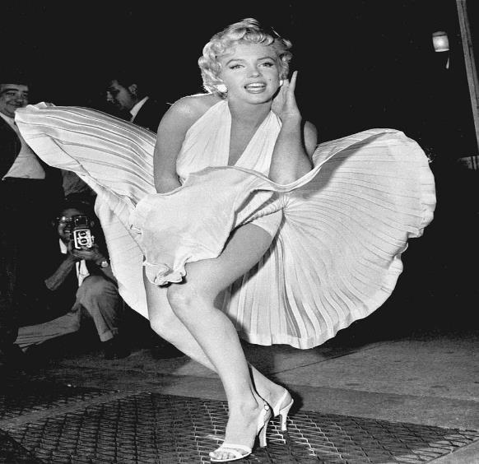
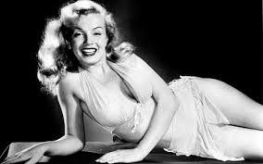
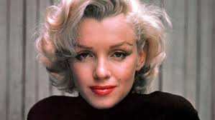
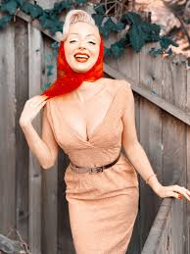
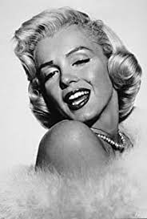
Homework 1 Marilyn Monroe – what do you know? Find out 10 interesting facts about her
acts

Slide 8
Lesson 2
The story of Mrs Johnstone.
Explorative strategies – Still Image and Narration
Read the lyrics from ‘Marilyn Monroe’ song. Create six tableaux which mark key moments in Mrs Johnstone’s life.
Once you have created/ designed the images add some narration. Will the narration be between each image or as each image is frozen? Consider how you move from one tableau to the next.

Slide 9
Once I had a husband - You know the sort of chap,
I met him at a dance- And how he came on with the chat
.He said my eyes were deep blue pools- My skin as soft as snow
He told me I was sexier than Marilyn Monroe
And we went dancing, We went dancing.
Then, of course, I found, That I was six weeks overdue.
We got married at the registry An' then we had a "do".
We all had curly salmon sandwiches, An' how the ale did flow.
They said the bride was lovelier than Marilyn Monroe
And we went dancing, Yes, we went dancing
Then the baby came along We called him Darren Wayne.
Then three months on i found that I was in the club again.
An' though I still fancied dancing, My husband wouldn't go
With a wife he said was twice the size of Marilyn Monroe
No more dancing, No more dancing.
By the time I was twenty-five, I looked like forty-two.
With seven hungry mouths to feed, And one more nearly due
Me husband, he walked out on me, A month or two ago
For a girl they say who looks a bit like Marilyn Monroe
And they go dancing, They go dancing
Yes, they go dancing, They go dancing.

Slide 10
Draw and label or describe the 6 freeze-frames you created.
Write down the lines that go with each freeze-frame.
Why did you choose these lines? (Hopefully because they are significant moments in Mrs Johnstone’s life.)
Why do you think Willy Russell choose to use Marilyn Monroe as a symbol throughout ‘Blood Brothers?’

Slide 11
Lesson 3
The deal between Mrs Johnstone and Mrs Lyons.
Read pages below and listen to My Child. In pairs role play the scene (no script) and feedback on ideas/ opinions/ themes/ motivations/ empathy?
In 3s work on a polished version of the scene. They should think about movement, space, gesture, voice, language, accent, pace and tension. Director should introduce the extract. Evaluate.

