Slide 1
What is a computer?

Slide 2
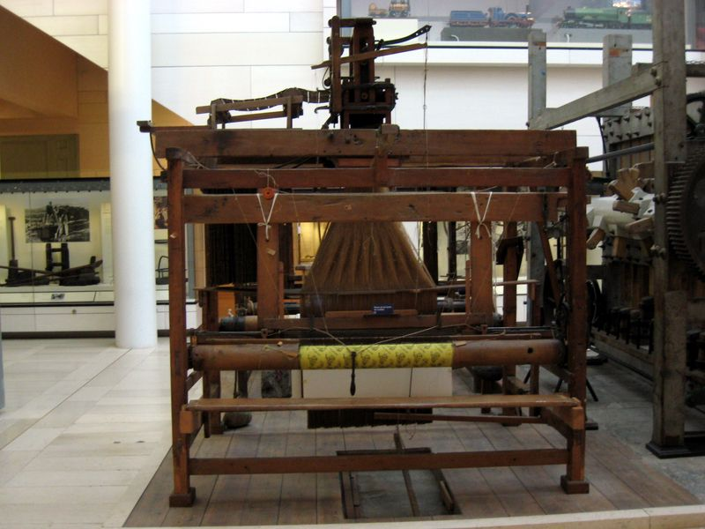
Jacquard Loom 1801

Slide 3
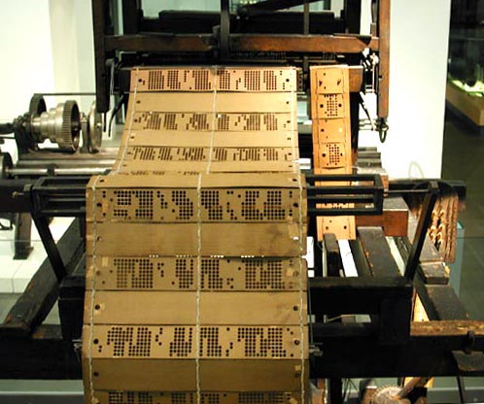
The loom was programmable!
It processed yarn into fabrics
The pattern to be woven was defined by a set of punched cards.

Slide 4
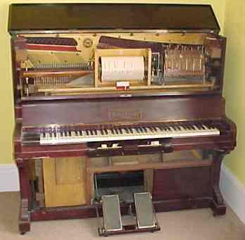
Pianola
Also, programmable! Musical tunes are stored on a rotating metal drum as spikes.
A pianola processes music

Slide 5
Computers
Computers are programmable machines
Programmes (or software) are written by programmers and control what the computer does.
Programmes are stored on media such as Hard Disks, Memory sticks, memory chips.
Computers process “data”.

Slide 6
A Computer System
Input Devices
Processing Devices
Output Devices
Storage Devices

